Slide 1
Visit to Bangladesh 2011
Rey Whetten and Steve Williams

Slide 2
Burnt Hills-Ballston Lake (“BHBL”)/ Granville / R.C. Dhaka West (“RCDW”) Co-operation Timeline
c.a. 2004 | RCDW propose a cleft lip project to Granville; project ultimately fails to materialize
2010 | RCDW approaches Granville about a possible cataract project. Steve Williams meets Rey Whetten at a District meeting and proposes co-operation. BHBL, Granville and District 7190 subsequently approve project, likewise TRF 560 cataract operations were performed by Islamia Eye Hospital in Dhaka
2011 | Rey and Steve are invited to visit Bangladesh Amongst other places they visit: Islamia Eye Hospital, SAHIC ENT Hospital and Kumudini Hospital
2012 | RCDW proposes project for operating room equipment for SAHIC ENT Hospital BHBL, Granville,, District 7190 and TRF all financially support project which proceeds
2013 | RCDW proposes a Vocational Training Team for Kumudini Hospital Granville agrees to seek team members, but has no success in finding candidates. Then DGN John Mucha proposes Dr. Kathy Braico, a pediatrician residing in Queensbury.
2014 | Project is financially supported by BHBL, Granville, Glens Falls and Lake George and DDF Dr. Braico and her assistant, labor and delivery nurse Amina, visit Kumudini successfully. (Their topic: maternal hemorrhaging and neo natal care).
2016 | RCDW proposes Pediatric Cataract Surgery Project for Islamia Eye Hospital Subject for discussion!

Slide 3
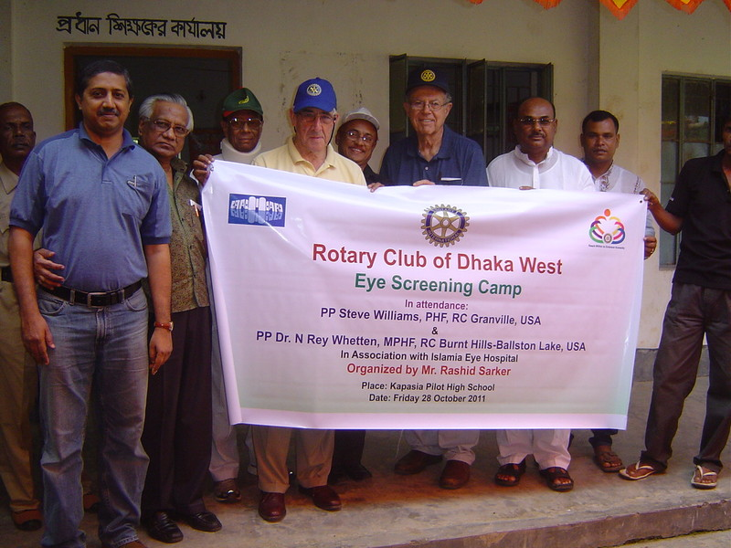

Slide 4
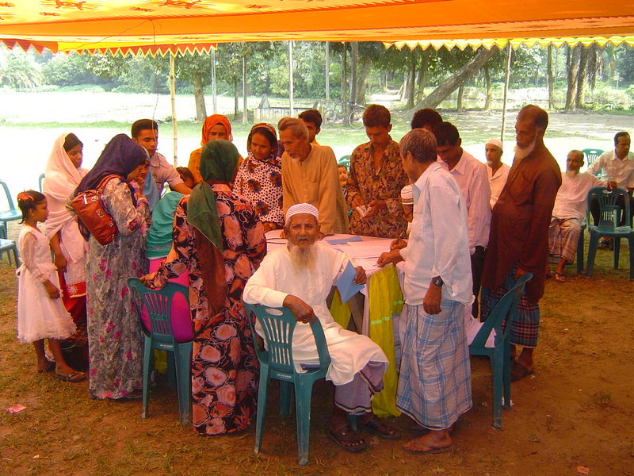

Slide 5
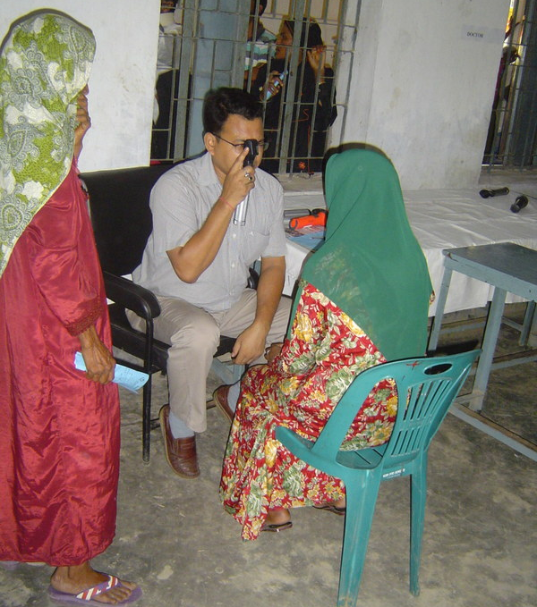

Slide 6
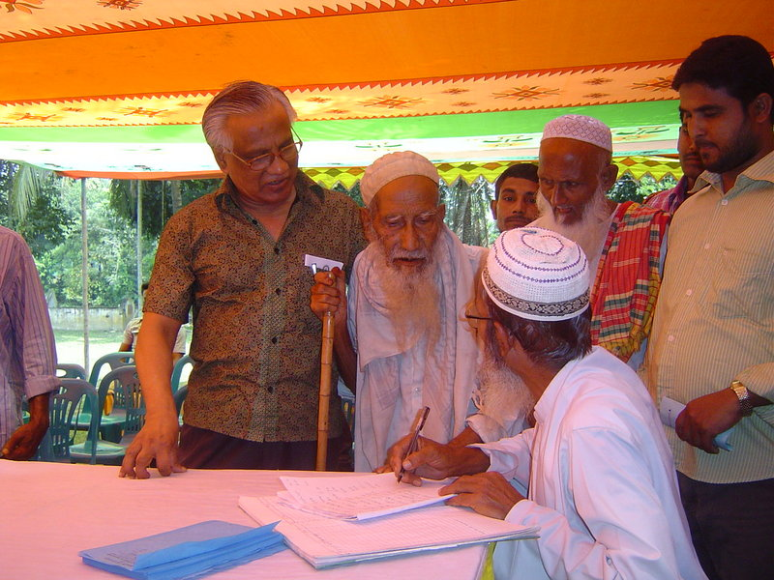

Slide 7
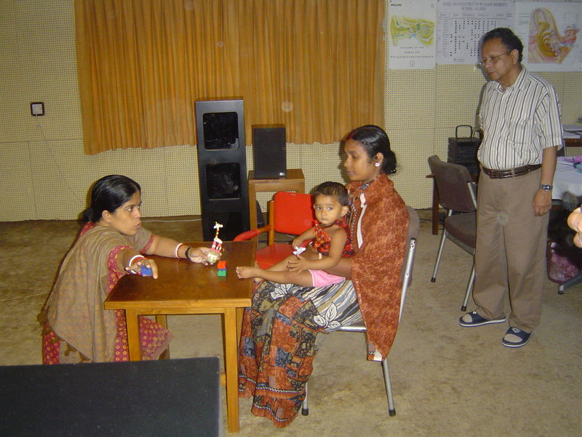

Slide 8
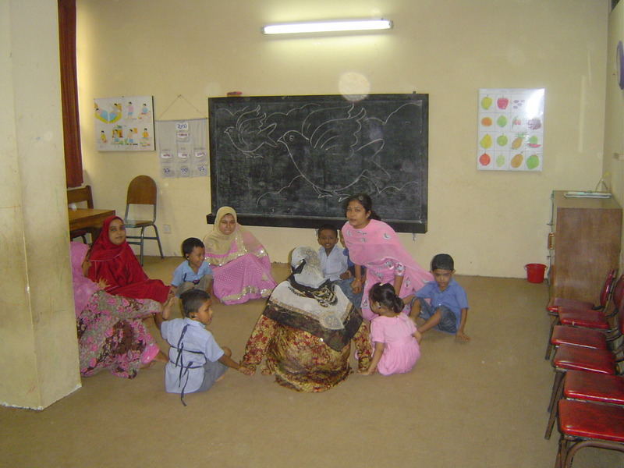

Slide 9
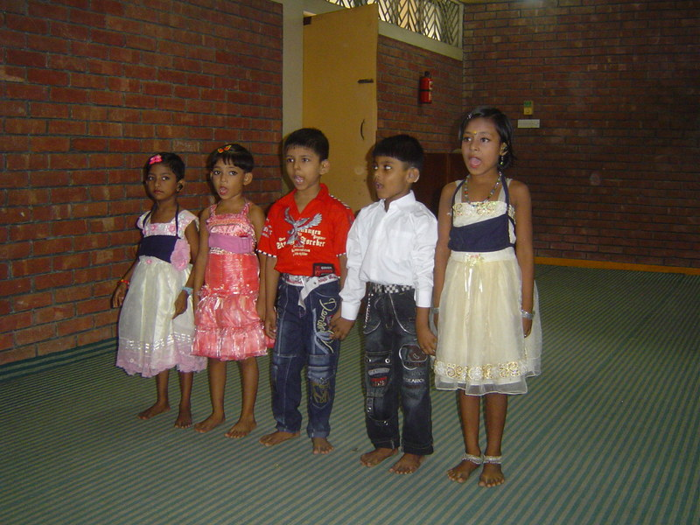

Slide 10
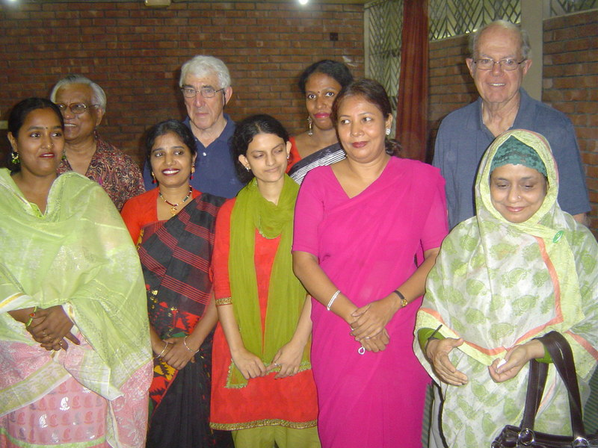

Slide 11
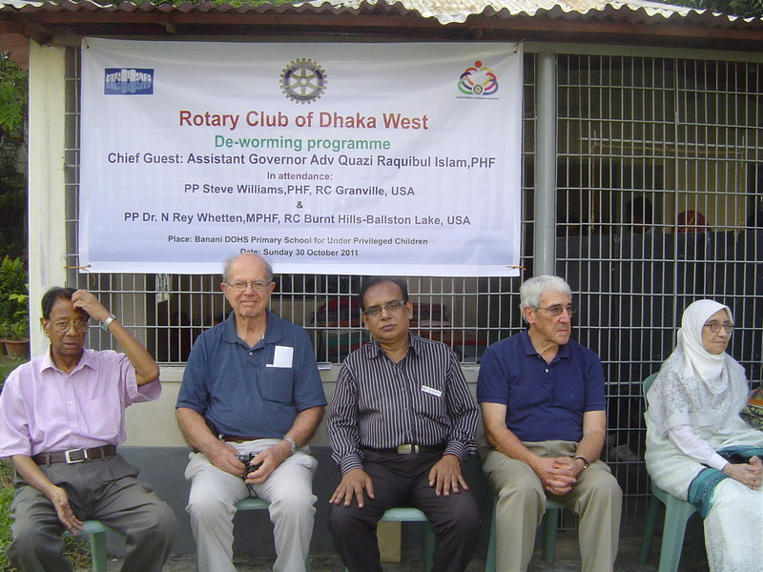

Slide 12
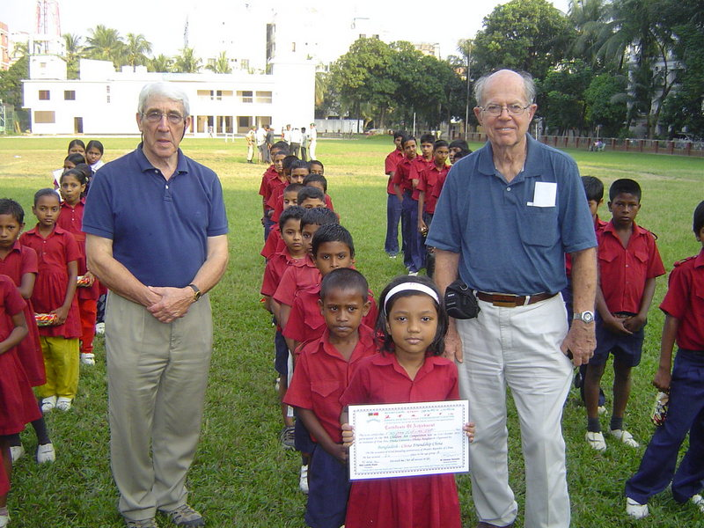

Slide 13
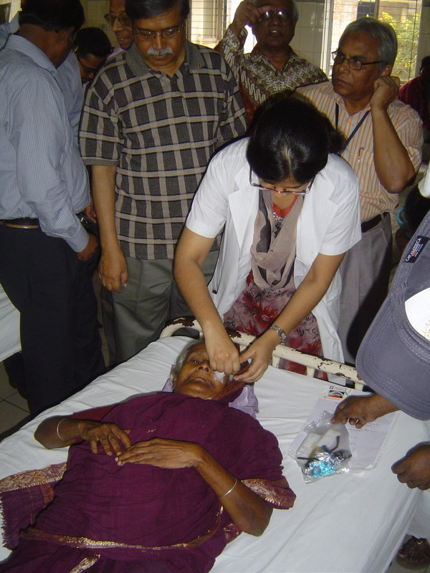

Slide 14
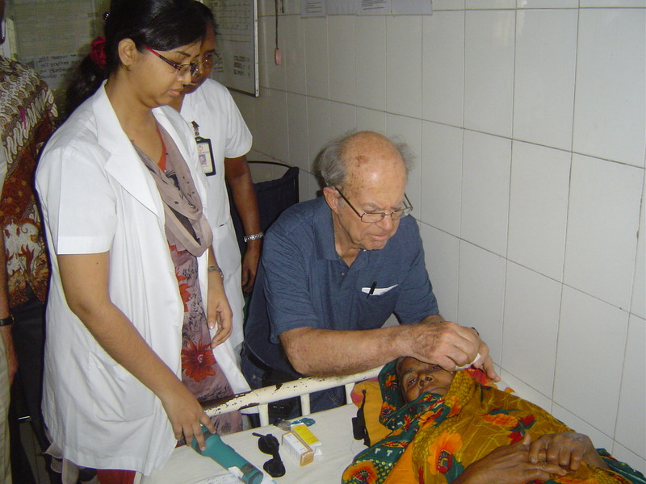

Slide 15
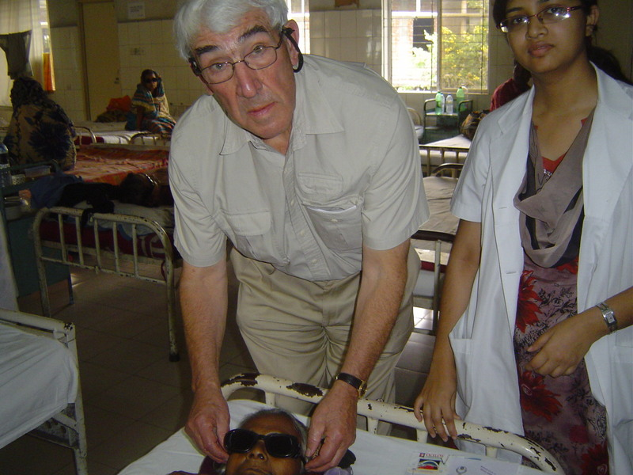

Slide 16
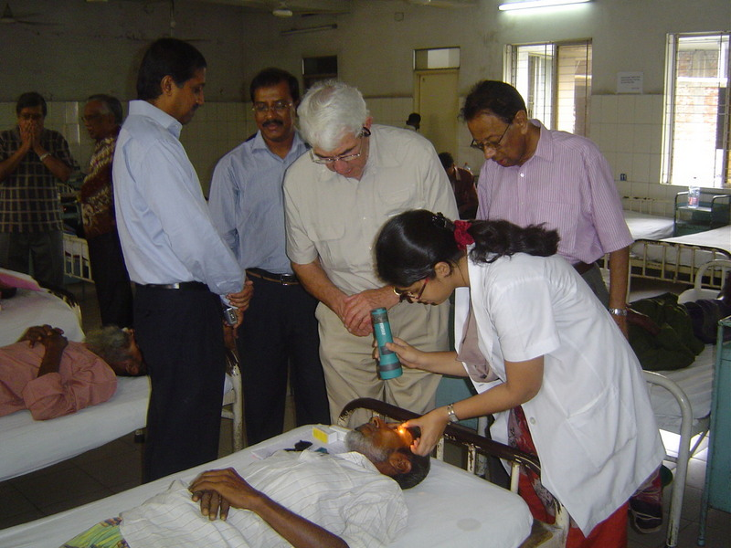

Slide 17
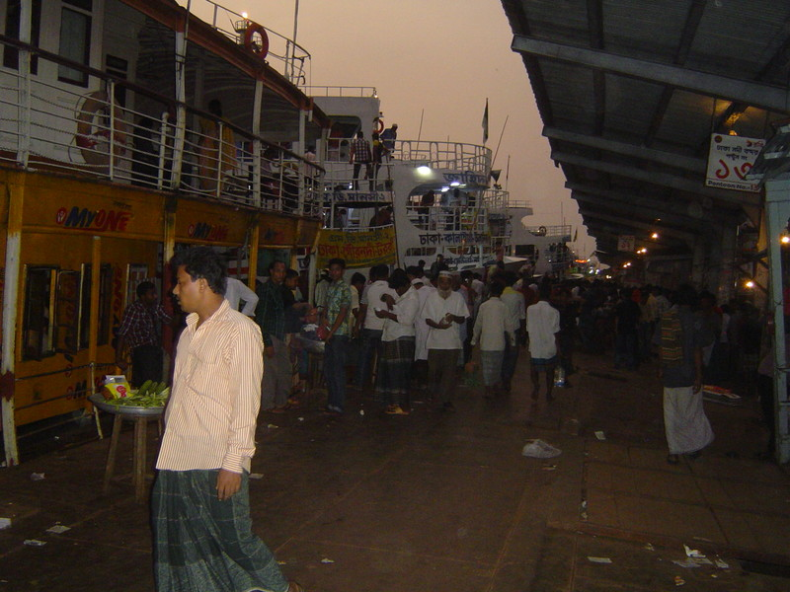

Slide 18
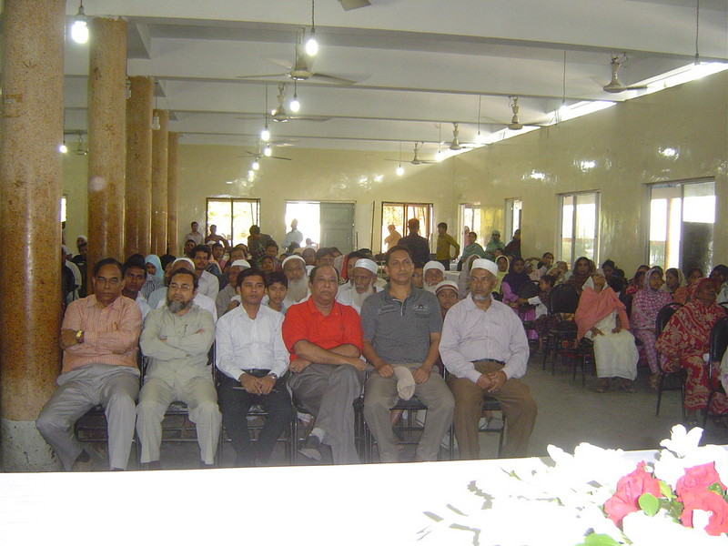

Slide 19
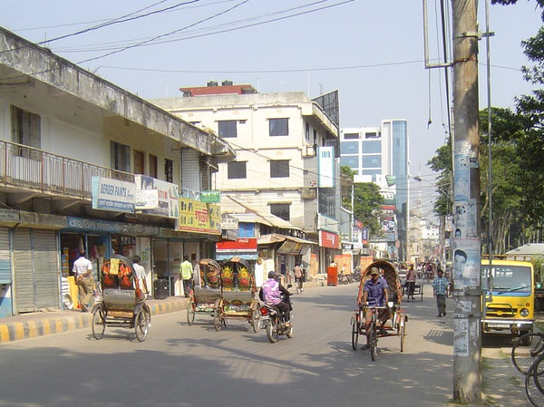

Slide 20
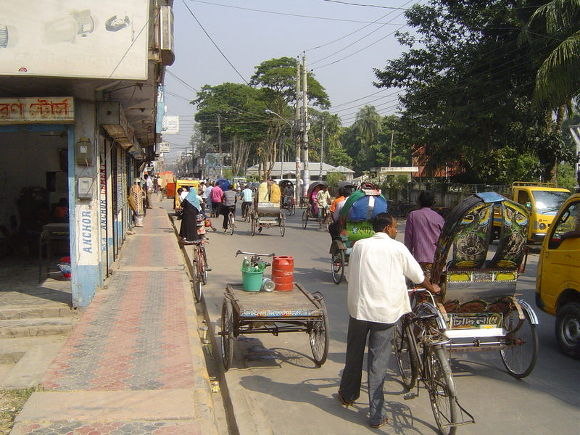

Slide 21
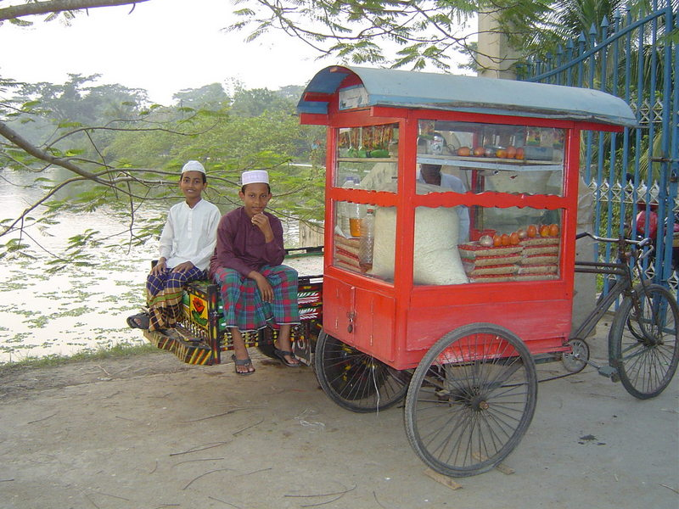

Slide 22
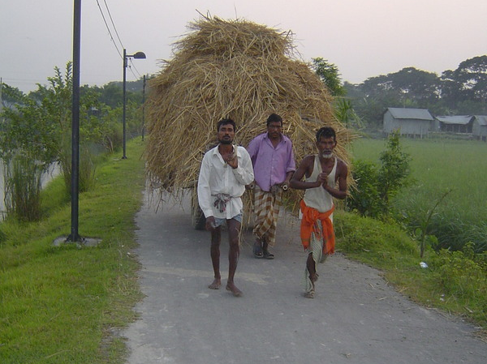

Slide 23
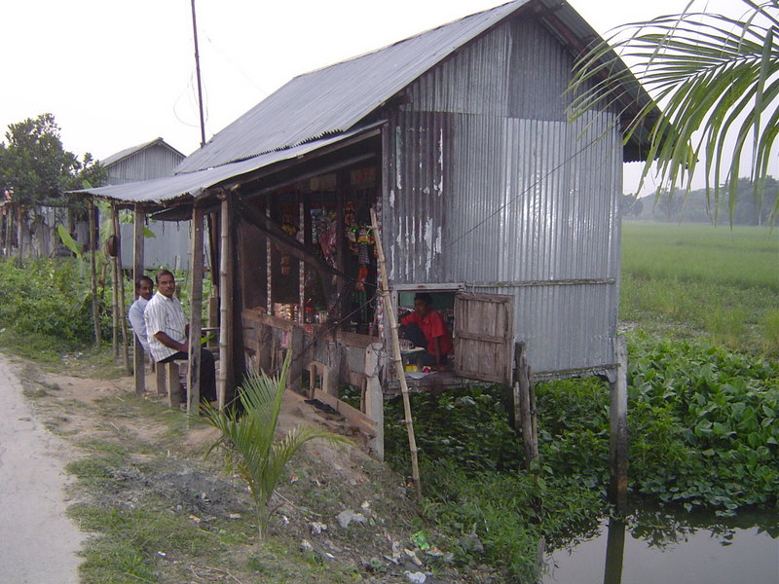

Slide 24
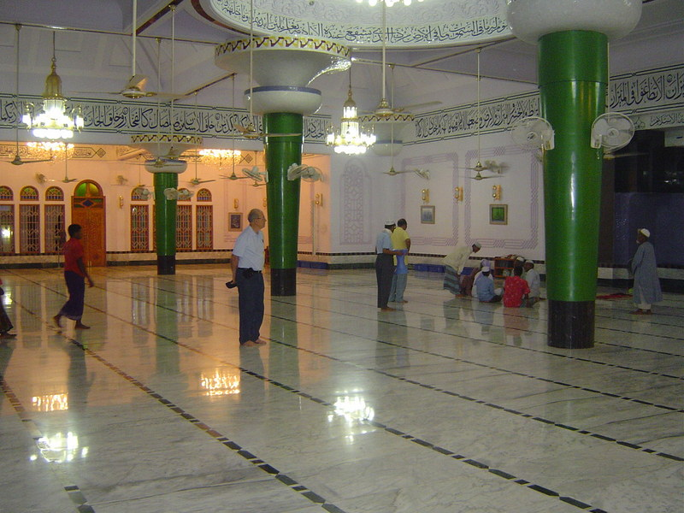

Slide 25
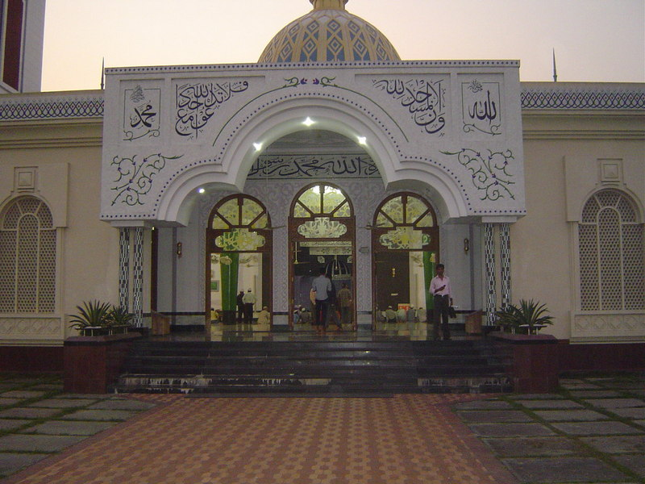

Slide 26
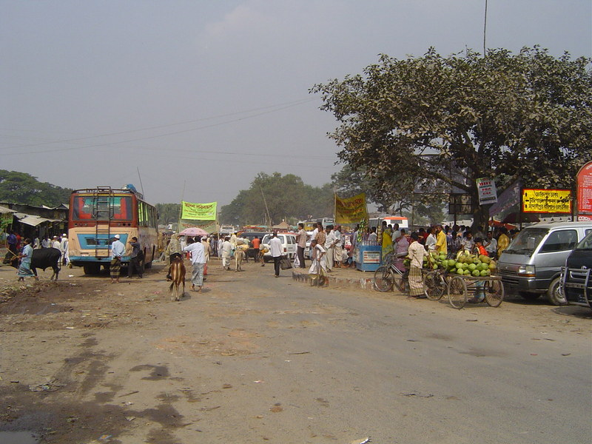

Slide 27
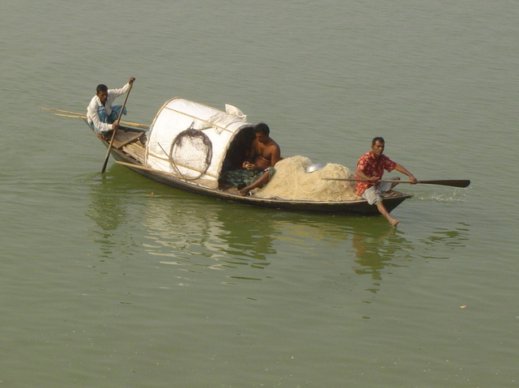

Slide 28
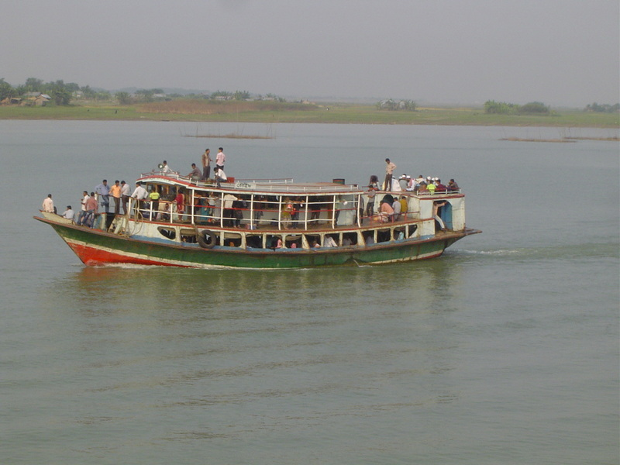

Slide 29
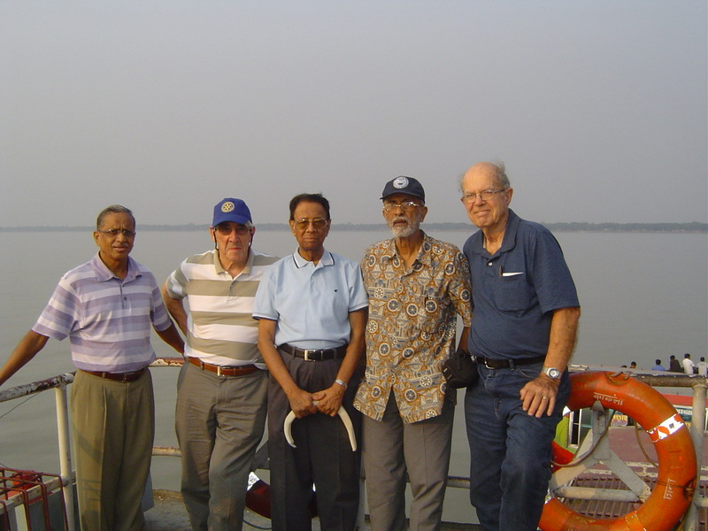

Slide 30
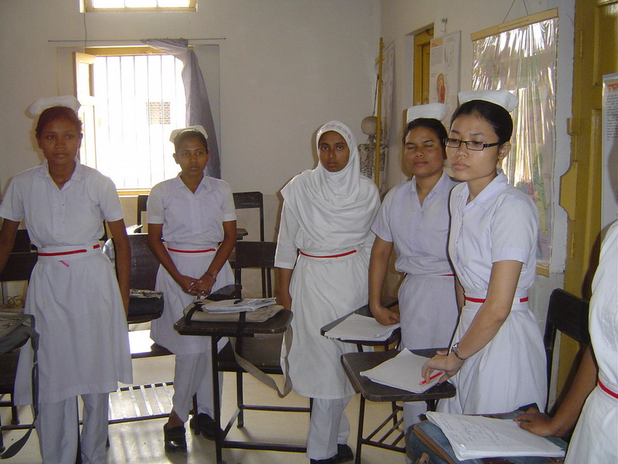

Slide 31
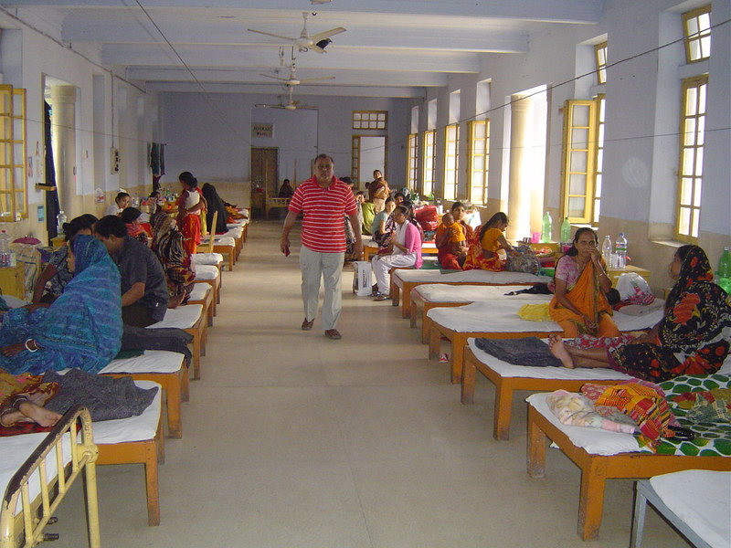

Slide 32
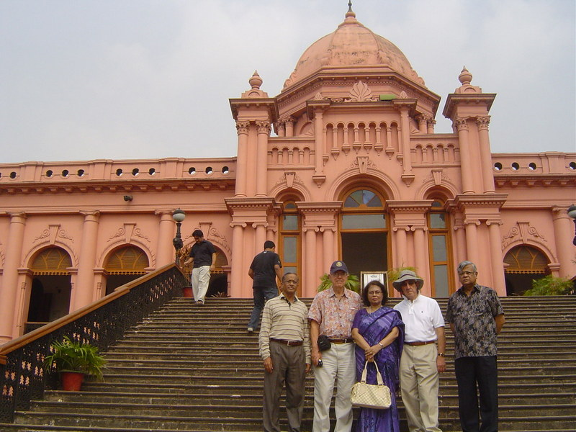

Slide 33
Pediatric Cataract Surgery Project: Bangladesh
Host | Rotary Club of Dhaka West (“RCDW”), Bangladesh
International | Granville R.C.
Global Grant # | 1636490 (prepared by RCDW). Category: Humanitarian
Beneficiary | Islamia Eye Hospital
Scope of Project | 150 children with cataracts will be treated Purchase of an IOL Master to improve the quality of cataract surgery Training of eye specialists on use of the IOL Master
Purpose of IOL Master | To measure the dimensions of a patient’s eyes to allow the design of the optimum intra ocular lens to be inserted during cataract surgery. An IOL Master is an optical device which will replace the sonar based instrument currently being used by the hospital.
Project Cost | $50,000
Pledged so far | $20,000 Bangladesh; $22,000 USA (Both assuming TRF matches)
Hopes for raising the balance required of $8000 (incl. TRF Matches) | PDG Sue Austin reports that she has approached other districts for their DDF. In parallel it is hoped that contributions from Southern Rensselaer and two further District 7190 clubs I am in contact with will help to close the gap.

