Slide 1
SRC Rotary
April 13, 2017
What’s the Buzz About Bees
The Plight of Bees

Slide 2
Bees in History
Laurie B
The bee was considered the sacred insect that bridged the natural world to the underworld in the mythology of ancient Near East and Aegean cultures.
Notes:
INTRO FACT read by Vanessa for Laurie B section: What ancient Hebrew name means bee?
Laurie Baldwin
Historical Perspective on bees, beekeeping and honey.
The presentation will be a brief review of interesting facts related to the following topics:
The cultural origins of beekeeping.
Bees,
beekeeping and honey in religion, mythology, symbolism and art.
Due to the short amount of time allotted for each of our topics mine will be delivered as interesting facts within each category listed above instead of a summery of information, something of a fast fun bullet point presentation. I will include visuals where appropriate.
I will not cover honey, bees or beekeeping as they relate to food, beauty or health as others will be reporting on those topics.

Slide 3
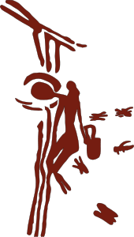
The Honey Seeker
Honey seeker depicted on 8,000 year old cave painting near Valencia, Spain

Slide 4
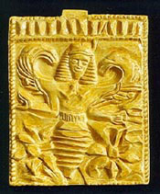
Melissa or the bee goddess
Ancient gold plaques embossed with the winged bee goddess.

Slide 5
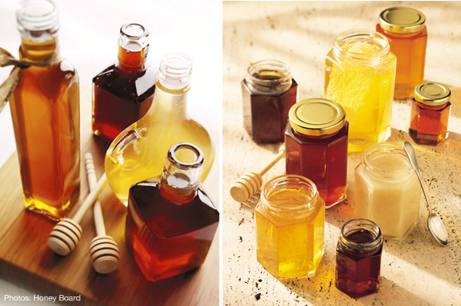
Honey:
Cooking & Nutrition
Notes:
INTRO BEE FACT read by Laurie introducing Karen: Honey bees are the only insect that produce food for humans
Section 2b Bees in History: Food perspective -
I was looking at some recipes, and I think that Honey Cakes would be a good idea for a recipe card and for sampling. It has a long history - prehistoric people came up with the idea of mixing flour and honey together to make a sweet cake. Considered to be a food of the gods, and used in ceremonies that required sacrifice - honey cakes were offered. Not necessary for me to submit any slides, just the recipe card.
There is a also a drink make with honey called Mead, its a honey wine. Don't know if I should find a recipe for that also. Will discuss it at the meeting tomorrow.
Let me know what else you need. I'm working on my presentation which consists of a little history of honey, nutritional value, cooking tips, storing and baking.
Will also include a little about Mead. It's not that long, definitely less than 5 minutes. The problem is, I keep finding more info, and changing what I have.
Thanks,
Karen

Slide 6
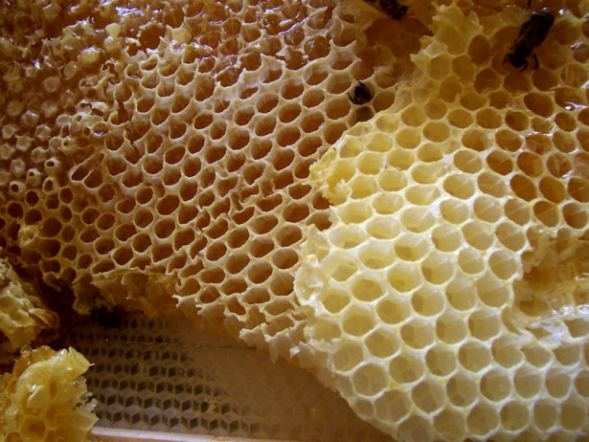
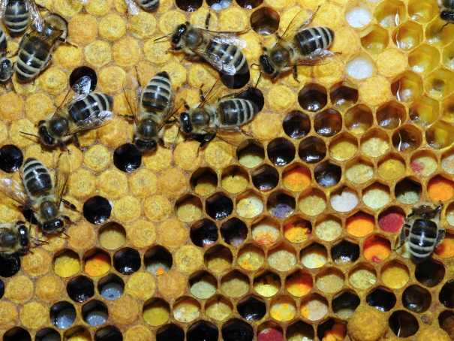
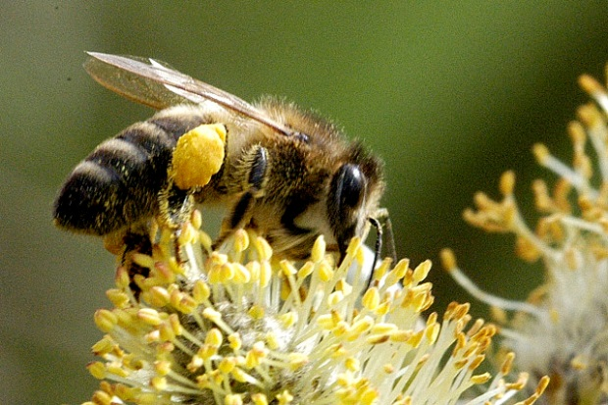
COSMETICS & WELLNESS
Honeycomb
Pollen stored in the comb
Honeybee with
pollen basket
Notes:
INTRO BEE FACT read by Karen introducing Ellen P. Did you know that the cosmetics industry is the single largest consumer of beeswax?“
For centuries, humans have used bee hives to produce many cosmetics and natural remedies. Bee products are produced from honey, pollen, propolis and royal jelly (and venom, but that won't be addressed here.) It should be noted that those allergic to bee stings may also be allergic to bee by-products.
- Honey promotes body and digestive health, is a powerful antioxidant, strengthens the immune system, eliminates allergies, and is an excellent remedy for skin wounds and all types of infections. Honey is the primary food for the hive so only extra honey should be harvested. Raw honey (unpasteurized) has anti-viral, anti-bacterial, and anti-fungal properties. Raw honey's benefits don't stop there. Raw honey can also stabilize blood pressure, balance sugar levels, relieve pain, calm nerves, and it has been used to treat ulcers. Raw honey is also an expectorant and anti-inflammatory and has been known to effectively treat respiratory conditions such as bronchitis and asthma.
- Pollen is the main protein source for bees - like honey, it should not be over-harvested or it will put stress on the hive. Pollen is said to be a superfood - lowers cholesterol, slows aging, prevents colds, full of vitamins, minerals & amino acids.
- Propolis is the resin bees collect from poplar and evergreen trees. It’s basically beehive glue. Although bees use propolis as caulk, humans use it to fight off bacteria, viruses, and fungi. Research shows that propolis taken from a beehive may relieve cold sores, canker sores, herpes, sore throat, cavities, and even eczema. Farming for propolis creates constant stress on the hive, since the bees sacrifice their food collection to keep the hive safe. Propolis is a natural antiseptic and anti-inflammatory.
- Some of the health benefits of royal jelly include its ability to prevent certain types of cancer, lower blood pressure, relieve infertility, lower cholesterol levels, protect the liver, reduce inflammation, heal digestive disorders, prevent premature aging, help in weight loss efforts, and increase circulation. Unfortunately, most experts agree that it is inhumane to harvest royal jelly - pollen is a good alternative.
Royal jelly is secreted from glands in the head of worker bees (sterile females) and fed to all bee larvae for three days whether they are destined to become drones (males), workers (sterile females) or queens (fertile females). Queen larvae continue to be fed royal jelly throughout development. In order to produce royal jelly for harvest, the hive must be stimulated to believe there is no queen and queen larvae destroyed. The hive cannot remain sustainable, and harvesting royal jelly can lead to death of the colony.

Slide 7
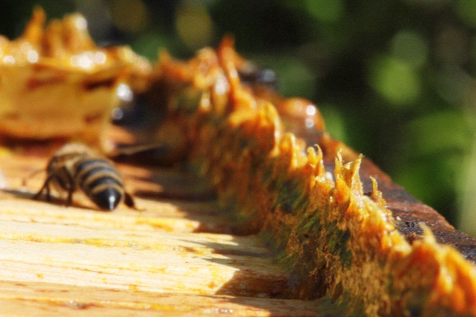
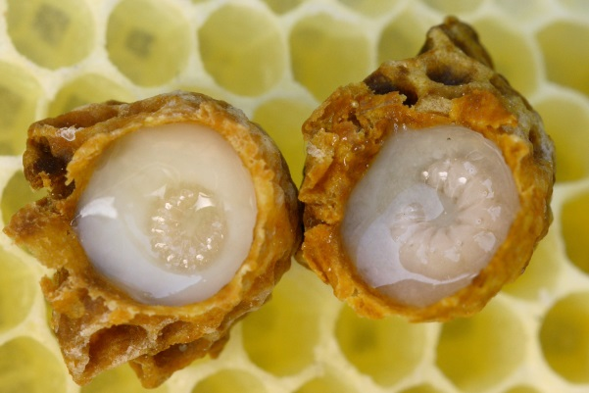
Propolis
Developing Queen larvae surrounded by royal jelly

Slide 8
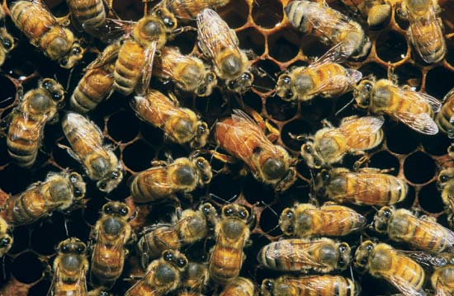
Colony Life
On the Honey Comb
Notes:
INTRO BEE FACT for Sues Smith section read by Sue Brown: 90% of a bee's life is spent in the dark on the comb.
The bee fact that can be used prior to my portion can be either, "90% of a bee's lifespan is spent in the dark, on the hive," or "a honeybee colony is a perennial and highly organized Super Organism." Not sure which is better based on the content, but can be determined as we fine tune the presentation.
Colony Life
Life cycle-egg, larva, pupa, adult
Bee castes- numbers per hive
-Queen: fertility and mating; end of useful life;
lifespan
-Workers: all female; typically lack fully developed
ovaries; lifespan
-Drones: all male; sole purpose to mate with queen’
lifespan
Division of labor
Colony Reproduction
When does it occur?
Formation of swarm cluster
Location of new site for hive
Communication of new location
Implications for future hive reproduction
Got a hive in your house?

Slide 9
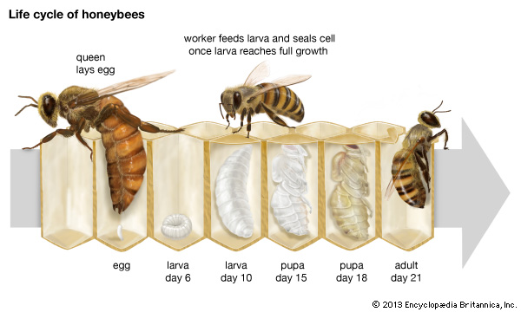
Life cycle of honey bees

Slide 10
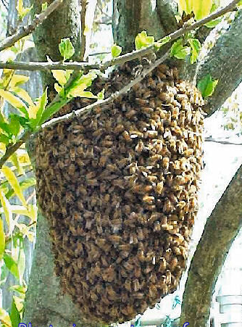
Swarm Cluster
Photo: beemaster.com

Slide 11
Colony Collapse Disorder
North American Honey Bee
Notes:
Bee fact read by Jenn introducing Debby O

Slide 12
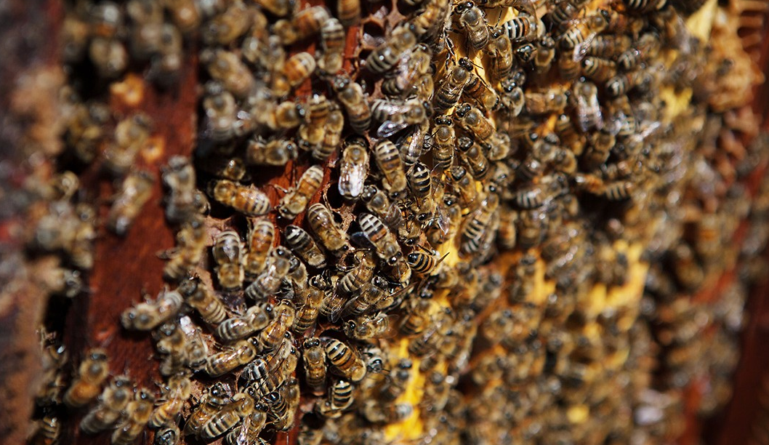
A healthy hive
Chris Jordan-Bloch / Earthjustice

Slide 13
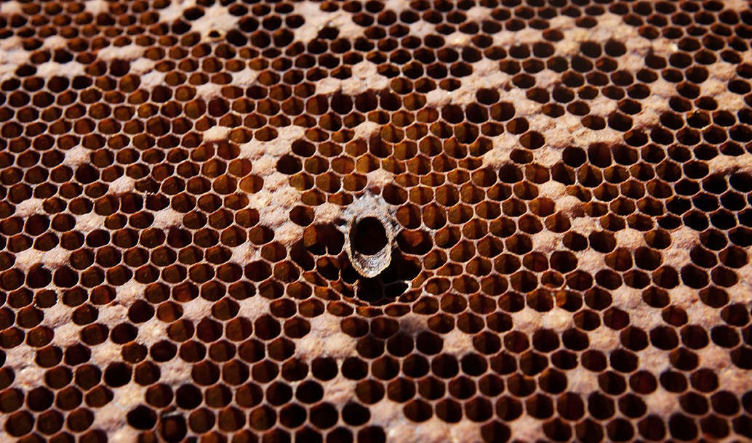
An unhealthy hive
Chris Jordan-Bloch / Earthjustice

Slide 14
Possible Causes
Pesticides…especially neonicotinoids
Mite infections
Malnutrition
Various pathogens
Loss of habitat
Beekeeping practices, especially the stress of moving hives from place to place

Slide 15
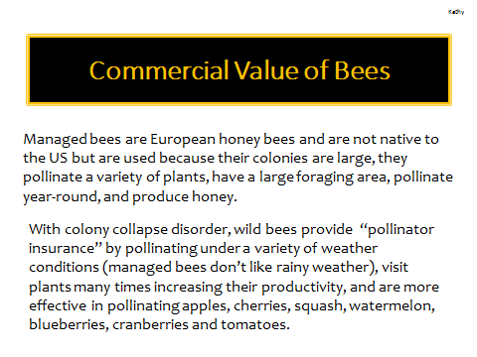

Slide 16
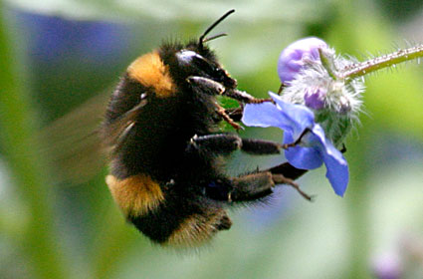
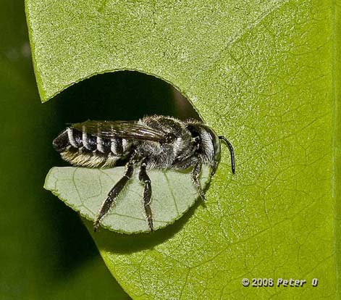
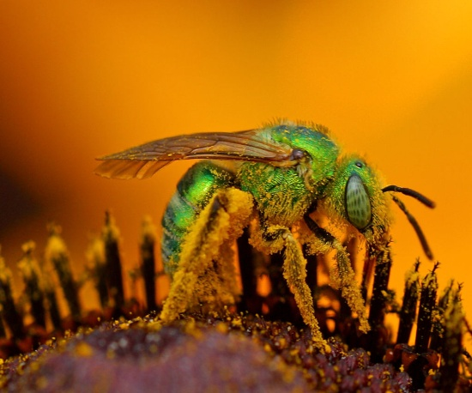
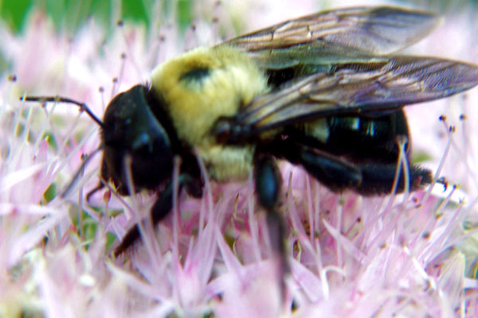
Among wild pollinators (which include butterflies, moths, flies, beetles, wasps, birds & some mammals) bees are the most important and include many varieties - mining bees, long-horned
bees…
Bumble bees
Leaf-cutter bees
Sweat bees
Carpenter bees

Slide 17
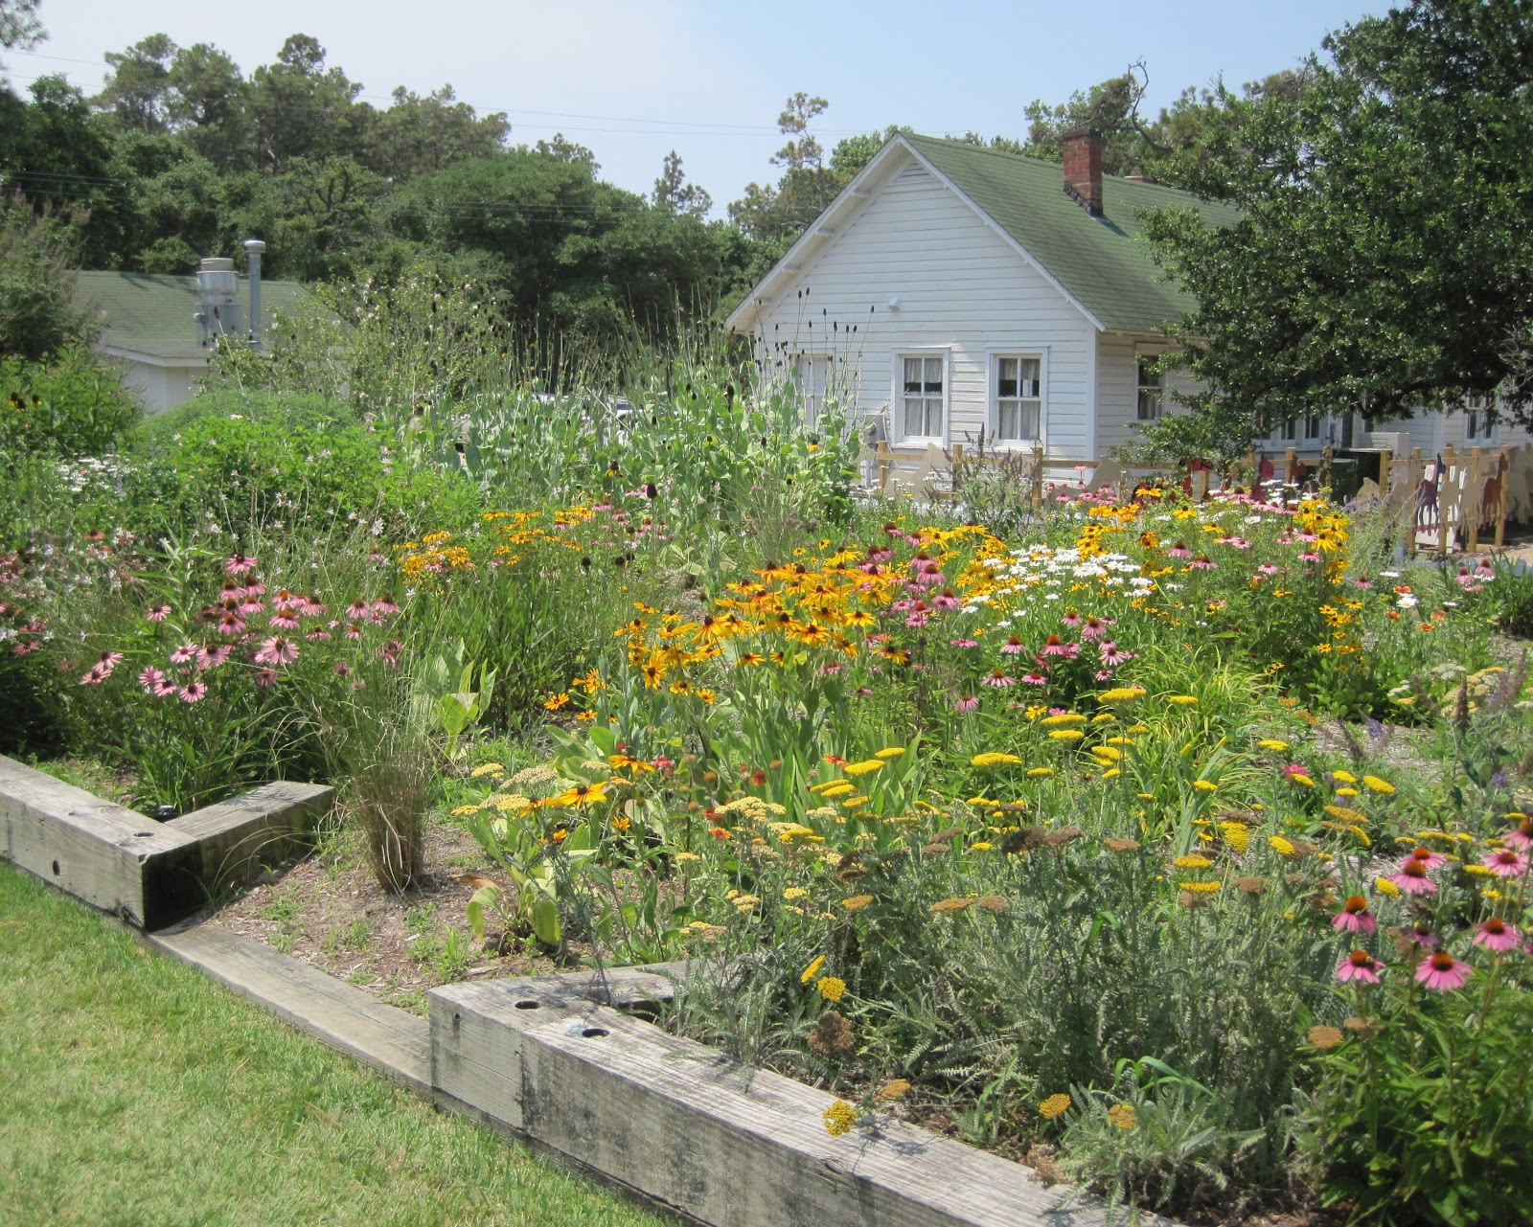
Creating a Bee-Friendly Environment
Debbie B
Notes:
INTRO BEE FACT read by Deb O introducing Debbie B: HOW MANY FLOWERS DO BEES FROM THE SAME HIVE VISIT IN A DAY?
Avoid pesticides
Neonicotinoids killing bees
Provide a wildflower rich environment
Bees need nectar and pollen
Native species best
Design habitat conducive to bees
Sun, open space with few big trees
Multiple large clusters of one species, repeat clumps within a few feet of each other
Provide variety of species with overlapping and sequential bloom periods
Create bee friendly lawns
Overseed current spaces with white/alsike clover to begin transition
Add mint, thyme, squill, crocus, chamomile
Leave “weeds” like creeping Charlie, dandelion, and violet
Mow once a month!!
Suggested plant materials for this zone include:
Purchase from sources which do not use pesticides during propogation

Slide 18
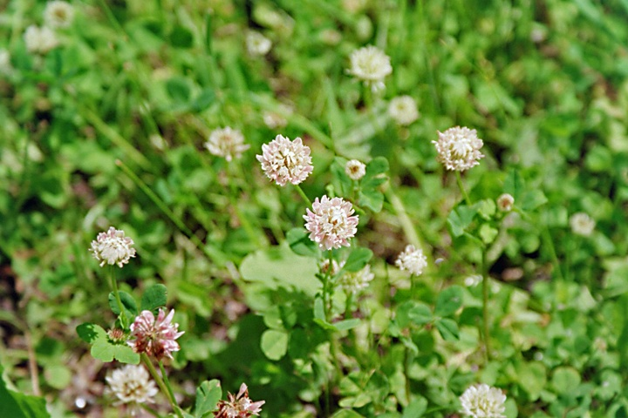
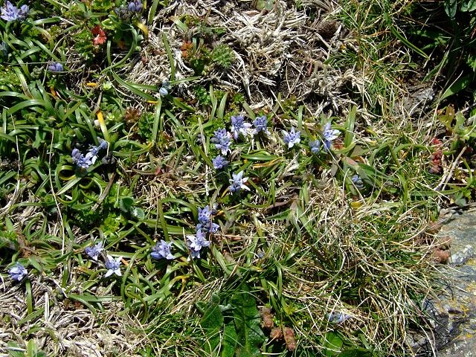
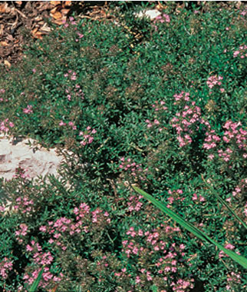
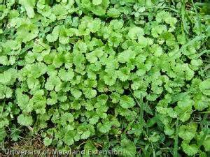
Create Bee Friendly Lawns
Alsike clover
scilla verna
Creeping thyme
Creeping Charlie

Slide 19
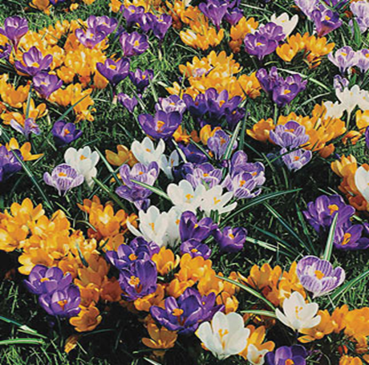
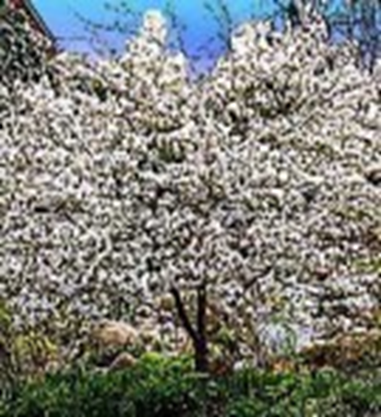
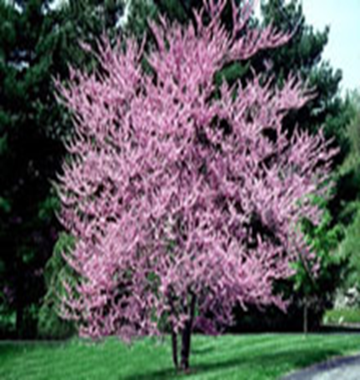
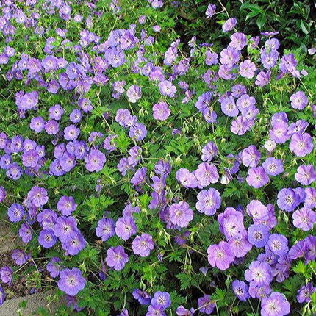
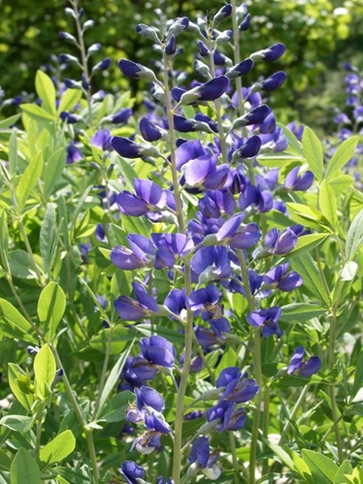
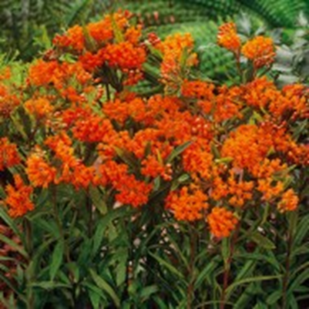
Suggested Bee Friendly Plants
Crocus
Amelanchier spp
Cercis canadensis
Geranuim cranesbill
Baptisia australis
Asclepias tuberosa

Slide 20
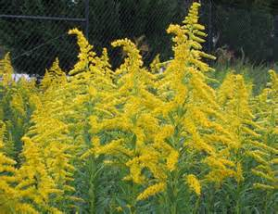
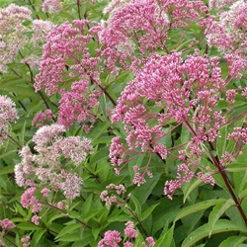
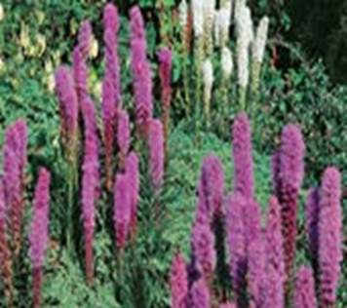
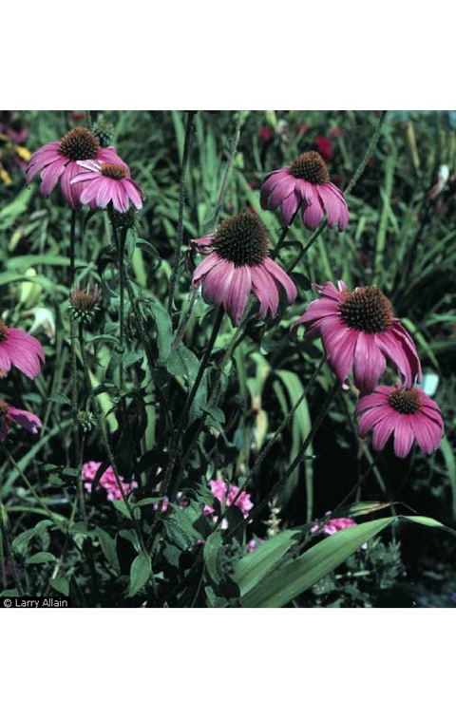
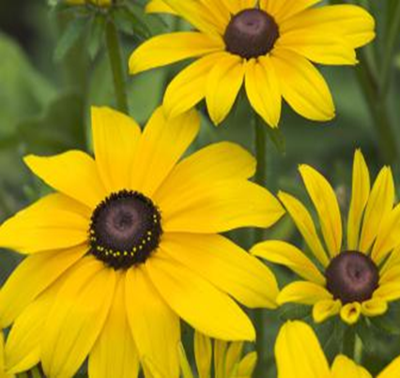
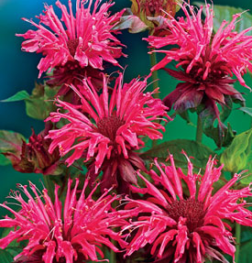
solidago
eupatorium
liatris
Echinacea purpurea
Rudbeckia black-eyed susan
monarda

Slide 21
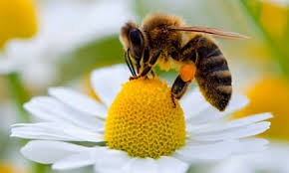
CALL TO ACTION
Who will save our pollinators?
Notes:
BEE FACT read by Debbie Brown introducing Ellen DP
About 37 states are taking action to get legislation to require GMO labels on foods.
Do you know what Federal Legislation would prohibit any mandatory Labeling of genetically engineered foods in the US?
Answer:
The bill, dubbed the “Safe and Accurate Food Labeling Act,” was drafted by U.S. Rep. Mike Pompeo from Kansas, and is aimed at overriding bills in roughly two dozen states
that would require foods made with genetically engineered crops to be labeled as such.
The bill specifically prohibits any mandatory labeling of foods developed using bioengineering.

Slide 22
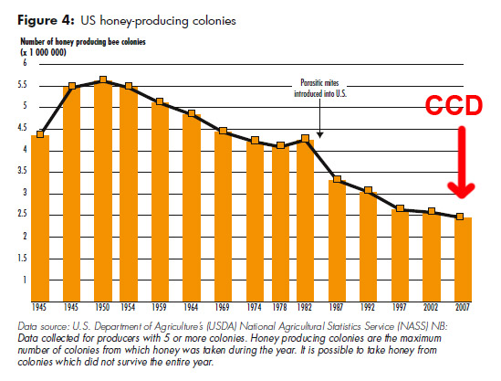
FEDERAL ACTION IN RESPONSE TO CCD
2006 US Farmers and Beekeepers note drastic drop and deaths of the honeybees.
2007 USDA leads a federal government response to Colony Collapse Disorder (CCD).
CCD Steering Committee established.
EPA, USDA, and other government agencies, and academia.
CCD Action Plan:
Survey
Collect data
Analyze bee samples
Choose mitigative measures to counter mortality
2008- USDA reports an average of 30% loss of managed bees per year.
2012

Slide 23


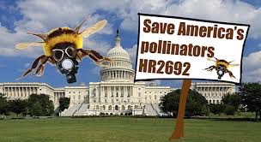
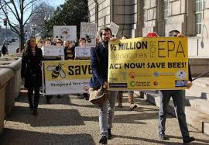

2013
April
March
S.809 Genetically Engineered Food Right-to-Know Act
HR 933 Farmers Assurance Provision Act
dubbed, Monsanto Protection Act.
July
HR 2692 Save the Pollinators Act
March
Sierra Club sues EPA to protect honeybees, a major pollinator.
September
HR 933 Monsanto Protection Act repealed

Slide 24
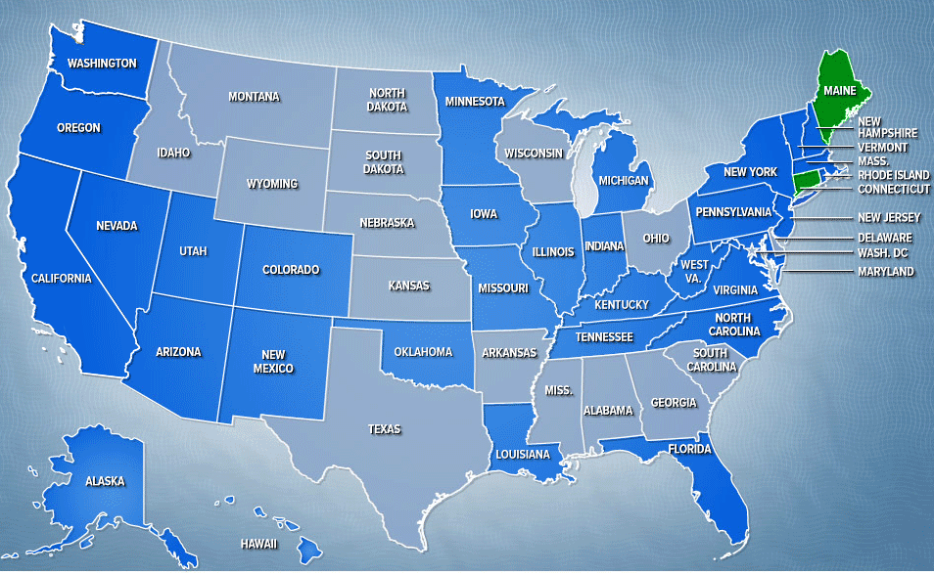
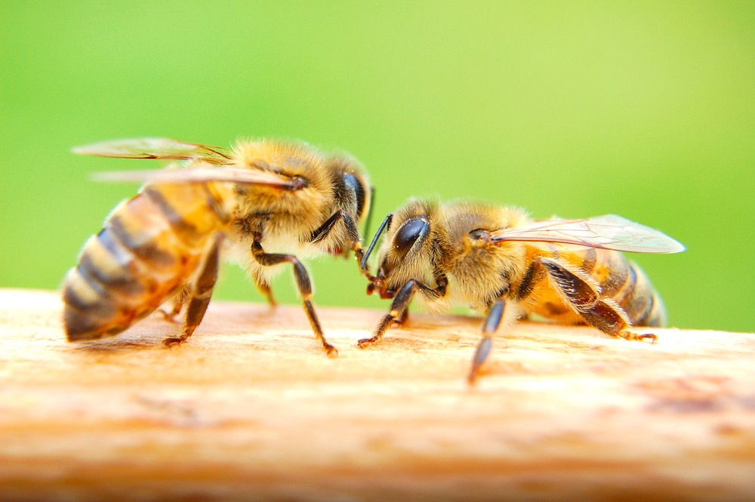
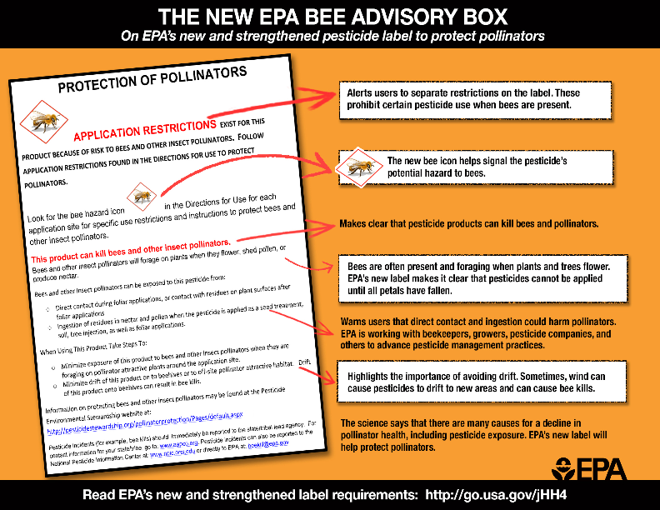
2014
HR 4432 “Safe and Accurate Food Labeling Act”
June
Pollinator Health Task Force >
National Pollinator Health Strategy.
Where can we be safe?
On the Wildlife Refuge. Yay!!
July
US Fish and Wildlife Services bans GMOs and insecticides at all US Wildlife Refuges
2015
EPA Sued for Violating Endangered Species Act for Allowance of New 2, 4-D/Roundup Pesticide
EPA creates Advisory Box Labels on pesticides.

Slide 25
2016 POLLINATOR PARTNERSHIP
ACTION PLAN
1. Reduce honey bee overwintering colony losses to no more than 15% within 10 years;
2. Increase the Eastern population of the monarch butterfly to cover approximately 15 acres in the overwintering grounds in Mexico; and,
3. Restore or enhance 7 million acres of land for pollinators over the next 5 years

Slide 26

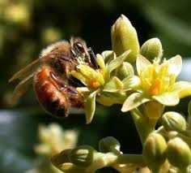
Bee Lovely and help
Save the Bees
Plant native species in your gardens.
Reduce use of pesticides.
Support local organic farms.
Don’t buy GMO plants or products at local stores.
Leave natural spaces for bees in your yard. Create bee havens
on your property.
Share the knowledge. Educate.

