Slide 1
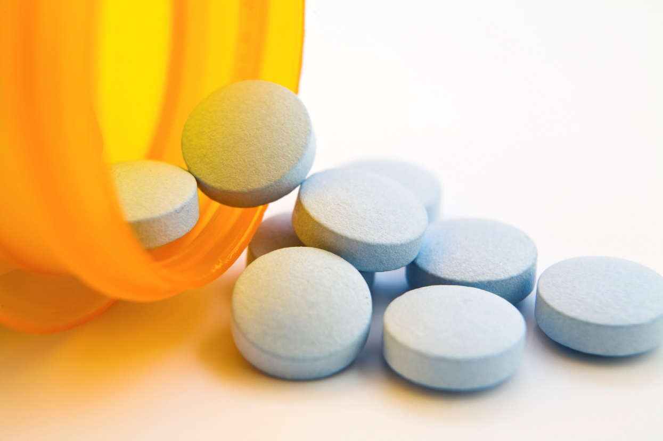

Alyssa Evans, LMHC
Student Assistance Counselor
Rensselaer County Mental Health
  Opioid and heroin addiction
  is an epidemic.

Slide 2
Agenda
Introduction
Data
Opioids
Heroine
Teen Brain and Development
Statistics
Gateway
Talk to Prevent
Coalitions

Slide 3


The epidemic is national.
3x
increase
in heroin-related overdose deaths since 2010 in the U.S.
Source: National Vital Statistics System, Mortality file

Slide 4
The epidemic is national.
78 people
die every day from heroin and opioid overdoses in the U.S.
Source: National Vital Statistics System, Mortality file

Slide 5

New York
is not immune.
1 in 14
New Yorkers will report substance dependence or use disorder this year.
Source: National Survey on Drug Use and Health , 2013 and 2014

Slide 6
Opioid Related Deaths
in New York State
1,443
1,227
2013
2014
Source: NYS Department of Health

Slide 7

This epidemic is killing people
at the same rate as the AIDS epidemic
did when it was raging at its peak
in the late 80s and early 90s.

Slide 8
Rx
Abusing prescription drugs is not safer than misusing illicit drugs.
Rx drug use is on the rise has resulted in unintended drug addiction and death.
  Pain Reliever Abuse (Opioid pain killers used to treat pain)
  Depressant Abuse (Anti-anxiety medication and sedatives)
  Stimulant Abuse (Used to treat ADHD and certain sleep disorders)
The majority of both teens and young adults obtain prescription drugs they abuse from friends and relatives, sometimes without their knowledge.

Slide 9
What Are Opioids?
Medicines that relieve pain
Can be natural (from the poppy plant) or synthetic (man-made)
Common Prescription Opioids
Hydrocodone (Ex: Vicodin, Lortab); Oxycodone (Ex: OxyContin, Roxicodone, Percocet)
  Commonly prescribed for a variety of painful conditions, including dental and injury-related pain
Morphine (Ex: DepoDur, Astramorph, Duramorph)
  Often used before and after surgical procedures to alleviate severe pain
Fentanyl
  50-100 times more potent than Morphine; Used to treat severe pain, often in patch form
Codeine
  Often prescribed for mild pain; Can also be used to relieve coughs and severe diarrhea

Slide 10
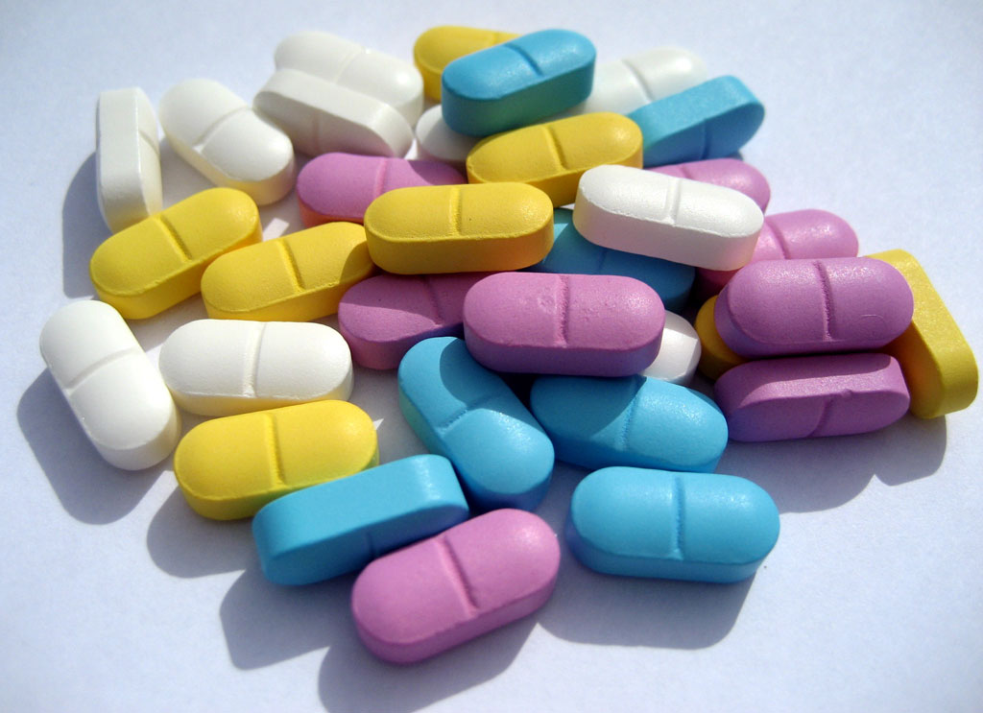
What Do Opioids Do?
Reduce and relieve pain
Can sometimes create a sense of euphoria
HIGHLY habit-forming and addictive
SIDE EFFECTS:
  Drowsiness and sedation
  Mental confusion
  Nausea and vomiting
  Constipation
  Pinpoint (constricted) pupils
  Slowed or depressed vital signs
    Body temperature, blood pressure, pulse and respiration rates
  Overdose and Death

Slide 11
Opioid Misuse/Dependence
Signs and Symptoms
Physical Signs
Change in appetite
Pupil size
  Small: opioid intoxication
  Large: opioid withdrawal
Nausea
Vomiting
Sweating
Shaking
Behavioral Signs
Change in personality/attitude
Change in friends
Change in activities, sports, hobbies
Poor attendance / grades
Increased isolation; secrecy
Wearing long sleeved shirts
Moody, irritable, nervous, giddy, or nodding off
Stealing

Slide 12
What is HEROIN?
A illegal narcotic used recreationally to achieve effects
similar to those caused by prescription opioids
How Does It Make You Feel?
  Relieves pain; Instant rush of good feelings and happiness, followed by slow, dreamlike euphoria
Heroin comes from the opium poppy flower
  It can look like a white or brown powder, or black tar
  Other names for it: horse, smack, junk, and brown sugar
How It Is Used
  Inject (most common and most dangerous), snort, or smoke it
    No matter how you use it, it gets to the brain quickly
  HEROIN IS HIGHLY ADDICTIVE – you quickly build a tolerance for it and need more each time to feel the same results

Slide 13
What is HEROIN?
Heroin is stronger, cheaper, and easier to get than prescription pills
  Also more dangerous – you never know what it is cut/mixed with
SIDE EFFECTS and RISKS ASSOCIATED WITH HEROIN:
  Slows vital signs (heart and pulse rate, breathing, blood pressure)
  Itching
  Nausea and vomiting
  Collapsed veins
  Infections of the heart lining and valves
  Skin infections like abscesses and cellulitis
  High risk of contracting HIV/AIDS, hepatitis B, and hepatitis C
  Lung diseases like pneumonia and tuberculosis
  Miscarriage

Slide 14

9 out of 10 people with a substance use disorder started using alcohol and marijuana before they turned 18.

Slide 15

Nearly half of young people who use heroin report abusing prescription pain killers before starting heroin.
Source: National Survey on Drug Use and Health. 2011-2013

Slide 16

The number of high school students reporting heroin use has doubled in the past 10 years.
Source: Youth Risk Behavior Surveillance System (YRBS) – Centers for Disease Control and Prevention (CDC)

Slide 17
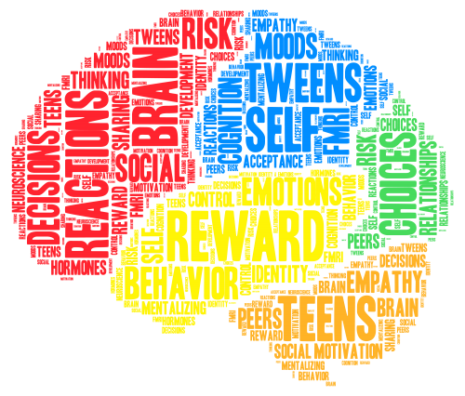
TEEN Brain Development
Brain development and maturation continues well into our early 20s
Areas of brain to develop in EARLY TEEN YEARS:
  Risk-taking and sensation-seeking
Areas of brain to develop LATER:
  Regulates emotions
  Impulse control
  Considering consequences
  Judgement and decision-making
Notes:
17
Let’s speculate a little bit about how brain development may influence the behavior of young people. Although science has not yet provided direct evidence for how brain development impacts specific teenage behaviors, here are five ways the developing brain may affect behavior.
Number one. Sensory and physical activities would likely be favored by an adolescent over complex, cognitive demanding activities. This principle is based on the notion that the more mature cerebellum may dominate over the more slowly developing prefrontal cortex. Thus, brain development may contribute to the general observation that many teenagers would prefer to listen to music or to skateboard, rather than to play chess or do complex algebra.
Number two. There is some suggestion from research that a developing nucleus accumbens, the part of the brain that directs motivated behavior, contributes to a preference for activities that produce high excitement yet require minimal effort. Not only would young people's preference for playing videogames be consistent with this principle, but so would using drugs.
Number three. Researchers speculate that a developing amygdala, the emotional processing center of the brain, may contribute to poor management of emotions. This may translate to the teenager to emotionally over-react to situations and expressing emotions in an exaggerated way (e.g., expressing excessive anger over a minor incident).

Slide 18
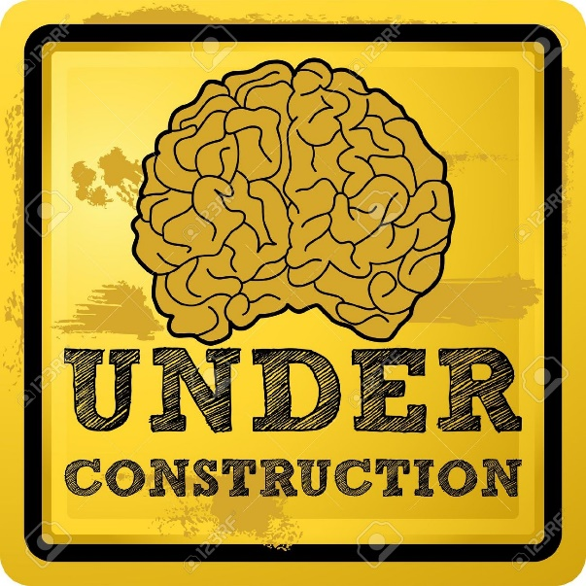
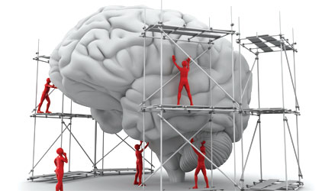
TEEN Brain Development
Brain development and maturation continues well into our early 20s
What does this mean?
  PHYSICAL, SENSORY-CONNECTED activities may be preferred over complex, intellectually demanding ones
  Activities with HIGH EXCITEMENT and require LOW EFFORT [video games, sports, sex, drugs] are often preferred
  Poor self control and emotion management can lead to OVERREACTION and EXAGGERATED EXPRESSING of emotions
Notes:
18
Let’s speculate a little bit about how brain development may influence the behavior of young people. Although science has not yet provided direct evidence for how brain development impacts specific teenage behaviors, here are five ways the developing brain may affect behavior.
Number one. Sensory and physical activities would likely be favored by an adolescent over complex, cognitive demanding activities. This principle is based on the notion that the more mature cerebellum may dominate over the more slowly developing prefrontal cortex. Thus, brain development may contribute to the general observation that many teenagers would prefer to listen to music or to skateboard, rather than to play chess or do complex algebra.
Number two. There is some suggestion from research that a developing nucleus accumbens, the part of the brain that directs motivated behavior, contributes to a preference for activities that produce high excitement yet require minimal effort. Not only would young people's preference for playing videogames be consistent with this principle, but so would using drugs.
Number three. Researchers speculate that a developing amygdala, the emotional processing center of the brain, may contribute to poor management of emotions. This may translate to the teenager to emotionally over-react to situations and expressing emotions in an exaggerated way (e.g., expressing excessive anger over a minor incident).

Slide 19
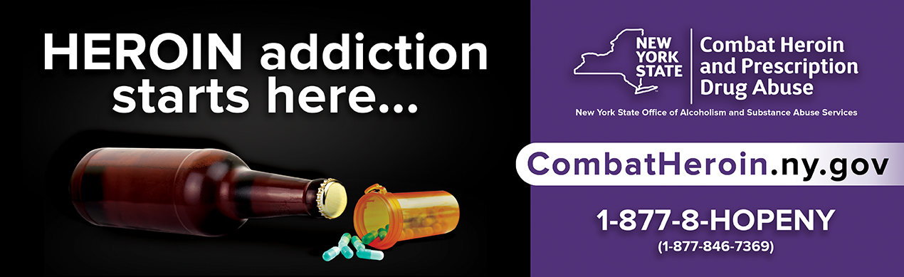
Do you think using
alcohol, marijuana and prescription pills
can lead to other drug use?

Slide 20
THE PROGRESSION OF ADDICTION IS SUBTLE
NYS Combat Heroin and Prescription Drug Abuse Kitchen Table Toolkit
Part 1: Talking with Community
https://youtu.be/JlsrknxjmgQ
NYS Combat Heroin and Prescription Drug Abuse Kitchen Table Toolkit
Part 2: Talking with Young People
https://youtu.be/vmeKncRj4ok

Slide 21
Do you think using
alcohol, marijuana and prescription pills
can lead to other drug use?
NO ONE EVER THINKS IT WILL HAPPEN TO THEM.
Notes:
Behavioral Pathway

Slide 22
Why Teens Use
Acceptance
Curiosity
Easy Access
Modeling
Self-medication

Slide 23
Family: You Matter
Every day, more than 4,000 teenagers try an illicit drug for the first time
Kids who learn about the risks of substance abuse at home are significantly less likely to use. Parents and other caring adults do matter and can make a difference.
Parents/Grandparents, your disapproval of underage drinking and substance use is the #1 reason kids choose not to drink alcohol or use.
Not all teen use is experimentation. Continuum of use.
Understanding that alcohol use, substance use, and relationship decision making is a normative part of a teenagers experience, does not mean co-signing and endorsing these things.
Expect it vs. Accept it
Modeling
Delaying Onset: For every year that use of a substance is delayed, the risk of developing a substance use disorder is reduced!

Slide 24
Prevent Prescription Drug Misuse
Lock Your Meds
Supervise Administration of Meds
Take medication as prescribed
Don’t share meds
Don’t mix meds
Take Inventory – routine tracking
Proper Disposal
Ask your provider is any of the medications prescribed for your family have a potential for abuse.
Educate yourself & your child
Set clear Rules & Monitor Behavior
Talk2PRevent

Slide 25
Take Action
Prepare Yourself
Confront the Issue
Have a Conversation
Set Standards
Ask for Help

Slide 26
Community Coalitions
Troy Drug Free Community Coalition - davia@triponline.org
TRACS- Berlin Area
RADAR- Rensselaer
Nopiates- Averill Park
Rensselaer County Stop Heroin Coalition

Slide 27
NEW YORK STATE’S 911 GOOD SAMARITAN LAW PROTECTS YOU AND CAN SAVE A LIFE
Call 911 without fear of arrest if someone is having a drug or alcohol overdose
The following are signs of an overdose. CALL 911 if the person:
Is passed out and cannot be woken up;
Is not breathing, breathing very slowly, or making gurgling sounds;
Has lips that are blue or grayish color.
Why should you care about the 911 Good Samaritan Law?
The law empowers YOU to save a person’s life.
The law encourages anyone to call 911 when they see or experience a drug or alcohol overdose.
Notes:
Naloxene Policy: East Greenbush, Averill Park, Lansingburgh, Colonie (?), Albany

Slide 28
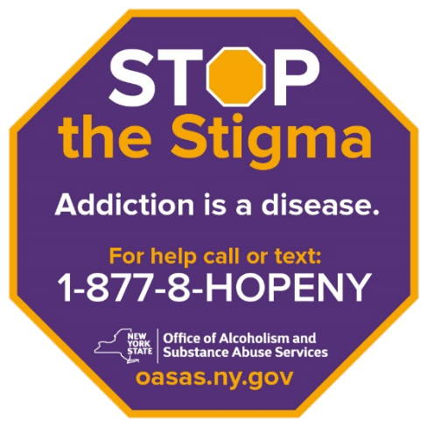

RESOURCES
Link to NYS OASAS http://www.oasas.ny.gov/index.cfm
Link to Talk2Prevent http://talk2prevent.ny.gov/
Link to Combat Heroin http://www.combatheroin.ny.gov/
Link to the Kitchen Table Toolkit http://www.combatheroin.ny.gov/kitchen-table-toolkit
Information on Good Samaritan law http://www.combatheroin.ny.gov/prevention
Spotlight on Synthetics http://www.oasas.ny.gov/AdMed/drugs/Synthetics.cfm
Download Combat Heroin materials http://www.combatheroin.ny.gov/resources
Reach out to your LOCAL PREVENTION and TREATMENT PROVIDERS!!!
OASAS Provider Directory: https://www.oasas.ny.gov/providerDirectory

Slide 29
