Slide 1

Rotary Next Gen

Slide 2


Rotary Next Gen
Ten years ago there were 1.2 million Rotarians worldwide.
Today there are 1.2 million Rotarians worldwide.
Fact: Worldwide Rotary is not growing, and in North America the trend is down.

Slide 3
Rotary Next Gen
1 July Historical Region Member Count 2010-2015
USA, Canada, & Caribbean | Members | Clubs
2010 | 387,303 | 8,823
2011 | 378,940 | 8,820
2012 | 373,656 | 8,850
2013 | 365,059 | 8,780
2014 | 360,243 | 8,724
2015 | 359,635 | 8,690
Gain/Loss | 27,668 | 133
% Gain/Loss | -7.1% | -1.5%
Average Starting Membership:
397,360
Average Ending Membership:
390,255
Net loss 2007 – 2011:
28,417
And, in 2007 membership stood at 406,260, so North American Rotary has declined 12.5% since then.

Slide 4
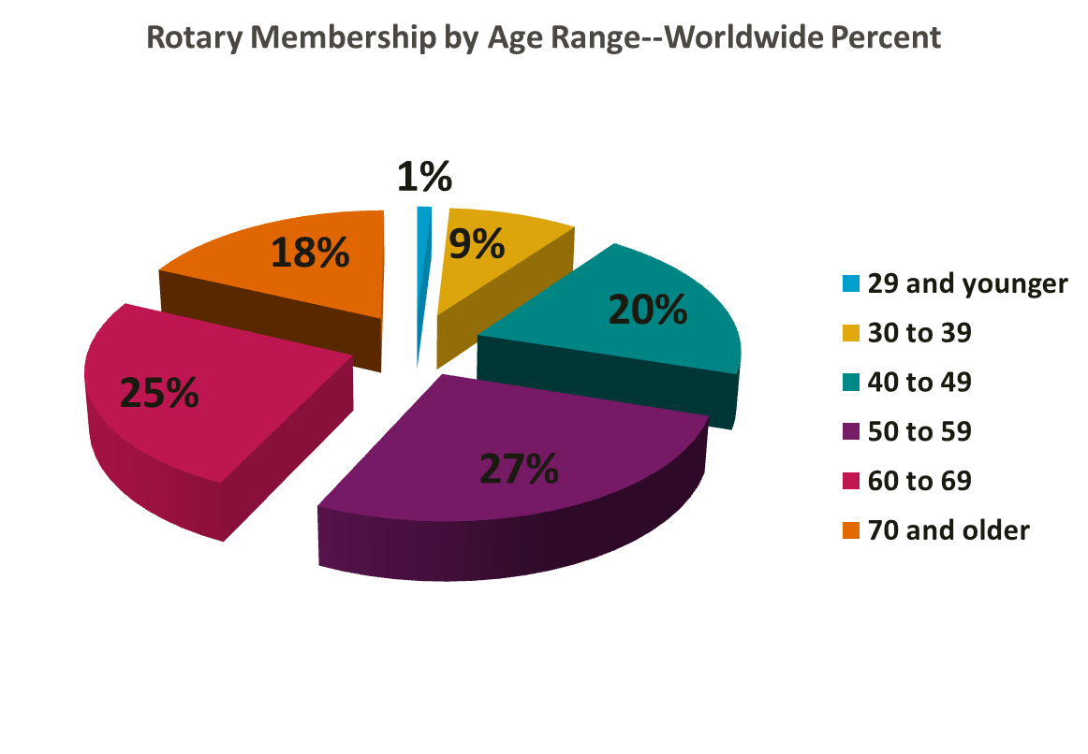
Rotary Next Gen
Ten

Slide 5
Rotary Next Gen
We say that we need to “get” more members.
  But, the biggest problem is that about 9.5% or members just “leave” Rotary. Some die for sure, but most just move or just leave. This is about RETENTION.
We say that we need to “get” more members.
  The low hanging fruit, however, is retention. The data shows that we are pretty good at getting new members who are just like us, but we do not effectively keep our members, especially those who are not just like us.

Slide 6
Rotary Next Gen
Certainly our Clubs should be doing everything they can to retain members.
Over time, though, our Clubs will need to increasingly recruit new members that are…

Slide 7
Rotary Next Gen
Generation X
Millennials
Young Professionals

Slide 8
Rotary Next Gen
Generation X and the Millennials are here to stay.
  There were 77 million Baby Boomers, but there are 51 million Gen X’ers and 75 million Millennials.

Slide 9
Rotary Next Gen
Improved retention helps replace Rotarians who age out.
Net overall growth will come from new members, and increasingly these new members will have to come from these younger generations.

Slide 10
Rotary Next Gen
We must understand
Generation X and
the Millennials (Gen Y).
And, Rotary must adapt.
Our Clubs must adapt, and our District must adapt.

Slide 11
Rotary Next Gen
Who are these young professionals?
  In their 20’s, 30’s and 40’s
  Starting or just hitting their career stride
  Working in white collar jobs
Who are these young professionals?
YP’s, also known as Millennials (Gen Y) and Generation X, are starting out in their careers, aged in their 20’s, 30’s and 40’s, and are typically working in white collar or professional jobs.

Slide 12
Rotary Next Gen
There are important distinctions between these groups, evidenced by distinct styles of behavior in the community and the workplace.

Slide 13
Rotary Next Gen
Generation X | Millennials
Born 1965-1976 51 million | Born 1977 – 1998 75 million

Slide 14
Rotary Next Gen
How do they behave, and what do they believe?
Generation X Accept diversity Pragmatic/practical Self-reliant/individualistic Reject rules | Millennials Celebrate diversity Optimistic/realistic Self-inventive/individualistic Rewrite the rules

Slide 15
Rotary Next Gen
How do they behave, and what do they believe?
Generation X Mistrust institutions PC Use technology Multitask Latch-key kids Friend are not family | Millennials Irrelevance of institutions Internet Assume technology Multitask fast Nurtured Friends = family

Slide 16
Rotary Next Gen
With these behavioral profiles, why does Rotary have a hard time attracting Gen X/Millennials?
  They mistrust institutions or find them to be irrelevant. We are an institution.
  We do not use technology well.
  We struggle with diversity.
  We have lots of “rules” that seem entrenched.
  We engage in group oriented behavior.

Slide 17
Rotary Next Gen
Look at what Rotary does offer that is appealing to the
Generation X/Millennial:
  We are pragmatic and optimistic.
  We offer a friend oriented experience which can be structured and supportive.
  We offer a place to learn and to both witness and practice “life”.

Slide 18
Rotary Next Gen
And, we have a core value which can be the instrument of our future membership success:
Service To Others

Slide 19
Rotary Next Gen
Gen X and Millennials believe in service…

Slide 20
Rotary Next Gen
Gen X and Millennials believe in service…
…but not the way we offer it.

Slide 21
Rotary Next Gen
Gen X, Millennials, and Service
  In 2012, 73% of Millennials volunteered for an NFP.
  4 of 5 said they did so for “the cause”.
  More than half said they were motivated in part by the chance to meet “like minded” volunteers.
  83% donated to an NFP in 2012.

Slide 22
Rotary Next Gen
“Young people value causes over specific organizations. They want to be involved in eradicating global poverty, combating human trafficking, or cleaning up a local watershed. It’s not just about joining the Kiwanis Club or the Elks Lodge…
*Case Foundation, 2013 Millennial Impact Report, fourth annual

Slide 23
Rotary Next Gen
…While previous generations joined clubs and organizations first, and only then discovered ways to serve, today’s young Americans see a problem first and then look for a way to solve it.”*
*Case Foundation, 2013 Millennial Impact Report, fourth annual

Slide 24
Rotary Next Gen
How do these generations seek and find the problem solving organizations of their choice?
Of course… through the palm of their hand… the internet!

Slide 25
Rotary Next Gen
  More than half follow 1-5 organizations through social media.
  2/3 subscribe to email newsletters.
  Relevancy to “the cause” is the how social media content is judged.
  71% say that the primary email annoyance is irrelevance and too many solicitations.

Slide 26
Rotary Next Gen
For Millennials, the internet is a far wider portal to the community than service clubs and fraternal groups, but young volunteers do value networking in the midst of service….
*Case Foundation, 2013 Millennial Impact Report, fourth annual

Slide 27
Rotary Next Gen
Almost 72 percent of respondents expressed interest in joining a young nonprofit professional group. Chambers of Commerce, United Ways, and Rotary Clubs should look to engage young people in combined service and networking activities.*
*Case Foundation, 2013 Millennial Impact Report, fourth annual

Slide 28
Rotary Next Gen
When it comes to our service projects, let’s match young professionals by their skills!
  42% of those surveyed said their motivation for getting involved with an organization was the chance to share their skills and expertise.

Slide 29
Rotary Next Gen
And, let’s organize our service projects to reflect the WAY that YP’s prefer to engage in service:
  77% prefer working with groups of fellow employees rather than performing independent service projects. 62% prefer to volunteer with people in their own department.

Slide 30
Rotary Next Gen
This is an opportunity to organize corporate
service days.

Slide 31
Rotary Next Gen
Further, these generations indicated a strong interest in entrepreneurship, and 27% of Millennials are already self employed.
  Integrating entrepreneurial opportunity and behavior into service projects creates a link to this interest.

Slide 32
Rotary Next Gen
  Let’s integrate entrepreneurial opportunity and behavior into service projects to create a link to this interest.

Slide 33
Rotary Next Gen
Service can be our primary magnet, and the way to connect is our belief that service to others in intrinsic to a meaningful life.
Gen X’ers believe in friends, not family, and Millennials believe that friends are their family.

Slide 34
Rotary Next Gen
  We Can Do This!

Slide 35
Rotary Next Gen
We must meet the coming generations where they are, not where we are. They will not come to us; we must find paths into their lives, taking into account their need for relevance, flexibility, friendship and opportunity to personally grow AS THEY SERVE.

Slide 36
Rotary Next Gen
So, when your Club considers service…
  What is your cause?
  How is your service activity organized to take advantage of the talent and skills of young professionals?

Slide 37
Rotary Next Gen
So, when your Club considers service…
  Does your service opportunity offer a networking component?
  Is your cause relevant? How do you know?
  Does your service project contain a substantial social media element – before, during and after?

Slide 38
Rotary Next Gen
Here’s the simple truth: these generations are coming through the pipeline. They want to serve, and we want them to serve as Rotarians…
And, every other service organization and non-profit wants them too.

Slide 39
Rotary Next Gen
Whoever does the best job of attracting them will benefit for years to come. Whether there are only a few or many YP’s for whom the Rotary ideals are meaningful, we need to make sure that we attract a hugely disproportionate majority of them to join Rotary…

Slide 40
Rotary Next Gen
… and then become Rotarians.

Slide 41
Rotary Next Gen
The future of Rotary
depends on our success.

Slide 42
Rotary Next Gen
We CAN do this!

