Slide 1
The ^ Great North American Whizbang Trivia Test
3r^{d} annual

Slide 2
Them’s the Rules
• The test is self-scored on the honor system.
• There are five categories, each consisting of five regular questions and one bonus question.
• Each of the regular questions is worth 1 point. Each of the bonus questions is worth 3 points. Thus, a perfect score is 40.
• Should the game end in a tie, we have three tiebreaker questions. Miss one and you’re out.
• Should the score remain tied after the tiebreaker questions, the test will be declared a draw.

Slide 3
Them’s the categories
• Television
• Food & Drink
• American History
• Sports
• Geography

Slide 4
Television:1
The word “television” was first used in:
• The sci-fi novel “The Bridge of Light,” published in the Fall 1929 edition of Amazing Stories Quarterly
• At the 1900 International World Fair in Paris during the inaugural International Electricity Congress
• In the 1927 edition of “New Words from the Merriam-Webster Dictionary”

Slide 5
The Answer
At the 1900 International World Fair in Paris during the inaugural International Electricity Congress held there.
It was coined by Constantin Dmitrovich Perskyi (1854-1906) in a paper he presented in French at the event. At the time, he was professor of electricity at the Artillery Academy of St. Petersburg, Russia. His paper referred to the work of other experimenters in the field who were attempting to use the photo-electric properties of selenium as the basis for their research in the field of image transmission.

Slide 6
Television: 2
W2XB was the first television station. It began broadcasting in the United States in 1928.
It still exists today, but we know it by another name.
What is it?

Slide 7
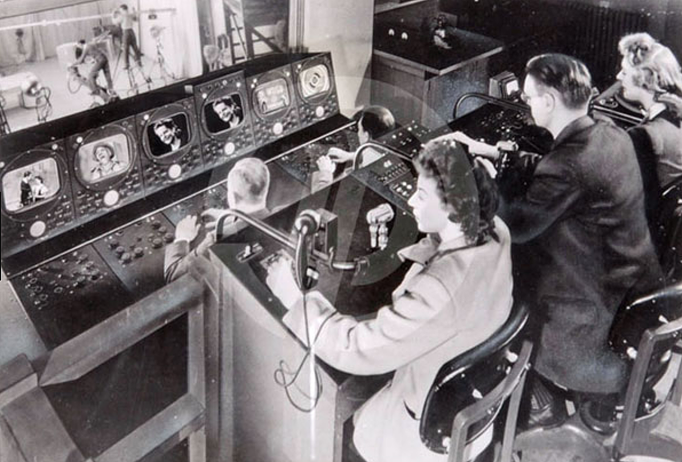
The Answer
None other than WRGB, our local CBS affiliate now known as CBS 6.
It began broadcasting on May 28, 1928, from Schenectady after a series of trial transmissions earlier that year.
It was one of the world’s first experimental stations. It later became one of a handful of television stations licensed for commercial broadcasting operation before the end of World War II.

Slide 8
Television: 3
The British Broadcasting Corp., familiarly called the BBC or “The Beeb,” began its regular public television broadcasting service in the United Kingdom in 1932.
Five years later, it broadcast the world’s first televised Shakespearean play, a 30-minute version of “Twelfth Night,” as well as the world’s first televised football (soccer) match. A year after that, it broadcast the first televised sci-fi show (“R.U.R.”), and first crime series (“Telecrime”).
Despite those advances, in 1939 it suspended its service. Why?

Slide 9
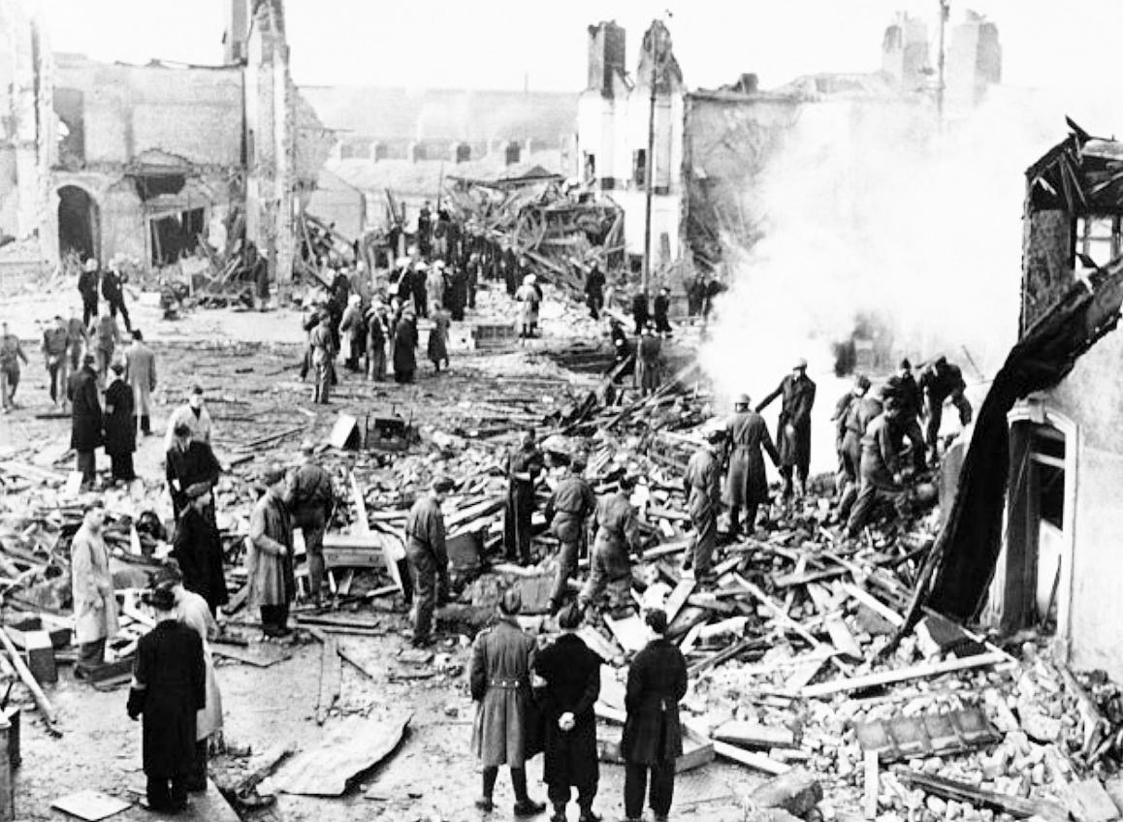
The Answer
A little thing called World War II interrupted, and the BBC shut its TV operation after broadcasting a Mickey Mouse cartoon on Sept. 1, 1939. The government feared that German bombers would be able to lock in on the signal. (Its radio studios were hit.)
Service resumed on June 6, 1946. Curiously, there is no visual recording of what was broadcast on that day.
\\\\\

Slide 10
Television: 4
Which of these TV series does not belong in this group?
• SpongeBob Square Pants
• The Simpsons
• Wings
• Crusader Rabbit
• Darkwing Duck
• Rugrats

Slide 11
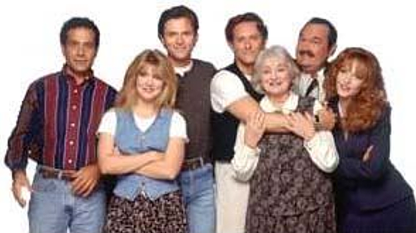
The Answer
“Wings” was the only one of the series that was NOT animated.
It ran for eight seasons
on NBC, from April 19, 1990, to May 21, 1997.
The sit-com starred Tim Daly and Steven Weber as the brothers Joe and Brian Hackett, who ran a one-plane airline on Nantucket.

Slide 12
Television: 5
Name the town in which each series is set. (You need to get all 4 right to earn a point.)
• Cheers (New York, Boston, Cleveland, Miami)
• Golden Girls (Los Angeles, Miami, Richmond, Honolulu)
• The Jeffersons (New York, Chicago, Atlanta, Seattle)
• The Office (Buffalo, Toledo, Scranton, Providence)

Slide 13
The Answer
• Cheers (New York, Boston, Cleveland, Miami)
• Golden Girls (Los Angeles, Miami, Richmond, Honolulu)
• The Jeffersons (New York, Chicago, Atlanta, Seattle)
• The Office (Buffalo, Toledo, Scranton, Providence)

Slide 14
Television: Bonus
Name 3 TV shows past or present with the word “family” in the title.

Slide 15
The Answer(s)
Family Guy
All In the Family
The Addams Family
Family Matters
Family Feud
The Family Crews
No Ordinary Family
The Goode Family
Modern Family
Find My Family
One Big Happy Family
Family Ties
… and any others you can think of.

Slide 16
Food & Drink: 1
This member of the gooseberry family is green, has a husk, a shiny inner skin, tiny seeds, and a tart taste.
Both its appearance and its name suggest a popular vegetable, and they go well together in salsa.
What is it?

Slide 17

The Answer
It’s the tomatillo (pronounced toe/mah/tea/yo)

Slide 18
Food & Drink: 2
Which young French wine is released annually on the third Thursday in November?

Slide 19

The Answer

Slide 20
Food & Drink: 3
Where was Waldorf Salad created?

Slide 21
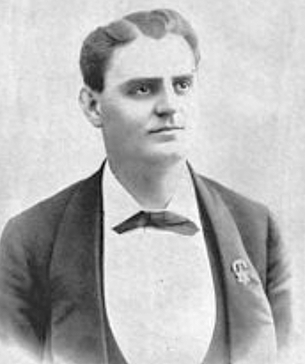
The Answer
At the Waldorf Astoria in New York City. Interestingly, creator Oscar Tschirsky was the hotel’s maître d’, not the chef. He concocted the salad in 1924, using fresh apples, diced celery, grapes and walnuts, dressed in mayonnaise, and served on a bed of lettuce.
He also was known in food circles as “Oscar of the Waldorf,” published a popular cookbook, and owned a farm in New Paltz where he hosted chefs and others at lavish dinners. The farm eventually became a retirement home for chefs.

Slide 22
Food & Drink: 4
What canned meat product made its debut in 1937 and became so popular in Hawaii and Guam during World War II that today that U.S. state and territory are its top consumers?

Slide 23

The Answer
Hawaiians consume an average of about 20 cans of Spam per person annually, while residents of Guam consume more than 16 cans per year.

Slide 24
Food & Drink: 5
Name the British Prime Minister of the 1800s who received a gift of tea flavored with bergamot oil, and had the variety of tea named for him.

Slide 25
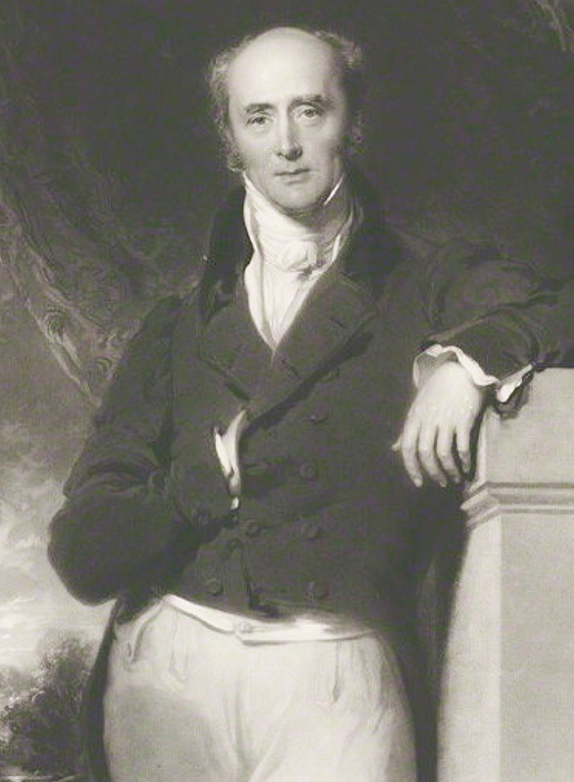
The Answer
Meet Charles Grey, the 2nd Earl of Grey and the Prime Minister of Great Britain in the 1830s.
According to family lore,
the tea was specially blended by a Chinese mandarin to suit the water at Howick Hall, the Grey family seat in Northumberland. The bergamot orange oil was used to counteract the preponderance of lime in the water there.

Slide 26
Food & Drink: Bonus
The Chinese restaurant takeout box was invented in what country?
• China
• Japan
• United States
• England
• India
• Morocco

Slide 27

The Answer
On November 13, 1894, Chicago inventor Frederick Weeks Wilcox patented a version of what he called a “paper pail,” which was a single piece of paper, creased into segments and folded into a more-or-less leakproof container secured with a thin wire handle on top.

Slide 28
American History: 1
Which of these cities never served as the capital of the United States?
• Baltimore, MD
• Williamsburg, VA
• Philadelphia, PA
• New York, NY
• York, PA
• Princeton, NJ

Slide 29
The Answer
The answer is Williamsburg, VA.
• Baltimore briefly was home to the Continental Congress when the British were threatening Philadelphia.
• Philadelphia was the first capital, home to six sessions of Congress.
• New York was the capital for four years, and hosted the first Congress.
• York, PA, was the first capital because it is where the Articles of Confederation were drafted.
• Princeton became home to Congress when ex-soldiers kept demonstrating at Independence Hall in Philadelphia for their back pay. Rather than acquiescing, Congress moved to New Jersey for several months.

Slide 30
American History: 2
The trial of John T. Scopes -- sometimes derisively called the “Scopes monkey trial” -- held on July 21,1925, in Dayton, TN, was about which of these things?
• Freedom of the press
• Prayer in public schools
• Teaching of evolution
• Education in private schools
• Malpractice limits for veterinarians

Slide 31
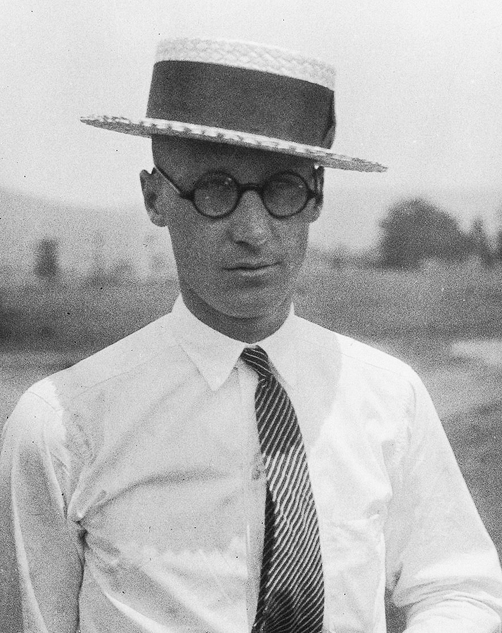
The Answer
The trial, officially called The State of Tennessee v. John Thomas Scopes, dealt with the charge that Scopes, a substitute high school science teacher, had violated the state’s prohibition (the Butler Act) on the teaching of human evolution.
It became the showcase for the “Evolution vs. Creation” debate, and the basis for the iconic play and subsequent film “Inherit the Wind.”
Interestingly, Scopes later said he actually had skipped the chapter on evolution but agreed to say he had taught it so a test case could be brought.

Slide 32
American History: 3
Which of these states were the last two admitted to the Union?
• New Mexico
• Colorado
• Oregon
• Puerto Rico
• Alaska
• Arizona
• Hawaii

Slide 33

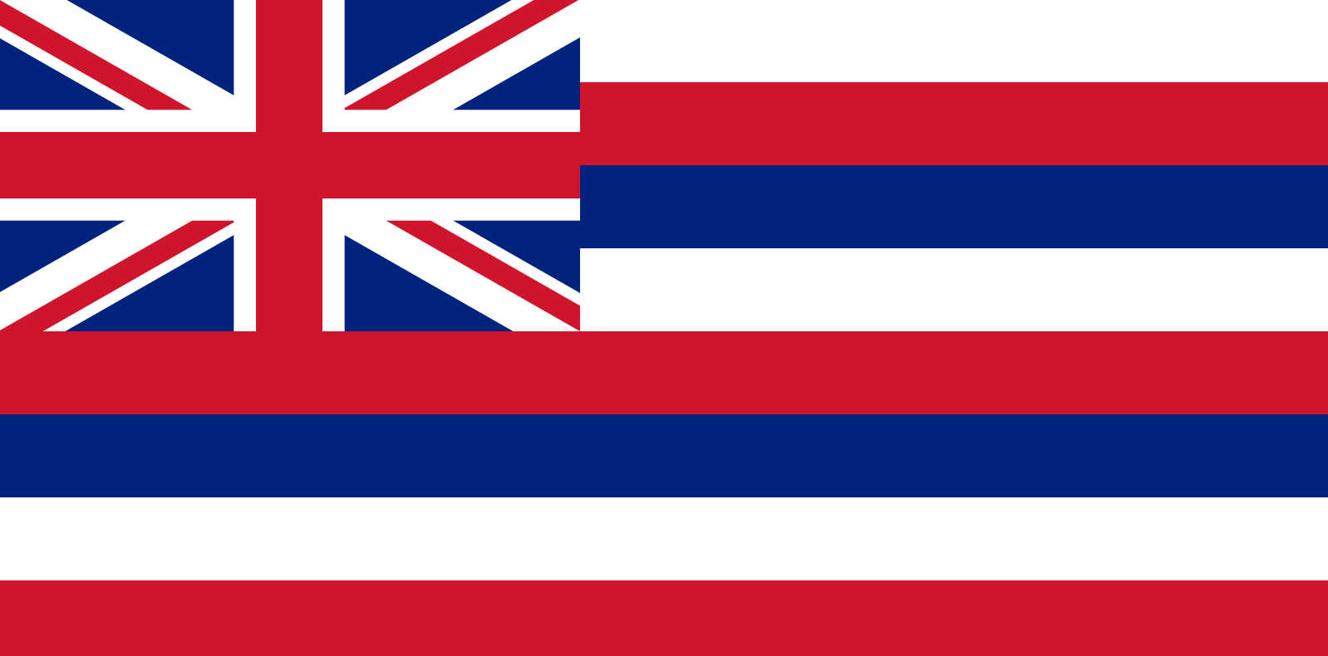
The Answer
Alaska, No. 49, admitted on Jan. 3, 1959.
Hawaii, No. 50, admitted on Aug. 21, 1959.
Prior to that, Arizona and New Mexico were the “newest” states, having been admitted in 1912.
Oregon was admitted in 1859, Colorado in 1876.
And Puerto Rico, of course, is not a state.

Slide 34
American History: 4
Presidential Stuff. Get all 3 to earn the point.
• Who was the only President to serve two non-consecutive terms?
• Before the 12th Amendment was passed in 1804, how was the Vice President selected?
• Walt Whitman’s poem “O Captain! My Captain!” was written about which President?

Slide 35
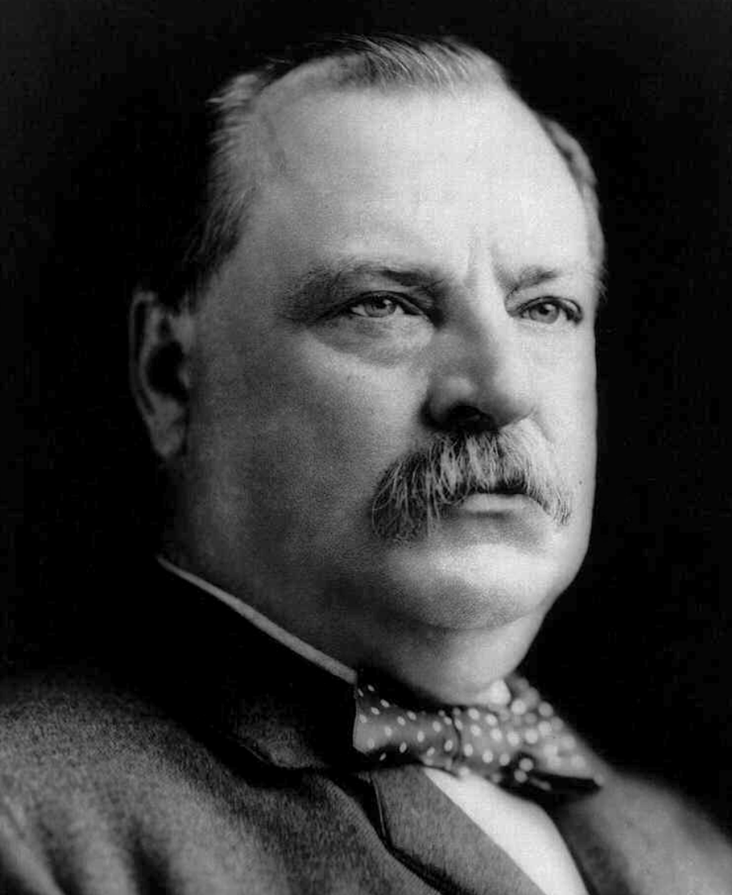
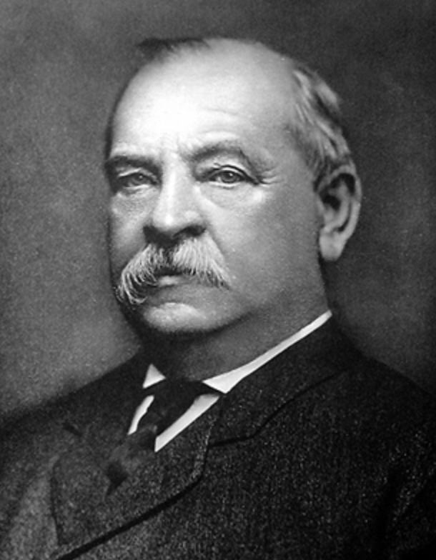
The Answer
• Grover Cleveland served as President from 1885-89, lost the next election, then served again from 1893-97.
• Before then12th Amendment, the presidential candidate getting the 2nd largest number of votes was elected Vice President.
• Whitman’s poem was written in 1865 upon the death of Abraham Lincoln.

Slide 36
American History: 5
Who was Leslie Lynch King Jr.?
Hint: He was the only person to serve as unelected President of the United States.

Slide 37
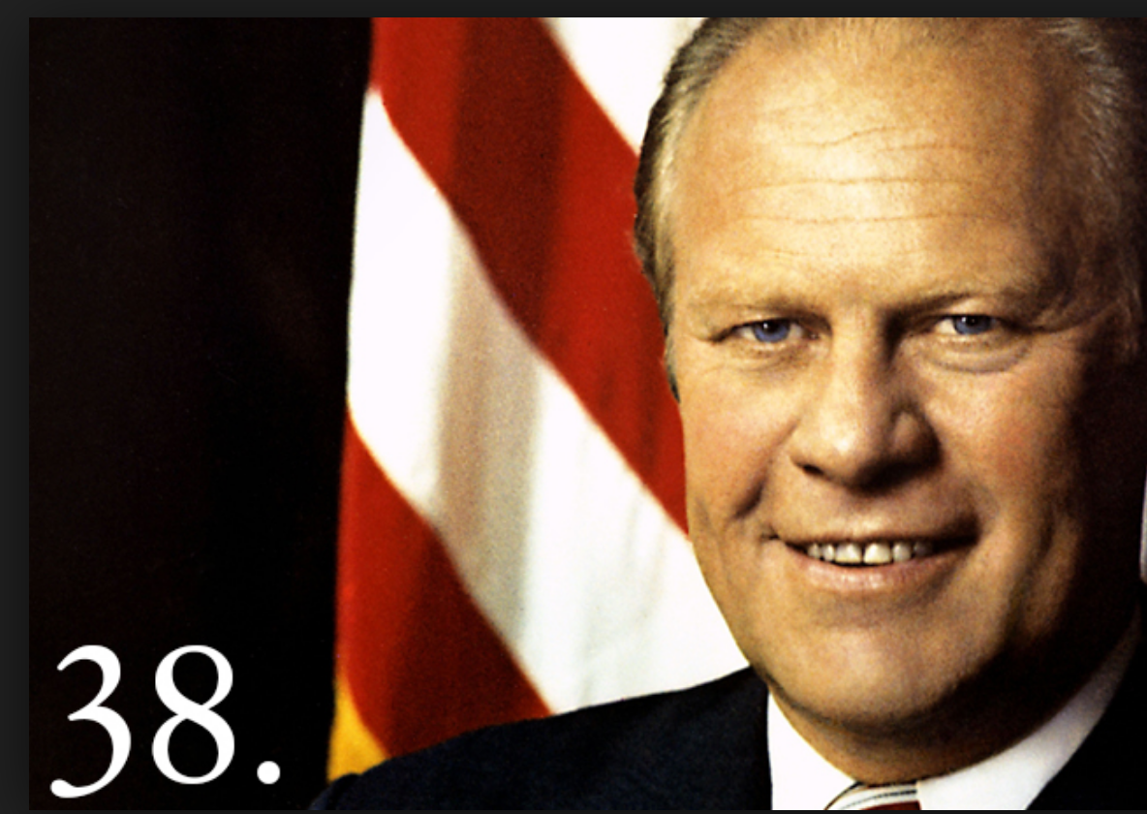
The Answer
Gerald Rudolph Ford Jr., the 38th President of the United States, was born Leslie Lynch King Jr. on July 14, 1913, in Omaha, NE.
His parents divorced later that year. His mother was remarried in 1916, to Gerald Rudolff Ford who adopted young Leslie several years later, although the youngster used the more conventional spelling of the middle name.
Ford was appointed Vice President in 1973 when Spiro T. Agnew resigned, and became the first unelected President in 1974 when Richard M. Nixon resigned.

Slide 38
American History: Bonus
Correctly answer 3 of these 5 to earn the points.
In what wars did the following battles involving U.S. forces take place?
• Battle of Chicamaugua
• Battle of Midway
• Battle of Belleau Wood
• Battle of Saratoga
• Battle of New Orleans

Slide 39
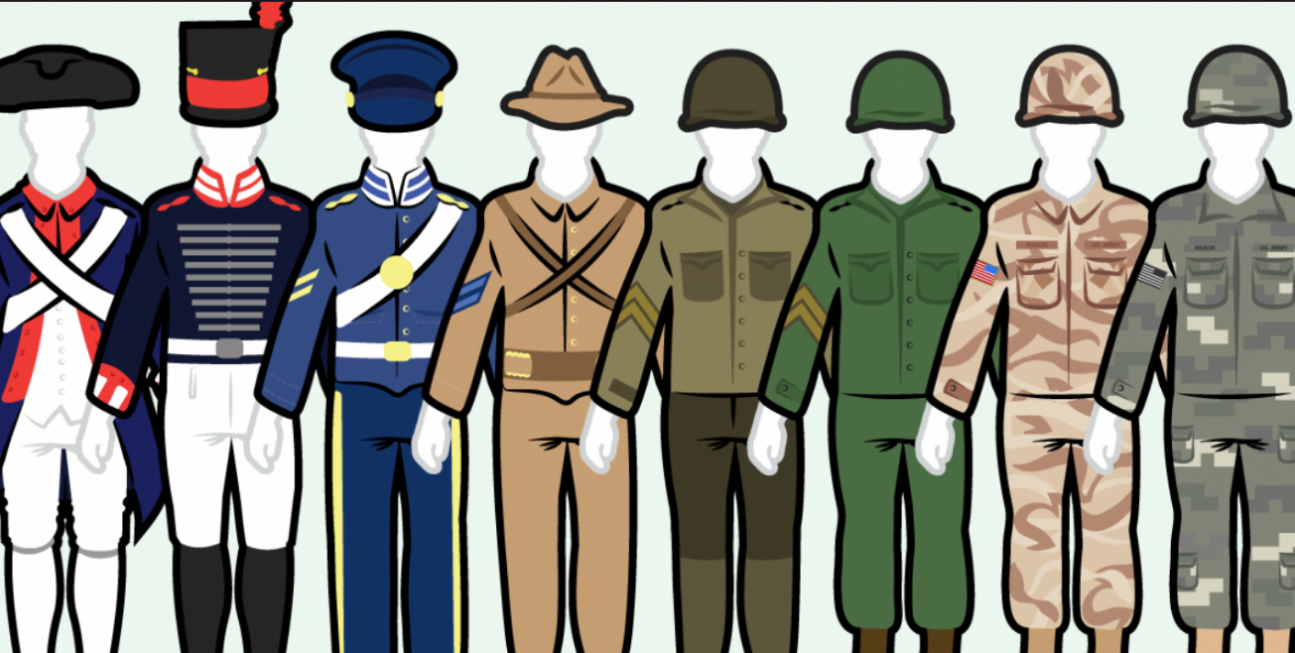
The Answers
• Chicamaugua: Civil War, Sept. 19-20, 1863
• Midway: World War II, June 3-7, 1942
• Belleau Wood: World War I, June 1-26, 1918
• Saratoga: Revolutionary War, Sept. 19-Oct. 7, 1777
• New Orleans: War of 1812, Jan. 8-26, 1815

Slide 40
Sports:1
Name 2 sports in which the action is initiated by a player known as a “bowler”?

Slide 41

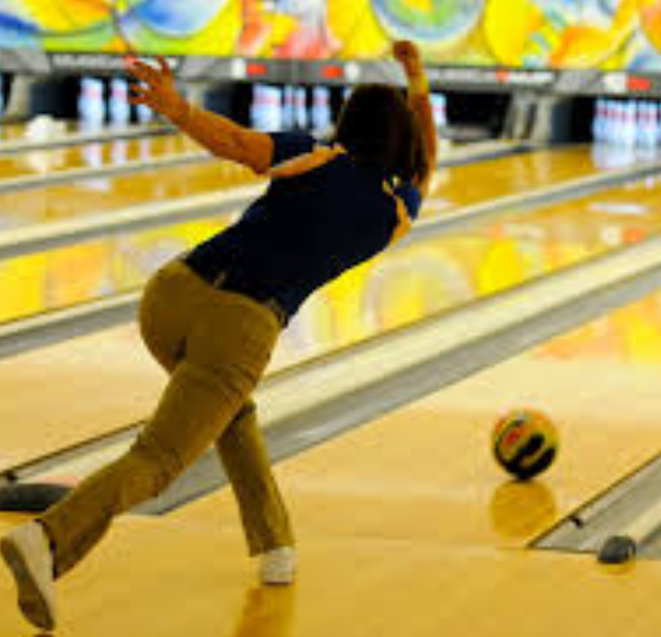
The Answer
In cricket, the player delivering the
Ball to the batsman is known as the
“bowler.”
And, of course, in 10-pin bowling
everyone who rolls the ball down
the lane is a “bowler.”

Slide 42
Sports: 2
Some Baseball Hall of Fame figures’ imaginative nicknames ended up up obscuring their original identities. Provide the real names of just 3 of these 10 people to earn a point.
• Yogi Berra • Whitey Ford
• Dizzy Dean • Pee Wee Reese
• Casey Stengel • Rabbit Maranville
• Babe Ruth • Connie Mack
• Cool Papa Bell • Duke Snider

Slide 43
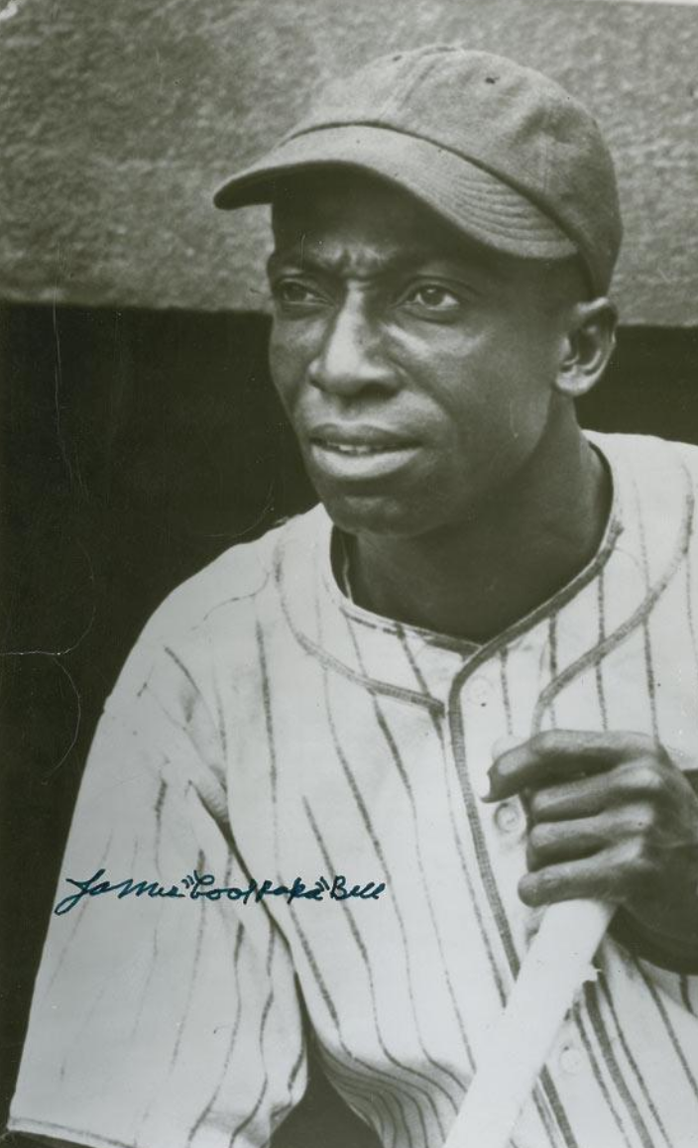
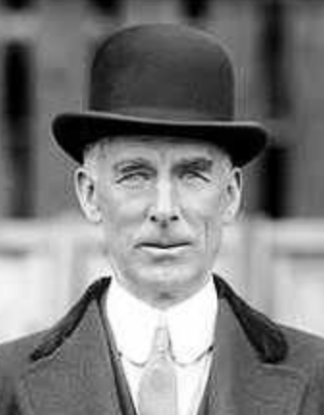
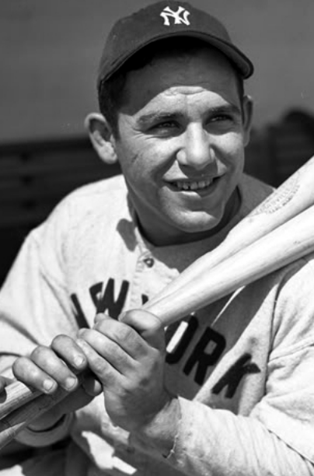
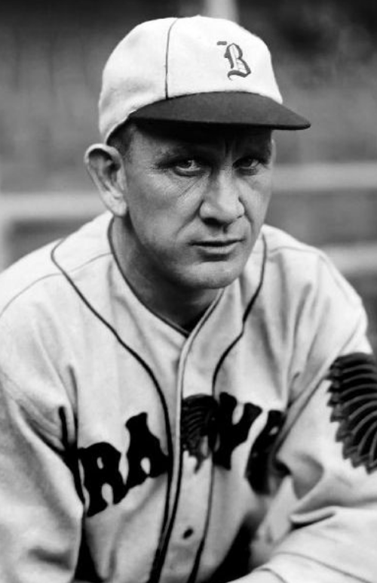
The Answers
• Lawrence Peter “Yogi” Berra
• Jay Hanna “Dizzy” Dean
• Charles Dillon “Casey” Stengel
• George Herman “Babe” Ruth
• James Thomas “Cool Papa” Bell
• Edward Charles “Whitey” Ford
• Harold Peter Henry “Pee Wee” Reese
• Walter James “Rabbit” Maranville
• Cornelius “Connie Mack” McGillicuddy
• Edwin Donald “Duke” Snider

Slide 44
Sports: 3
Pro football by the numbers.
Get just 3 answers correct and you earn a point.
• How long is the field, excluding end zones?
• How long is each end zone?
• The NFL consists of how many teams?
• Each team is divided into what 3 groups for a game?
• How long is each quarter in regulation play?
• How many points are awarded for a safety?
• Since the field is divided into a pair of 50-yard areas, how many 50-yard lines are there?

Slide 45

The Answers
Pro football by the numbers.
Get 3 answers correct and earn a point.
• How long is the field, excluding end zones? 100 yards
• How long is each end zone? 10 yards
• The NFL consists of how many teams? 32
• Each team is divided into what 3 groups for a game? Offense, defense, special teams
• How long is each quarter in regulation play? 15 minutes
• How any points are awarded for a safety? 2
• Since the field is divided into a pair of 50-yard areas, how many 50-yard lines are there? 1

Slide 46
Sports: 4
The Buffalo Bills hold the dubious distinction of losing four consecutive Super Bowls. However, two others also have lost four times, although (very little consolation) not consecutively. Who are they?

Slide 47
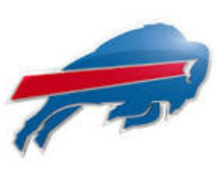
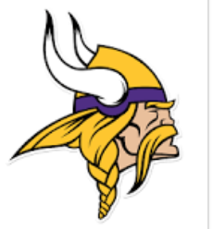
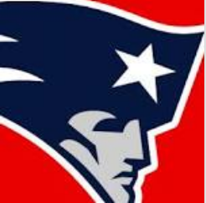
The Answer
Buffalo lost in 1990, 1991, 1992, 1993
Minnesota lost in 1969, 1973, 1974, 1976
New England lost in 1985, 1996, 2007, 2011

Slide 48
Sports: 5
What was the first sport in which women were invited to compete at the Olympic Games?
Hint: Charlotte Cooper of Great Britain was its first gold medalist.

Slide 49
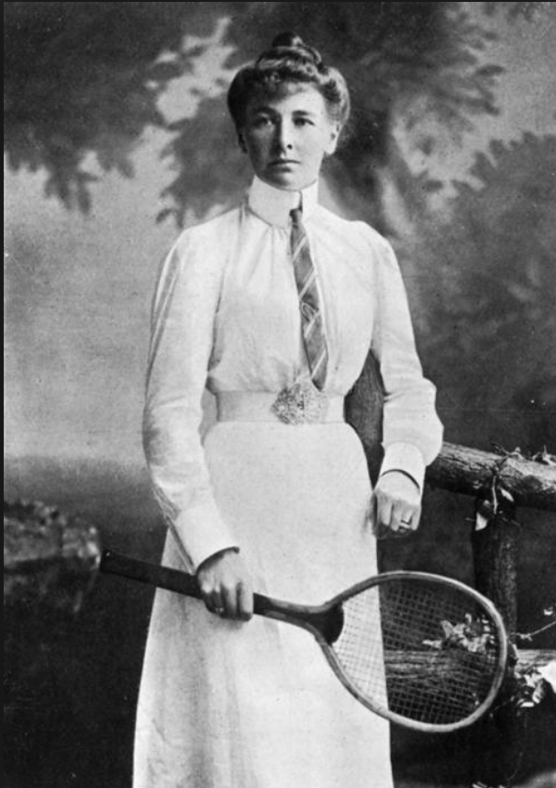
The Answer
The sport was tennis, and the venue was the 1900 Games held in Paris. Charlotte Cooper defeated Helene Prévost in straight sets in the final to become the first individual female Olympic champion. Partnering with Reginald Doherty, she also won the mixed doubles title in straight sets over Harold Mahony and the unfortunate Ms. Prévost.

Slide 50
Sports: Bonus
Dr. James Naismith, a 30-year-old Canadian-American physical educator, physician, chaplain, and sports coach, invented the game of basketball in 1891 shortly after moving to the United States.
The question is, where did he introduce his new sport?

Slide 51
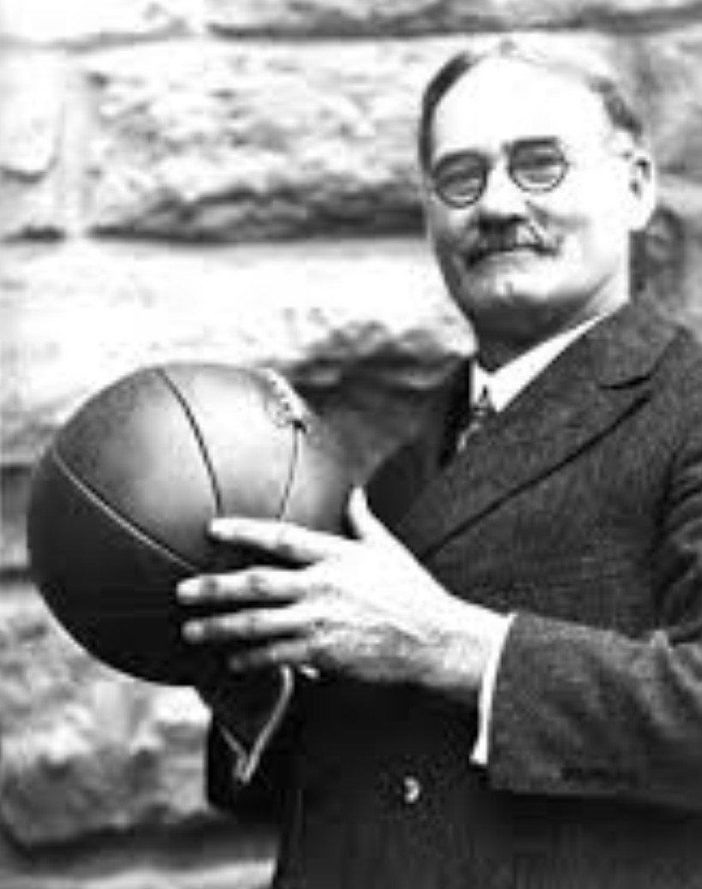
The Answer
At the YMCA in Springfied, MA.
The first games were played 9 vs. 9, using a soccer ball. The hoop consisted of a peach basket nailed to the wall. Dribbling was not yet allowed (players had to be stationary when in possession of the ball) and after each basket, play was restarted by a jump ball. Three consecutive fouls by one team would result in a point for their opponents. The game consisted of two 15-minute halves, and substitutions were not allowed. The first game ended with a score of 9-3.

Slide 52
Geography: 1
Which major city is located in both Asia and Europe?

Slide 53
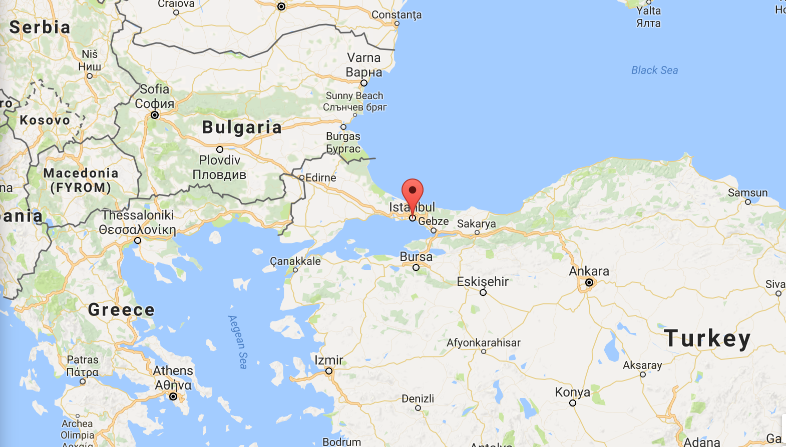
The Answer
Istanbul, the most famous and cosmopolitan city in Turkey, straddles Europe and Asia across the Bosphorus Strait.

Slide 54
Geography: 2
Which country has the most natural lakes?
• Canada
• United States
• Russia
• Argentina
• Tanzania

Slide 55
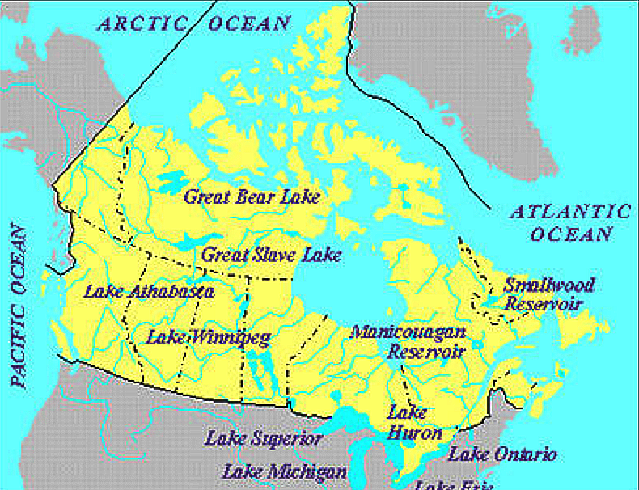
The Answer
Canada has more than half of all the natural lakes in the world. 9% of the country is covered in fresh water.

Slide 56
Geography: 3
What city is believed to be the oldest continuously inhabited city in the world?

Slide 57
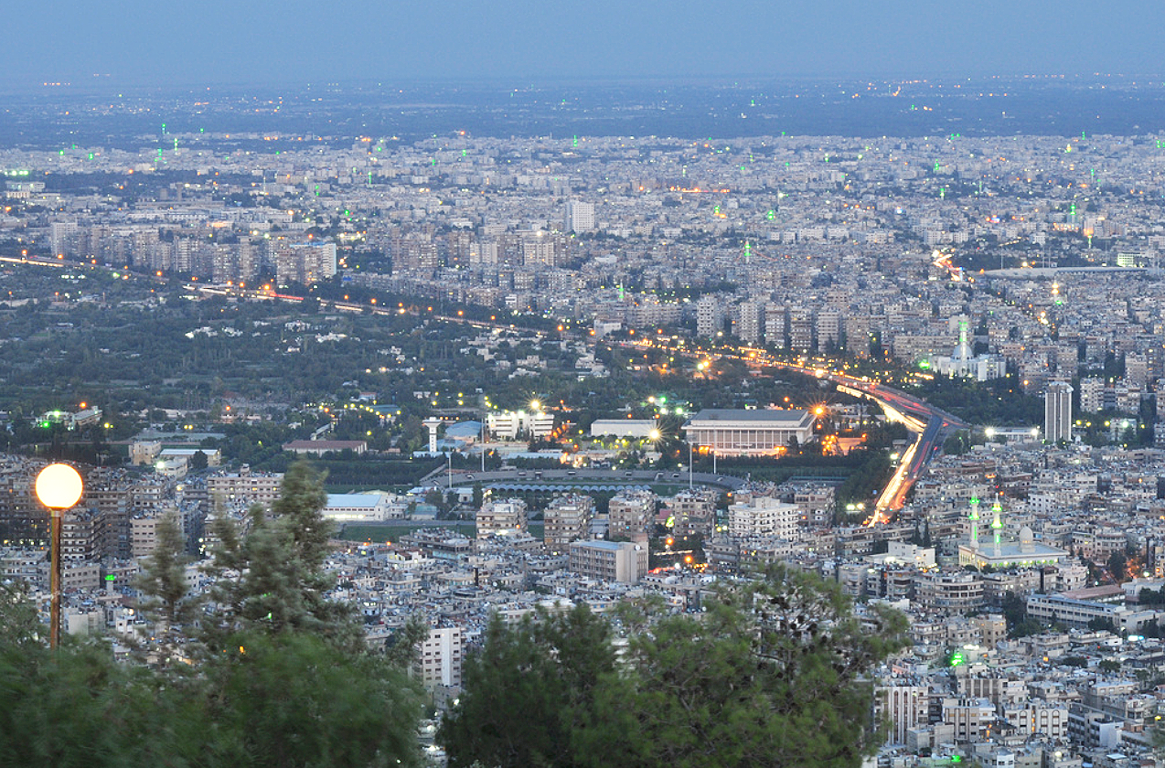
The Answer
Damascus, the capital of Syria, is widely believed to be the oldest continuously inhabited city in the world, with evidence of habitation dating back at least 11,000 years.

Slide 58
Geography: 4
Which are the westernmost and easternmost states in the U.S.? (Be careful, this is a tricky one!)
• Washington and New York
• Alaska and Alaska
• Hawaii and Maine
• California and Florida

Slide 59
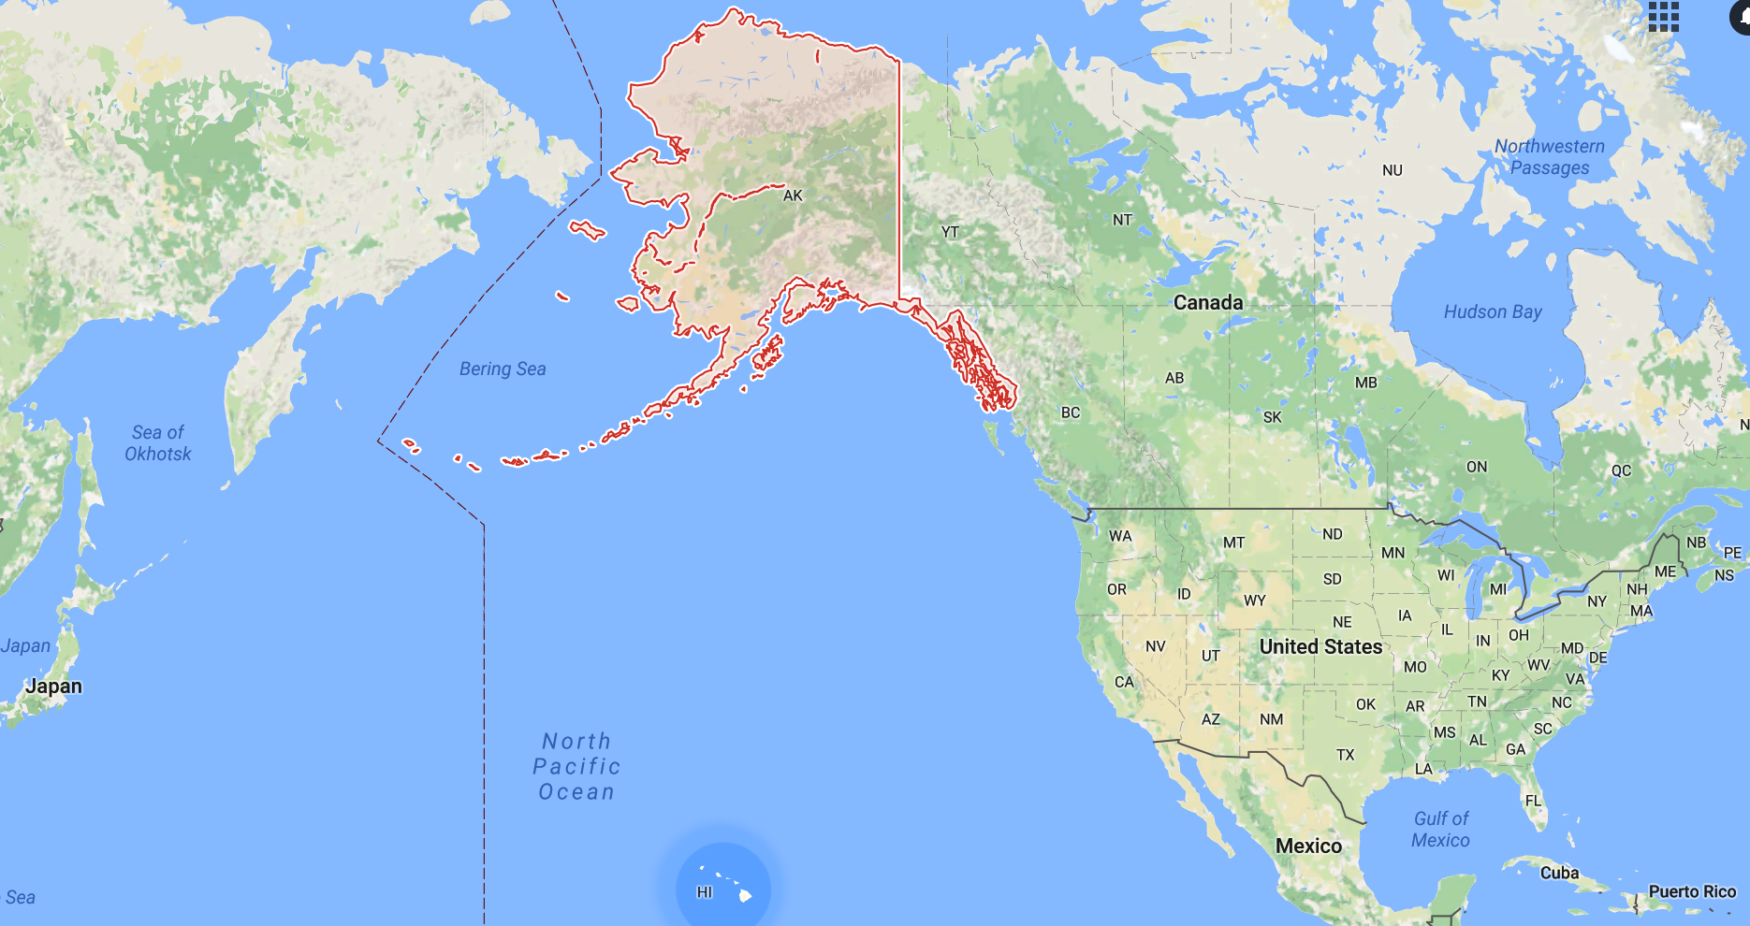
The Answer
“Alaska and Alaska.” Not only is it both our northernmost and westernmost state, parts of it extend so far in the direction of Asia that it actually stretches into the Eastern Hemisphere. Thus, it is our easternmost state, too.

Slide 60
Geography: 5
This state is the 10th largest of the United States in land mass. However, it is 50th in terms of population, smaller than that of many cities. Name it.

Slide 61
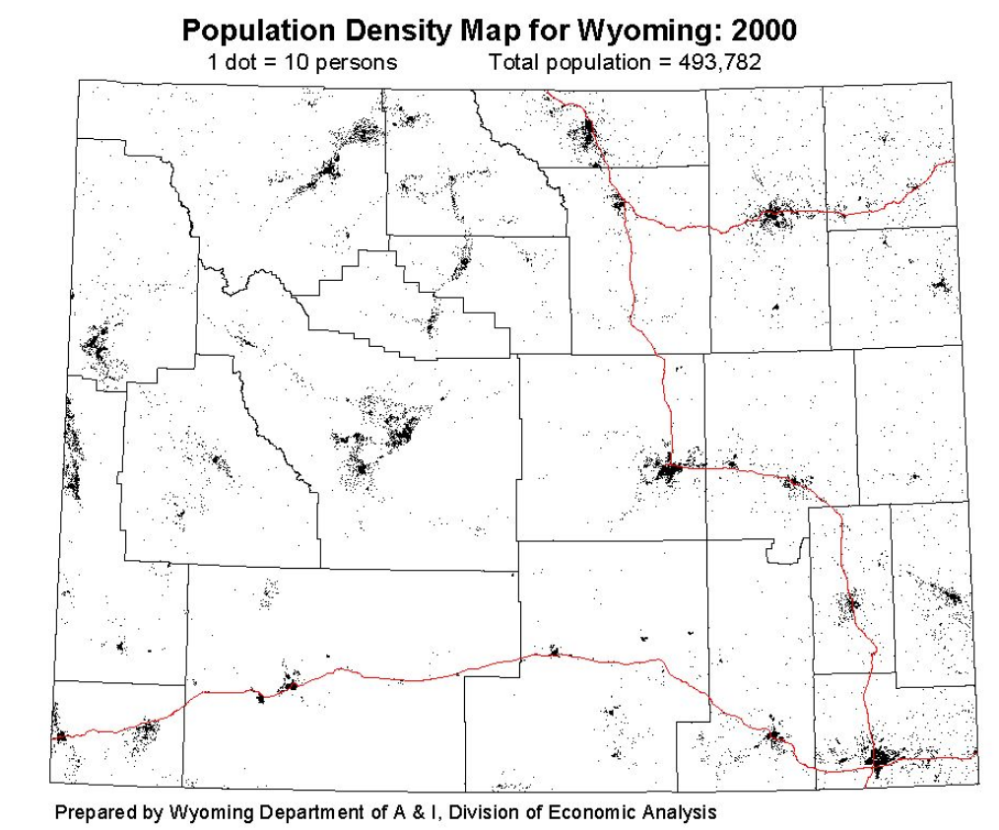
The Answer
Wyoming has a population of just 585,000. That means more than 30 U.S. cities have larger populations.
The Equality State’s two largest cities – Cheyenne and Casper – are each only slightly larger than Troy, NY. Its smallest town, Lost Springs, has a population of 4.

Slide 62
Geography: Bonus
In which U.S states are these famous landmarks located?
• Death Valley
• Mount Denali (formerly Mount McKinley), America’s tallest mountain
• Lake Ponchartrain Causeway, the world’s largest bridge
• A city whose original name was El Pueblo de Nuestra Señora la Reina de los Angeles del rio Porciuncula

Slide 63
The Answer
• Death Valley is in California (Death Valley National Park extends into Nevada)
• Mount Denali is in Alaska
• The Lake Ponchartrain Causeway is in Louisiana
• Today we know El Pueblo de Nuestra Señora la Reina de los Angeles del rio Porciuncula simply as Los Angeles (the original name translates as “The Village of our Lady the Queen of the Angels of the Porciuncula River”)

Slide 64
And, if we have to break a tie …

Slide 65
Tiebreaker No. 1
What is a group of crows called?
• A battle
• A murder
• A ladle
• A plethora
• A flock

Slide 66

The Answer
It’s a murder of crows.

Slide 67
Tiebreaker No. 2
What are the more common names for these animals?
• gnu
• woodchuck
• puma

Slide 68
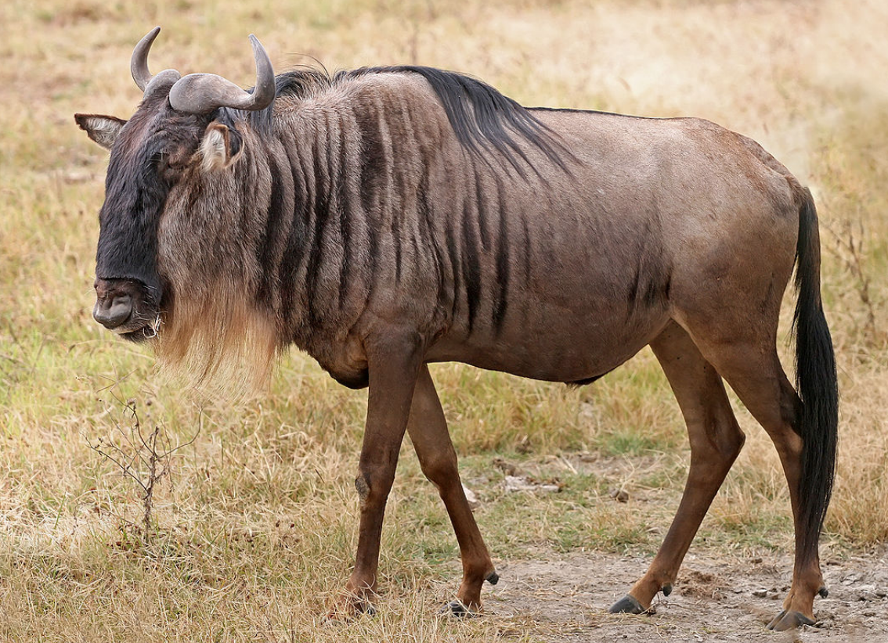
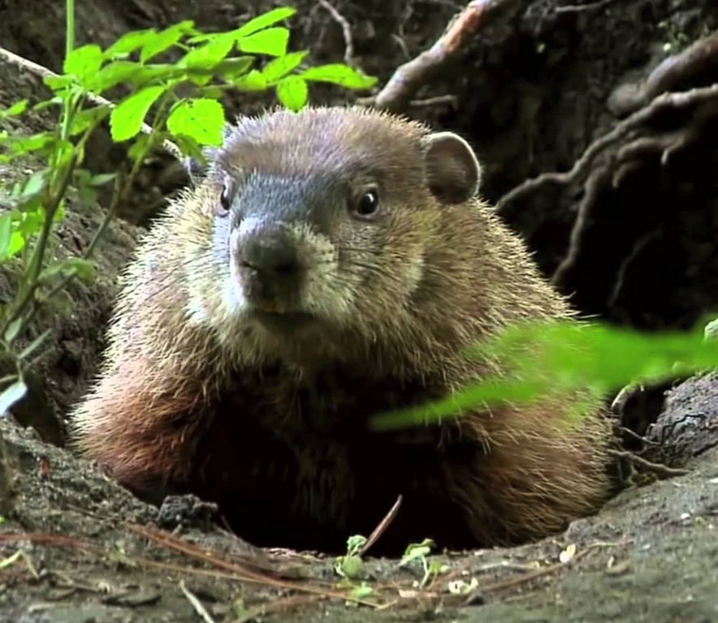
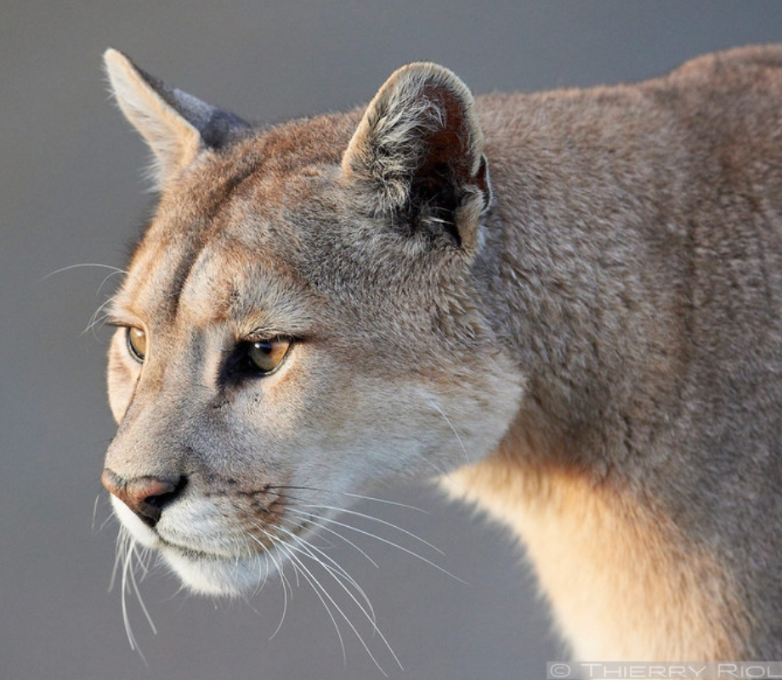
The Answer
• The gnu is better known as a wildebeest, the Afrikans language’s name for “wild beast.” It is a a member of the antelope family, but uglier.
• The woodchuck is a groundhog. Over and over again.
• A puma also is known as a mountain lion. Or a cougar. Or a Florida panther. Etc.

Slide 69

Tiebreaker No. 3
No, this is not the emblem of the International Red Cross. What is it?

Slide 70
The Answer
This is the national flag of Switzerland. It is one of only two square sovereign-state flags, the other being the flag of Vatican City.

Slide 71

\
]’[gkuhkol;

