Slide 1
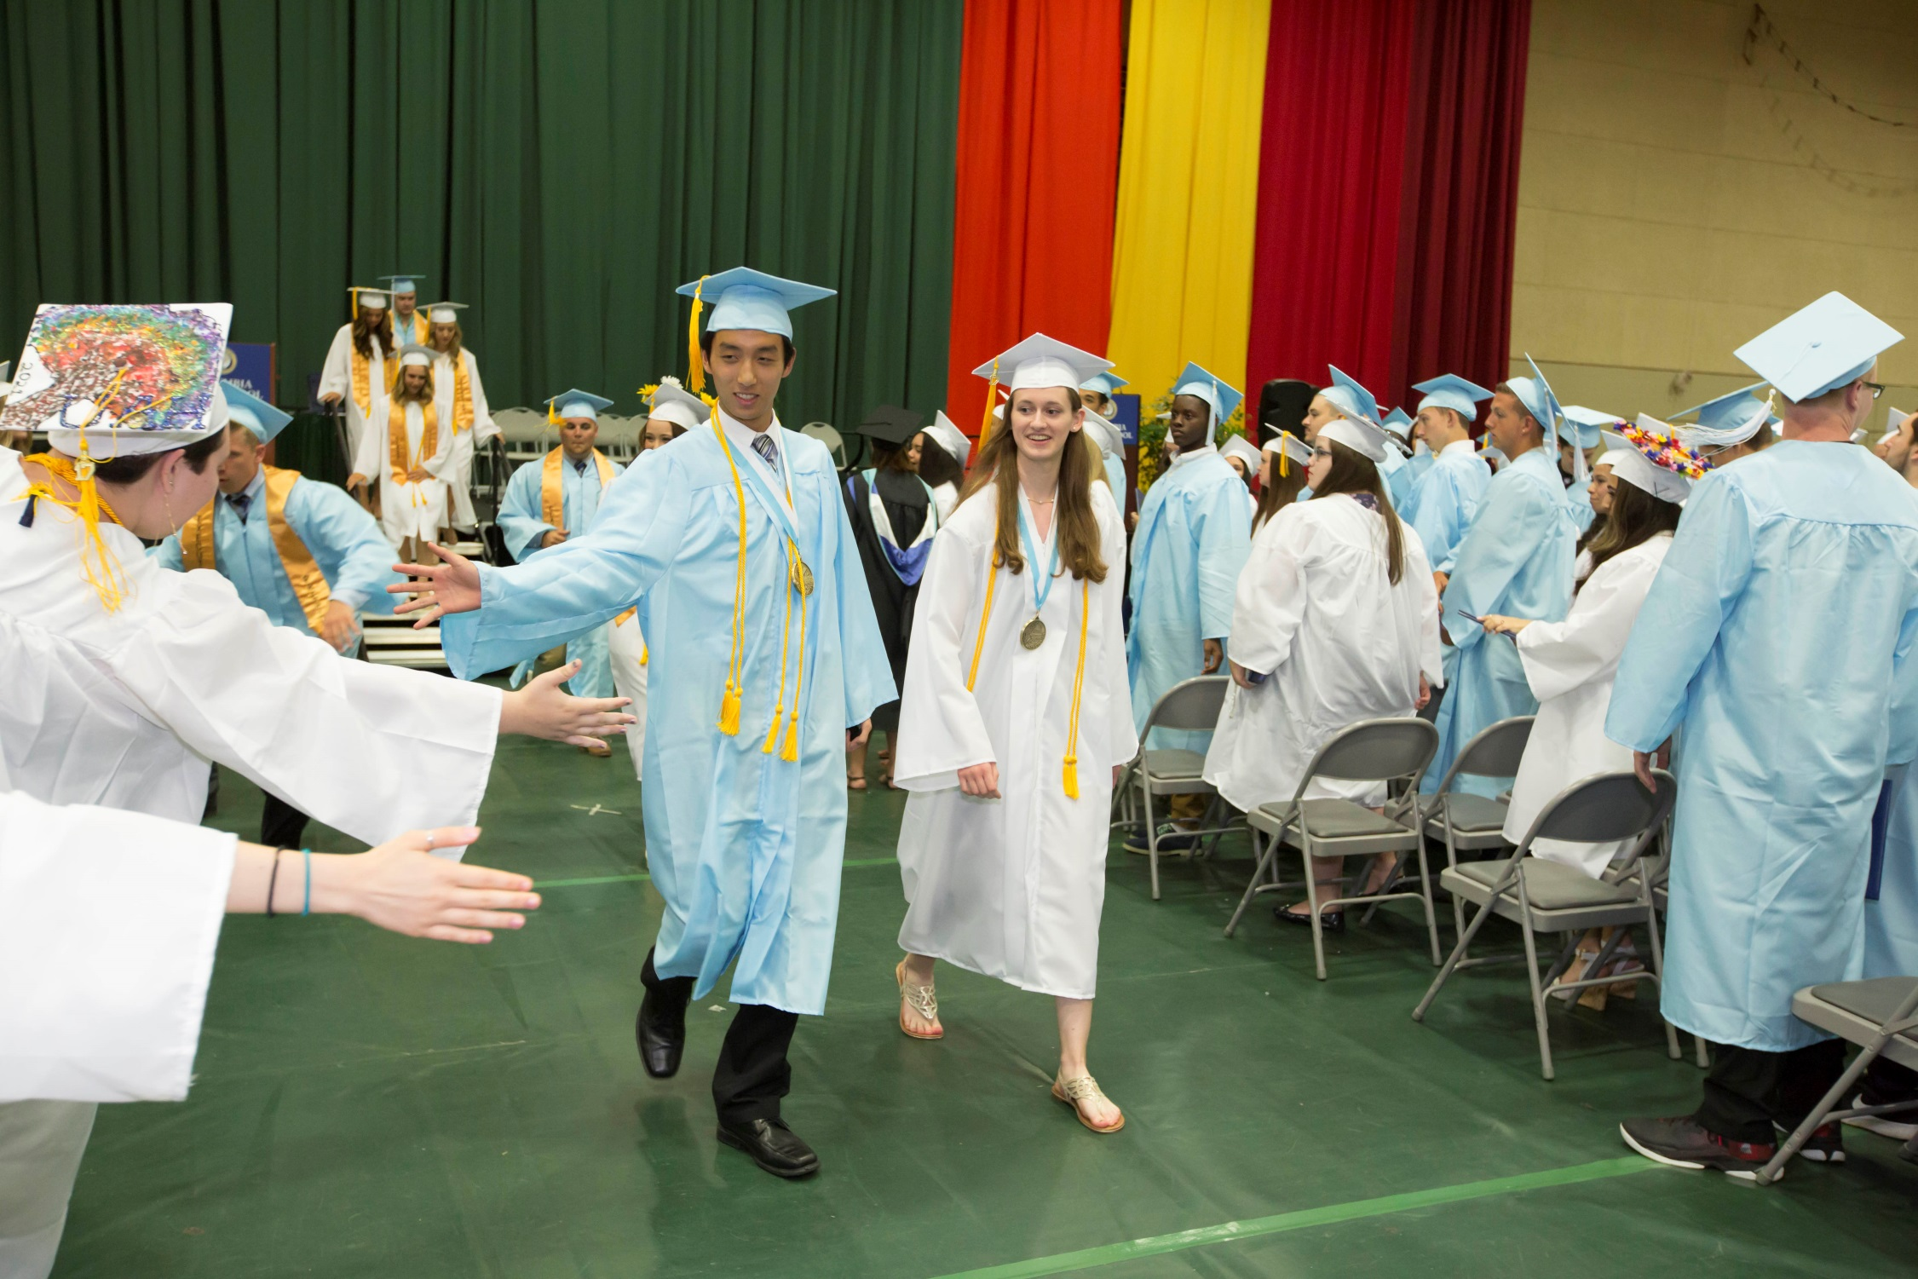

East Greenbush Central Schools - Becoming a “Lighthouse” District
Report to SORENSCO Rotary Club
September 28, 2017
Jeffrey P. Simons, Superintendent of Schools

Slide 2

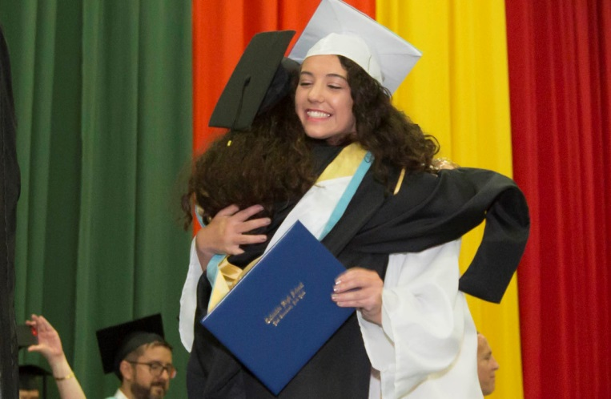
Where have we been?
High Academic Achievement
Excellence in Classroom
Teaching
Supportive Safety Nets
Positive Parental and
Community Support

Slide 3

State of Our Schools
92% graduation rate
6th ranked school district in Capital Region
Grades 3-8 Proficiency Rates
  59% ELA (39.8% state avg.)
  61% Math (40.2% state avg.)
Regents Exams Mastery Level (above 85%)
  84% ELA (50% state avg.)
  33% Algebra I (19% state avg.)
  32% Algebra II (17% state avg.)
  33% Geometry (15% state avg.)
Last 10 years
  Enrollment down 585 students
  13% increase in economically disadvantaged students

Slide 4
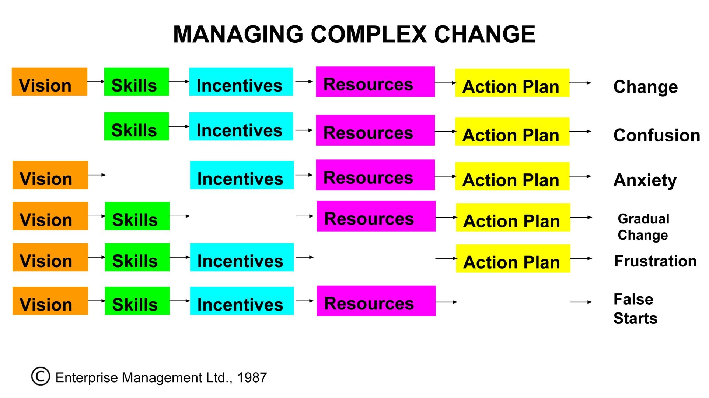
Managing Complex Change

Slide 5
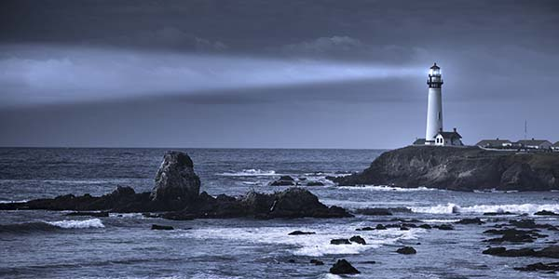
Where are we going?
Innovative, Rigorous, Engaging Curriculum
Multiple Measures of Achievement
21st Century Learning Technologies
Differentiated Enrichment and Academic Support
Rigorous College Level, AP, Arts, Humanities and CTE Coursework
Workplace Learning and
Mentorship Experiences

Slide 6
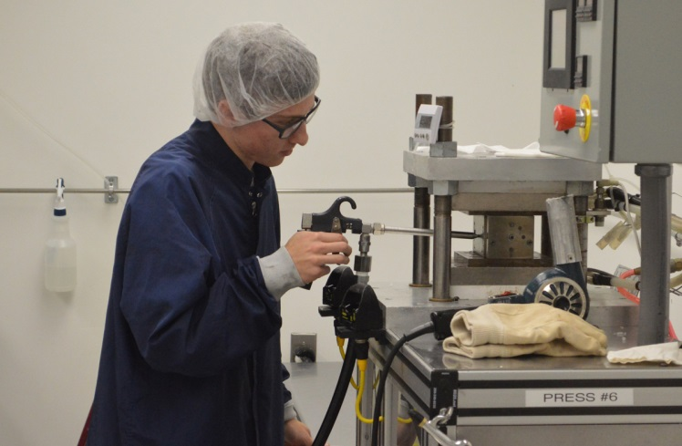
Workplace Learning, Mentorships and Community-Based Learning
Strategic Partnerships
All Children Deserve High Expectations
Guaranteed Viable Curriculum
that Provides Connections For Students
College and Career Ready
High Levels of Literacy, Numeracy
and Technical Rigor Required in Most Fields
Employers Need Graduates with Hard and “Soft” Skills

Slide 7
Top Skills Employers Seek
Ability to work in a team structure
Ability to make decisions and solve problems
Ability to communicate verbally with people inside and outside an organization
Ability to plan, organize and prioritize work
Ability to obtain and process information
Ability to analyze quantitative data
Technical knowledge related to the job
Proficiency with computer software programs
Ability to create and or edit written reports
Ability to sell and influence others *2015 Forbes Survey

Slide 8
How will we get there?
Strategic Partnerships
Collaborative Planning and Communication
Prioritize Goals and Objectives
Cyclical Reviews
Climate of Trust

Slide 9
Questions?

