Slide 1

Our website, social media, & you
Or, How to Catch Up With the People Who Got There Before You

Slide 2
How did most of us grow up communicating?
Person to person conversation
U.S. Mail
Newspapers & Magazines
Radio & TV
Land line telephones
Hand bills/flyers/posters
Telegrams

Slide 3
How many of those methods still work well?
Person to person conversation: Always good BUT …
Mail: Email is faster, cheaper, more convenient
Newspapers & Magazines: Circulation precipitously falling
Radio & TV: Streaming video, fragmented audiences are threats
Land Line Phones: Supplanted by cellphones with no LD fees
Hand bills/flyers/posters: Slow distribution, more costly
Telegrams: Say what?

Slide 4
How have most Americans adapted?
Just 10 years ago, only 7% of adult Americans used social networking sites.
Today, nearly two-thirds of American adults (65%) use them.
The Pew Research Center, which began systematically tracking social media usage in 2005, reports that research documented in great detail shows the rise of social media has significantly affected such things as:
-- work
-- civic activities
-- community news and information
-- general news consumption
-- getting and sharing health information
-- parenting
-- dating
-- stress levels

Slide 5
Do People We Want As Rotarians Use It?
First of all, we want an inclusive membership of community-minded people to become, or remain, Rotarians.
That means women and men of good character, all races, ages, ethnicities and religions, a mixture of careers and occupations, etc. PLUS, we need people in the early and middle stages of their careers who network with others, understand group dynamics, people who can maintain the pace of Rotary into the future.
While much of traditional media is skewed to appeal to specific demographic groups, proprietary websites such as ours and social media in general appear to be a much broader way to communicate.
Here’s how that breaks down by key categories.

Slide 6
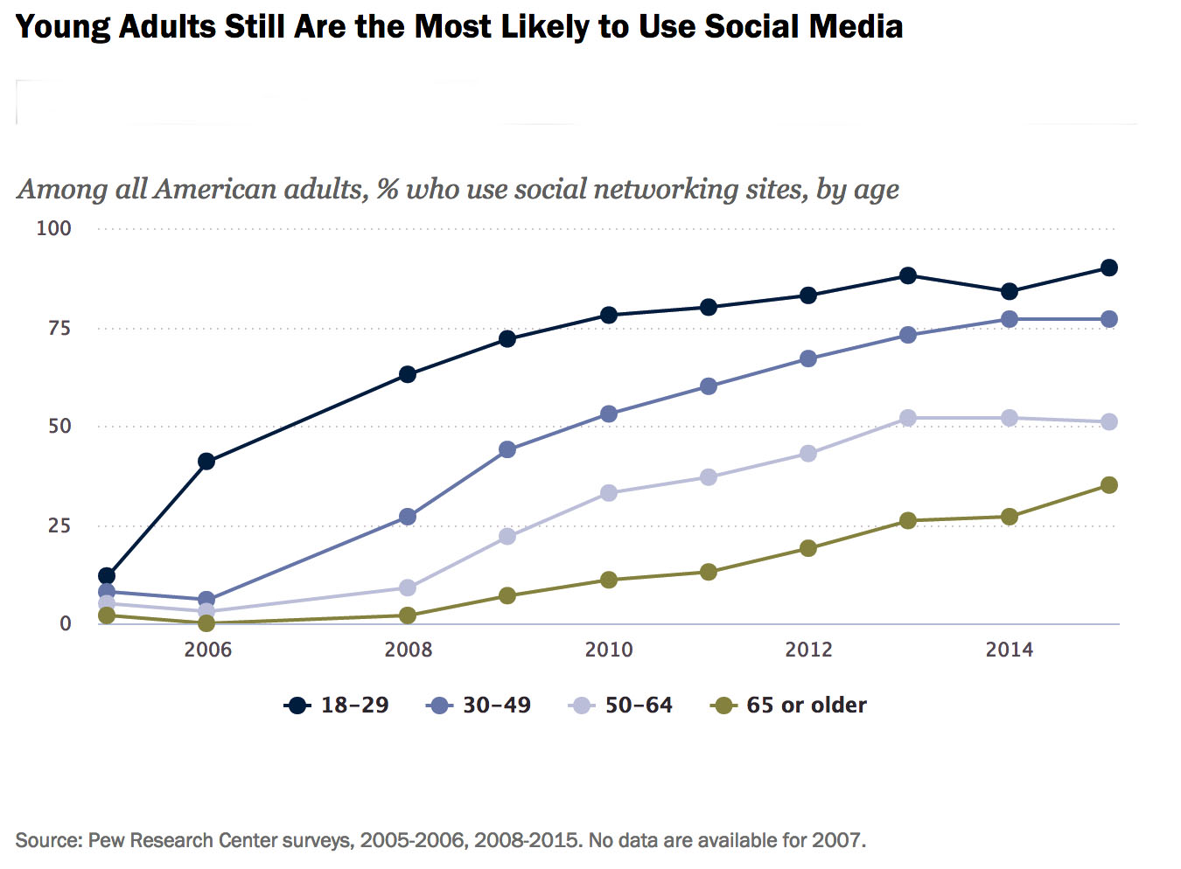
Who are the major social media users?

Slide 7
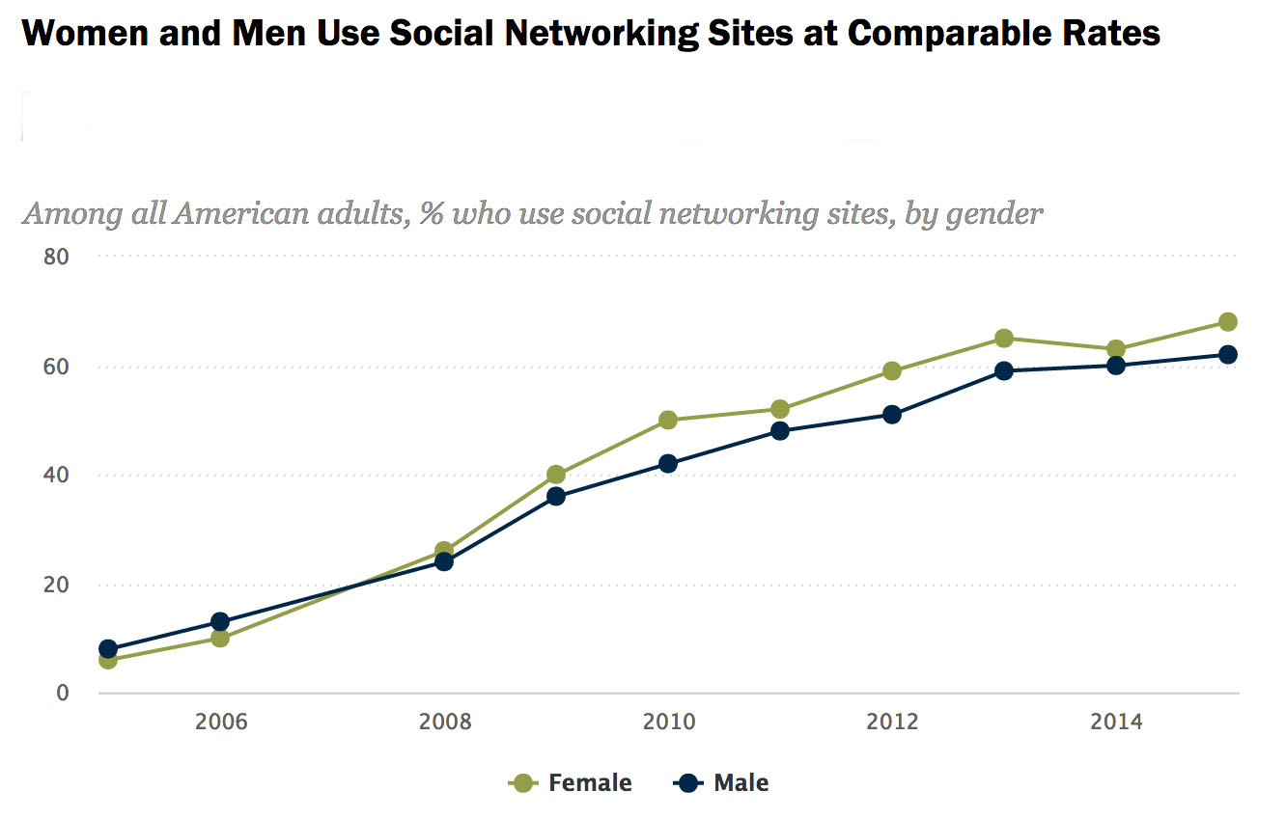
Social media ain’t just a guy thing

Slide 8
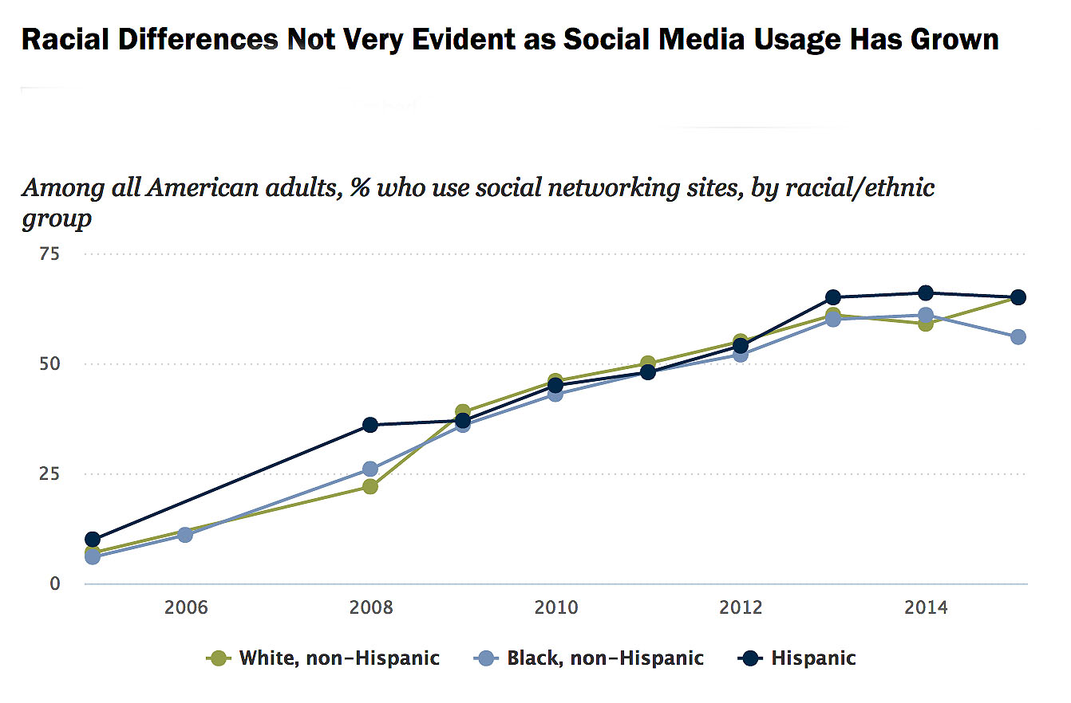
And, it ain’t just a white thing, either

Slide 9
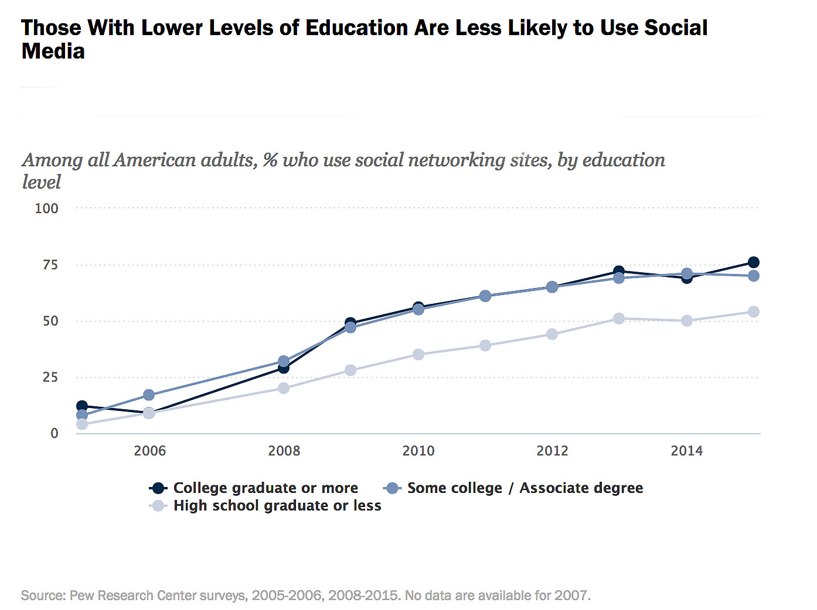
But, it is an educational thing

Slide 10
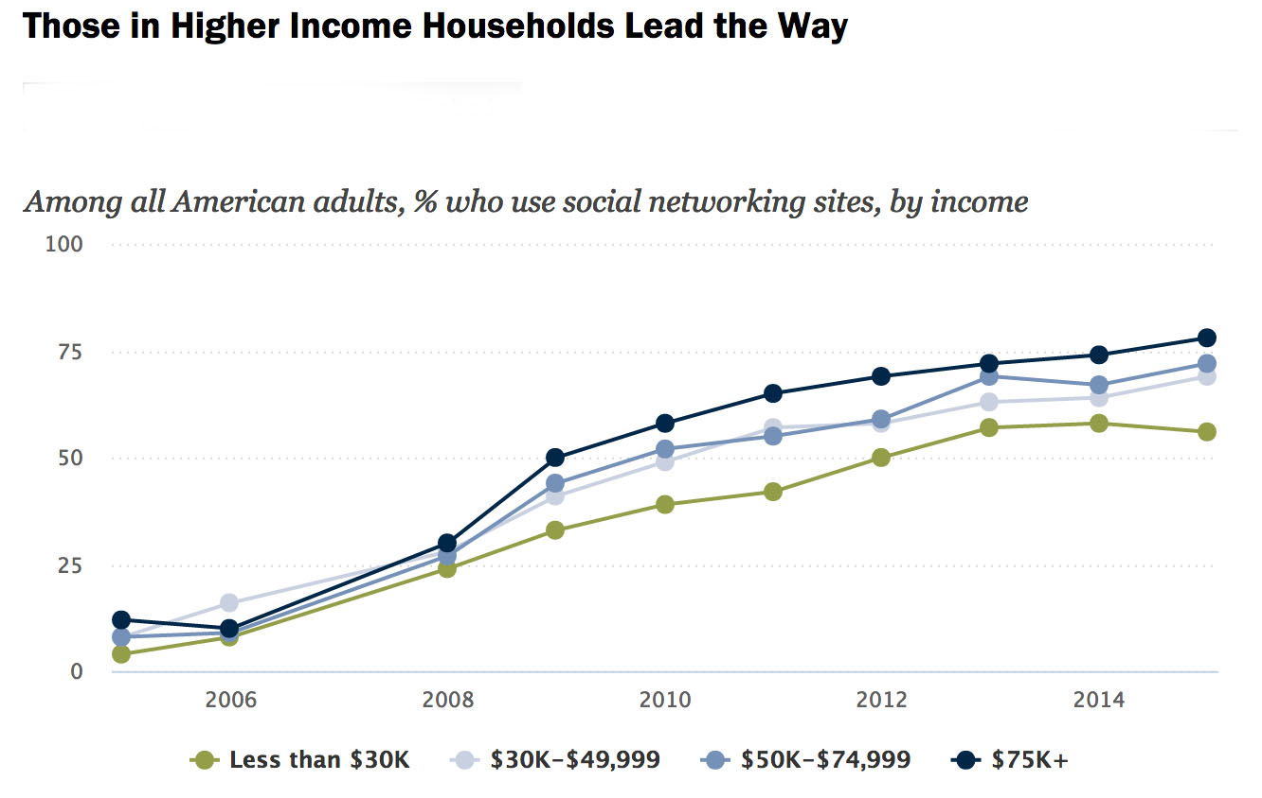
And, to some extent, a financial thing

Slide 11



SRC offers key social media communication tools
… as supplements to email, flyers, traditional media and, of course,
that old reliable -- person–to-person conversation.

Slide 12
So, let’s take a quick tour of what we have
– and how to use it!
://Srcrotary.org

Slide 13
Tour of our website
• Rolling blog: News, updates, event photos, messages …
• Inside Information: List of links to the site’s inside pages
• Recommended Links: Connections to various Rotary sites
• Search This Site: Type in what you’re looking for and go there
• Social Media: Links to our Facebook and Twitter pages
• Follow the Blog: Sign up to get automatic notices
• Older Posts: Instant link to blog posts prior to May 2016

