Slide 1
A Retrospective:
Capital District Landscapes, Houses and Gardens through the eyes of 1936 Residents

Slide 2
Today’s Presentation
  • Regional landscapes
  • Historic homes
  • Public spaces
  • Private gardens

Slide 3
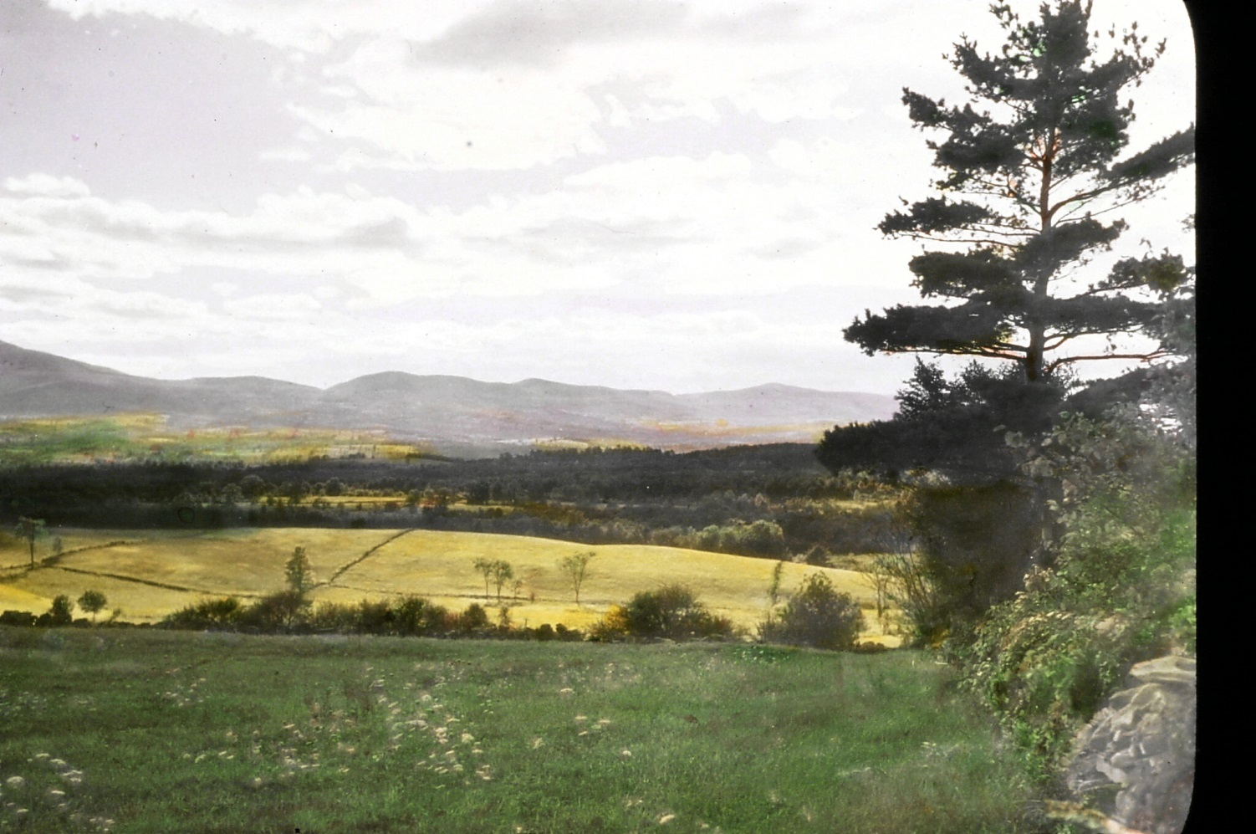
Catskill Mountains
“It has its own peculiar charm, a something not found elsewhere.”
Thomas Cole
Notes:
Catskills slide # 1
Albany Schenectady and Troy lie in a beautiful region surrounded by five of the most picturesque and diverse mountain districts of the northeastern states. To the north rise the Adirondacks and their nearer foothills about Lake George. To the northeast are the Grafton Hills. To the East lie the Berkdshires. To the south and nearer at hand, the Catskills whose familiar outline may be seen on clear days from our cities

Slide 4
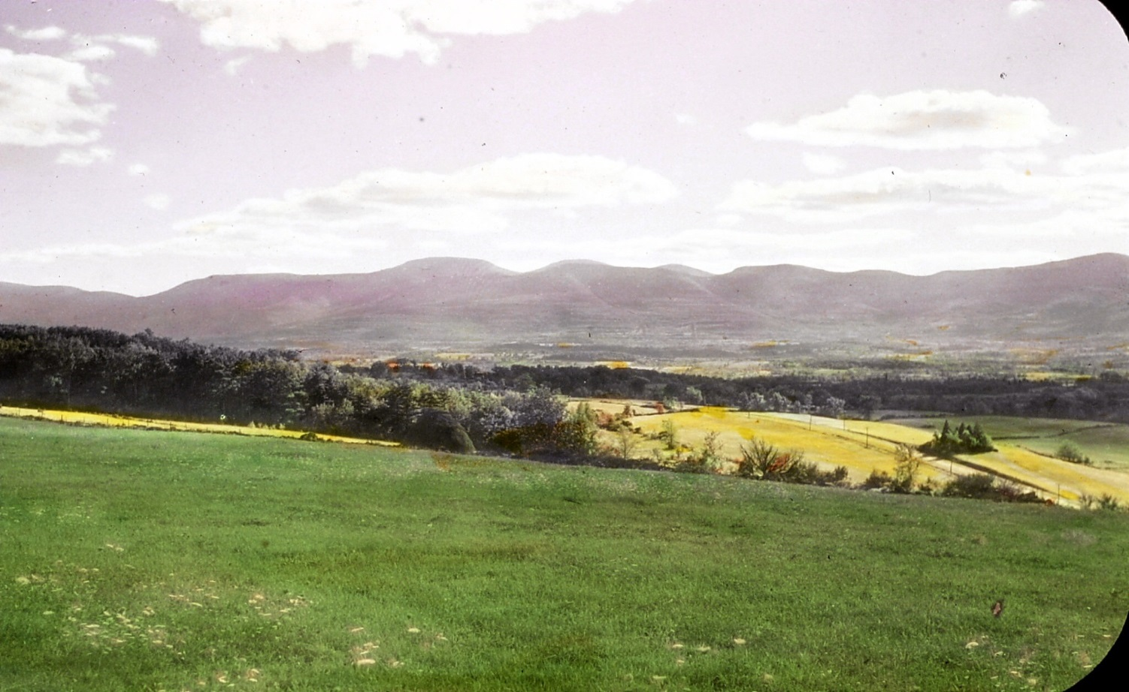
Catskill Mountains
High Peak, Black Dome Mountain,
Black Head Mountain
“Haunt of Rip Van Winkle”
Notes:
Catskills slide # 2 High Peak dome and Black Head, their summits dark with hemlock forests. Cole was not the only painter who enjoyed these hills as Woodstock and other art colonies still attest. The Catskills are noted too as the haunt or Rip Van Winkle as the home of John Burroughs, as one of the finest parks of the State Forest Preserve and is the site of NYC’s Ashoken reservoir the building of which together with its aqueduct was almost as great an undertaking as the Panama canal itself.

Slide 5
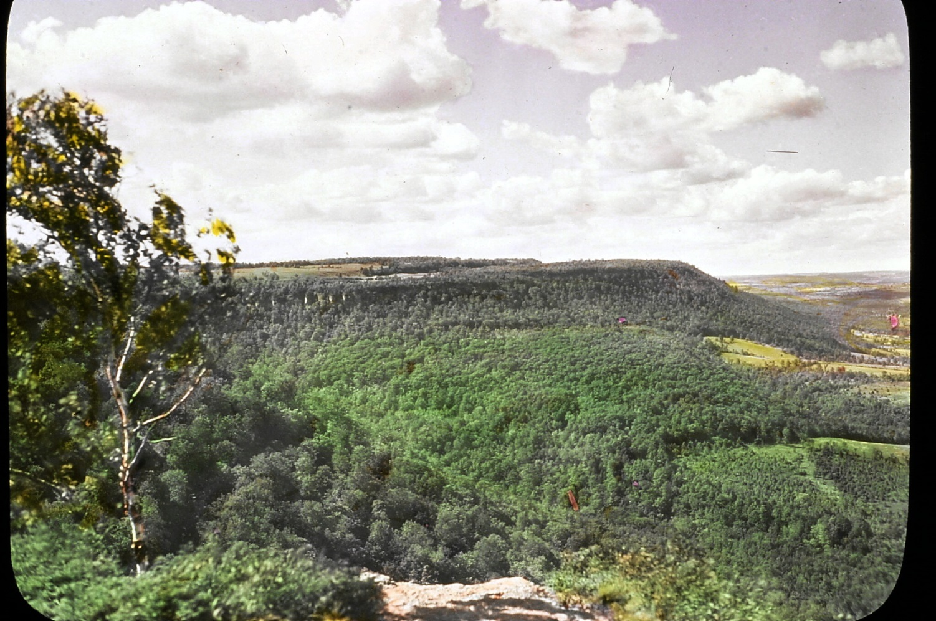
Helderberg Mountains
“A shoreline of a long ago sea.”
Notes:
Helderbergs slide # 3

Slide 6
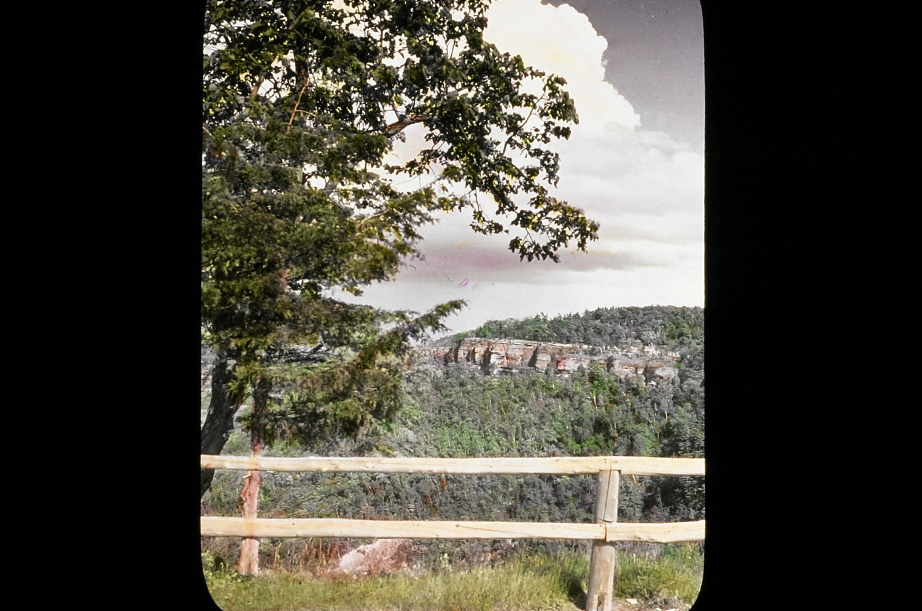
Helderberg Mountains & Thatcher Park
“Cliffs rise above their wooded slopes, showing hundred feet of sheer vertical palisade.”
Notes:
Helderbergs slide #4

Slide 7
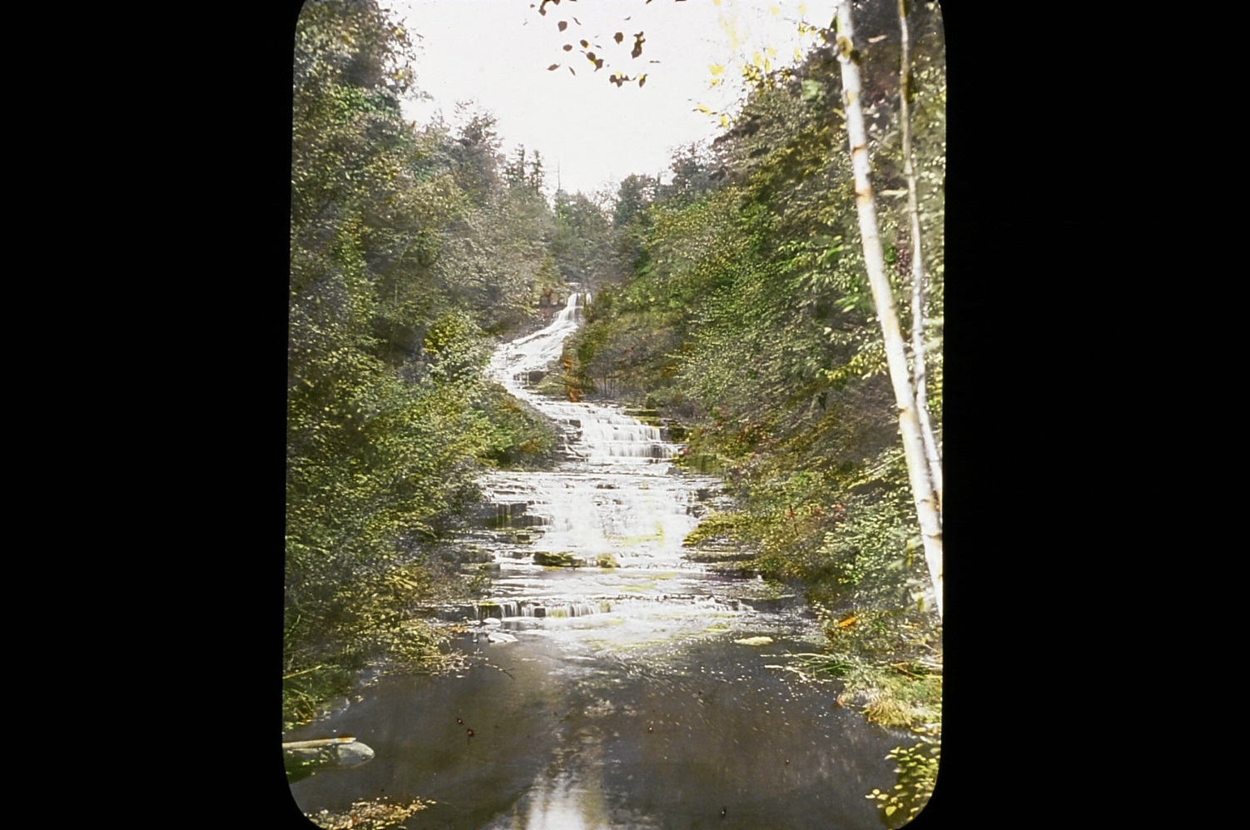
Rensselaerville Falls
“The waterfall is a natural stairway formed by the erosion of successive shale deposits.”
Notes:
Rensselaerville falls slide # 5 Several miles away at Renselaerville a memorial preserve of nearly five hundred acres has recently been given to the public. It includes this waterfall, a natural stairway formed by the erosion of successive shale deposits. Along such streams are found great beds of maiden hair and many other ferns. The rare walking leaf fern is also occasionally found in the Helderbergs.

Slide 8
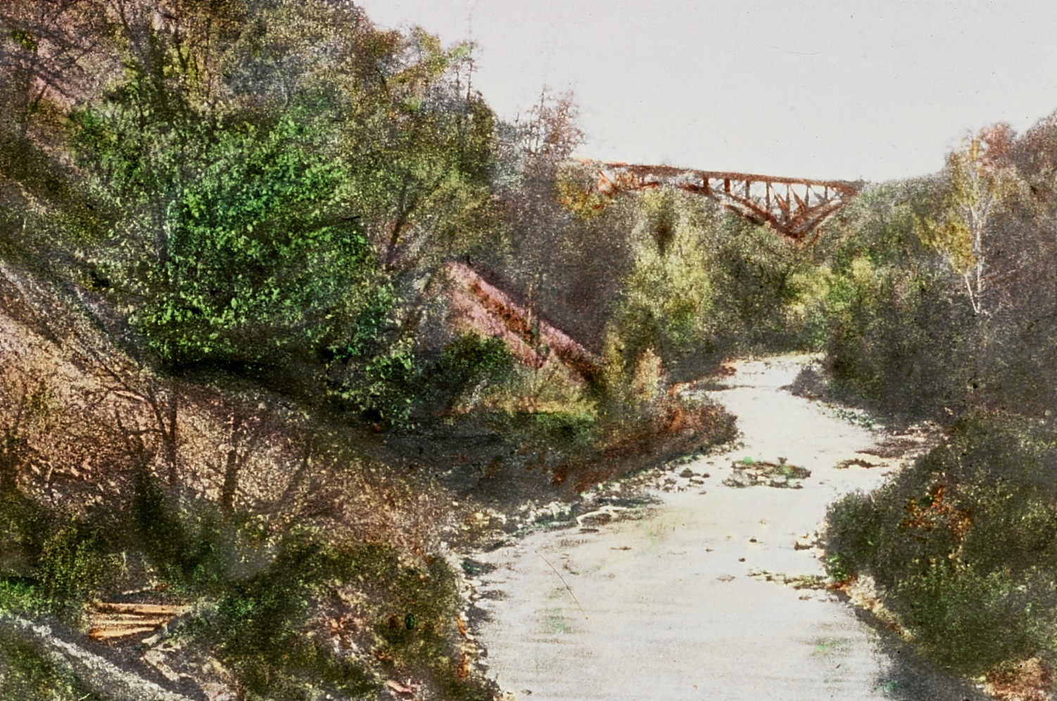
Normanskill, 1936
“Forthwith we are in the realm at once of poetry and of history.’’
“
Notes:
Normanskill slide # 8 Turning to the left we cross the Normanskill, de Noormans Kil or Northmans stream as it was called by the early Dutch because of a Norwegians Mill near its mouth and forthwith we are in the realm at once of poetry and of history/For this tributry of theHudson is the reputed Vale of Tawasnetha described in Hiawatha: In the vale of Tawasentha, in the green and silent valley, by the pleasant water courses dwelt the singerNawadaha.
Round about the Indian village, spread the meadows and the cornfields and beyond them stood the forest…..etc

Slide 9
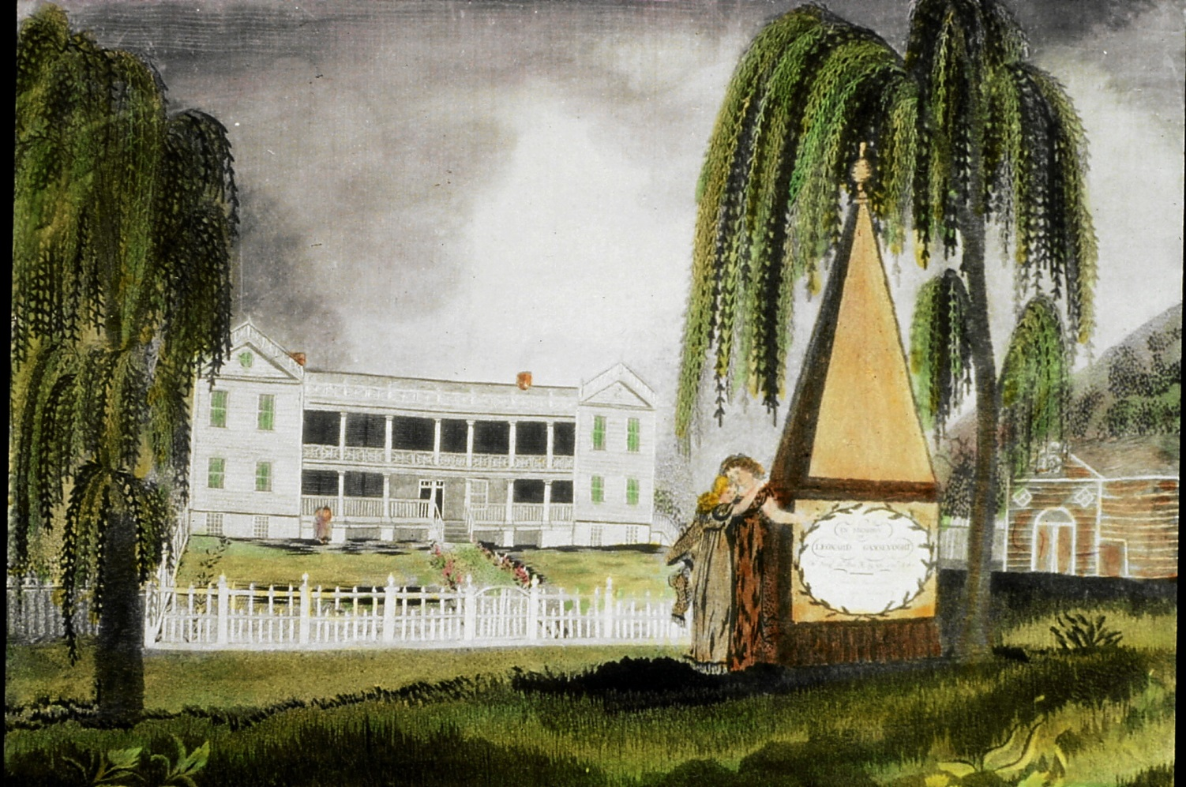
Historic Homes
Needlepoint of Whitehall

Slide 10
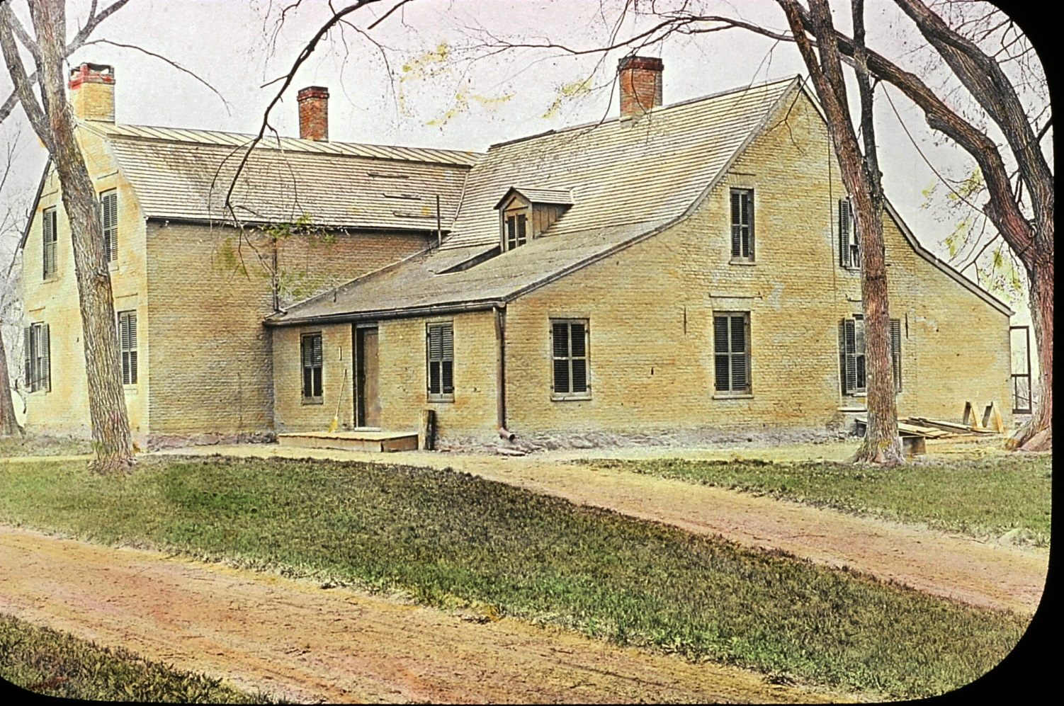
Schuyler House at The Flatts
Part of the Colony of Rensselaerwyck
Notes:
Rear Flatts # 15

Slide 11
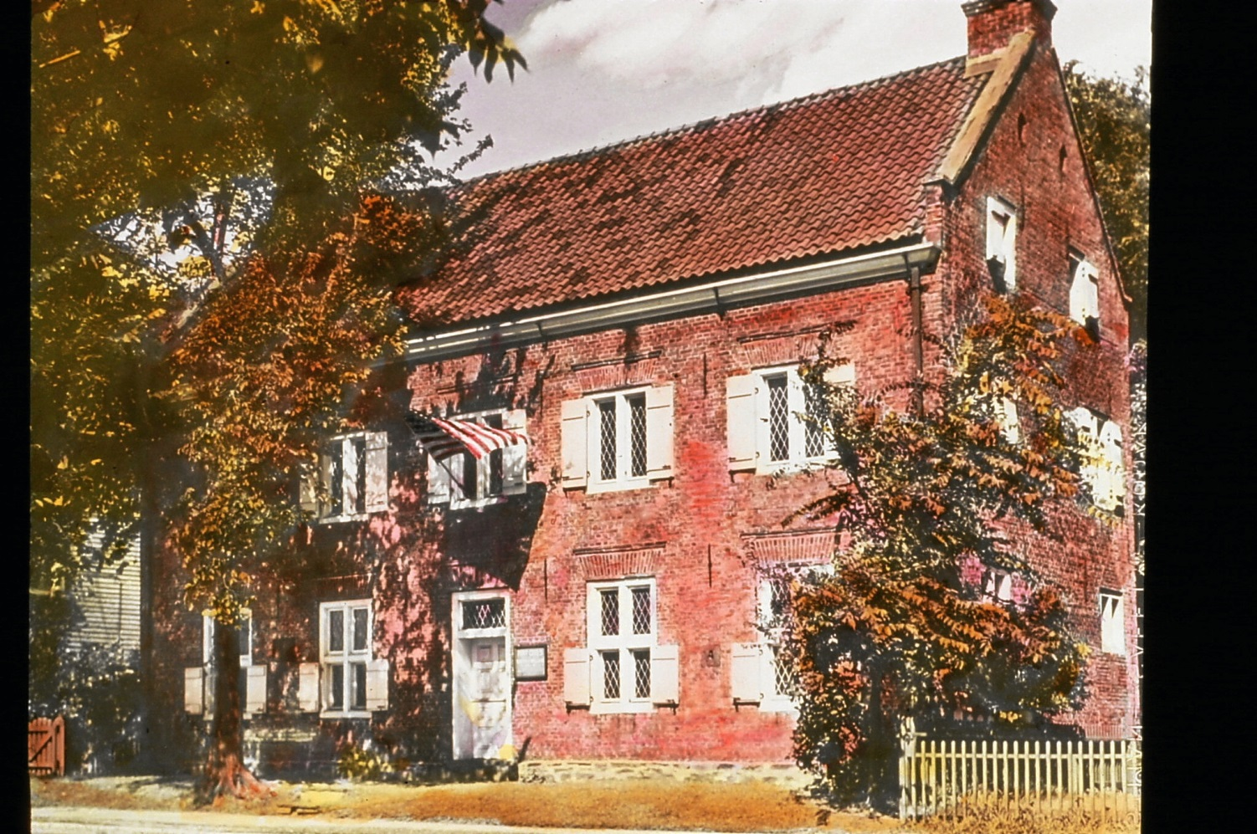
Fort Crailo or “Crows Woods”
Built by Van Rensselaer Family in 1660s
Notes:
Fort Crailo # 17 These early summer mronings Lord Howe must have
? FOGC

Slide 12
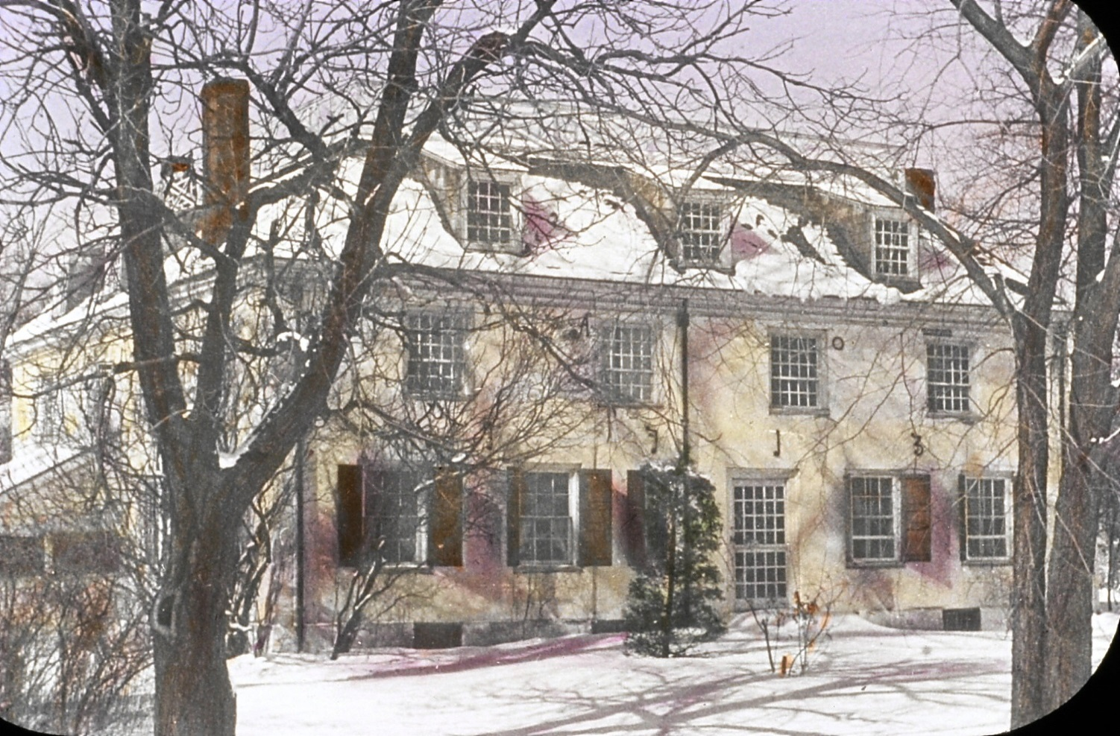
Glen Sanders Mansion
Described in 1936 as “one of the most notable and interesting colonial homes in America.”
Notes:
Glen Sanders slide # 19

Slide 13
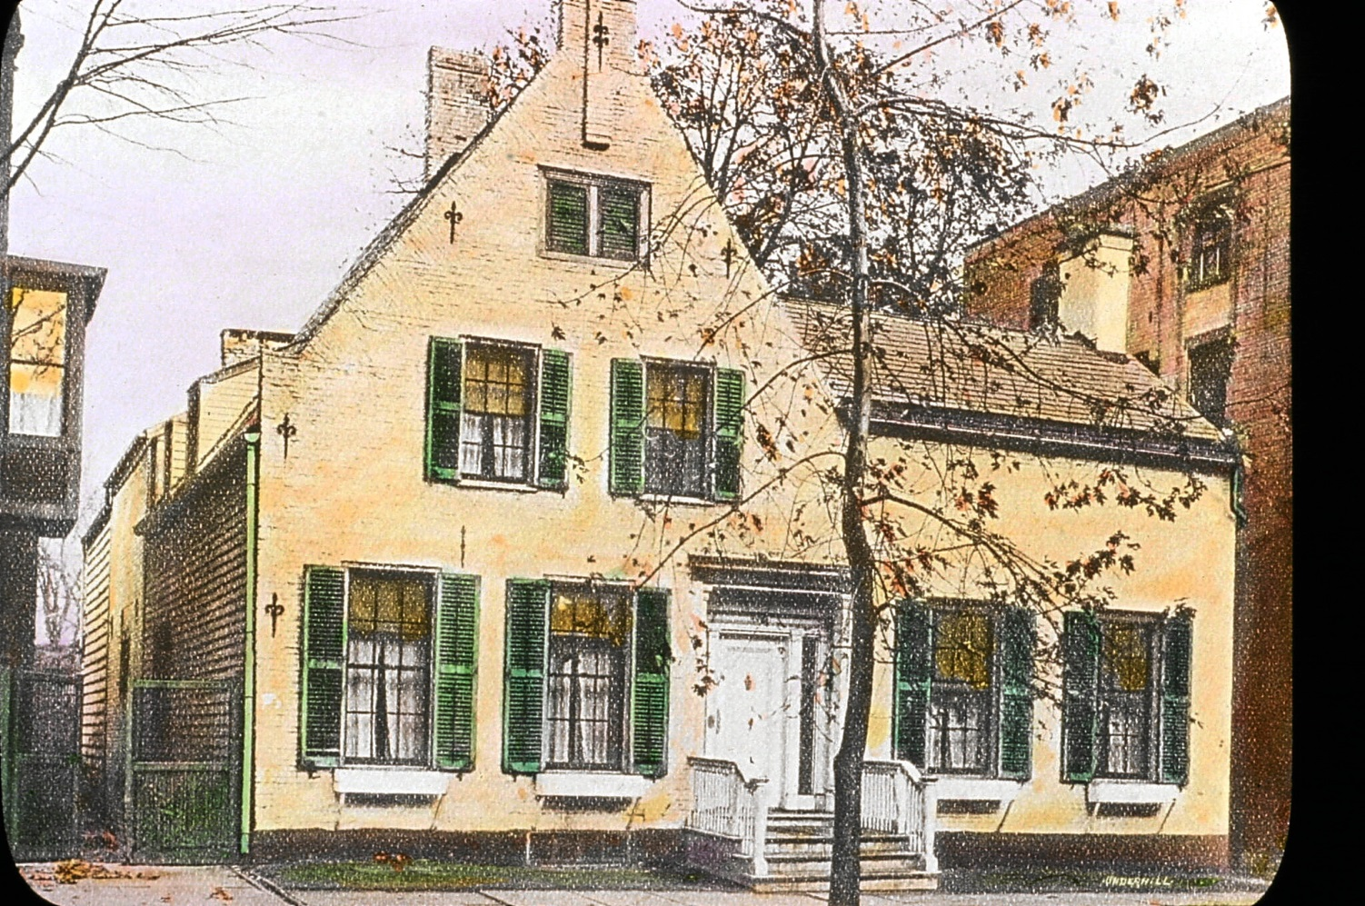
Abraham Yates House
Union Street, Schenectady
Built 40 years after the burning of Schenectady, 1664
Notes:
Yates House slide # 22

Slide 14
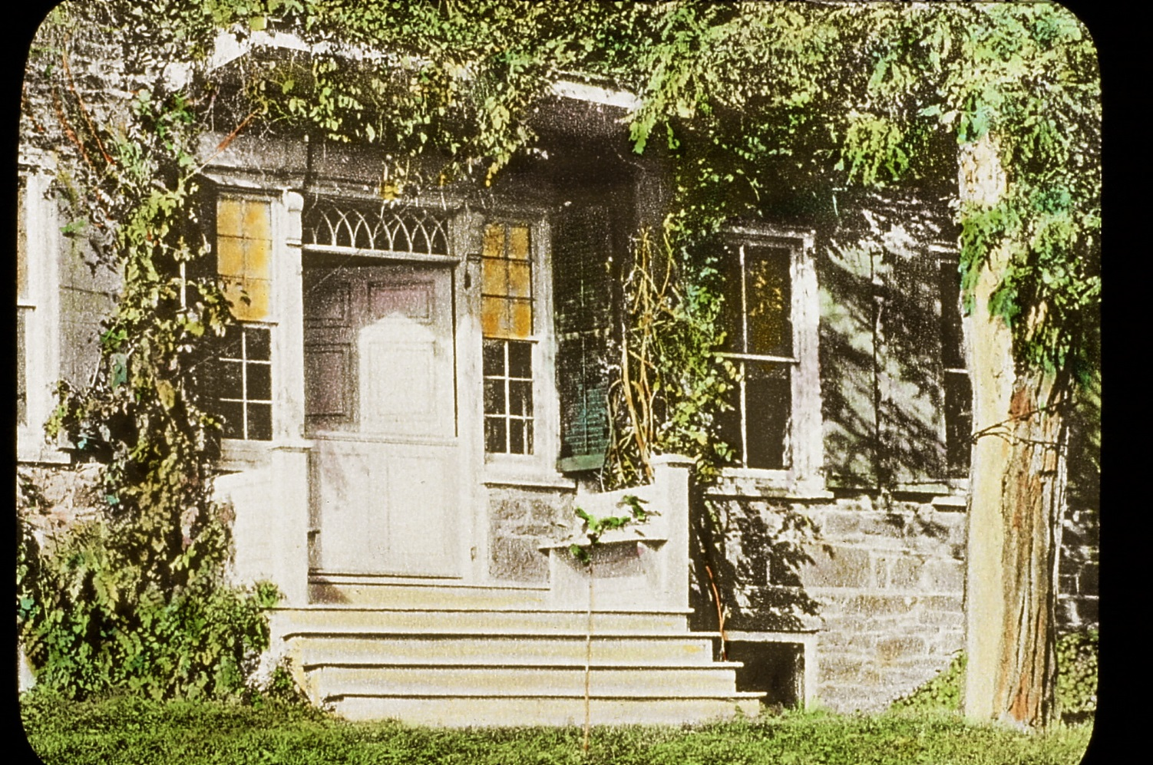
Coeymans Bronk House
“Distinguished by a double Dutch door and its stoop with a vine covered hood, indications of the hospitality to be found within.”
1992 added to the National Register of Homes
Notes:
Coeymans#44 the Coeymans Bronk house

Slide 15
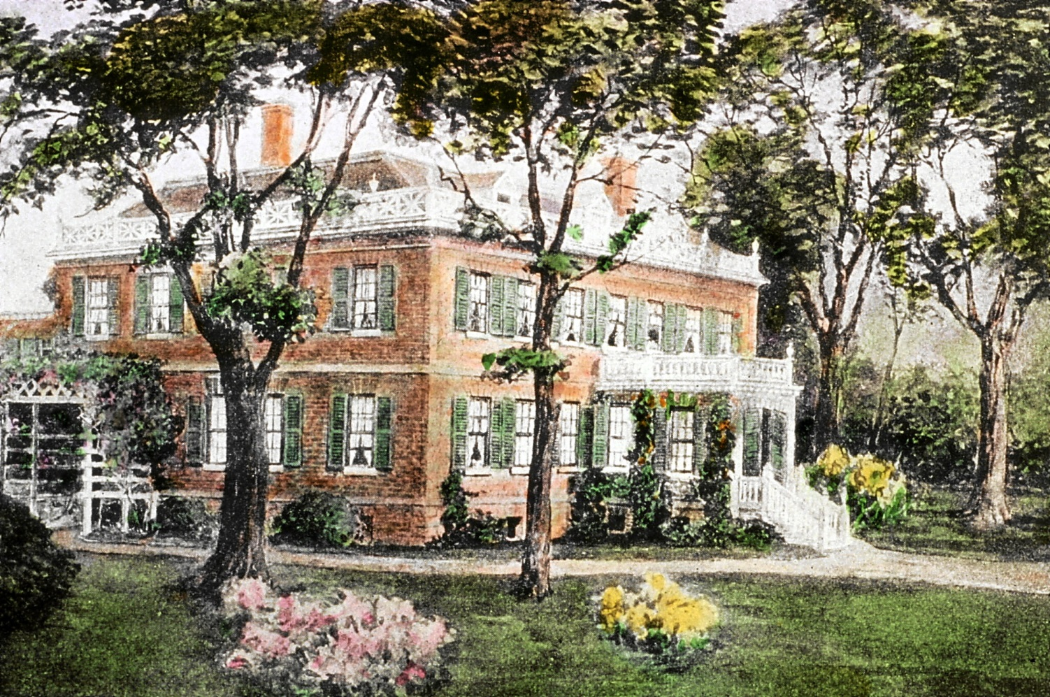
Schuyler Mansion
Notes:
Schuyler slide # 46
Sarah Slingerlands and Sheila Hart were locked in the car while their mothers weeded in the garden

Slide 16
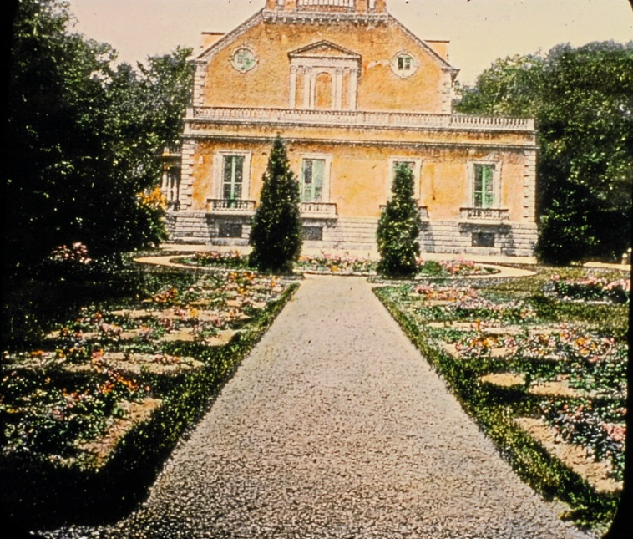
Van Rensselaer Manor House
Built by Patroon Stephen Van Rensselaer
Notes:
Slide# 50 The Manor House

Slide 17
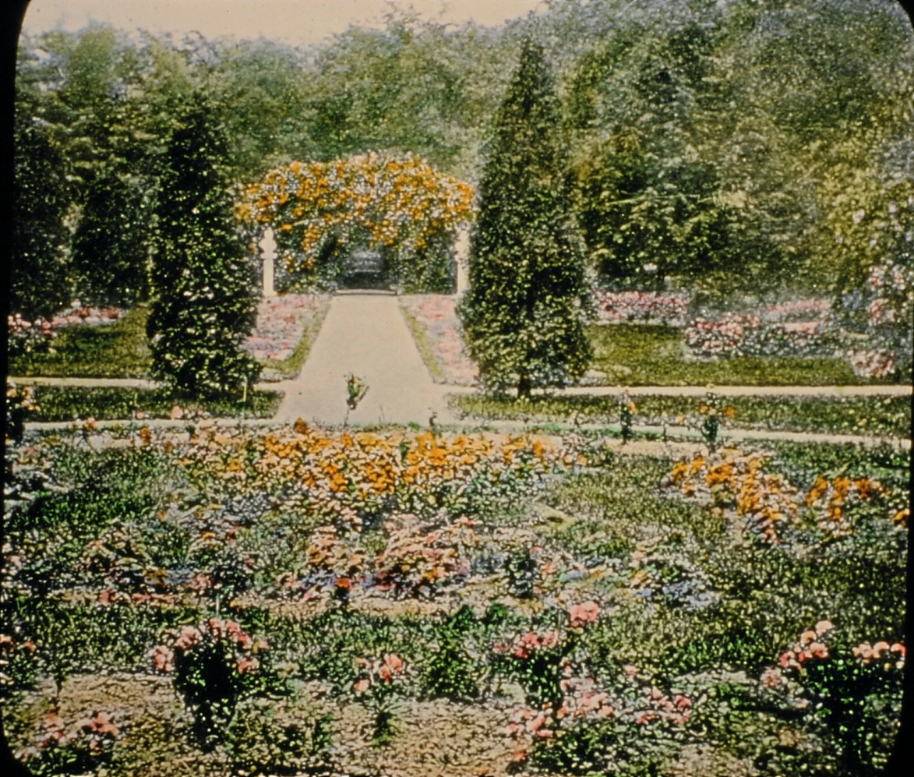
Van Rensselaer Manor House Garden
“Elaborate gardens of the last Patroon,
Stephen Van Rensselaer” included a greenhouse.

Slide 18
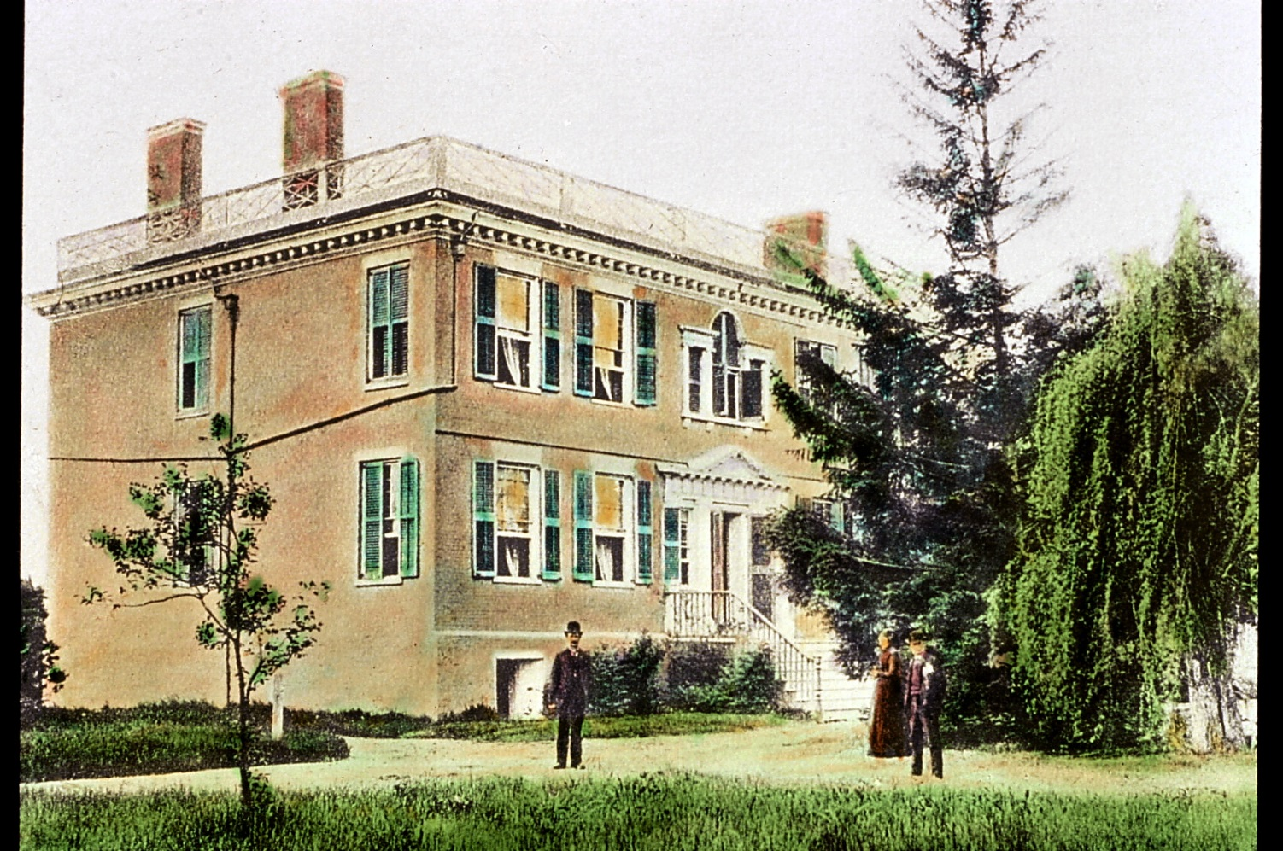
Vlie House
“Poppies, verbena and hollyhock grew haphazardly.” i
Notes:
Vlie House Slide # 52 On the River Road, perhaps half a mile south of Fort Crailo, Vlie House (House by the Marsh) stood for more than one hundred and fifty years. It was bulit by an English gentleman, Henery Cuyler, on leased land and later revertedto a branc h of the Van Rebnnsseleaer family. Built of brick in the Georgian style at about the same time as the Schuyler mMansion, Vlie House was equally beautiful in design and workmahship. In 1926 it was demolished to make room for the lumber yards fo the Port of Renssleaer but is still

Slide 19
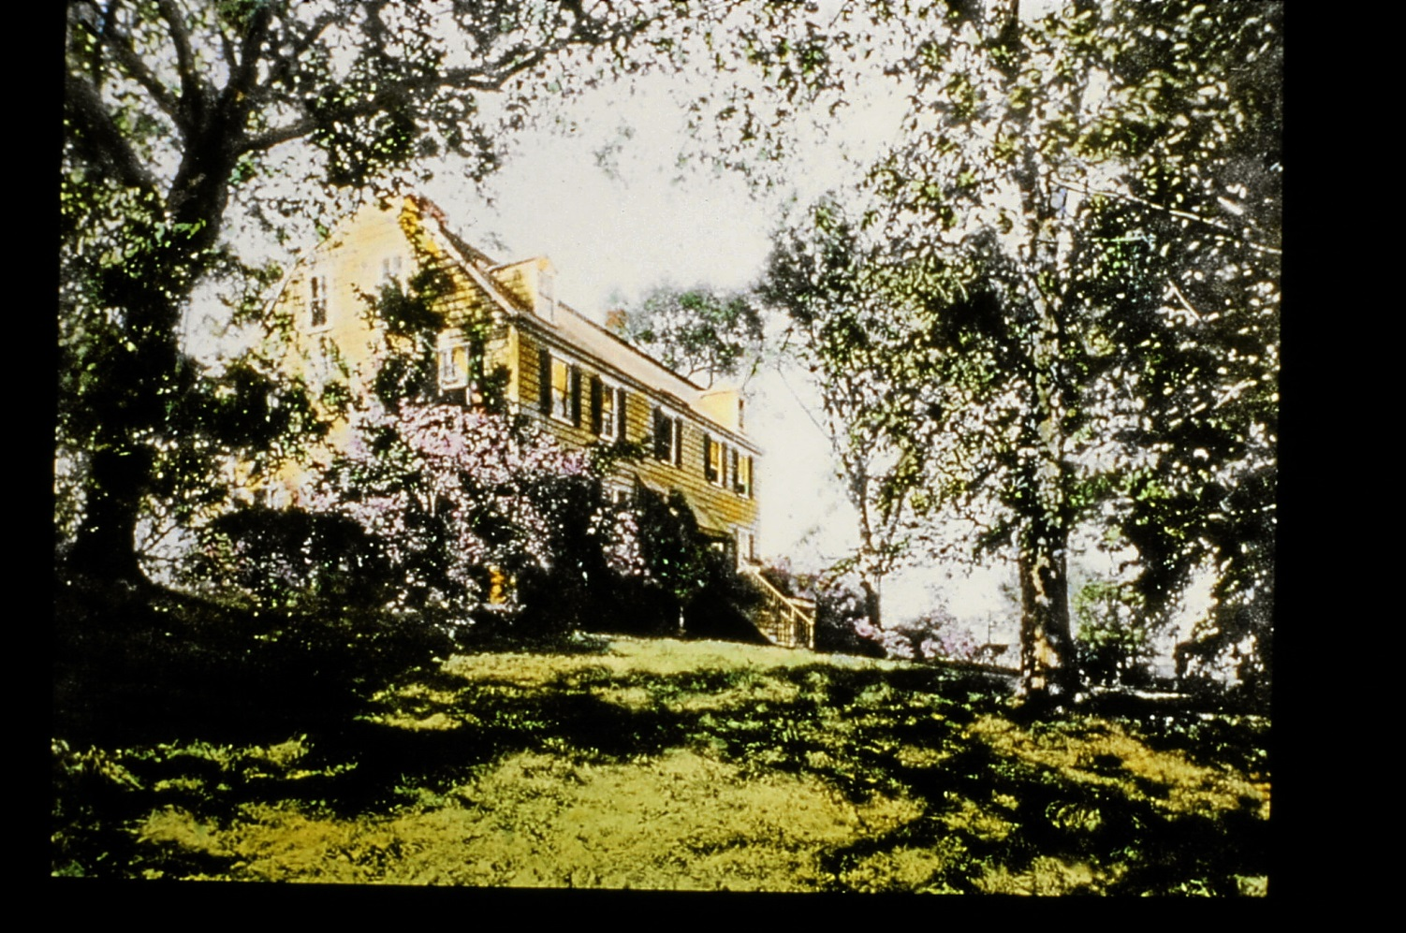
Cherry Hill
Built in 1768 by Colonel Philip Van Rensselaer
The last of the Van Rensselaers, Miss Emily Rankin, lived in Cherry Hill until her death in 1963 when she gave the home to NY State.
Notes:
Mrs. Rankin lived in Cherry Hill and was Secretary of FOGC. Kept all the records including the glass slides.
Joanne found these at GCA headquarters in a room with a little door.

Slide 20
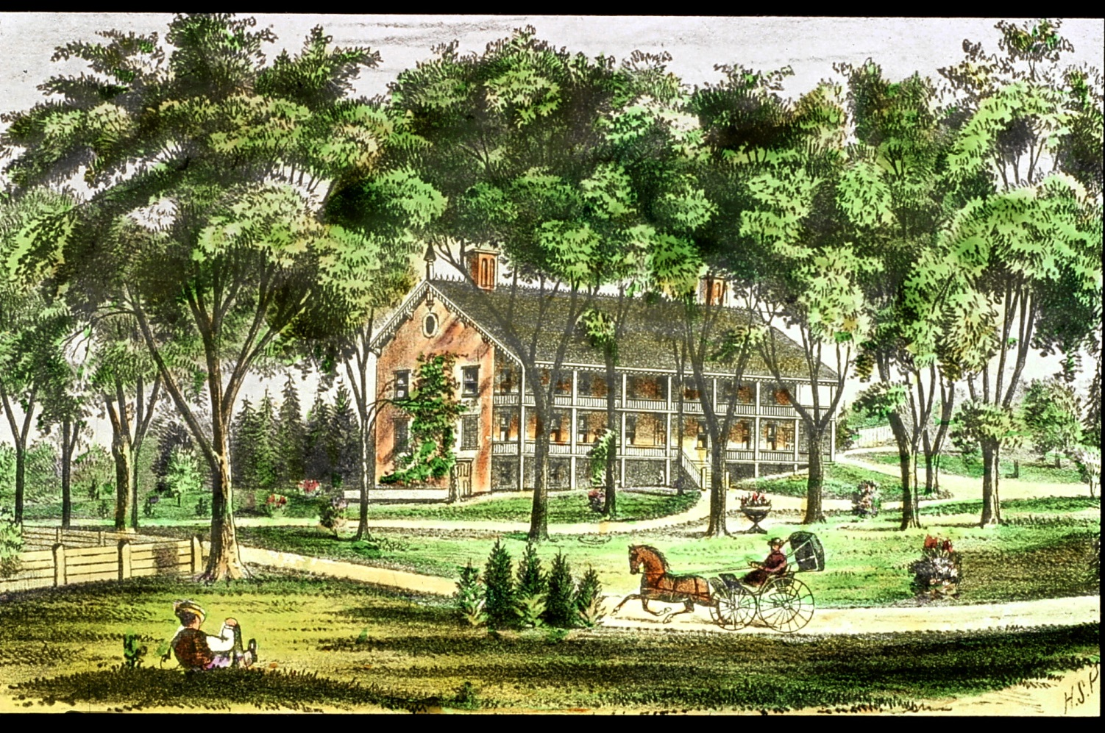
Greenbush Cantonment
1812 headquarters of a U.S. military contingent.
Notes:
Cantonment # 57

Slide 21
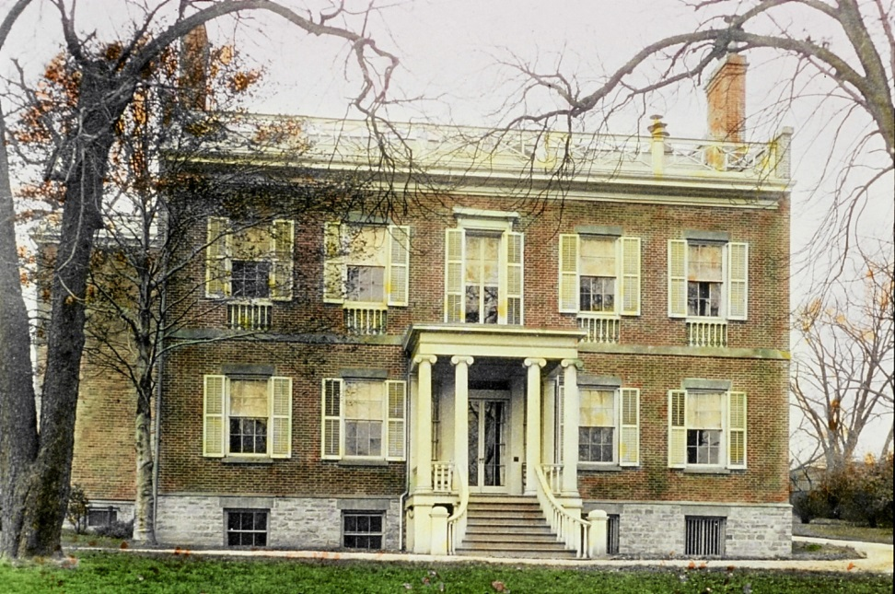
Ten Broeck Mansion, on Prospect Hill
Built by General Abraham Ten Broeck in 1798, the year after Albany became the permanent capital of NY State.

Slide 22
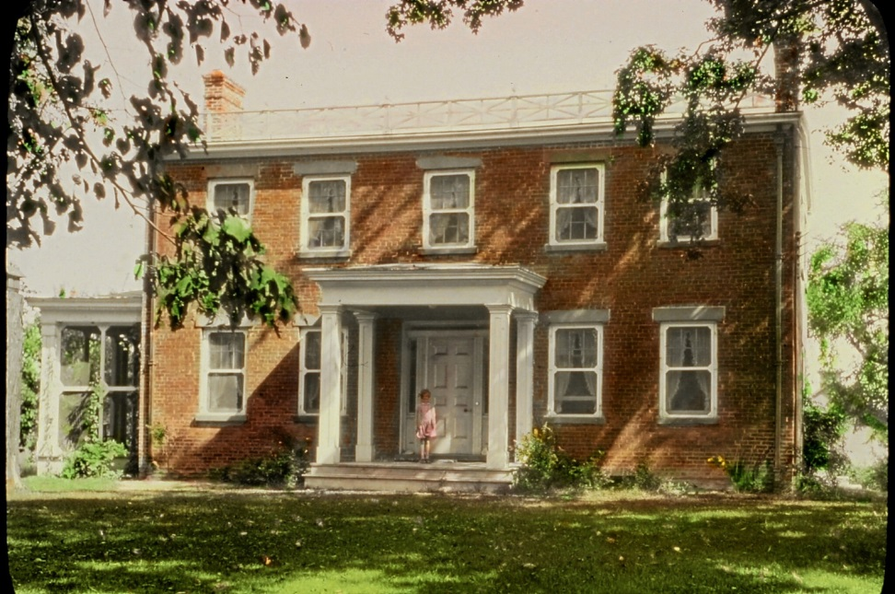
Mulberry Hill
Count and Countess de la Tour du Pin
In 1794, they fled the French Revolution to the current Town of Colonie with the aid of General Philip Schuyler.

Slide 23
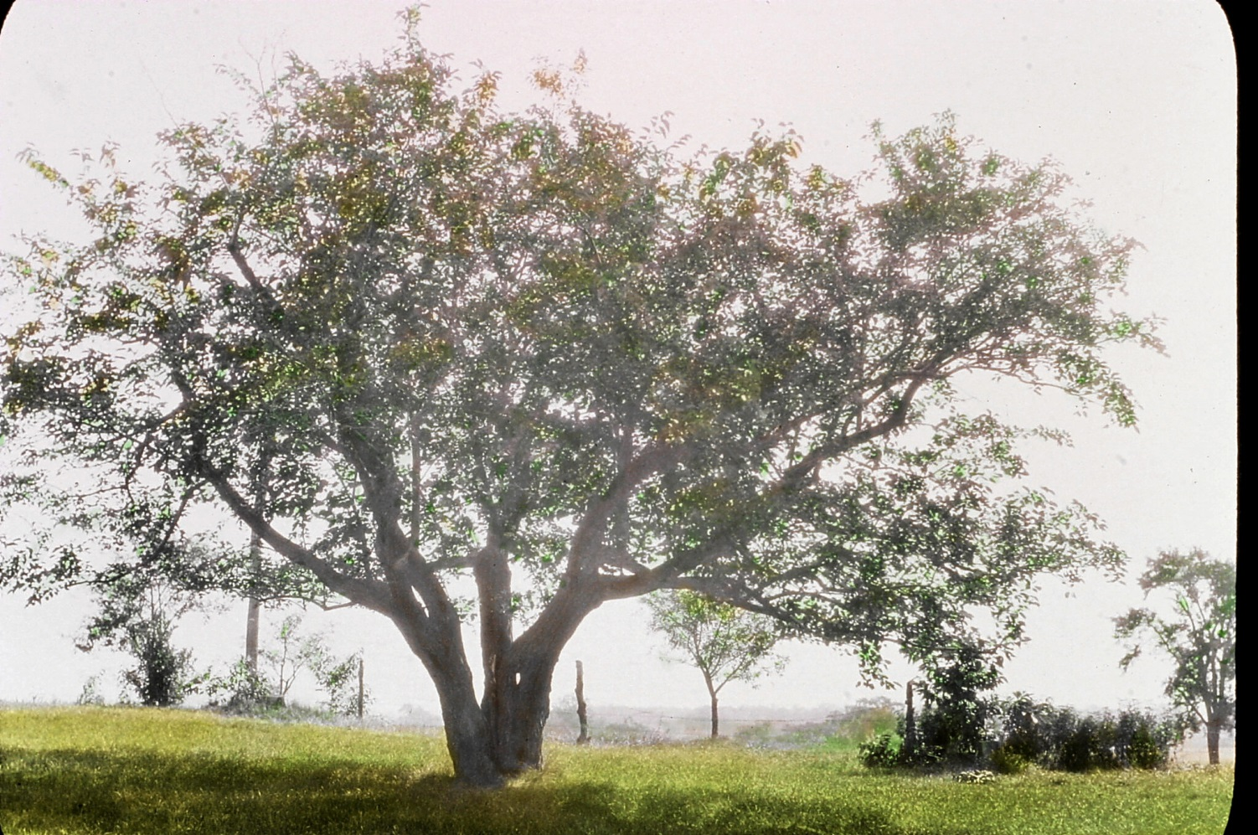
Mulberry Tree
Planted by Charles Talleyrand, the European diplomat who was a frequent visitor.
It remains there today.
Notes:
Mulberry tree # 56

Slide 24
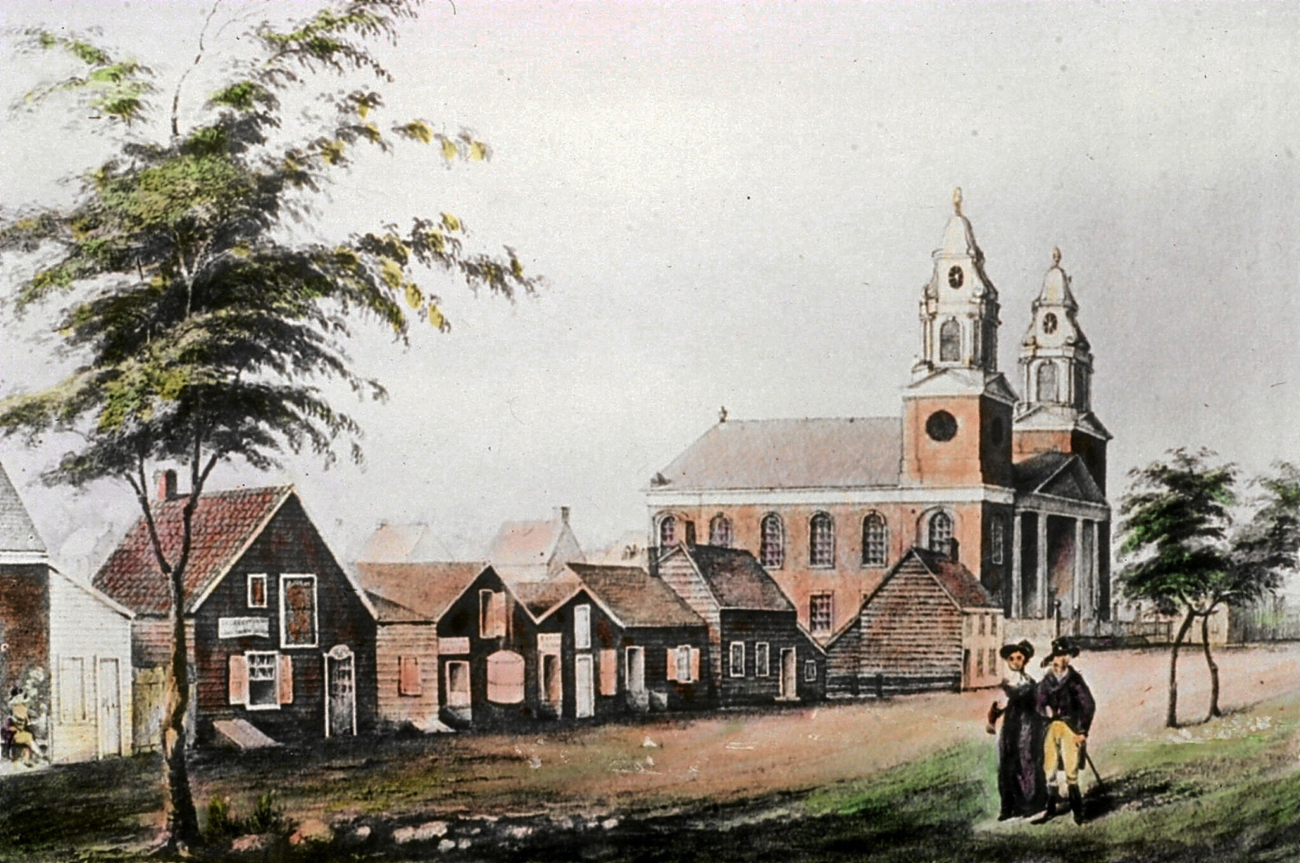
Public Spaces
Pearl Street, Albany
Notes:
Pearl street # 60

Slide 25
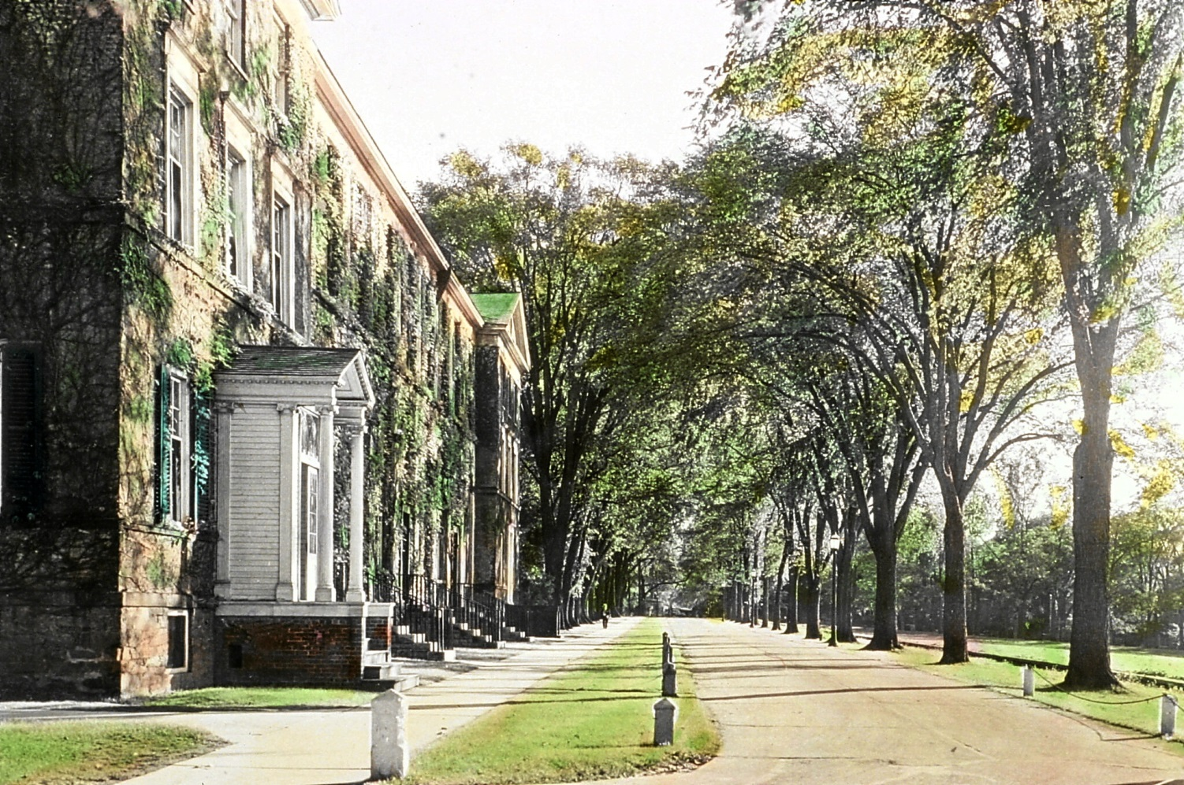
South College at Union College
1814
President Eliphalet Nott
Notes:
South College Union slide # 23

Slide 26
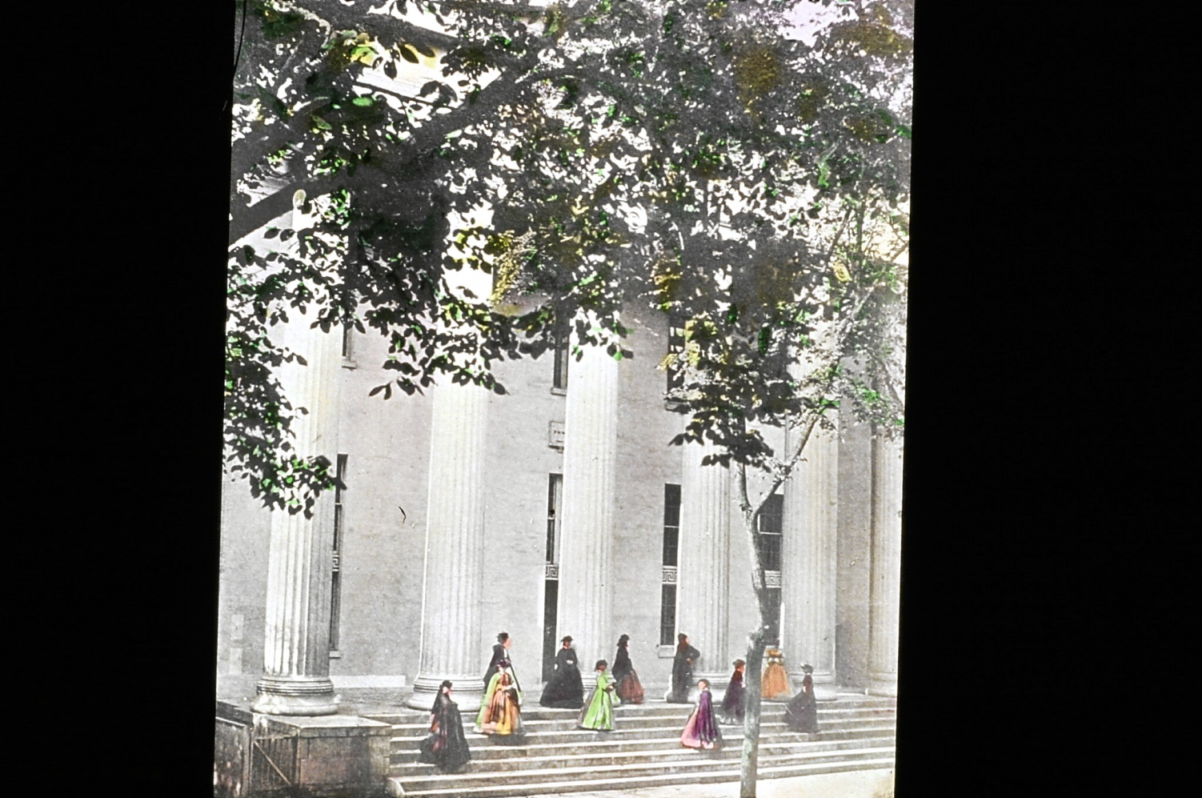
Albany Female Academy
Built in 1814 , originally located on Washington Avenue
Notes:
Albany Academy for Girls # 58

Slide 27
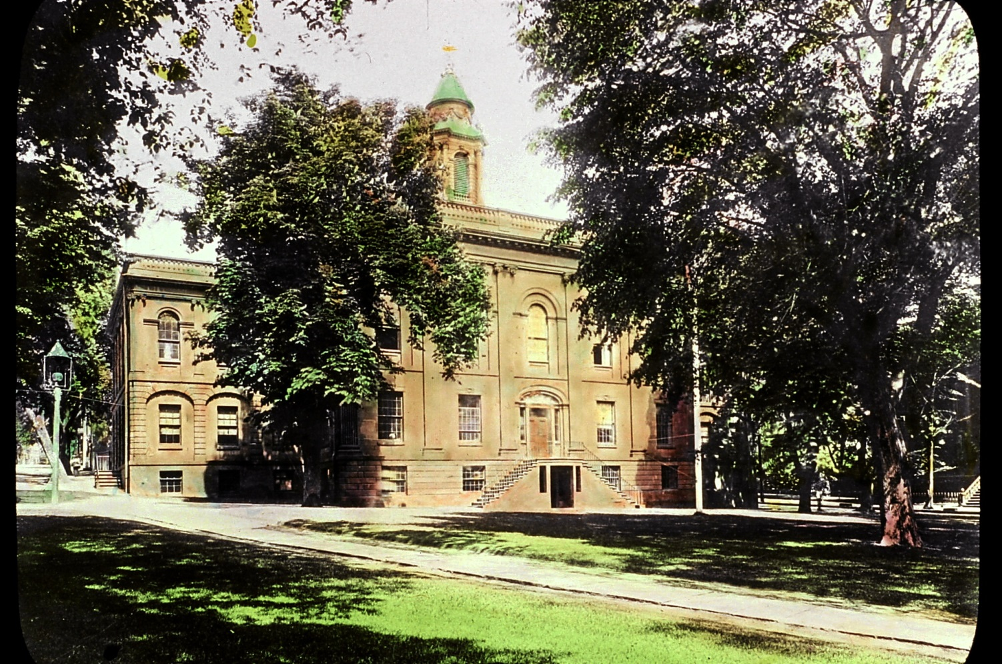
Albany Academy
Built in 1813, located in Academy Park. Its charter was signed by Mayor Philip Schuyler Van Rensselaer.
Notes:
Albany Academy # 59

Slide 28
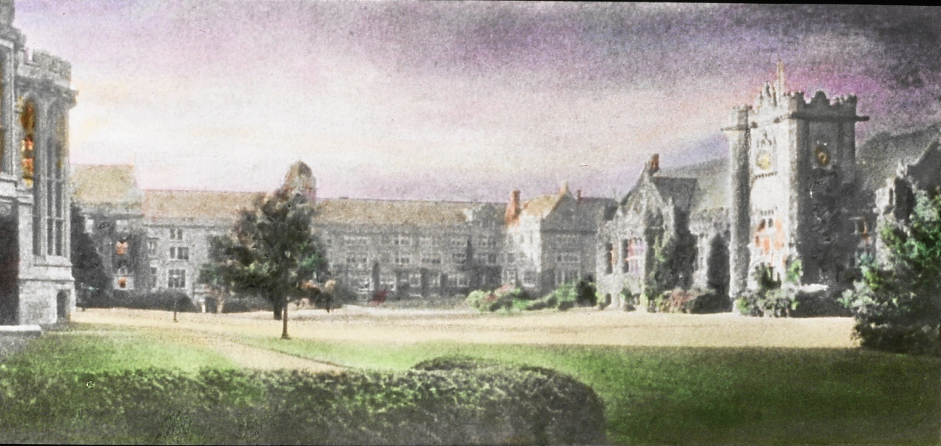
Emma Willard School
Founded in 1814 in Troy, New York

Slide 29
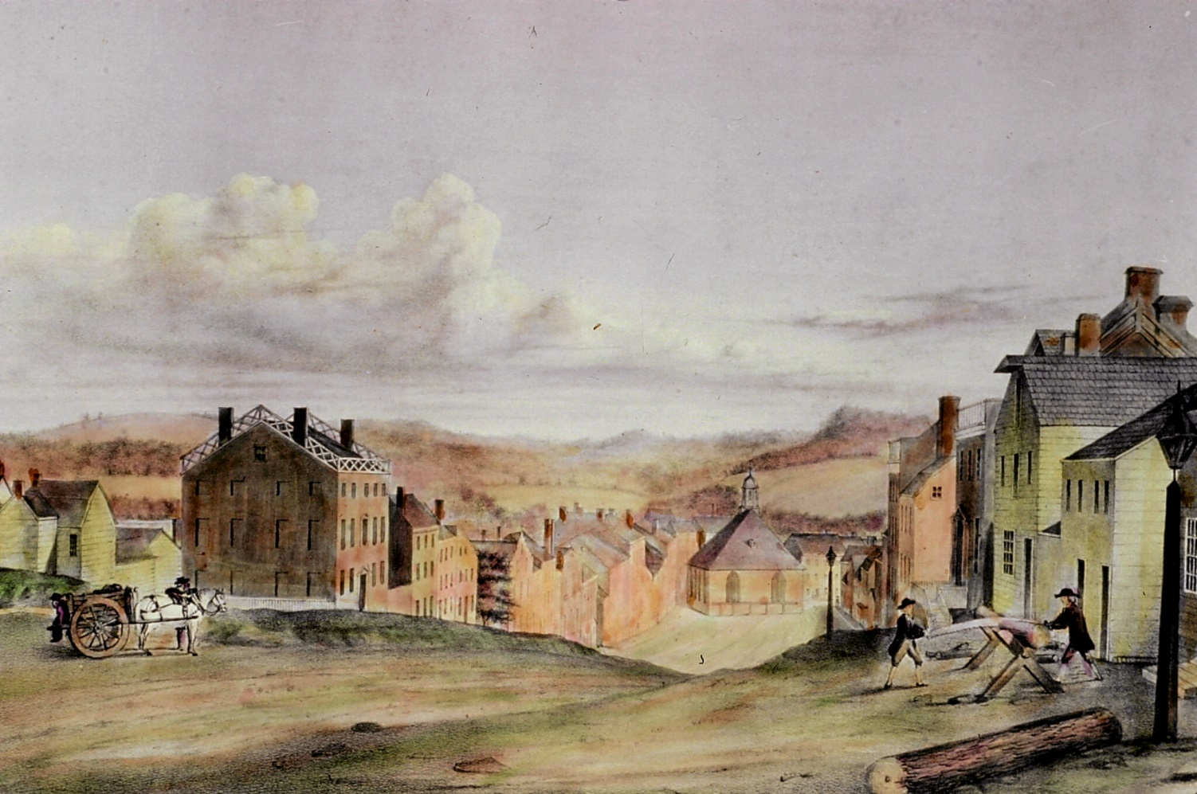
State Street, Albany, 1805
Notes:
State street #61 (FOGC glass slides)

Slide 30
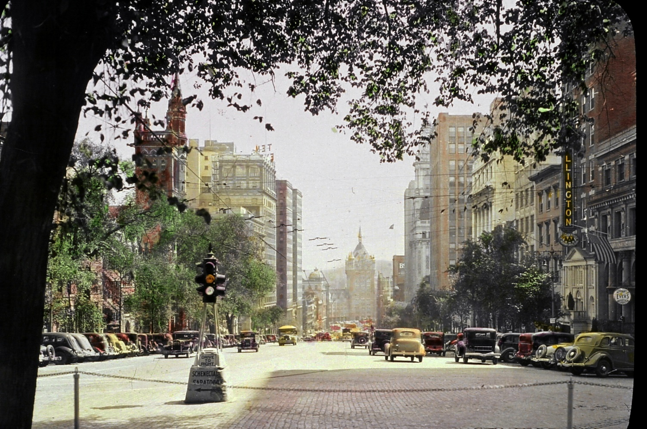
State Street “Today”
1936
Notes:
State street 1938 # 62 FOGC glass slide collection

Slide 31
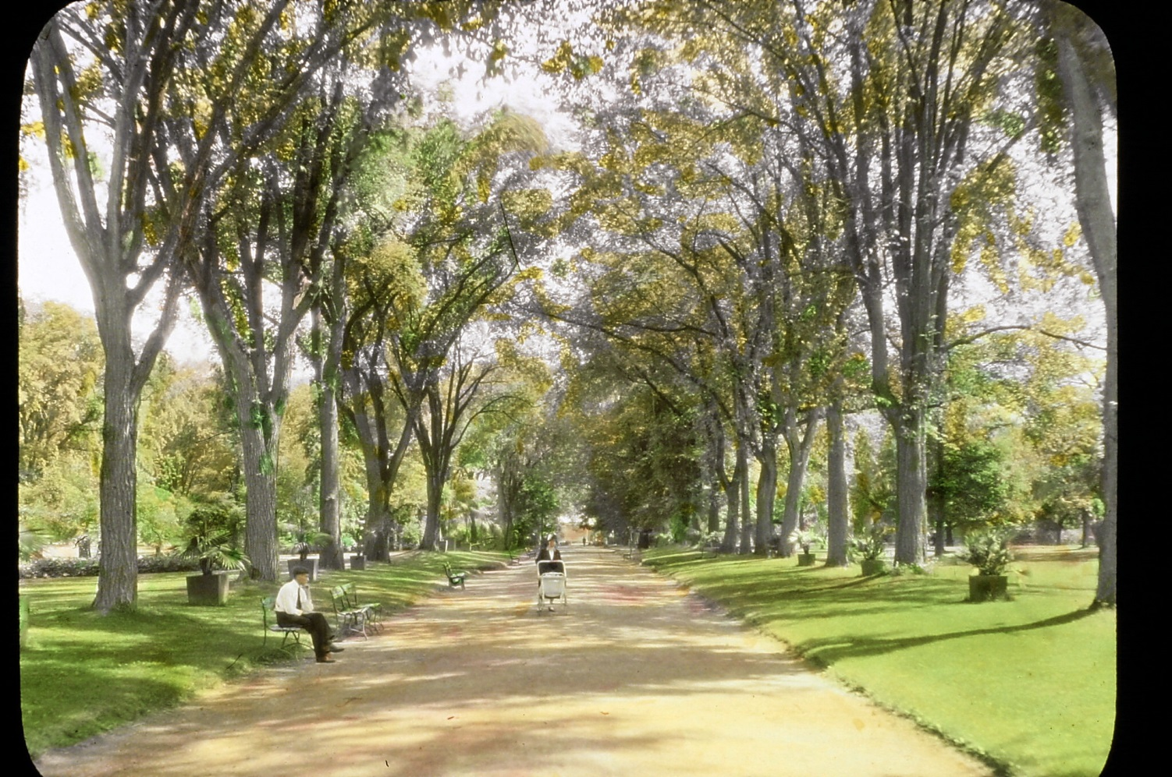
Washington Park
“Our city garden, Albany’s most beloved antiquity.”
Notes:
Washington park # 77 FOGC glass slide collection

Slide 32
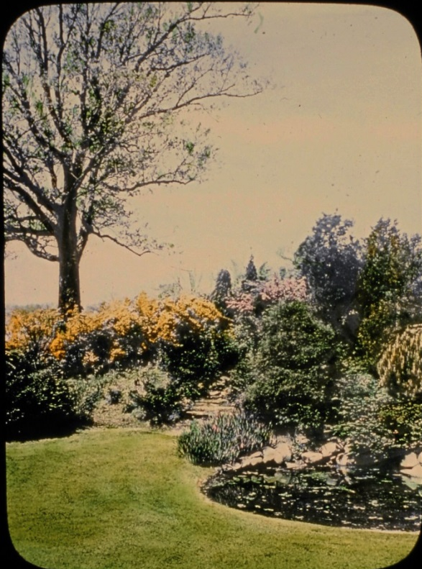
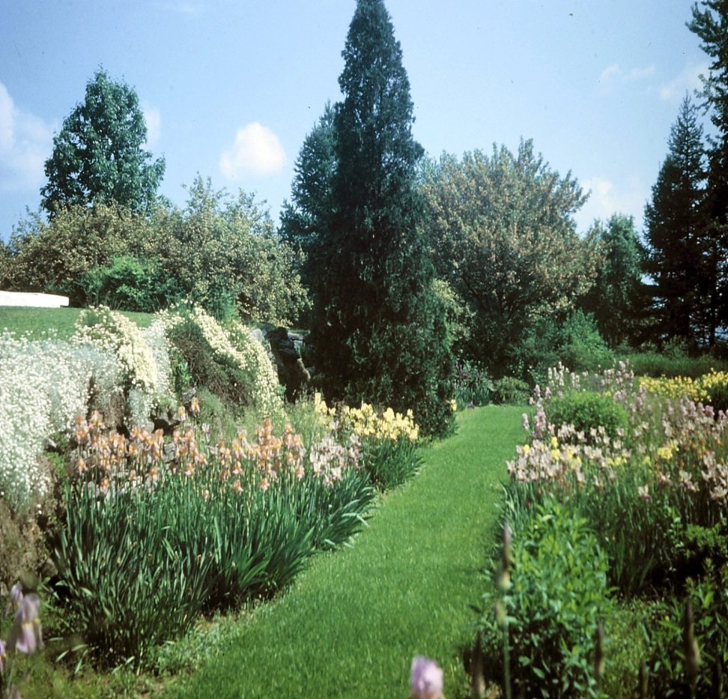
Private Gardens
Mrs. Edwin Corning Garden

Slide 33
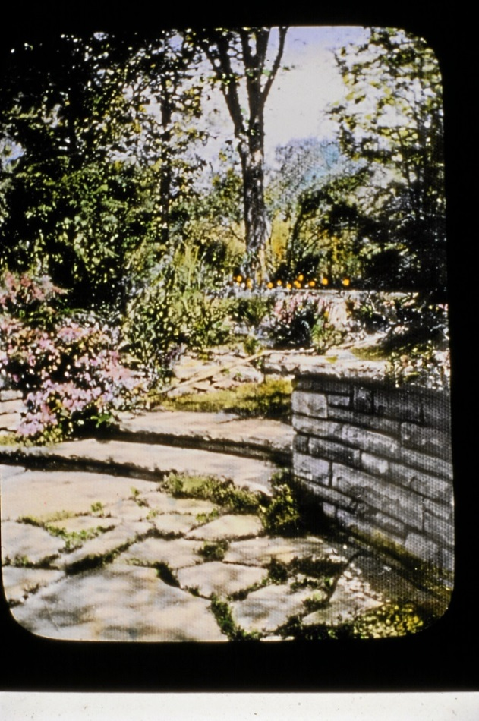
Mrs. Lawrence Achilles’ Garden

Slide 34
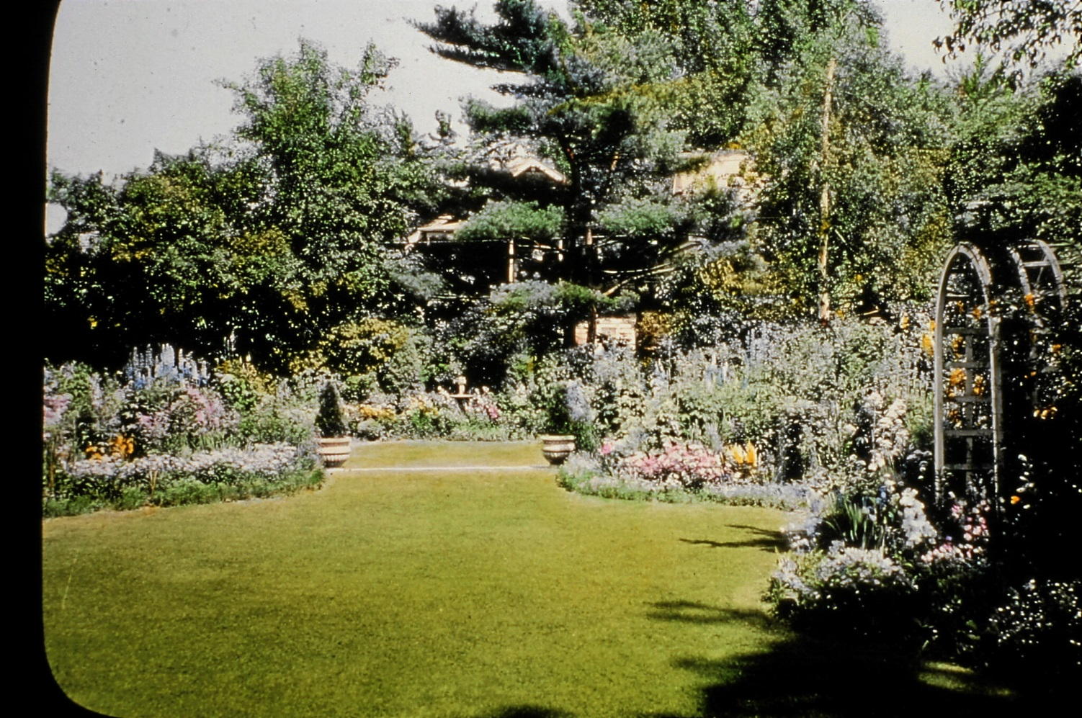
Mrs. Walter Stearn’s Garden at Union College
“The use of suitable shrubbery creating two levels connected by low steps can give a sense of space and seclusion.”

Slide 35
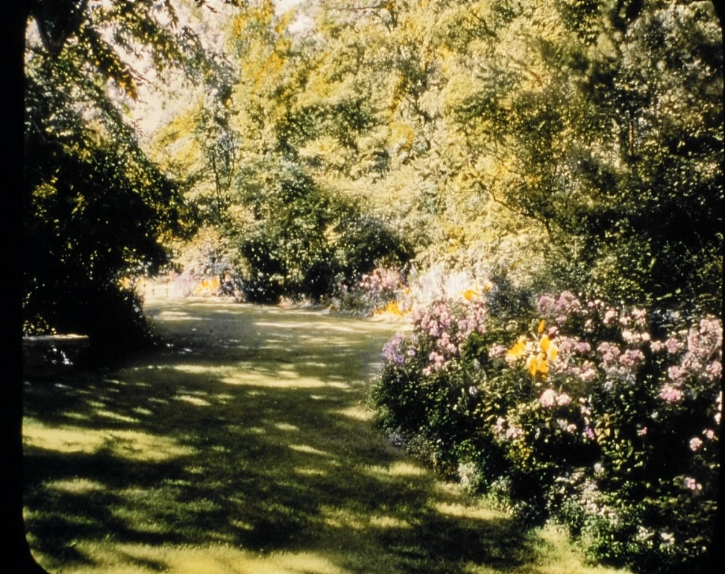
Mrs. C. Langdon Perry’s 1936 Garden

Slide 36
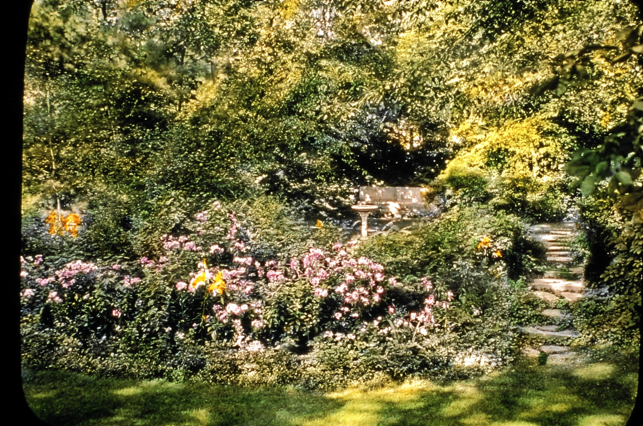
A second view of Mrs. Perry’s Garden
Stones from old quarry visible
“Tall trees and naturalistic planting has much of the woodland charm of the neighboring Jackson garden.”

Slide 37
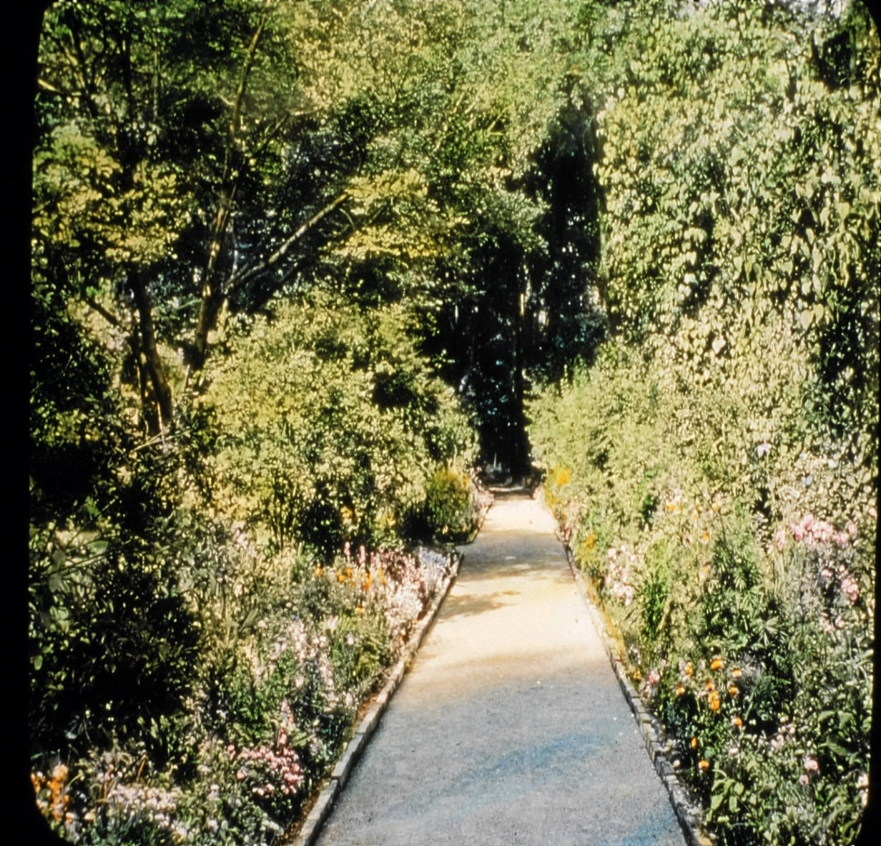
Jackson Garden
“Beyond the smaller gardens there are about 30 acres of tall woodland threaded by shady paths.”
Dr. Isaac Jackson, 1834
Oldest cultivated garden on any U.S. college campus

Slide 38
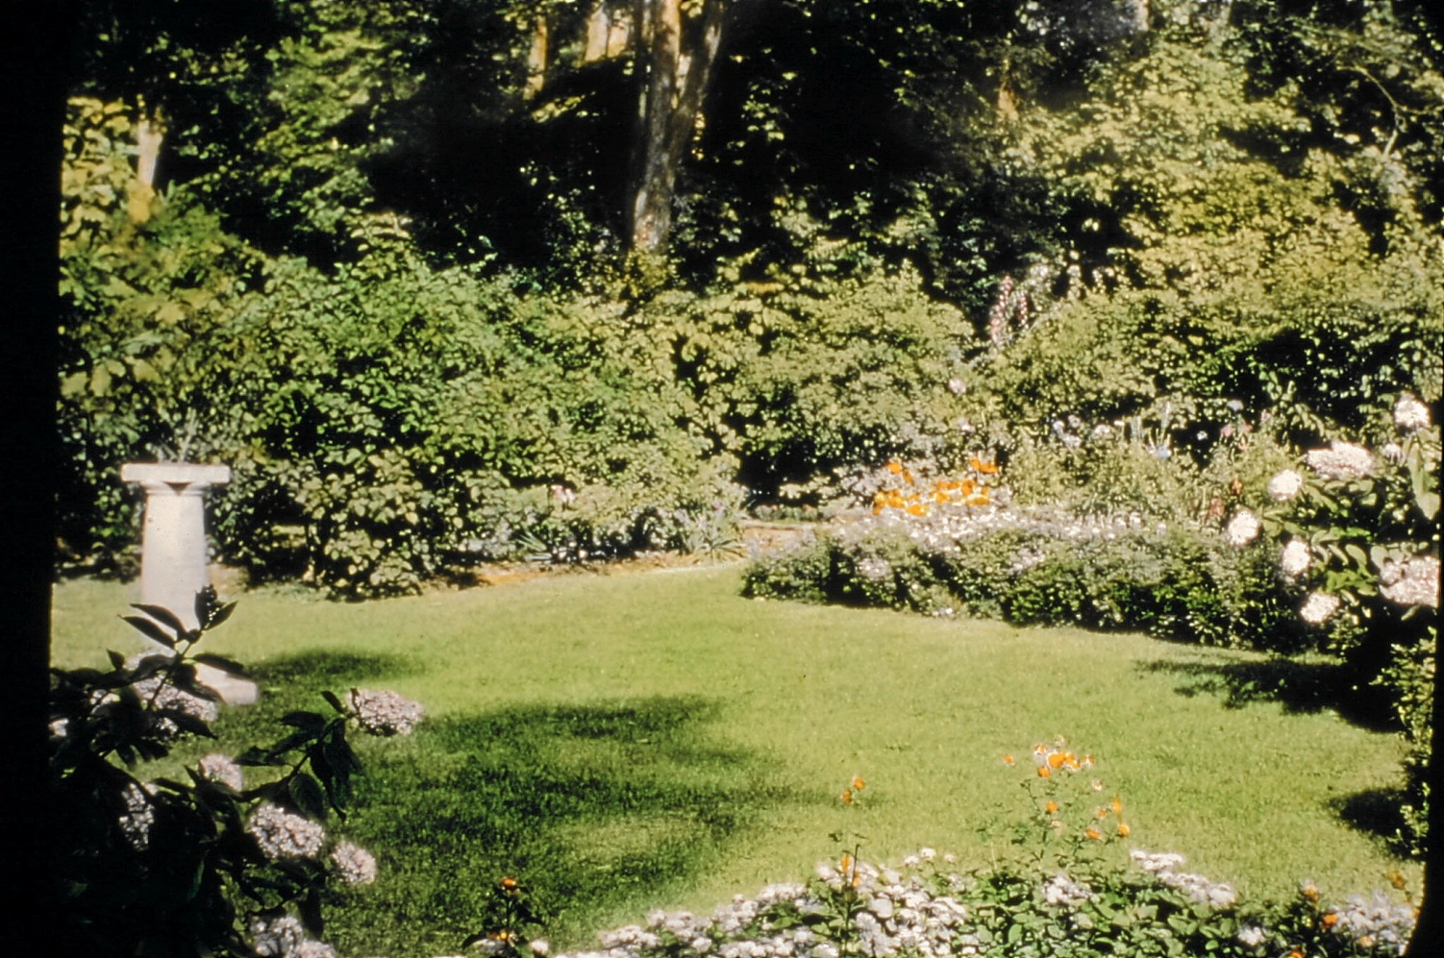
Jackson Garden Sundial
The original sundial no longer exists.
Notes:
Slide 28

Slide 39
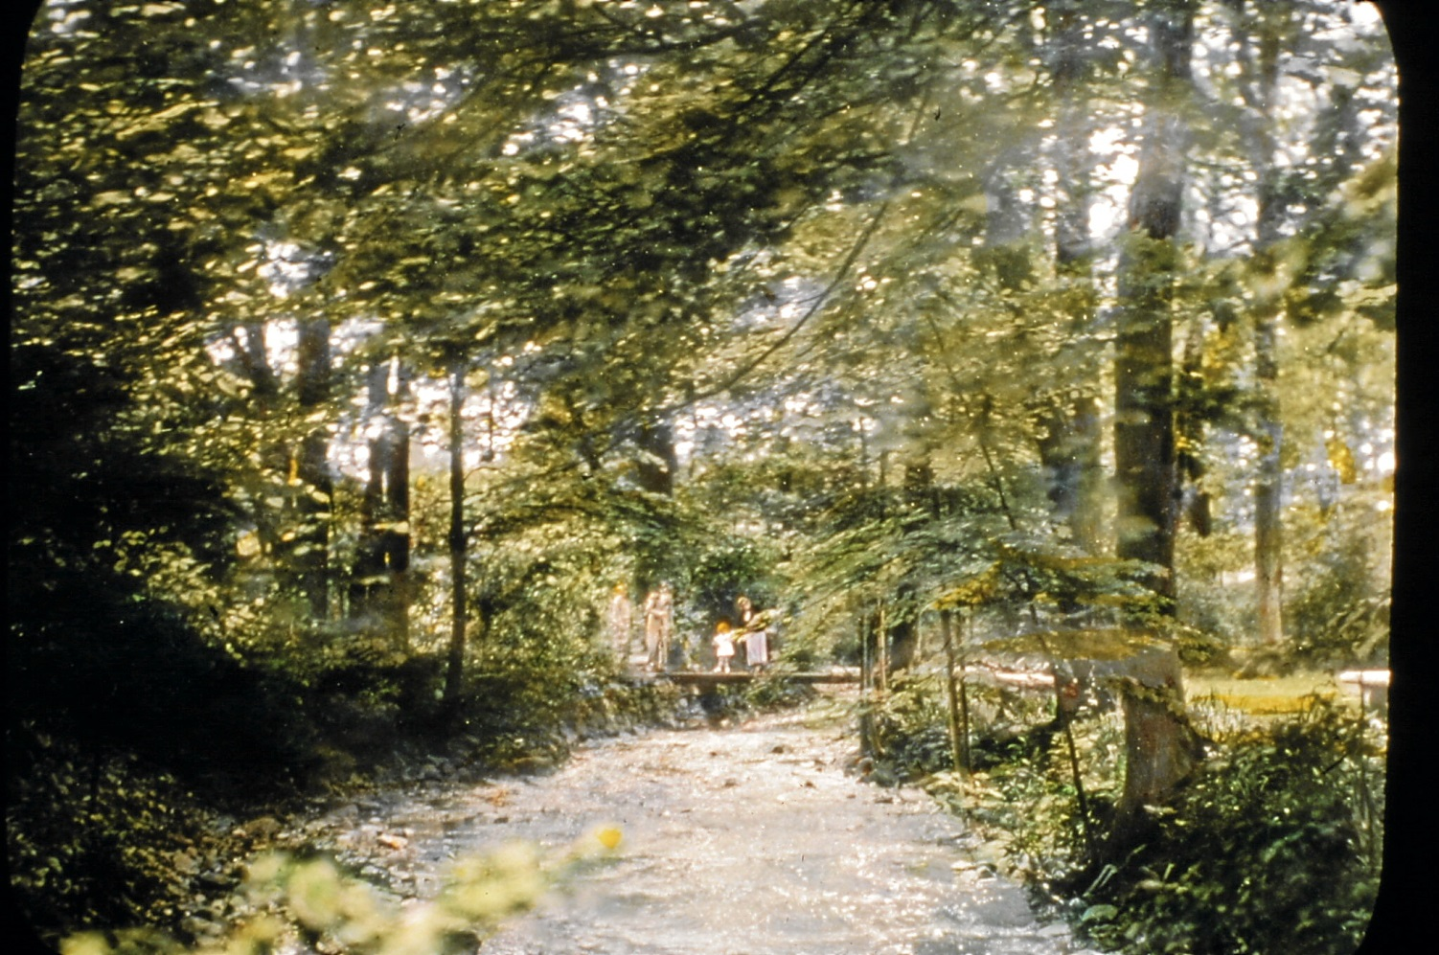
Brook at the Jackson Garden Union College
Referenced in the alma mater song as
“the brook that bounds through Union’s grounds.”
Notes:
Slide 29

Slide 40
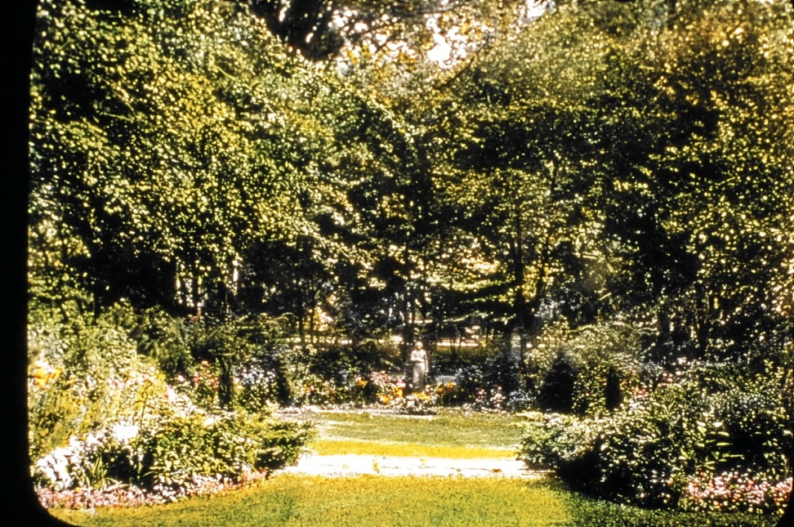
The President’s Garden, Union College
“small but perfect garden” given by Mrs. Walter Baker in 1934 to the President
Statue of George Washington in a toga

Slide 41
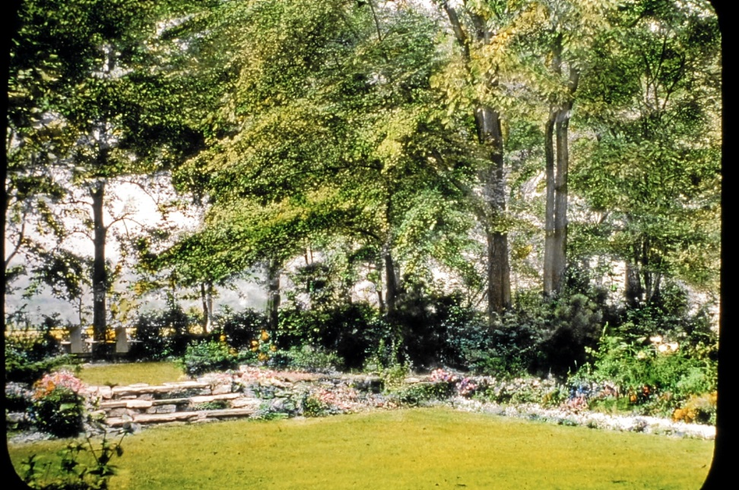
The President’s Garden Union College
Designed on 2 levels with a shady drip pool

Slide 42
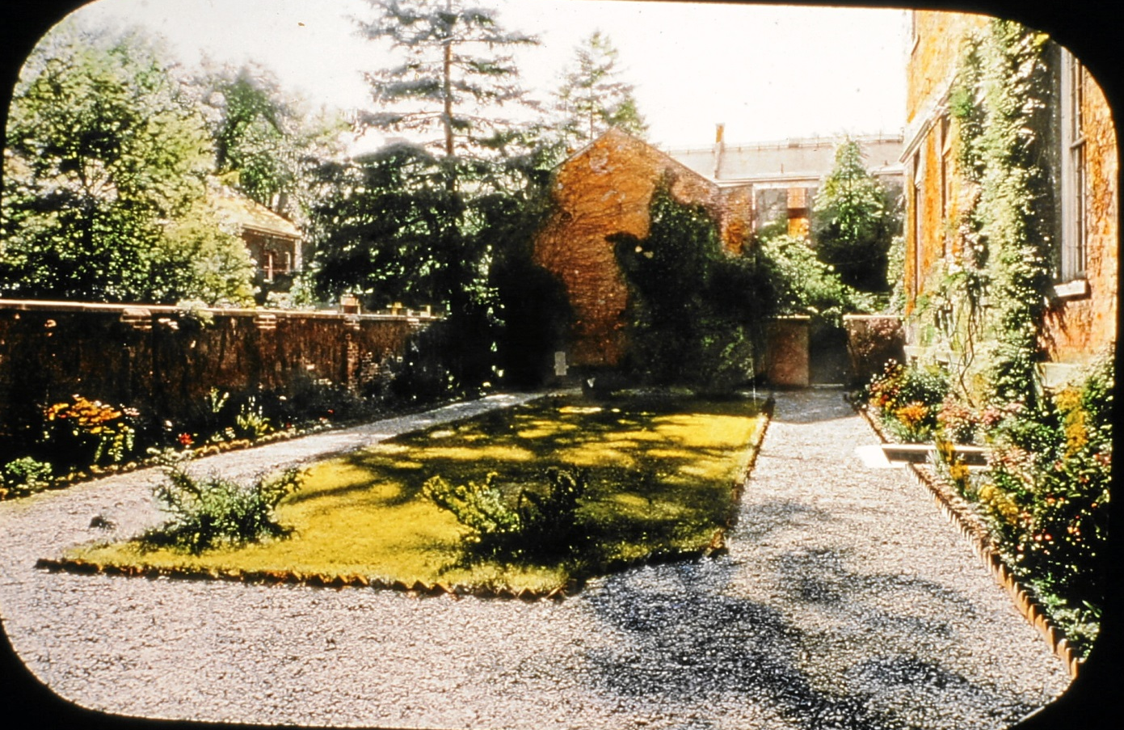
Mrs. Perkins’ Garden 1936 Union College
She wrote in 1906:
“Everything looks lovely in the garden … . My soul revels in the beauty of it all. I am fairly tipsy with joy.”

Slide 43
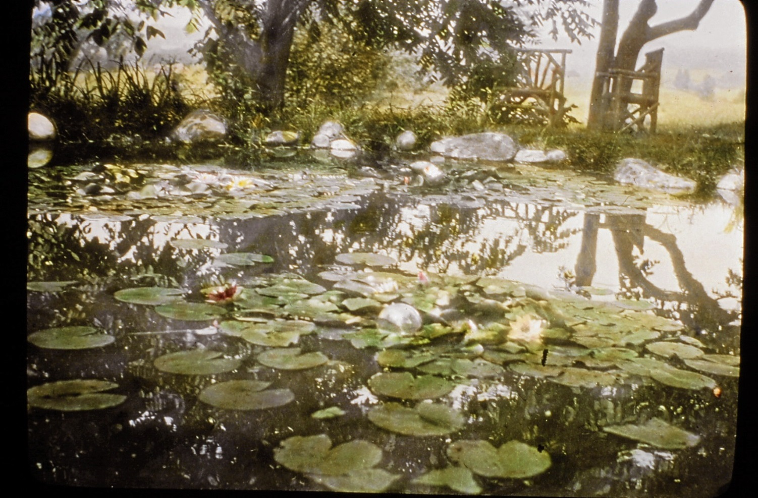
Mrs. Betts’s Garden at Orchard House
Spring Ave, Troy
“Who would not like to have a lily pond such as this one at Orchard House, Mrs. Edgar Betts’s home?”

Slide 44
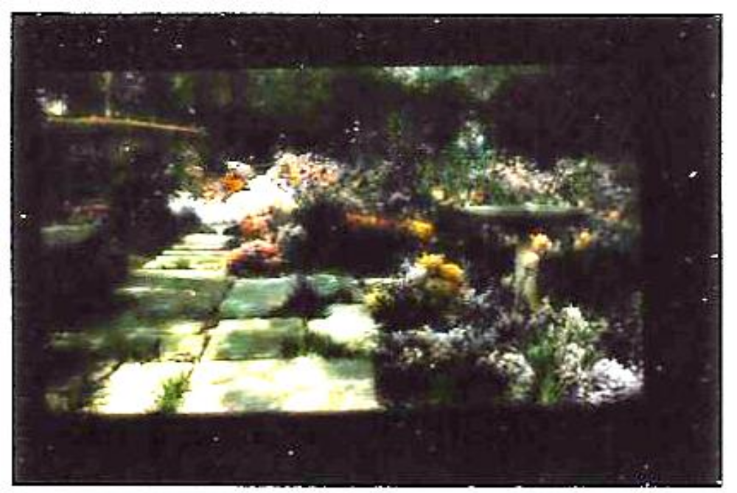
Mrs. William Leland Thompson’s Garden
Red Brick Farm
1936-1937
Thompson Hill Road, East Greenbush

Slide 45
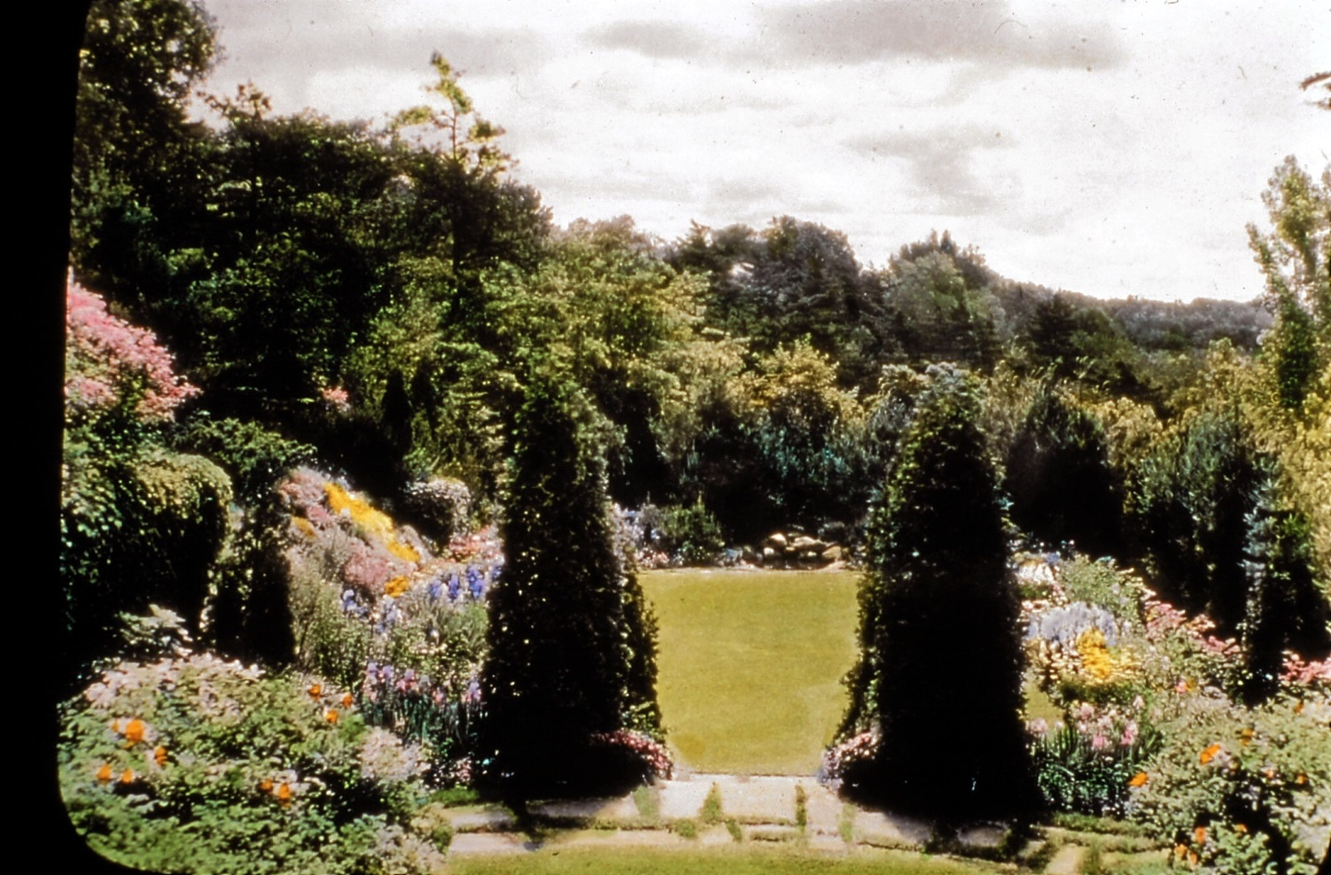
Mrs. Eugene Warren’s Garden
Westover Road, Troy
“Formal garden and native wood have been skillfully blended.”
Notes:
Wife of Judge Warren 10 Westover Road, Troy. House is still there, gardens are gone

Slide 46
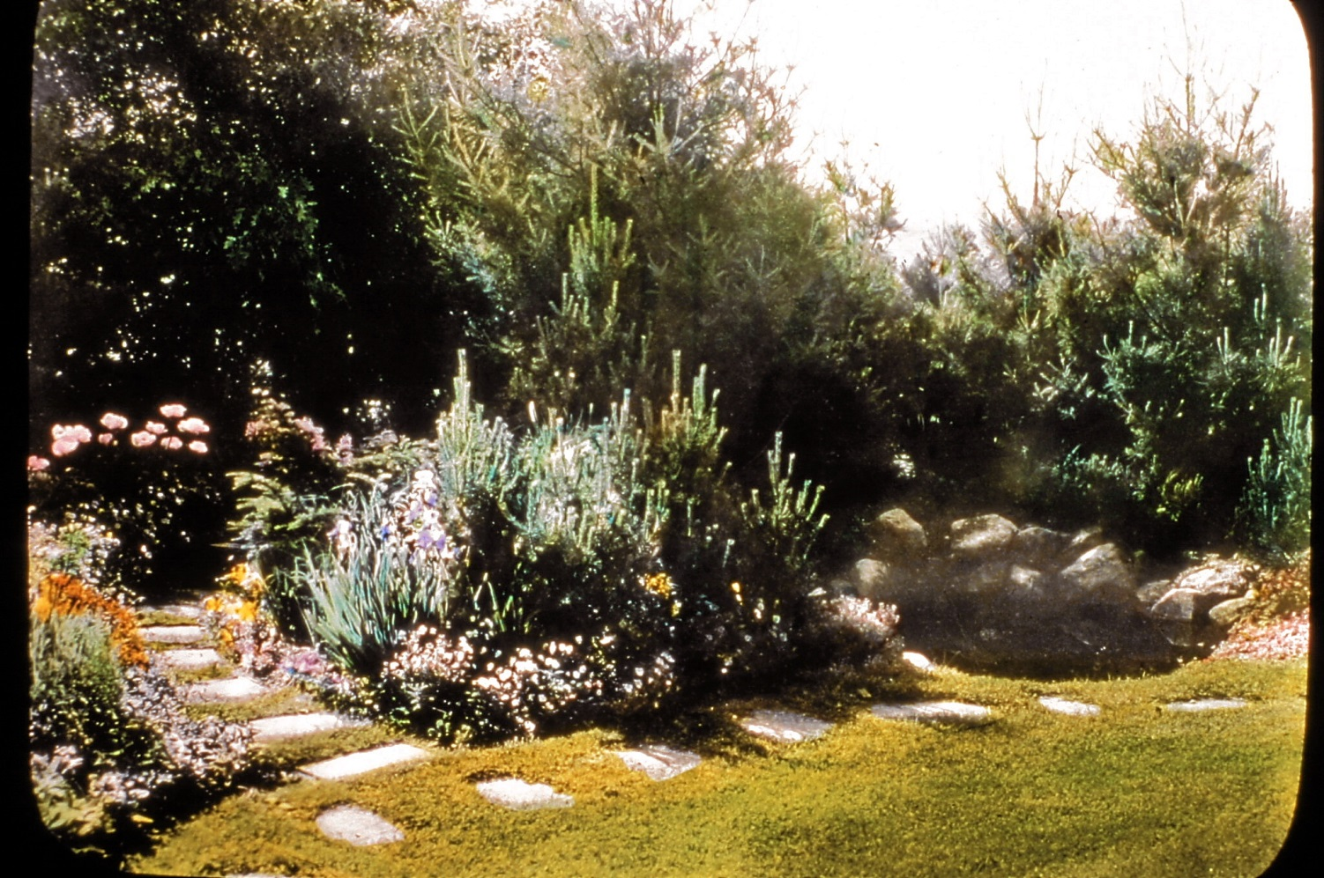
Mrs. Eugene Warren’s Garden
“Mrs. Eugene Warren has a cutting and propagating garden and a beautiful wooded ravine, the path bordered with wildflowers.”

Slide 47
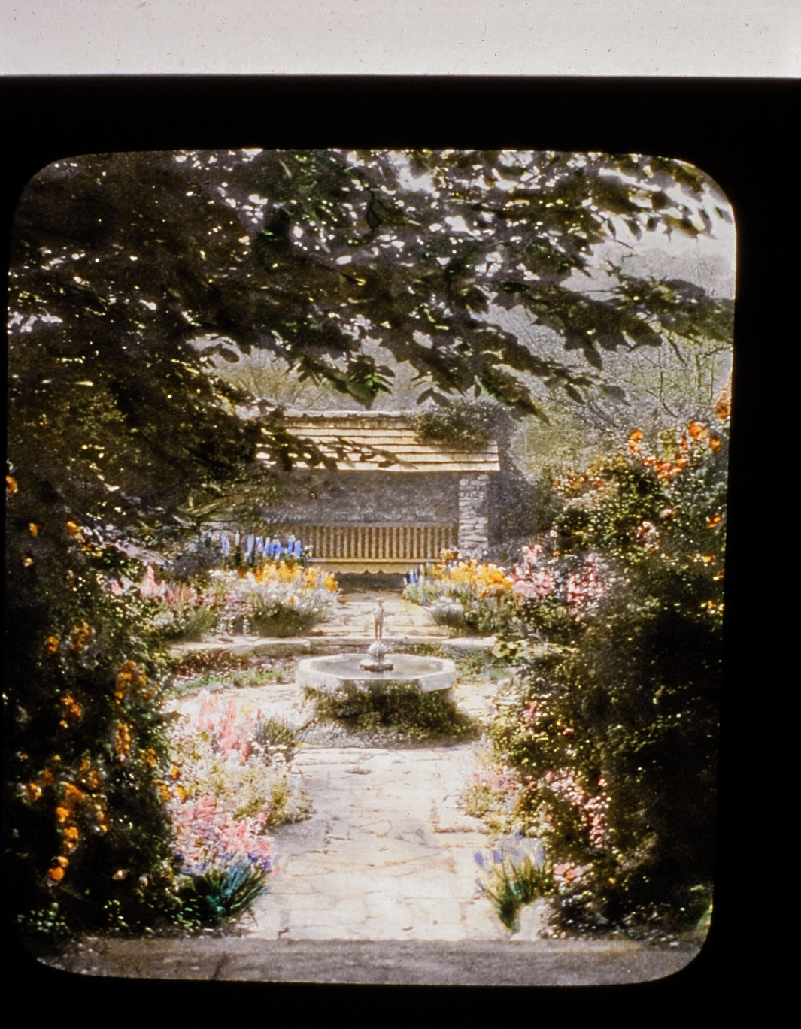
Mr. Ide’s Garden
This small circular garden centered about a fountain is reached by a flight of stone steps leading down through the surrounding wall of shrubbery.
It was designed by Mr. George Ide for his garden at Williamstown

Slide 48
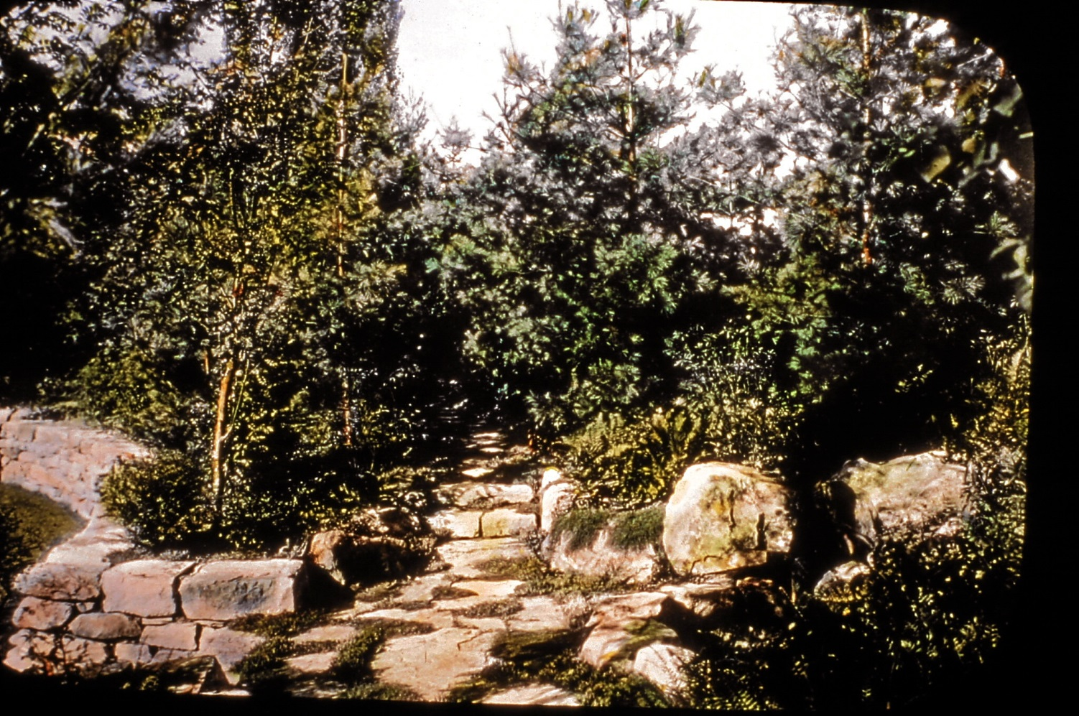
Mrs. S. Alfred Cluett’s Garden
Williamstown
“The paths that lead from one to another of the series of beautiful gardens on this estate form a delightful feature of landscape design.”
“

Slide 49
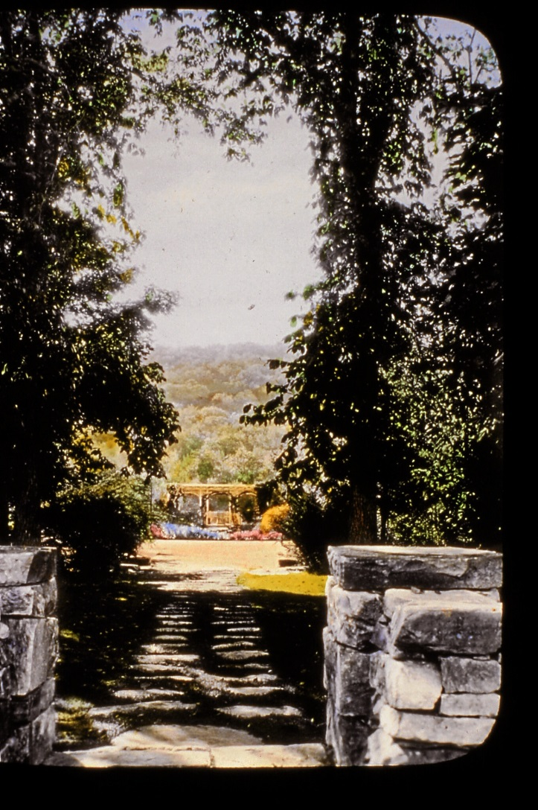
Mrs. S. Alfred Cluett’s Garden
“The vistas of the surrounding hills add beauty to Mrs. Cluett’s garden.”
Estate is now the 20 acre campus of Pine Cobble School.

Slide 50
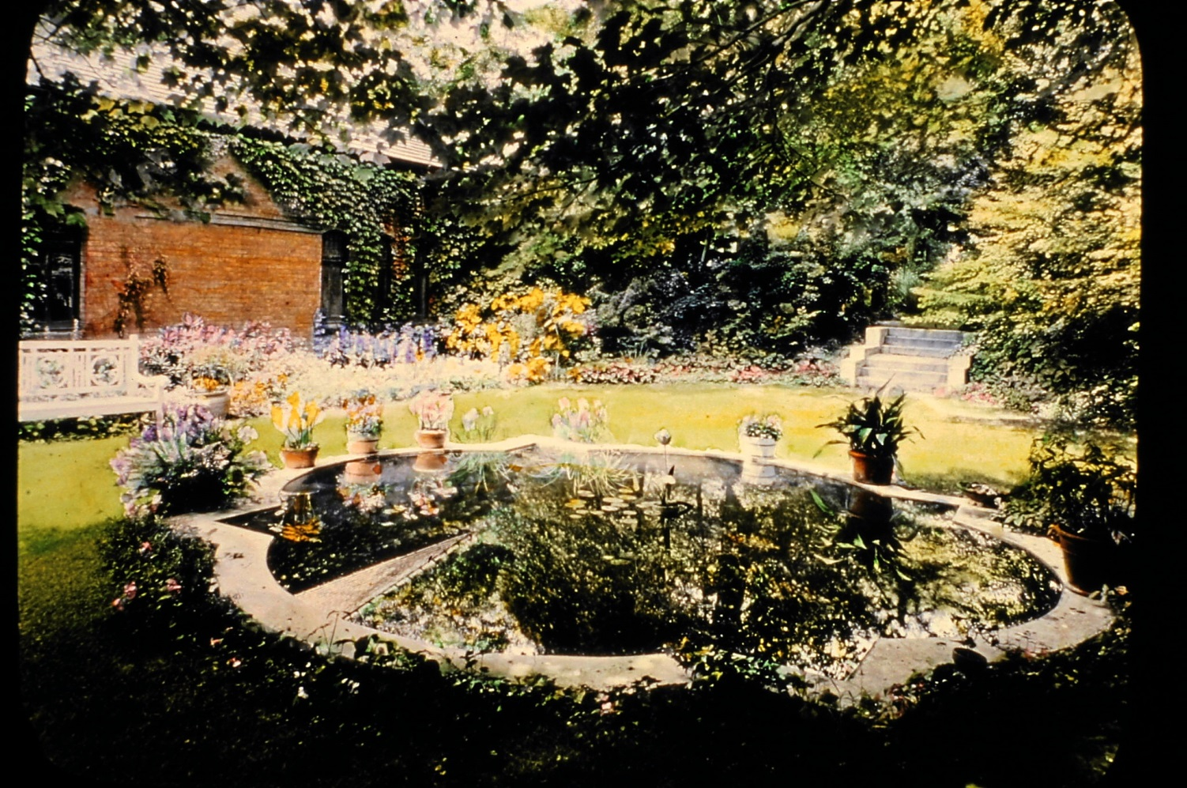
Mrs. Robert Pruyn’s Garden
Englewood Place, Albany

Slide 51
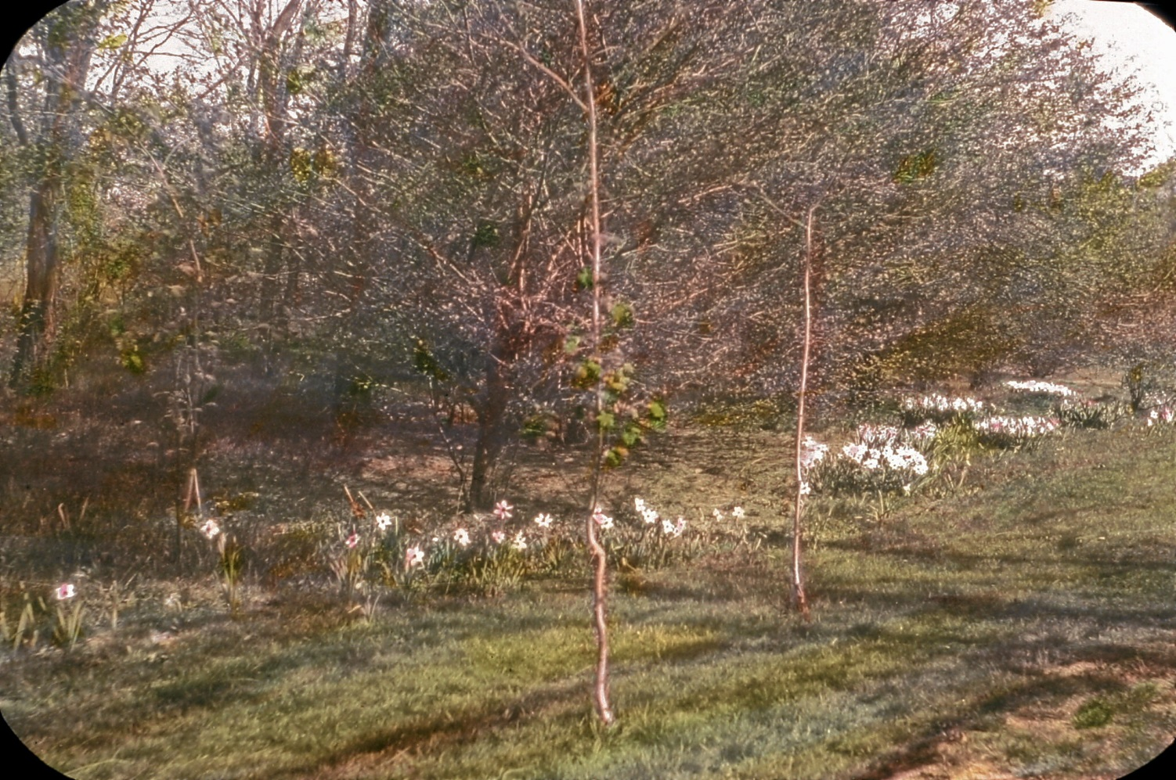
Mrs. Dudley T Humphrey’s Garden
Loudonville Road, Loudonville
“A delicate spring picture made by a border of narcissi along the budding hedge row that shields the garden from the highway.”

Slide 52

Mrs. L. W. Gorham’s House and Garden
This brick house built in 1809 at Vischers Ferry Township of Halfmoon was moved to Loudonville Road
.Ampelopsis (aconiatifolis or pepper vine) canopies the door.

Slide 53

Mrs. Alfred Renshaw’s Garden
Fiddlers Lane, Loudonville

Slide 54

Mrs. Erastus Corning II’s Garden

Slide 55


Slide 56

“We cherish the memory of such old houses or the names of which still bring memories of former days ... .”
Notes:
Edwin Corning # 58

Slide 57

“Yesterday’s gardens are today’s history.
Today’s gardens are tomorrow’s history.”

