Slide 1
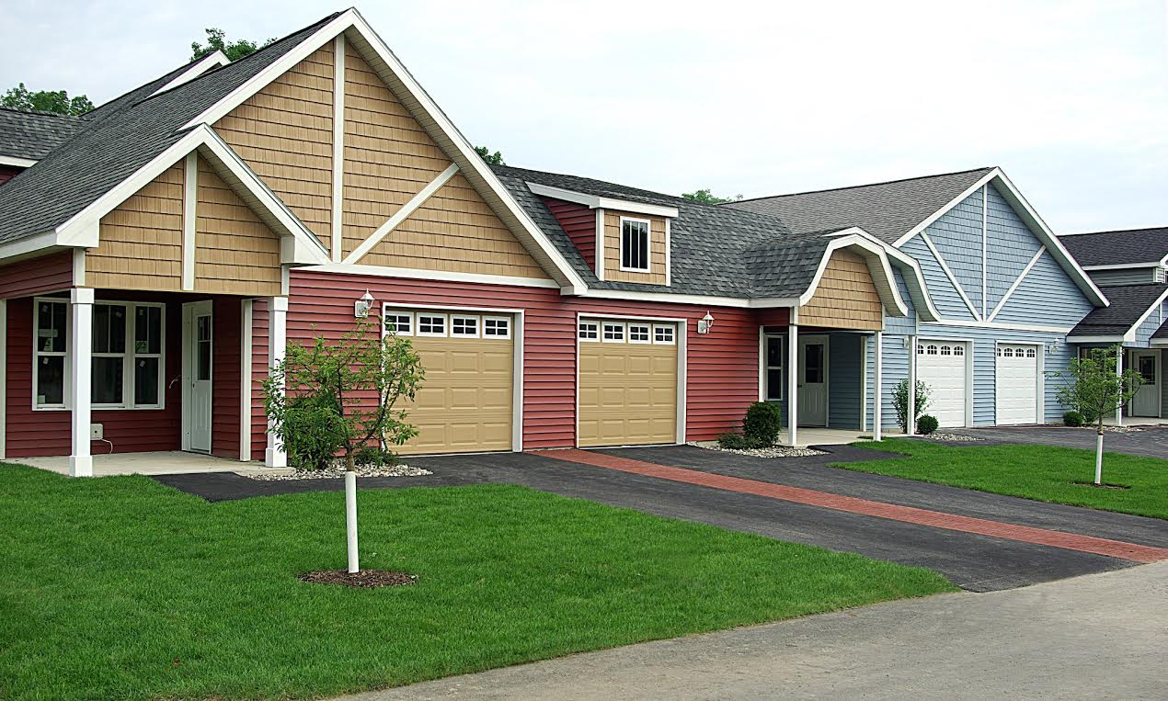

The Spinney Group
Home to a New Generation

Slide 2
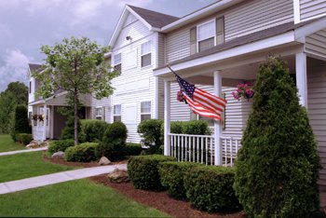
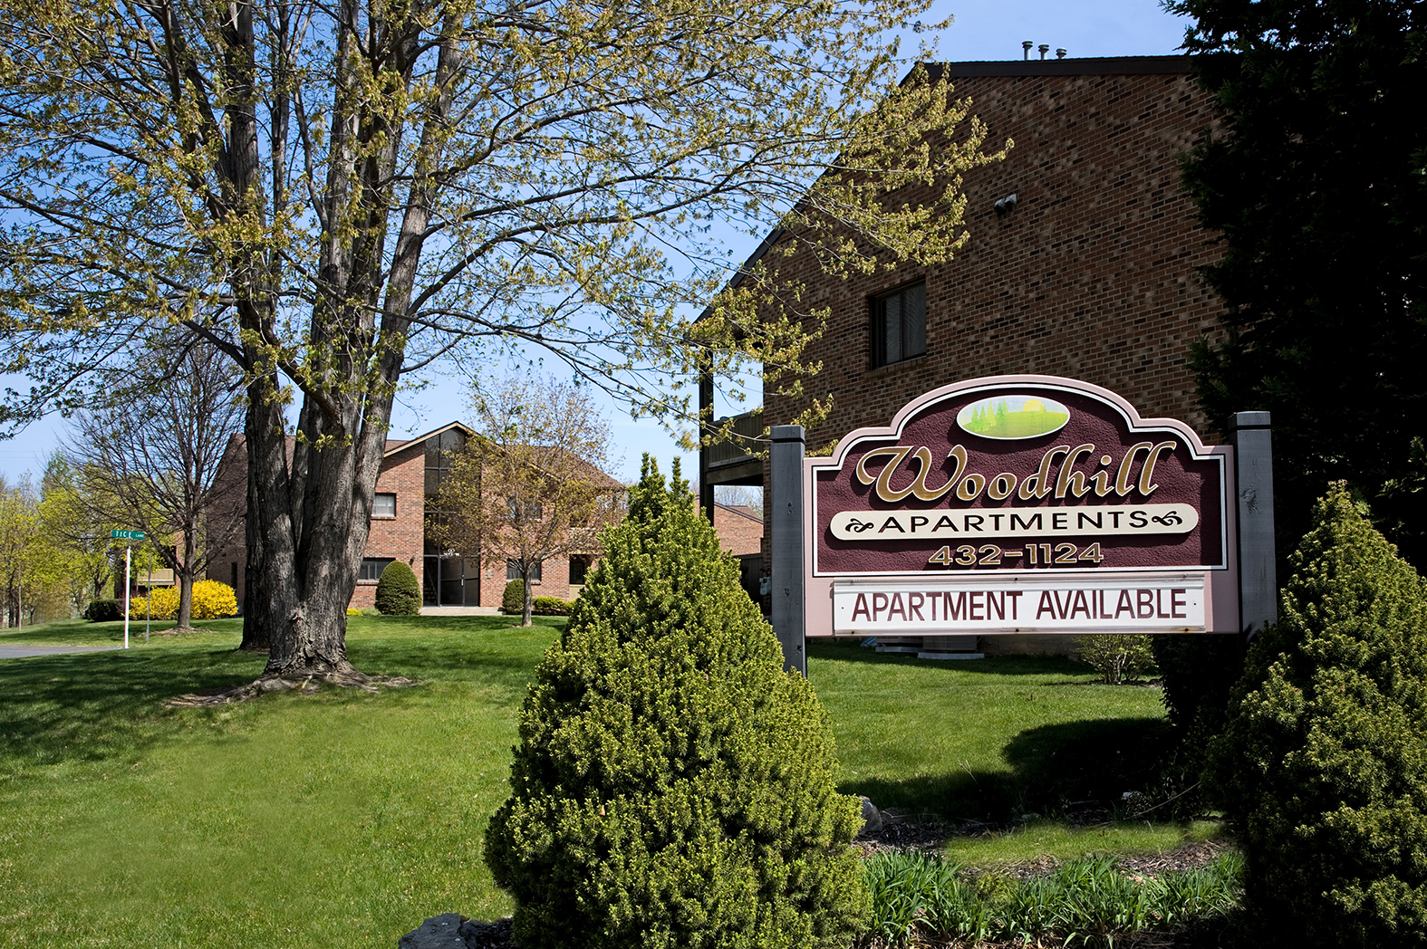
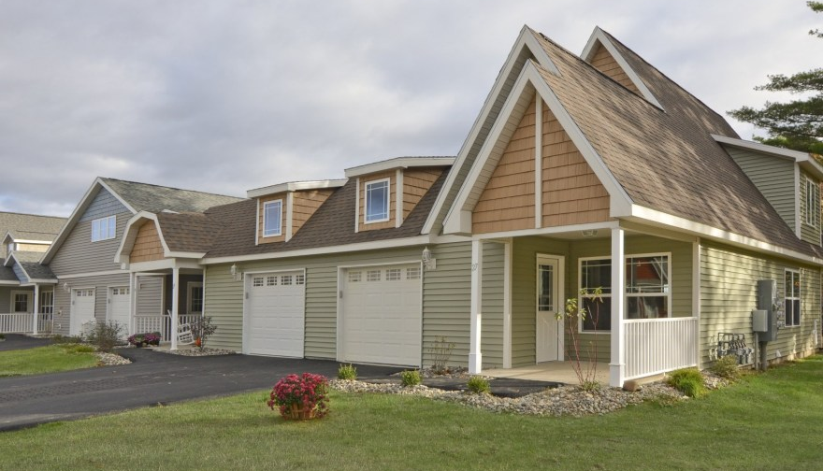
The Spinney Group
Family owned property-management and development company based out of Delmar, NY
Started by Edward Feinberg and Rex Ruthman in the 1980’s
Own and manage
  Residential Properties
    Adams Station Apartments, Delmar, NY
    Woodhill Apartments, Glenmont, NY
    Delmar Place Apartments, Delmar, NY
    The Spinney at Pond View, Castleton, NY
    The Spinney at Van Dyke, Delmar, NY
  Commercial Properties
    Professional Arts Building, 2500 Pond View, Castleton, NY
    Brandon Place, 401 New Karner Road, Albany, NY

Slide 3
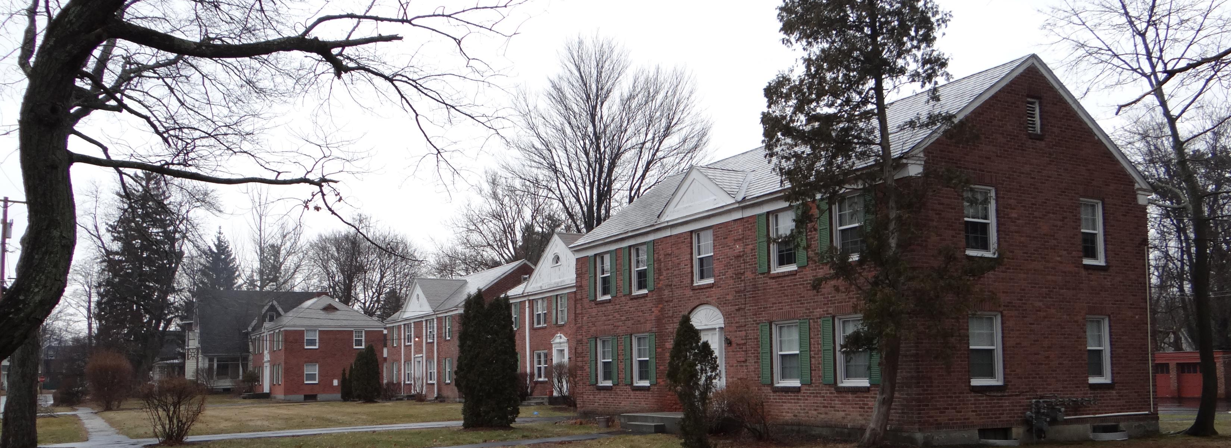
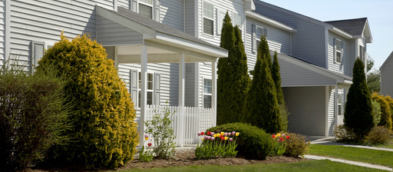
Current Multi-Family Projects
Delmar Place Apartments – 20 units
Adams Station Apartments – 282 units
Woodhill Apartments – 60 units

Slide 4
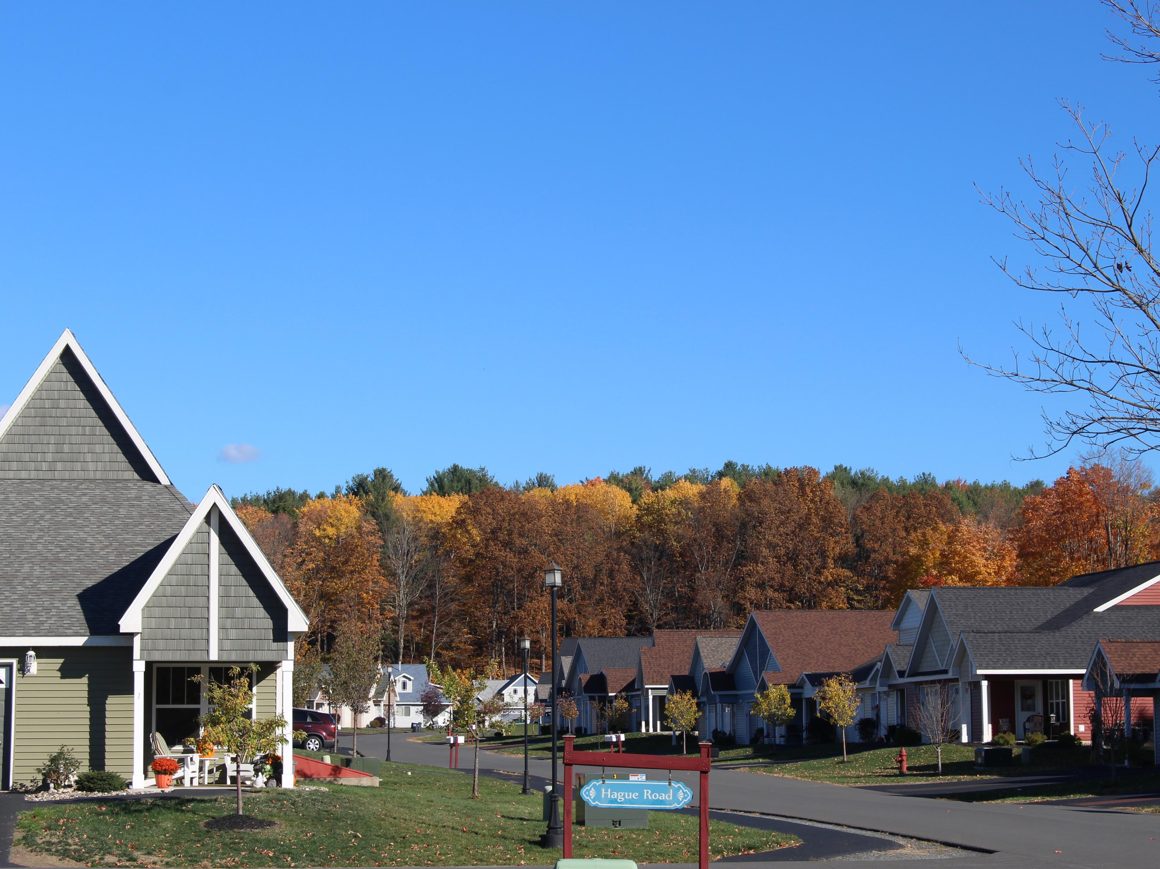
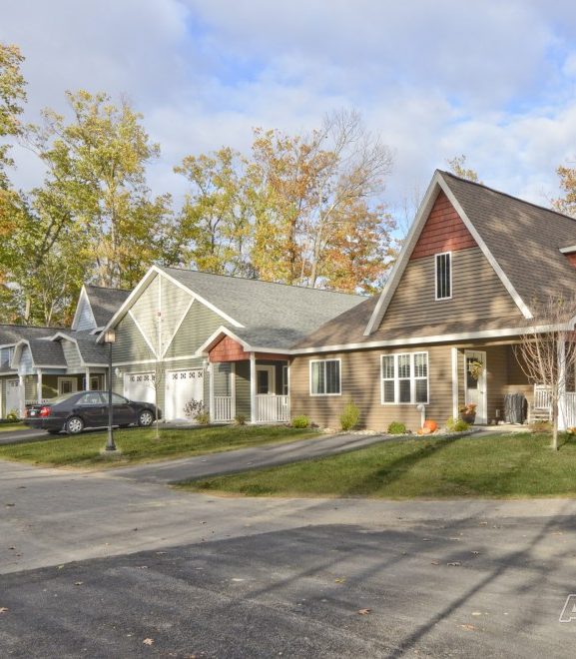
Current Age-Qualified Projects
The Spinney at Pond View – 186 units
The Spinney at Van Dyke – 102 units

Slide 5
New Construction Focus on Age Qualified Communities
3rd & 4th phase of The Spinney at Van Dyke
The Spinney at Ballston Lake Proposal

Slide 6
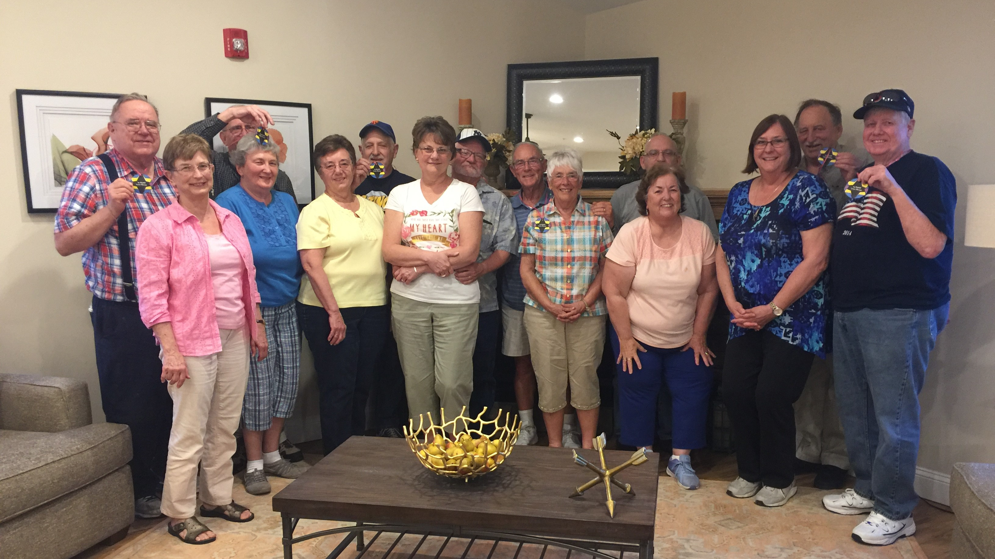
Benefits of A Spinney Lifestyle
Amenities mirroring single family home
  Privacy
    Private front porch
    Private rear patio
    Attached direct-access garage
  Unique touches
    Open layout
    Window seats
    Ample storage
    Fixtures to allow one to age in place
Without the burdens of home ownership
  24 hour emergency maintenance
  Landscaping and snow removal included
  No more property taxes, home insurance, stairs
Community
  Monthly activities
  Clubhouse space
  Neighbors turning into friends

Slide 7
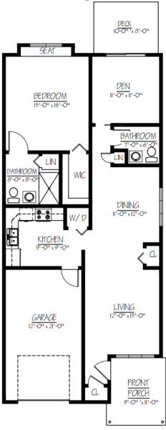
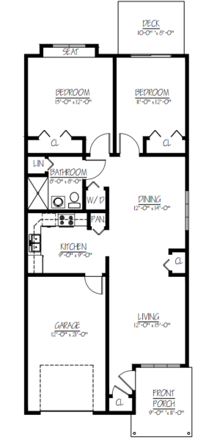
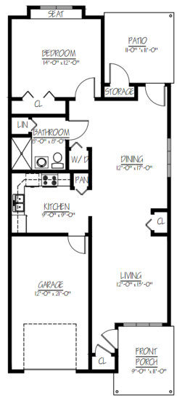
Cottage Layout Examples

Slide 8
Questions?

