Slide 1
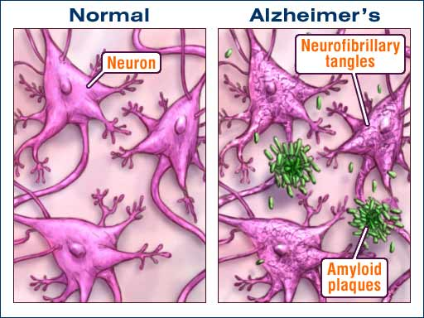
Is the Pharmaceutical Industry Ignoring Alzheimer’s Disease?

Slide 2

A Sign of the Times
“Pfizer Ends Funding For Alzheimer's, Parkinson's Research” – Newsweek 2018
Ending all “neuroscience discovery and early development efforts.”
The Pfizer neuroscience group had nine drugs in clinical development,
and four of them are focused on Alzheimer’s.

Slide 3

Theories
Two of the main characteristics of the disease, tangles and plaques, can be explained however; which takes precedence in the disease pathology is unknown.
Tau hypothesis targets tangles.
Amyloid hypothesis targets plaques.

Slide 4
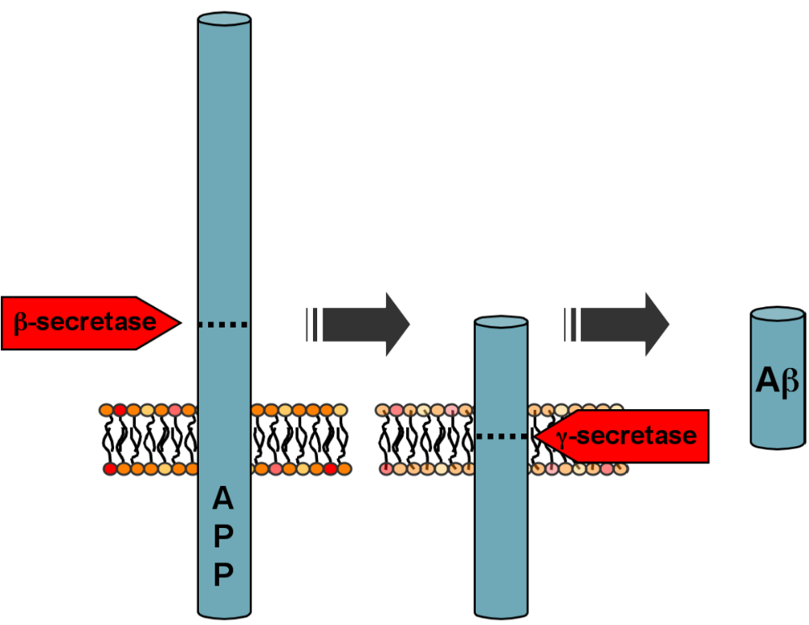
Amyloid Plaques Explained
AB forms aggregates that lead to formation of plaques

Slide 5

Past Lessons
of Failure
Early 2000’s Pfizer and Eli Lily each had antibody drugs that cleared Aβ and showed potential removing plaques.
Both were progressed to phase III trials with an overall sense of optimism.
Both drugs failed to show cognitive or functional improvement
vs. placebo

Slide 6


Fallout
“Critics” (aka investors) were crying that the amyloid plaque theory was dead.
From 2002-2012, 244 compounds entered clinical trials and only 1 received FDA approval.

Slide 7
Further Studies
In 2012 Merck quietly began Phase I studies on a small molecule β-secretase (Verubecestat).
In 2016 Merck reported that it reduced amyloid in humans who took the drug for 1-2 weeks.
Results helped propel full blown trials in patients with mild to moderate Alzheimer’s and separately with patients with early signs.
Feb. 2017 – pulled plug on trial with mild to moderate patients.
Feb. 2018 - pulled plug on trial with early signs.

Slide 8
Further Studies
Some consider the Merck failure the final nail in the coffin for the amyloid theory. However, other companies continue to push on.
Lilly/Astrazeneca and Biogen/Esai each have their own β-secretase inhibitors in phase 3 trials.
Amgen/Novartis have an ongoing trial with individuals who are healthy but at risk of Alzheimer’s based on their age, genotype and amyloid levels.

Slide 9

A New Hope
Feb. 2018 - Researchers at the Cleveland Clinic have reversed the development of
amyloid plaque in mice with Alzheimer’s disease by gradually depleting their
levels of BACE1.
The BACE1 depletion also boosted their learning and memory, as
measured in a contextual fear conditioning test.

Slide 10
Amyloid Plaques Explained
This may only be a snapshot of a larger process at work.

Slide 11
An Eye Toward the Future
“Denali Therapuetics pulled off 2017’s biggest biotech IPO, pocketing $250 M for Parkinson’s and Alzheimer’s trials.” – Fiercebiotech.
A number of universities and research institutes are uncovering potential pathways and targets.
Efforts are underway to uncover the upstream force that leads to tangles and plaques.

