Slide 1

Interact Club Cosenza

Slide 2
Rotarian Year 2015/2016
President: Matilde Piluso
Vice-President: Ludovica De Rose
Secretary: Alessandra Barbarossa
Treasurer: Ludovica Fava
Prefect: Elisabetta Verre

Slide 3
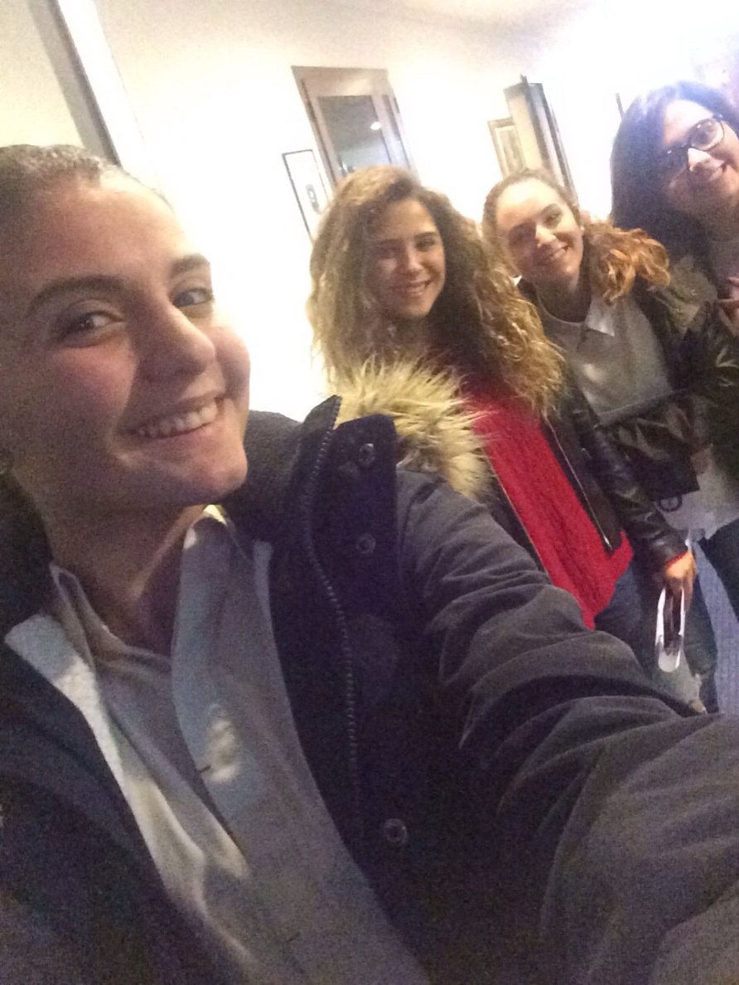
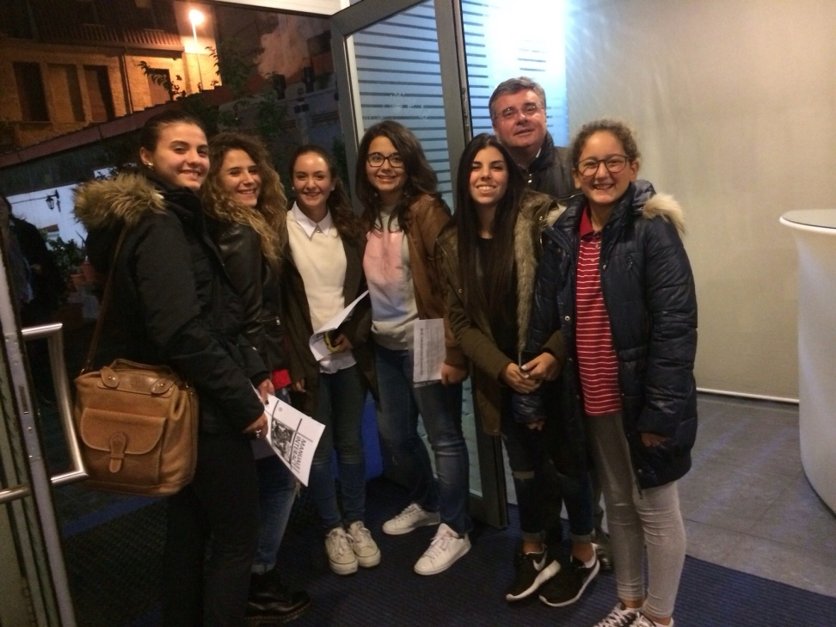
October 2015: first Interact reunion

Slide 4
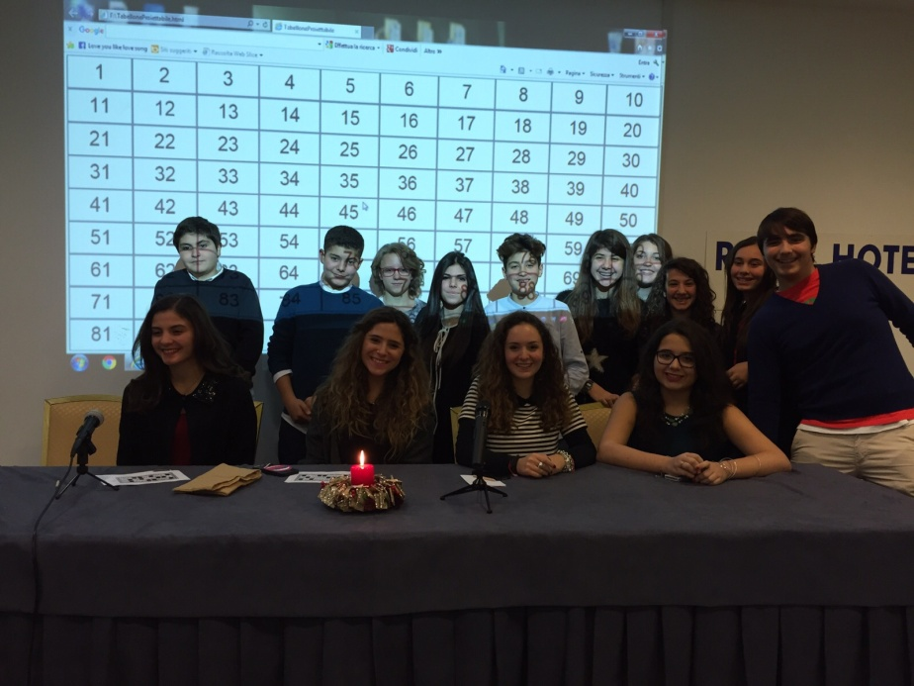
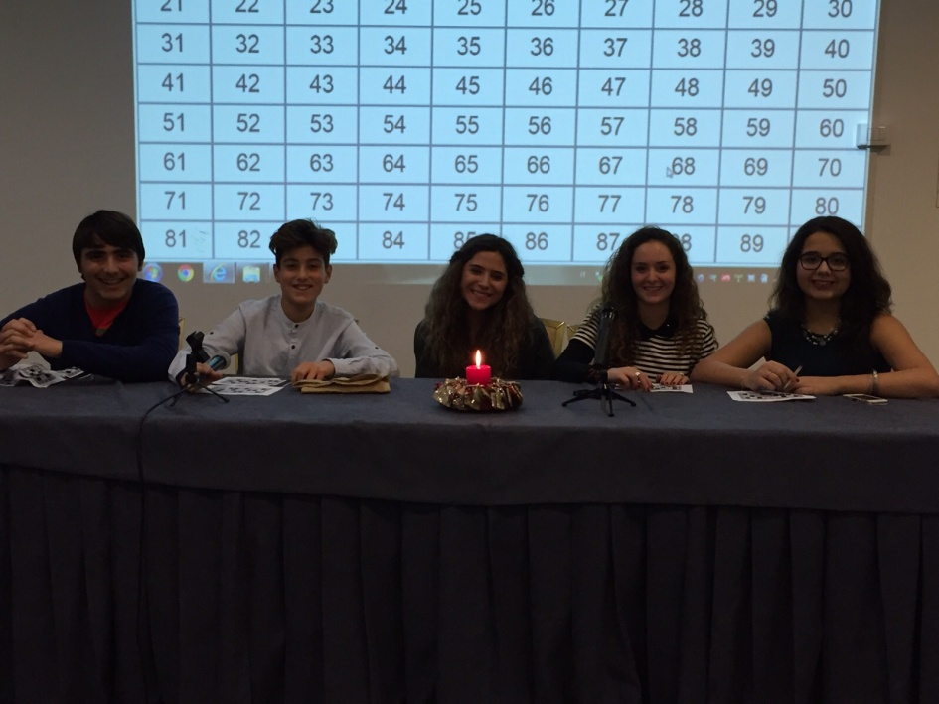
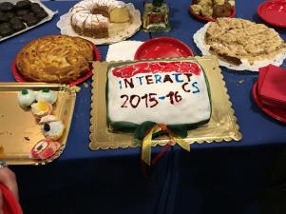
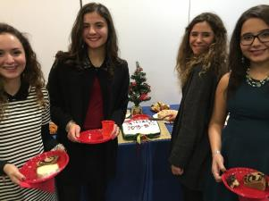
20th december 2015: tombola between friends and best wishes for Christmas

Slide 5
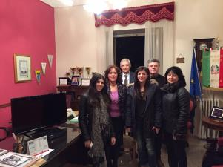
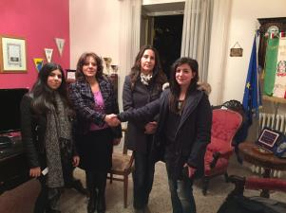
17th february 2016: delivery of multimedial and educational objects to «Convitto Nazionale del Liceo Classico B.Telesio»

Slide 6
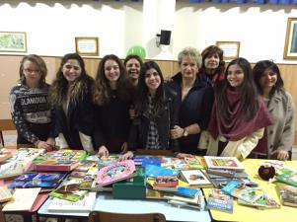
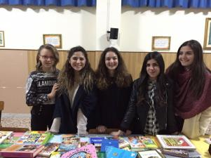
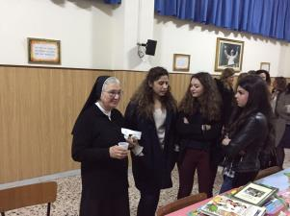
21st march 2016: delivery of 150 books to a local «house-family» for the contest “a book is always a good idea” in collaboration with the Inner Wheel Club of Cosenza

Slide 7
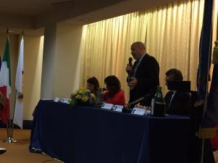
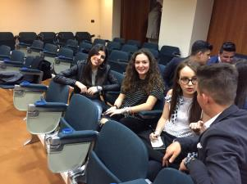
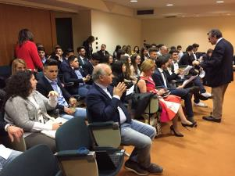
23rd april 2016: participation to the District Assembly in Lamezia Terme

Slide 8
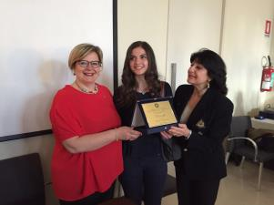
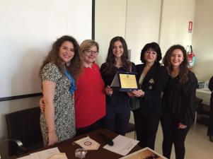
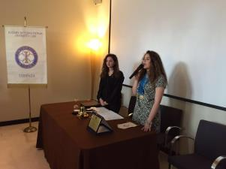
14th May 2016: photography exhibition as the end of the photography contest in honor of a great Rotarian friend “Fausto Carnovale” on the theme of diversity

Slide 9
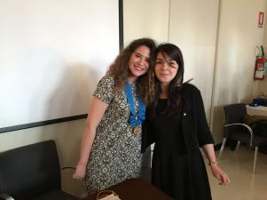
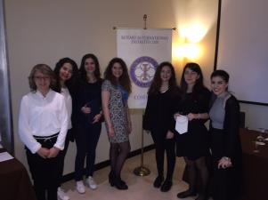
…and entrance of a new member

Slide 10
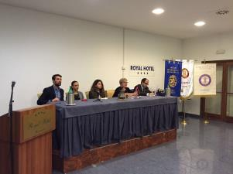
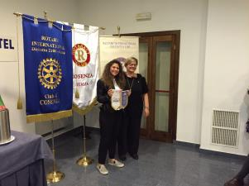
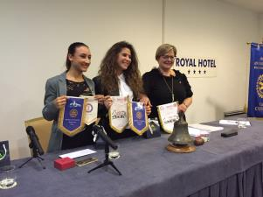
17th may 2016: reunion of the Rotarian family (Rotary, Rotaract and Interact)

Slide 11
Rotarian Year 2016/2017
President: Ludovica De Rose
Vice-President: Alessandra Barbarossa
Secretary: Elisabetta Verre
Treasurer: Ludovica Fava
Prefect: Giulia Dodaro

Slide 12
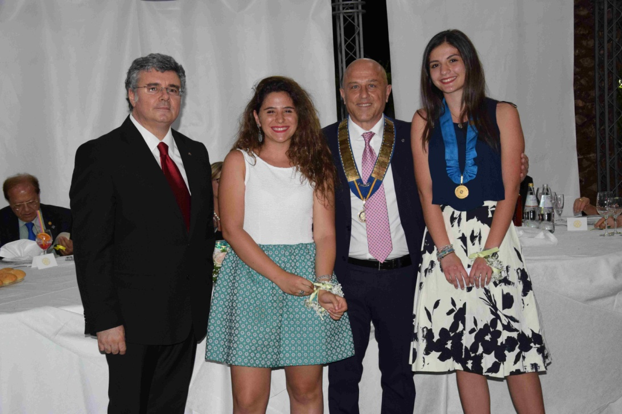
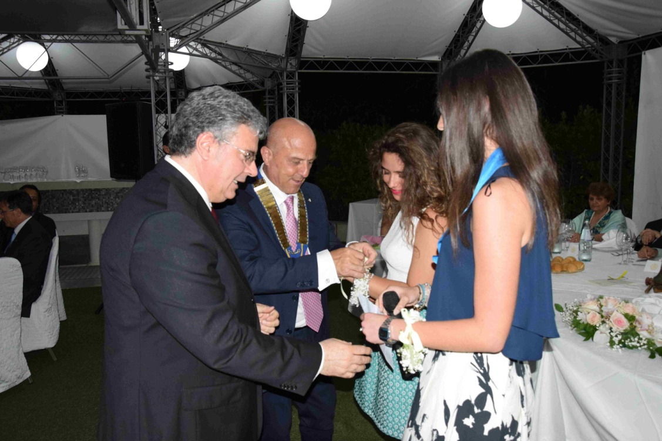
5th July 2016: exchange of the roles

Slide 13
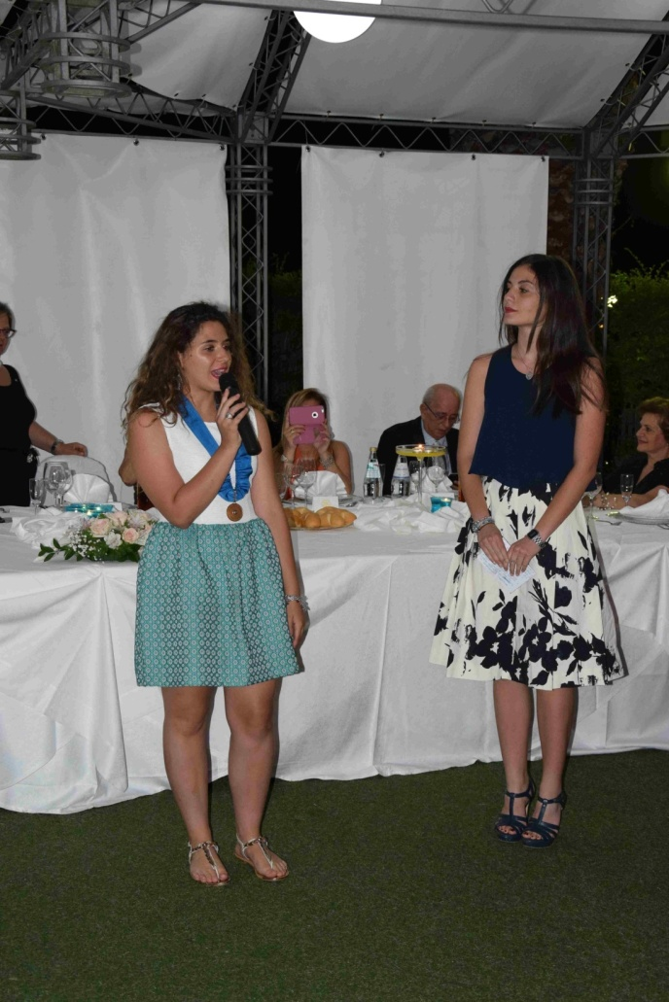
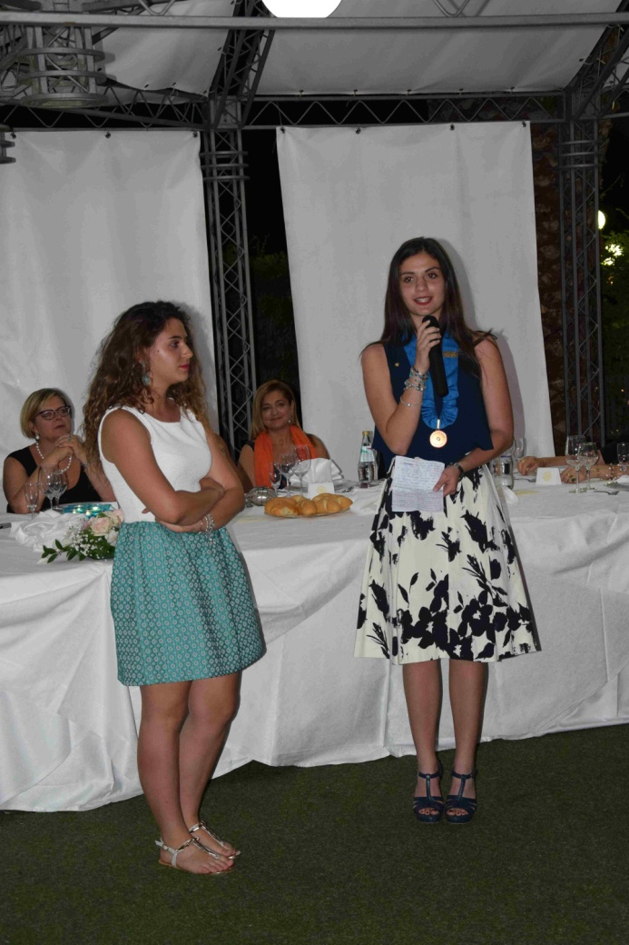
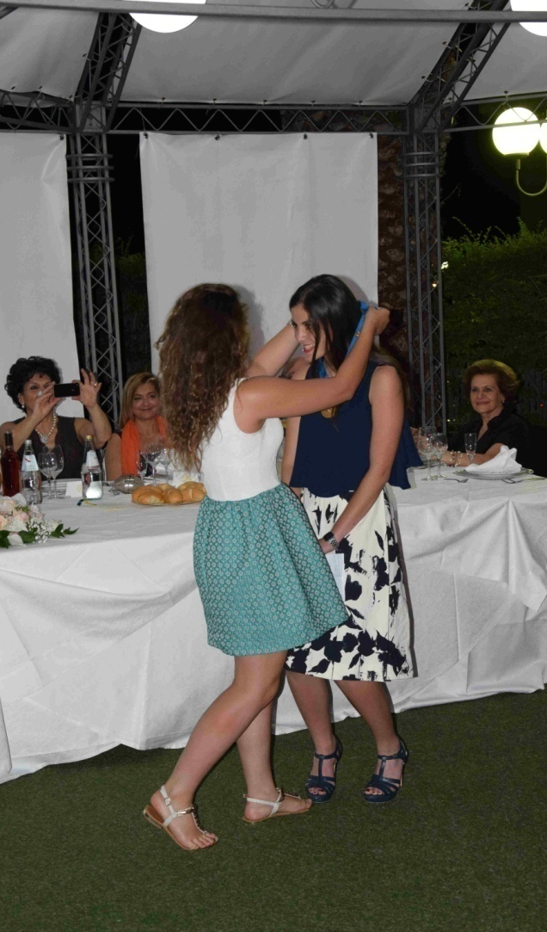

Slide 14
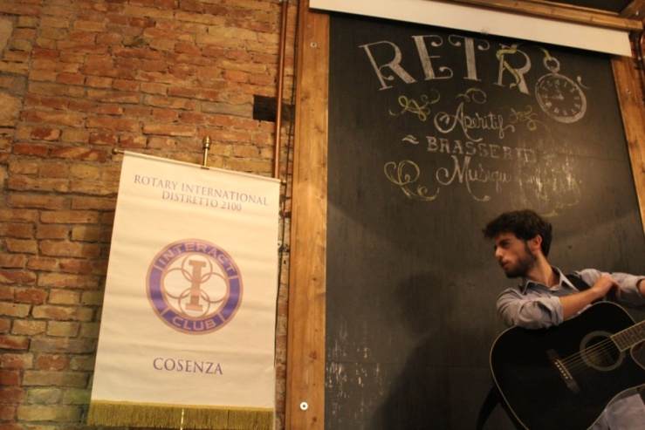
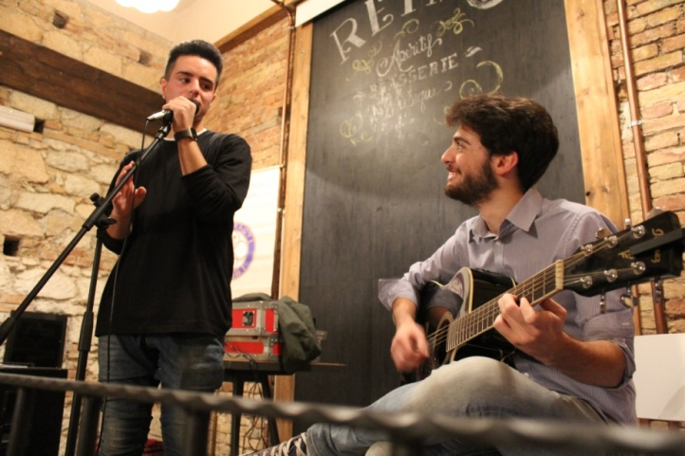
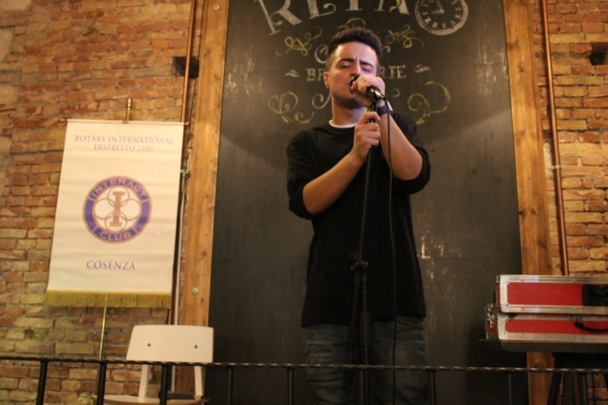
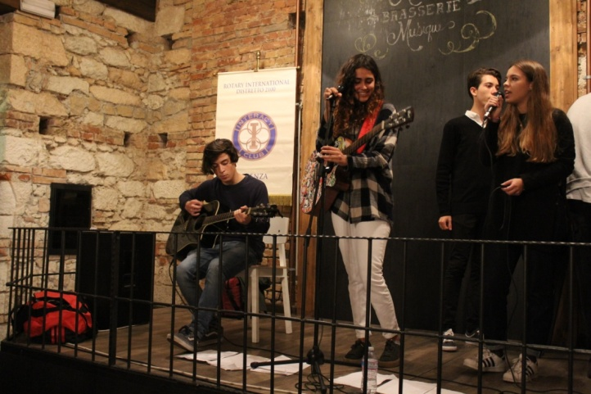
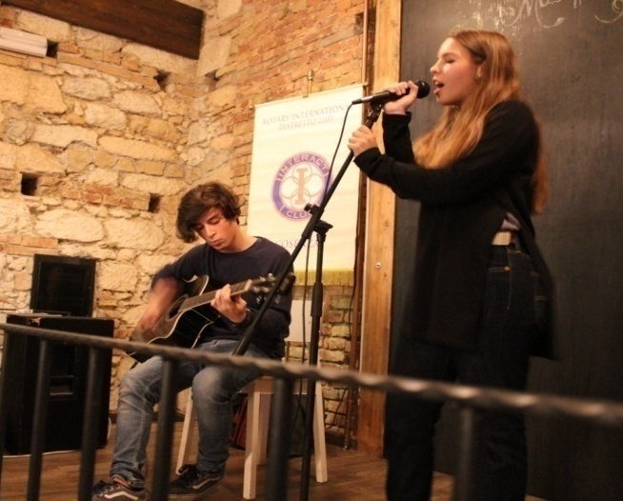
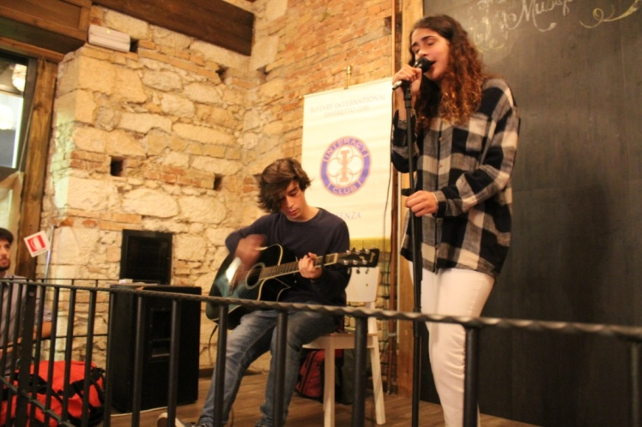
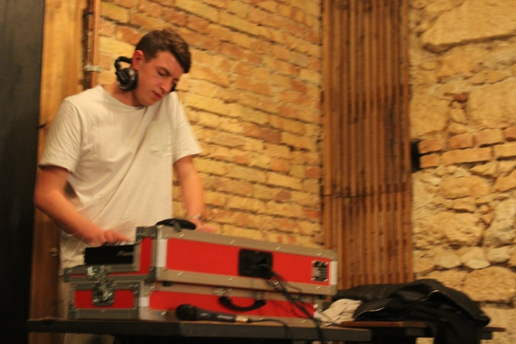
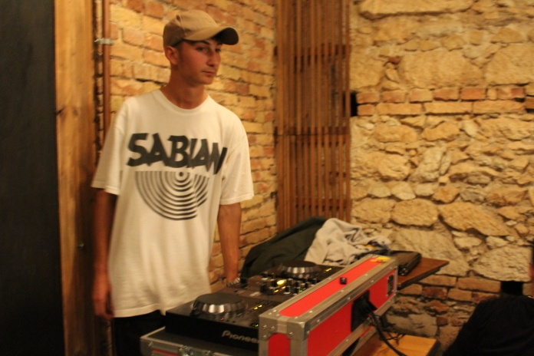
23rd october 2016: solidarity and musical evening for a strong and terrible earthquake in the Centre of Italy

Slide 15
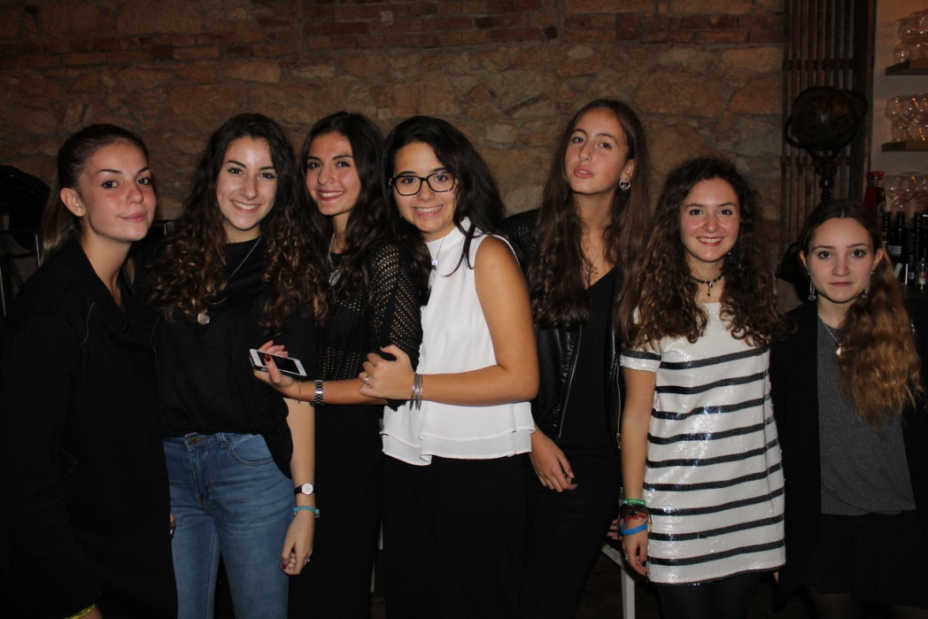
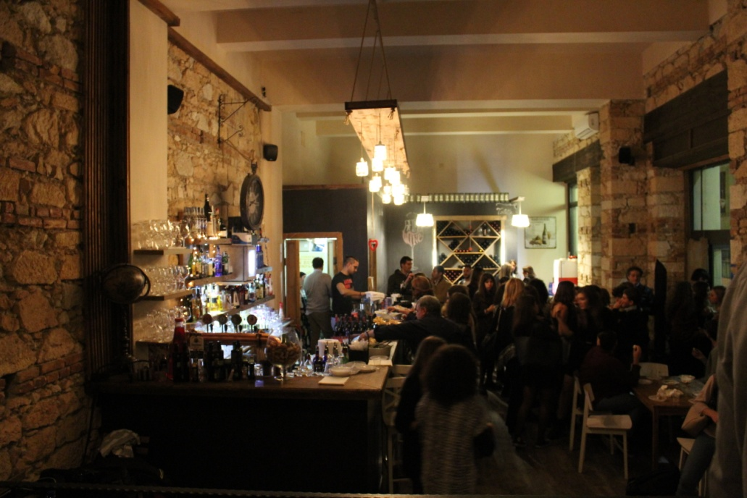
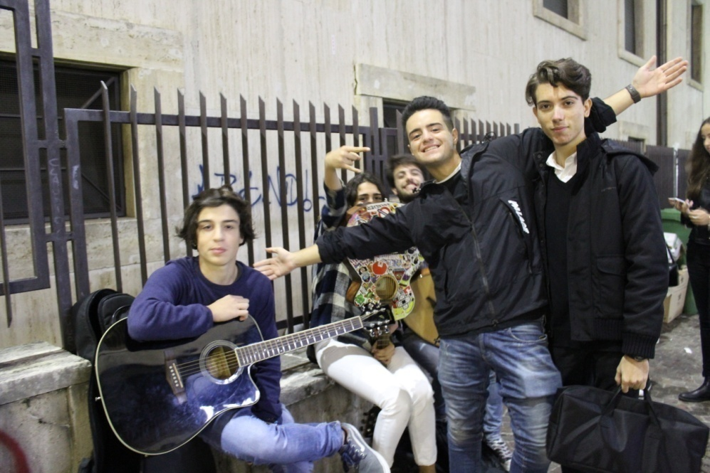
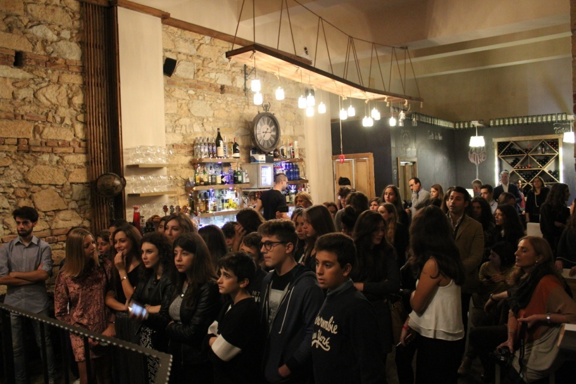

Slide 16
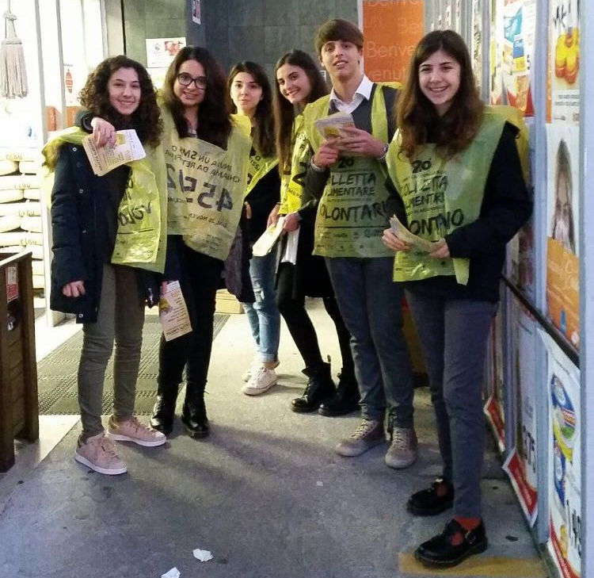
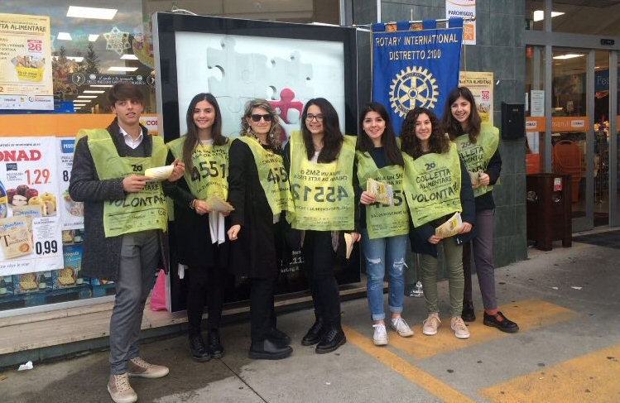
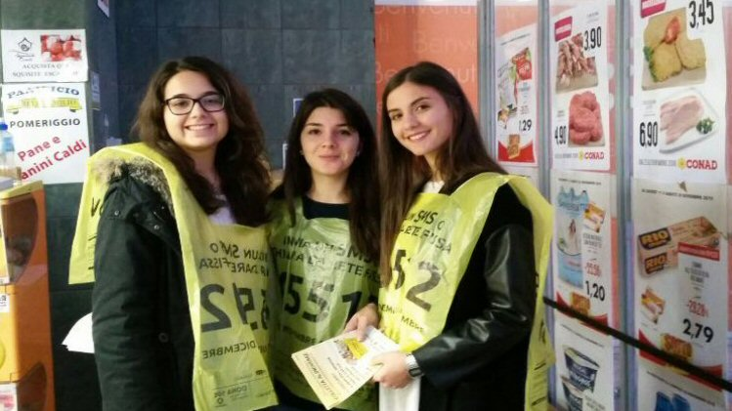
26th november 2016: participation to «Banco Alimentare», collection of food for people in need

Slide 17
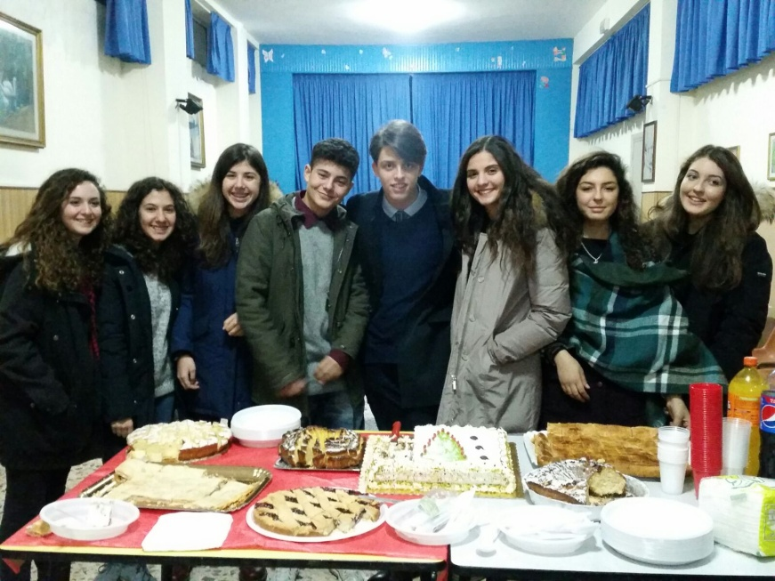
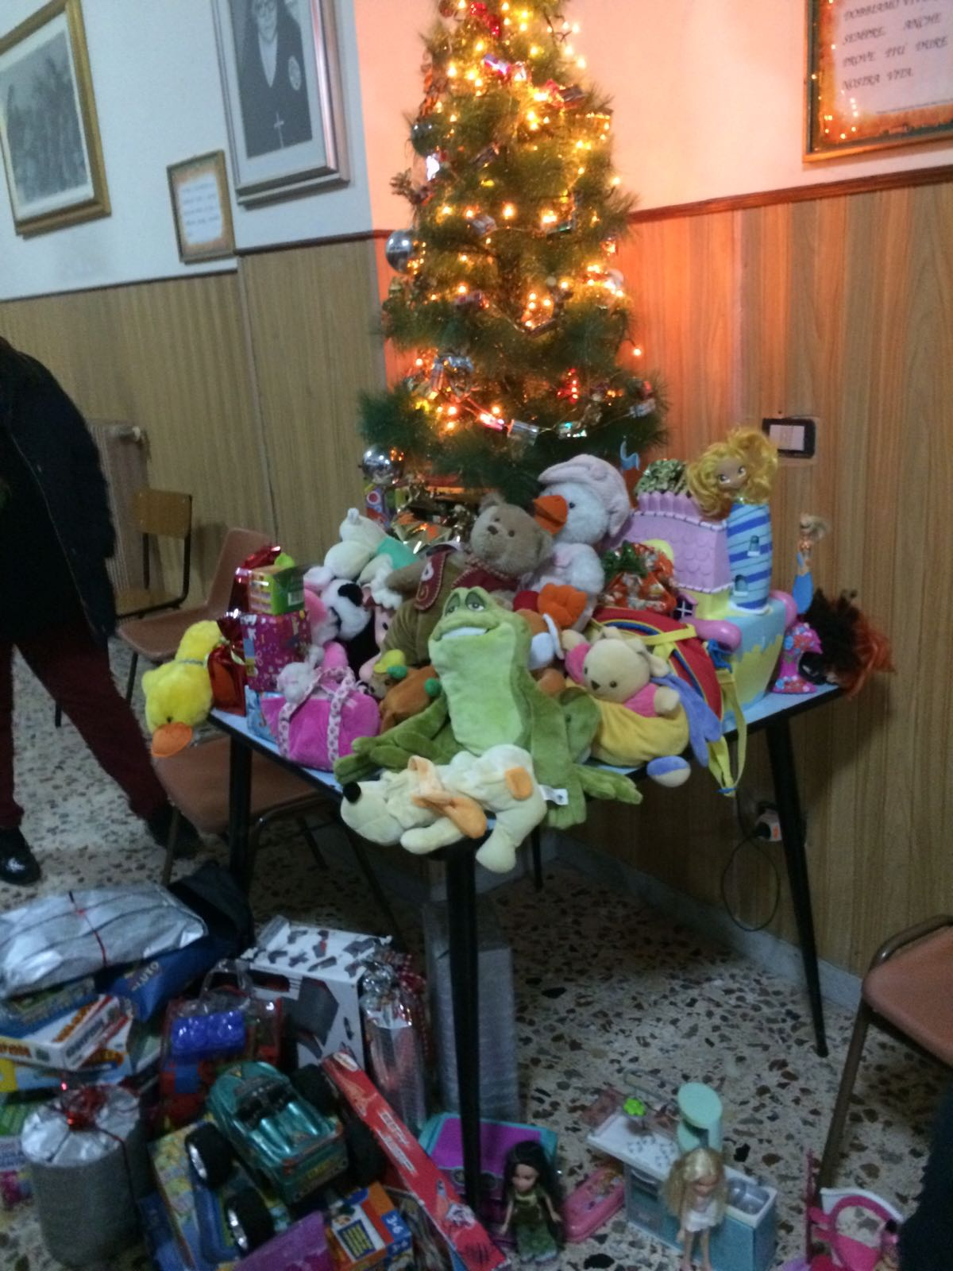
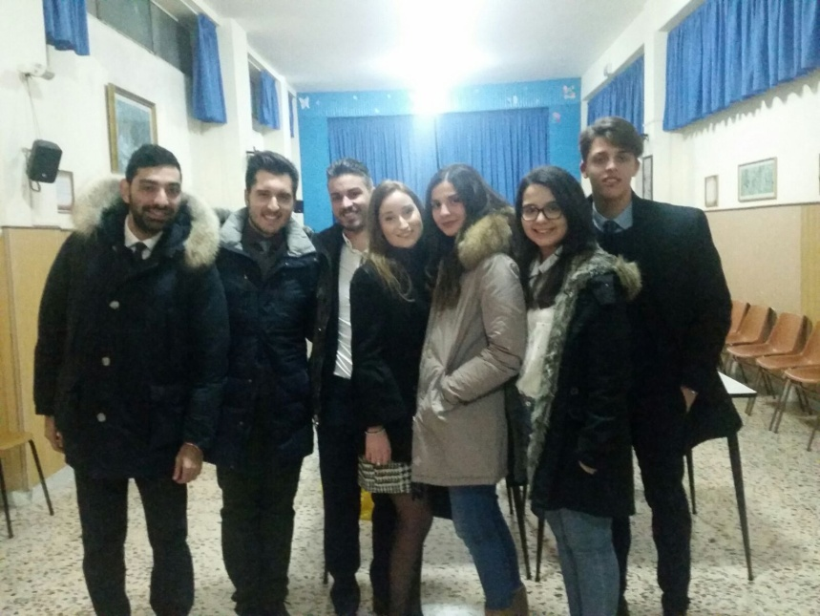
14th december 2016: donation of toys to the local House Family of the city, in collaboration with the Rotaract Club and the Inner Wheel of Cosenza

Slide 18
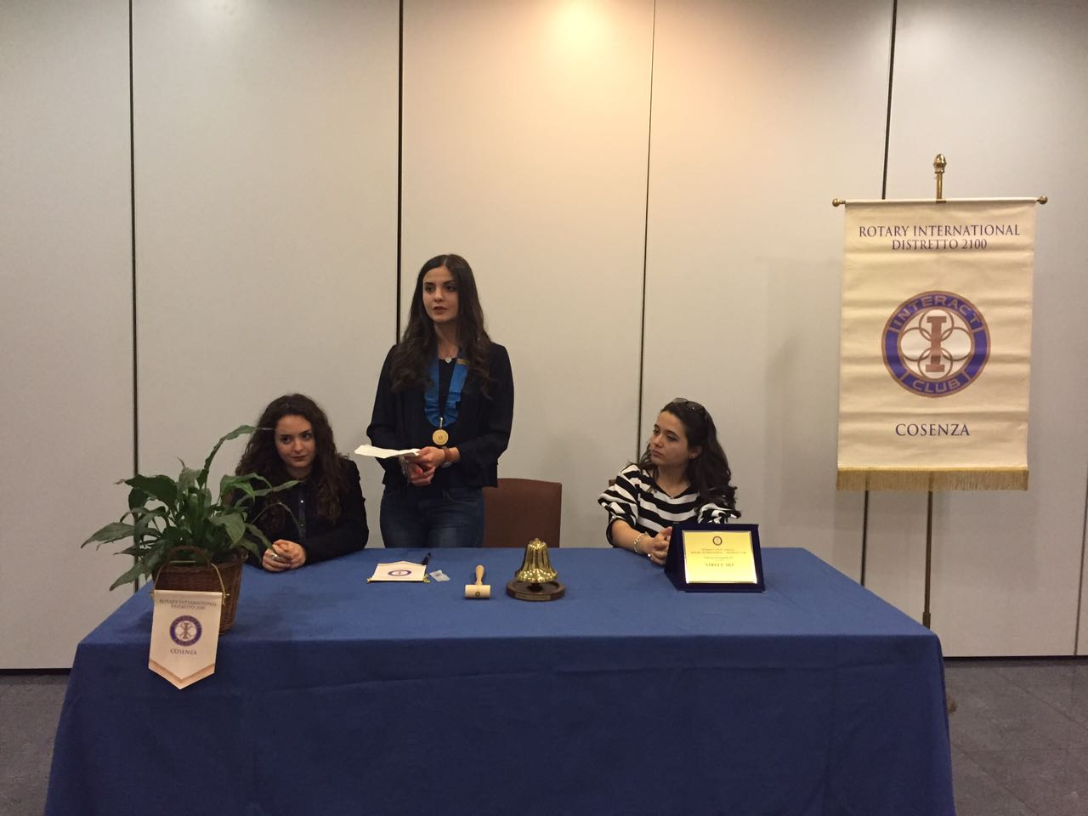
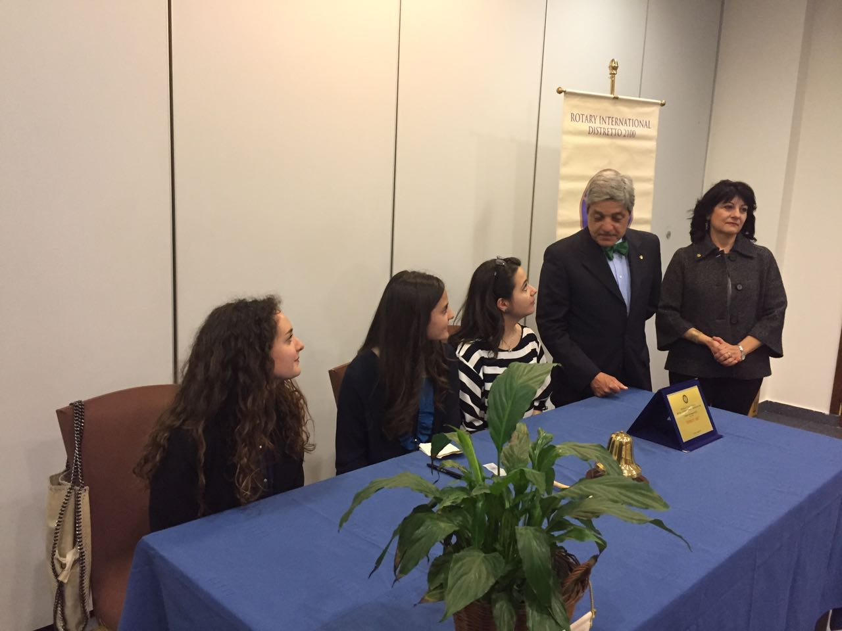
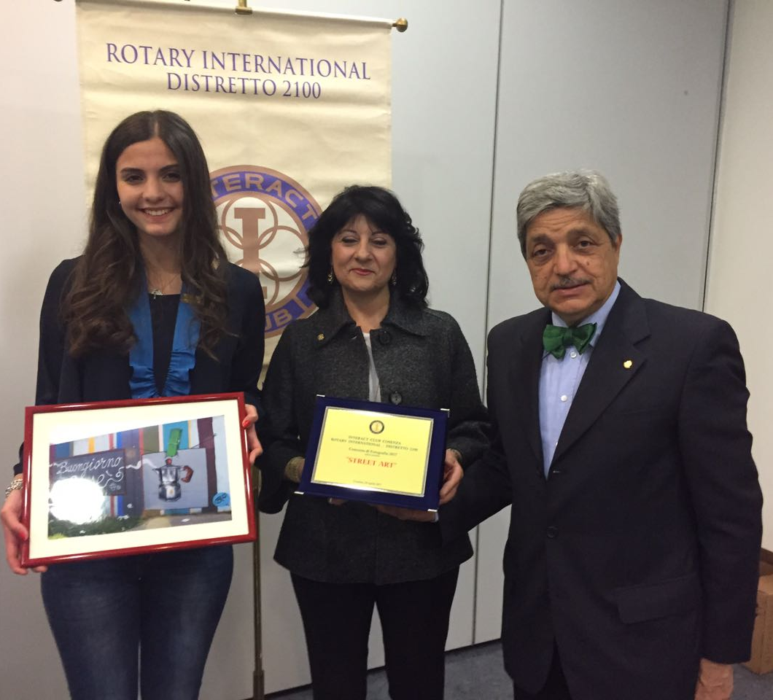
29th april 2017: 2° edition of the photography contest “Fausto Carnovale” on the theme of street art

Slide 19
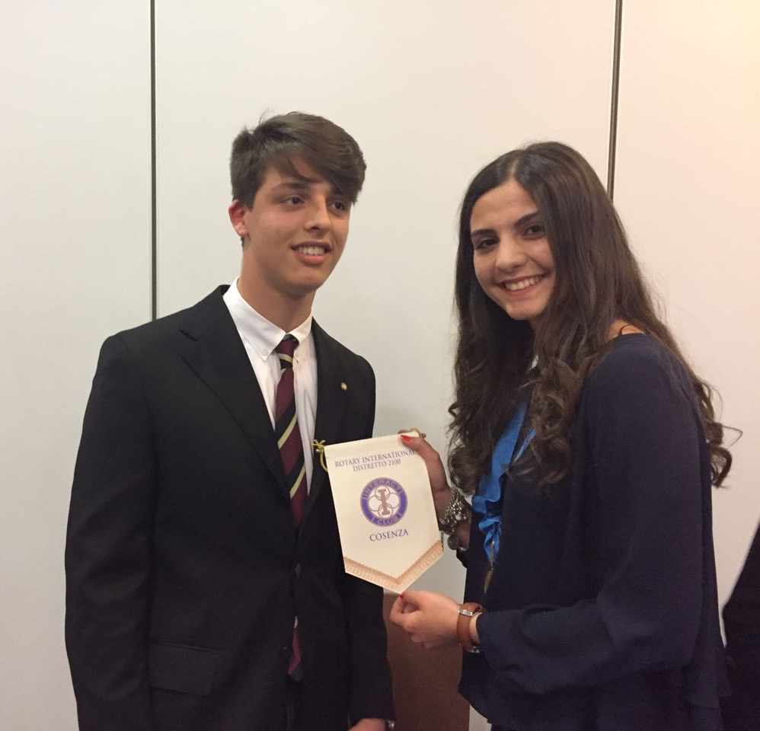
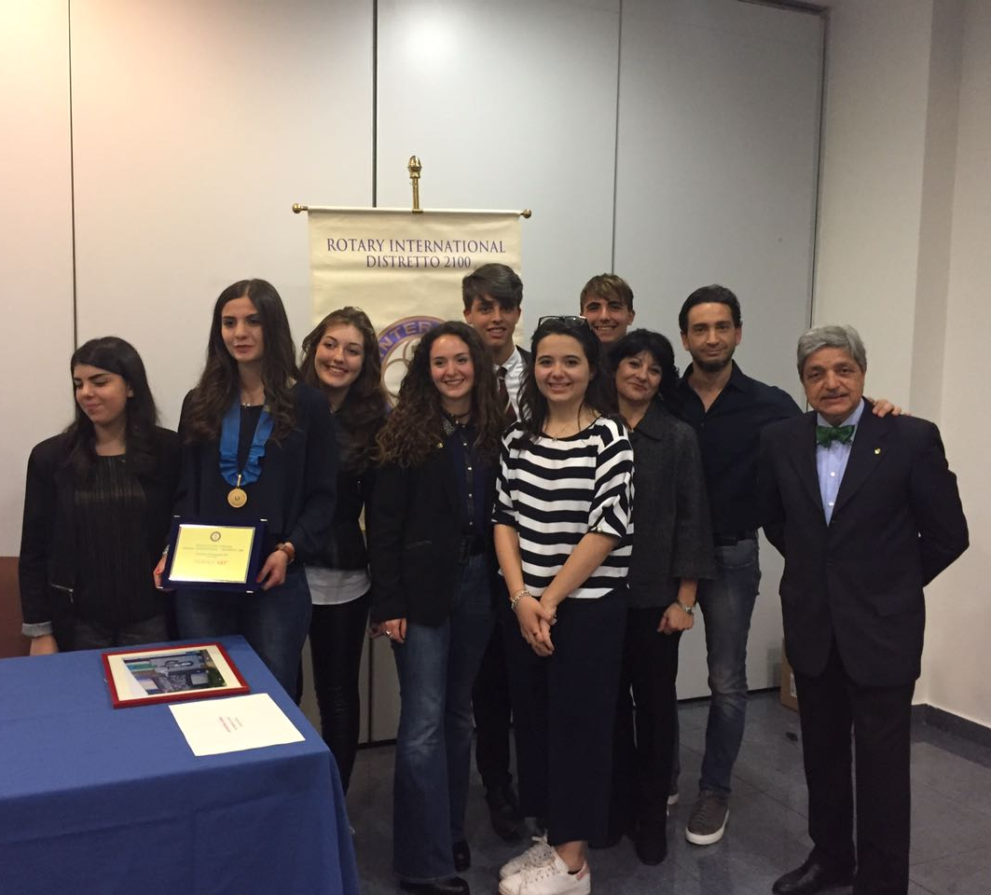
…and entrance of a new member

Slide 20



30th april 2017: Participation to the Rypen

Slide 21



13rd June 2017: meeting“Social Us” about what social networks us teenagers use

Slide 22
Rotarian Year 2017/2018
President :Alessandra Barbarossa
Vice President: Elisabetta Verre
Secretary: Maria Corrada Verardi
Treasurer: Maria Pia Palazzo
Prefect: Lucia Vittoria Scarcello

Slide 23




4th july 2017: exchange of the roles

Slide 24





Slide 25



5 e 6 september 2017: participation to the District Training in Maratea
District Governor
District Representative
District Delegate

Slide 26





Slide 27




24th October 2017:30th anniversary of the Interact Club Cosenza

Slide 28





31st October 2017: collection of food for a local church

Slide 29

4th November 2017: donation of the successful collection of food to the church

Slide 30




29th November 2017: meeting about the importance of blood donation in collaboration with the local center of blood drive

Slide 31



17th December 2017: Christmas tombola of solidarity between friends for the project in collaboration with the local centre of blood drive

Slide 32


21st December 2017: afternoon of solidarity in a local house family

Slide 33


4th January 2018: consignment of our proceeds from the Christmas tombola to the local center for blood donation

Slide 34



15th and 16th March 2018:participation and hospitality at the Rypen 2018

Slide 35


Slide 36










Slide 37







