Slide 1

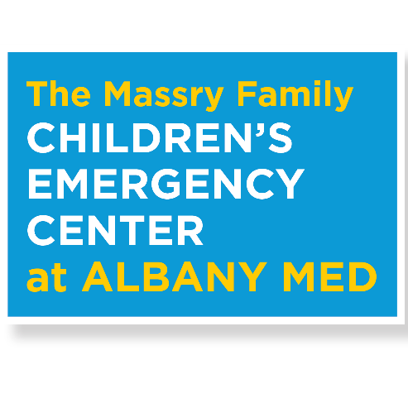
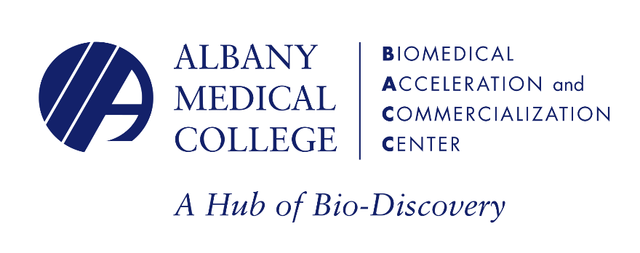



Leading the Way

Slide 2
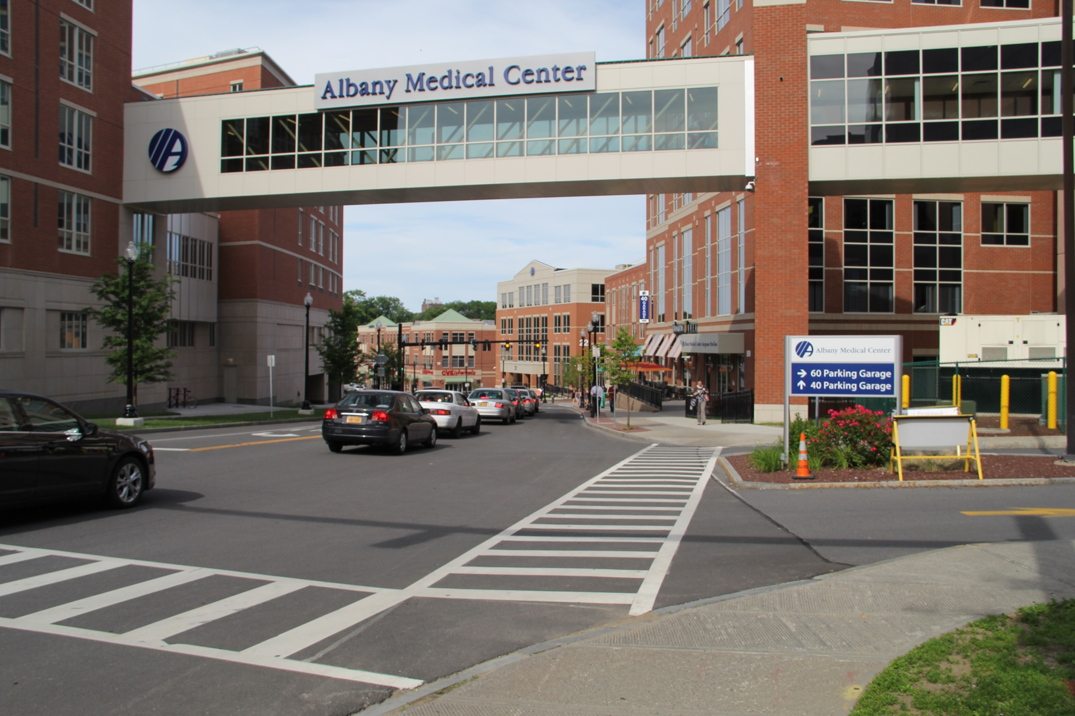

Slide 3

  “Choosing between the best care for their child and a less frightening place is a decision no parent, or grandparent, should ever have to make. Soon all of the children and teens of our community and region will have a ‘place of their own’ to receive outstanding emergency treatment.”
  -- James J. Barba
  President and CEO, Albany Med

Slide 4
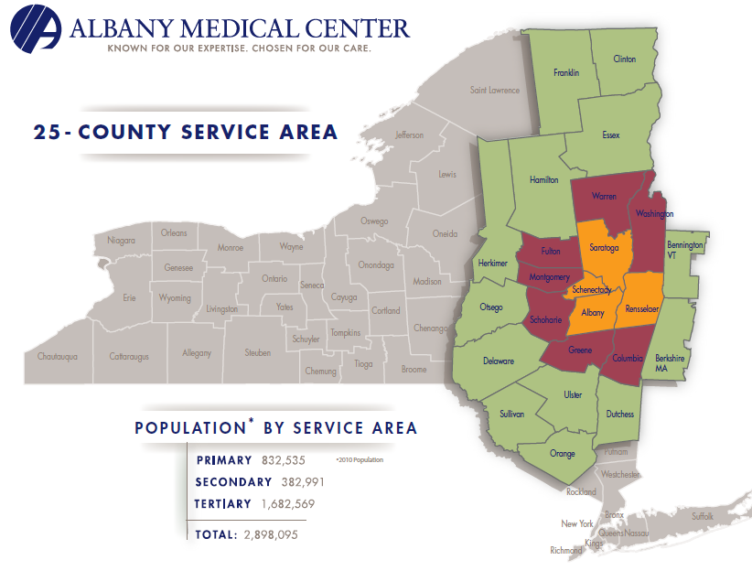
The current Department of Emergency Medicine
Only Level I Trauma Center in 25 counties
More than 76,000 visits,
16,000 pediatric visits, annually
Staffed by board-certified emergency medicine physicians
24/7/365
Atmosphere is not always conducive to families
Notes:
Albany Med is the only Level I Trauma Center in Albany Med’s 25-county service area – one of the busiest trauma centers in New York State
More than 76,000 visits to our Emergency Department annually, 16,000 pediatric visits
Pediatric emergency department will be staffed by board-certified emergency medicine physicians trained to handle highly complex, life-threatening cases as well routine medical emergencies
Open 24 hours a day; 7 days a week., every day of the year
Albany Med’s emergency department is the place for children to be in an emergency, but the atmosphere in the busy adult-centered trauma center is not always the best for children and families

Slide 5
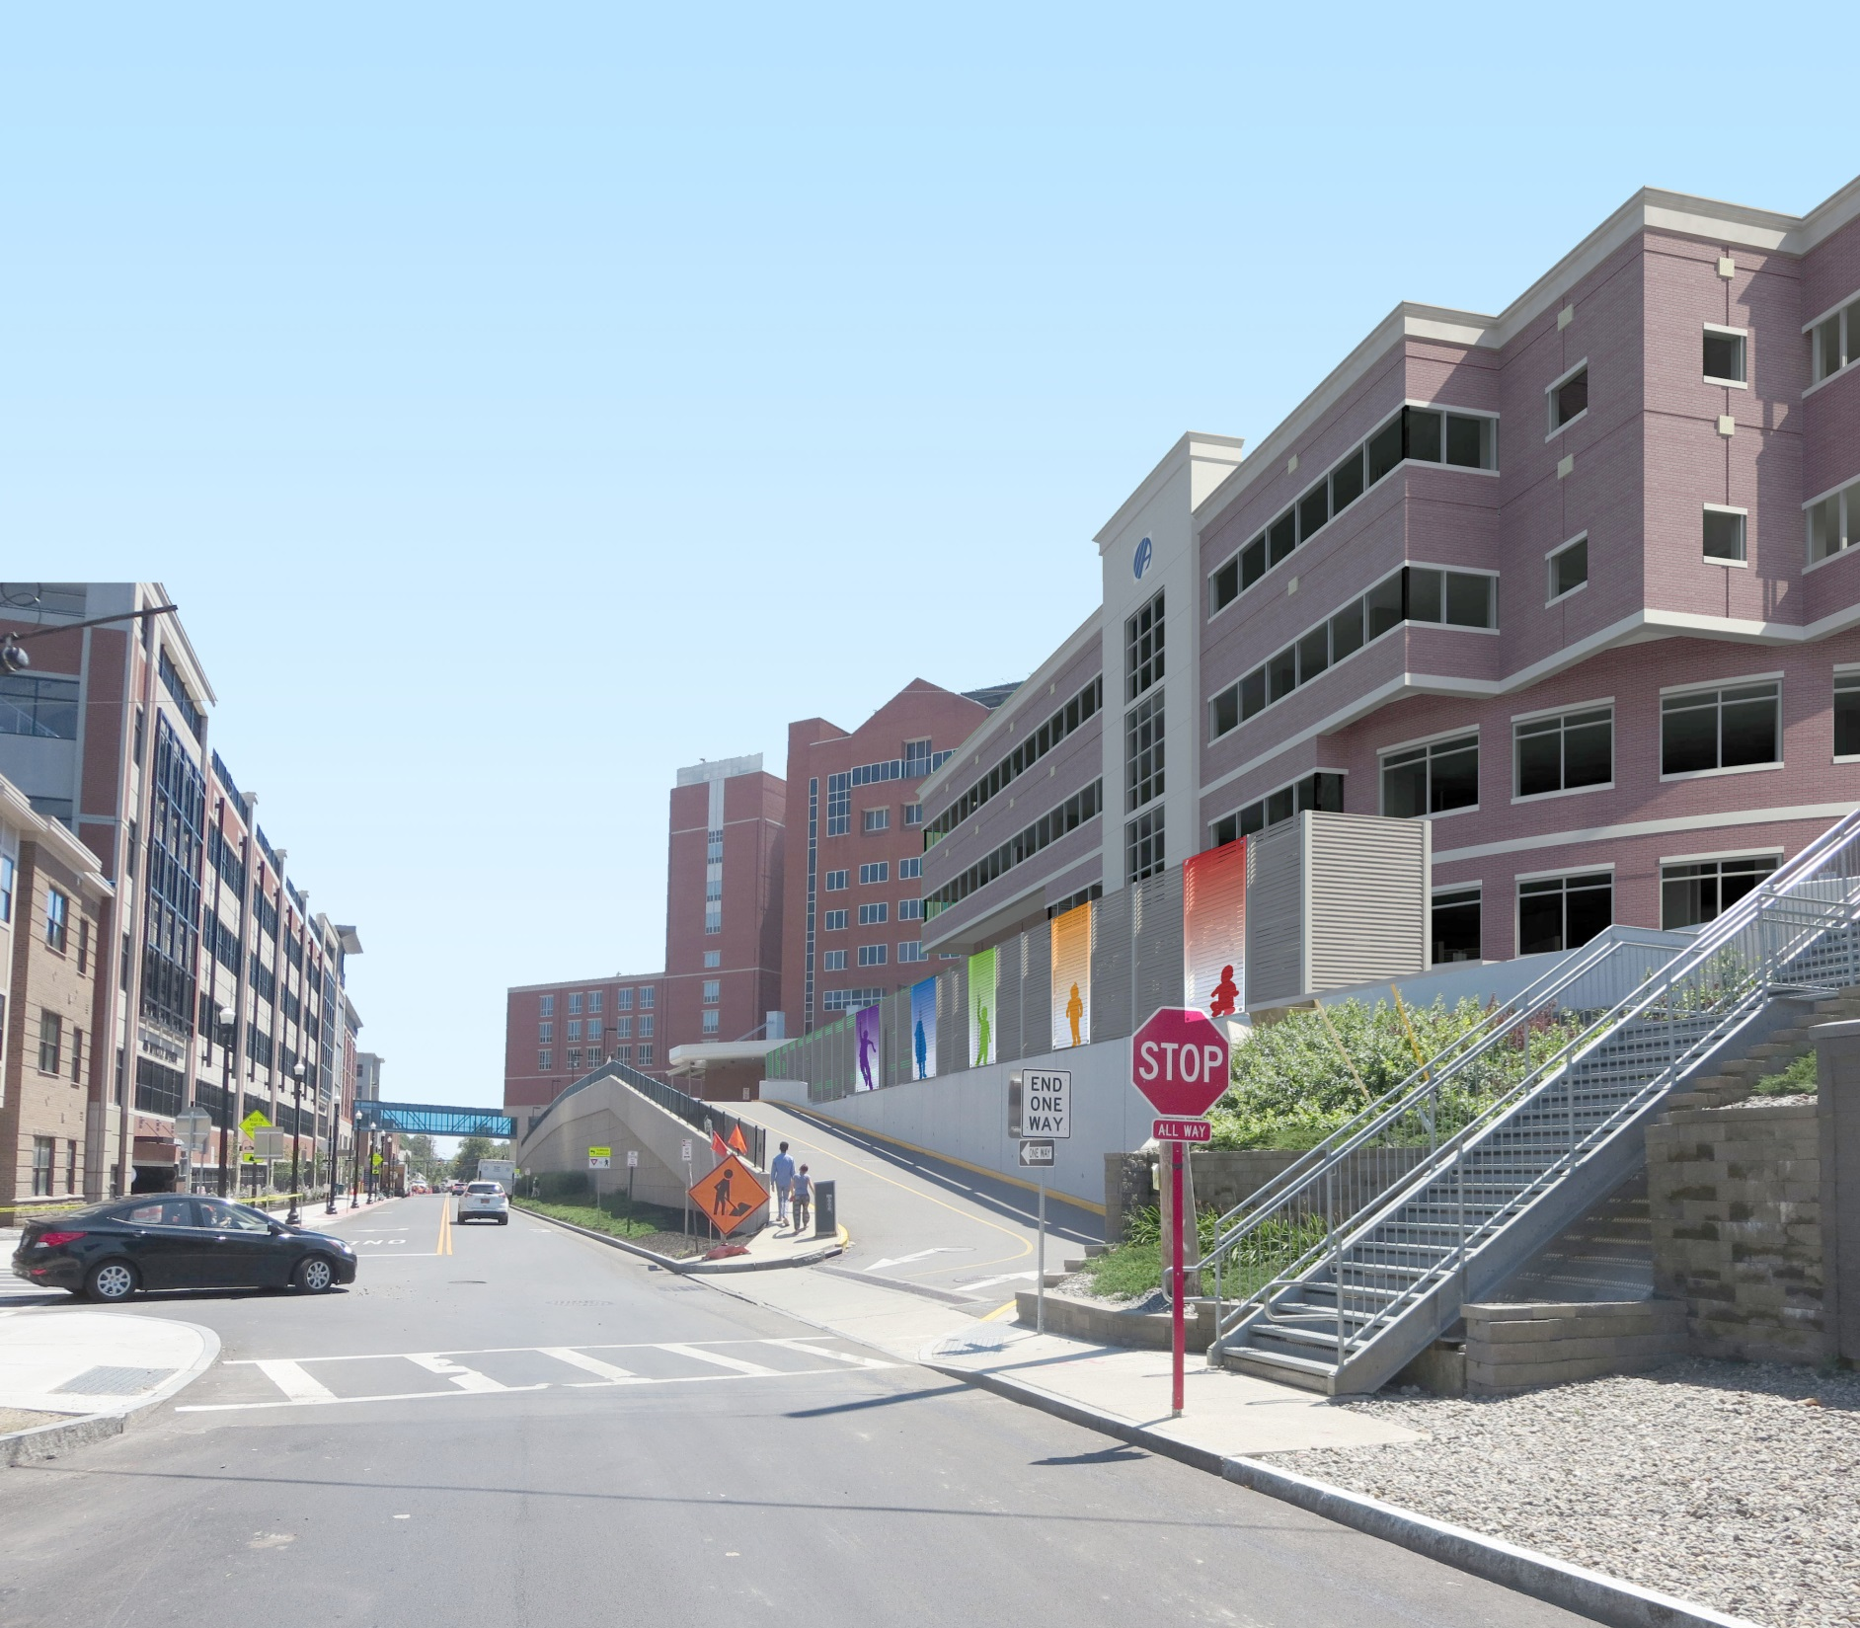
Introducing the region’s first pediatric emergency department
View from Myrtle Avenue, Albany
Only one of its kind in northeastern New York and western New England
Staffed by experts in pediatric
emergency medicine
Separate from current
Emergency Department
Notes:
This will be our region’s first and only dedicated pediatric emergency department and it will provide a safe and special environment for children and teenagers
It will be staffed by the area’s only fellowship-trained pediatric emergency physicians, as well as specially trained pediatric nurses and other staff
It will be located adjacent to but totally separate from the current emergency department on the Albany Med campus, but connected by a walkway for staff

Slide 6
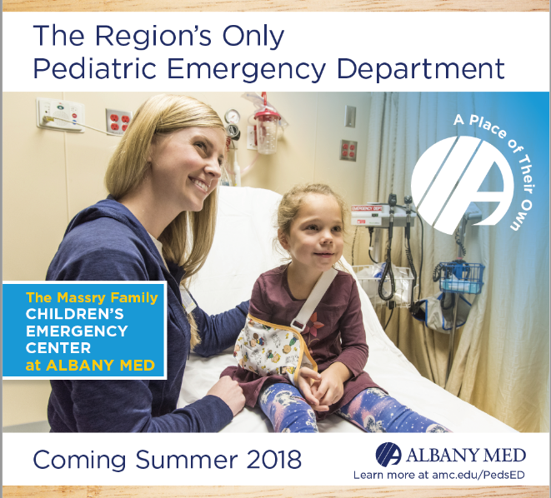
Opening summer 2018
$50 million project funded by generous private and corporate donors, state and federal grants
24/7/365
Notes:
The new facility will be opening this summer
The $50 million project funded by generous private and corporate donors, state and federal grants, with a fundraising goal of $20 million.
Will be open 24/7, 365 days a year, for children to age 18
Major drivers of pediatric ED visits: fever and flu-like symptoms, respiratory-related symptoms, seizures, and injuries

Slide 7
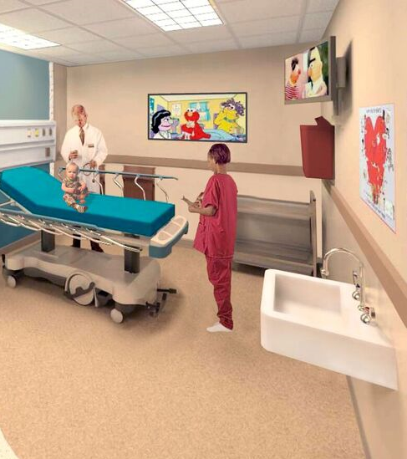
Acute Care/Trauma Floor
On-site X-ray and imaging
Trauma bays, private treatment rooms
Orthopaedic and procedure rooms
Waiting room/play area
Easy access for patients and ambulances
Minor Care/Observation Unit
(opening 2019)
Notes:
The Massry Family Children’s Emergency Center will be located adjacent to the current Emergency Department and will consist of two floors.
On-site X-ray and imaging, with special precautions taken for children to reduce radiation. We have specialists in pediatric radiology who are experts in “imaging lightly.”
Private treatment rooms mean more patient privacy and comfort, and also reduce risk of disease transmission.
Orthopaedic and procedure rooms: rooms separate from treatment rooms where casting and other medical procedures are done
Easy access to facility: including valet parking, close access for ambulances, rooftop medical helicopter pads located at Albany Med.
Short-stay unit is for less serious conditions like minor cuts or burns or minor illnesses that can be treated quickly so children can get “in and out.” The observation unit is where children’s conditions can be observed for up to 23 hours. After, they may go home or be admitted to the children’s hospital. These two units will open in 2019.

Slide 8
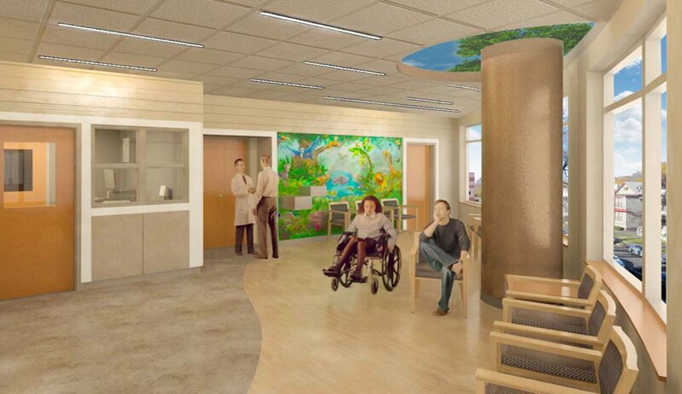
Professionally designed with the input of an architect with expertise in pediatric emergency rooms to efficiently improve patient flow to lessen waiting time and impart a calming atmosphere
Notes:
Family-friendly waiting rooms and décor designed with input from nurses and physicians.
When designing the ED, we took into account children and teens so that the atmosphere is not too “babyish” but is still family-friendly.
The theme is based on woodlands.

Slide 9

Why send a sick or injured child to Albany Med?
Sick and injured children, difficult to diagnose, need expert care
Staffed by region’s only physicians fellowship-trained in pediatric emergency medicine
Ready access to the region’s only children’s hospital, the Bernard & Millie Duker Children’s Hospital at Albany Med
More than 400 physicians and other health care providers trained in more than 40 pediatric fields at children’s hospital
Notes:
Sick and injured children can be difficult to diagnose, and need expert care; some conditions, like the flu, can have different symptoms in children; some conditions only affect children for the most part, such as croup and some other viral illnesses like Coxsackie virus.
All physicians in the peds ED will be specially trained in pediatric emergency medicine; staff will include a child life specialist.
All medical equipment geared toward children and teens, similar to what you would find in a pediatrician’s office, i.e. smaller gowns, smaller blood pressure cuffs, smaller orthopedic equipment for casting
As an academic medical center, we have highly trained staff who are up-to-date on latest research and procedures, drug regimens, etc.
Ready access to the region’s only children’s hospital, the Bernard & Millie Duker Children’s hospital at Albany Med, including the only Pediatric Intensive Care Unit (PICU) and highest-level Neonatal Intensive Care Unit (NICU), as well as a pediatric inpatient unit
Children’s hospital: More than 400 physicians and other health care providers specially trained in more than 40 pediatric fields, virtually every one there is.
Including pediatric pulmonary disease, pediatric surgery, pediatric gastroenterology, pediatric anesthesia and pediatric neurology. These are just a few examples.

Slide 10
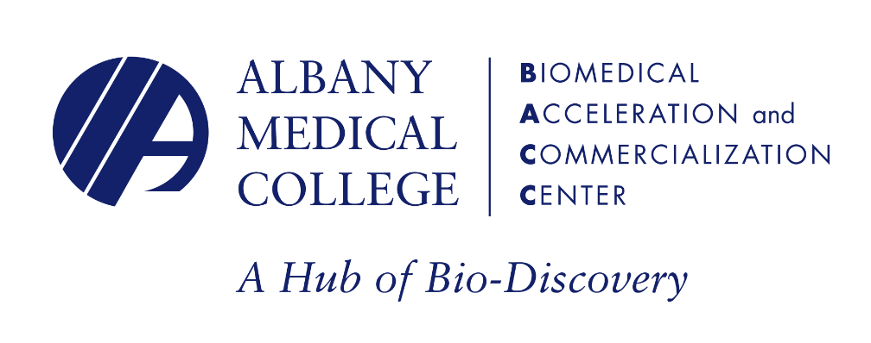
In 2015, Albany Med embarked on a
new and very different enterprise...
Biomedical Accelerator and
Commercialization Center
(The BACC)
Provides entrepreneurs and start-up businesses with an environment to refine their technology, business skills and connect with researchers, physicians and patients
Biomedical research and development landscape has dramatically changed
Greater focus on bringing discoveries more quickly to
the marketplace
Recognition that region can
be powerhouse for biomedical innovation
Final placement and design of named signage awaiting review from architect.
Notes:
Launched to provide local entrepreneurs and start-up businesses with an environment to refine their technology, business skills and connect with researchers, physicians and patients
Biomedical research and development landscape has dramatically changed
Greater focus on bringing the most promising discoveries more quickly to the marketplace… …and, to patients
Recognition that entrepreneurial and scientific resources, individuals and businesses in this area could make this region a powerhouse for biomedical innovation

Slide 11
“The BACC gives some of the best and brightest in our region a way to take their ideas or start-up companies to the next level – great ideas that might have languished in the lab or on a computer are on the road to helping make our region a center for biomedical innovation and fueling a growing sector of our economy.”
-- Vincent Verdile, M.D.,
Dean, Albany Medical College
Final placement and design of named signage awaiting review from architect.

Slide 12
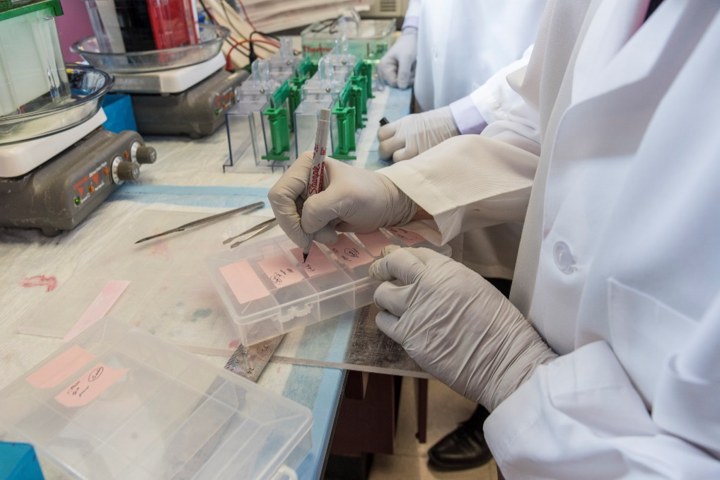
Why Albany Med?
State-of-the-art laboratories
Wet labs, ventilating equipment, critical resources
Major academic medical center
500 full-time physicians, 80 biomedical scientists at Albany Med
Final placement and design of named signage awaiting review from architect.
Notes:
Why Albany Med?
•Albany Medical College already houses state-of-the-art biomedical laboratories
•Access to wet labs, ventilating equipment, critical resources that only Albany Med can provide
•Albany Med is a major academic medical center, the region’s only, and therefore entrepreneurs and start-ups have access to great minds: 500 full-time physicians, 80 biomedical scientists already working at Albany Medical Center/Albany Medical College, medical students and biomedical students
•The BACC also partnered with area institutions to expand ability to serve community

Slide 13









Creating products that will improve patient health and well-being, and maybe even cure diseases, is our ultimate mission of the BACC
Notes:
Creating products that will improve patient health and well-being, and maybe even cure diseases, is our ultimate mission of the BACC. Entrepreneurs are working on projects as diverse as a technology to prevent bedsores to the development of a new cream to treat the skin disease rosacea as well as a drug that could treat or prevent breast cancer.

Slide 14
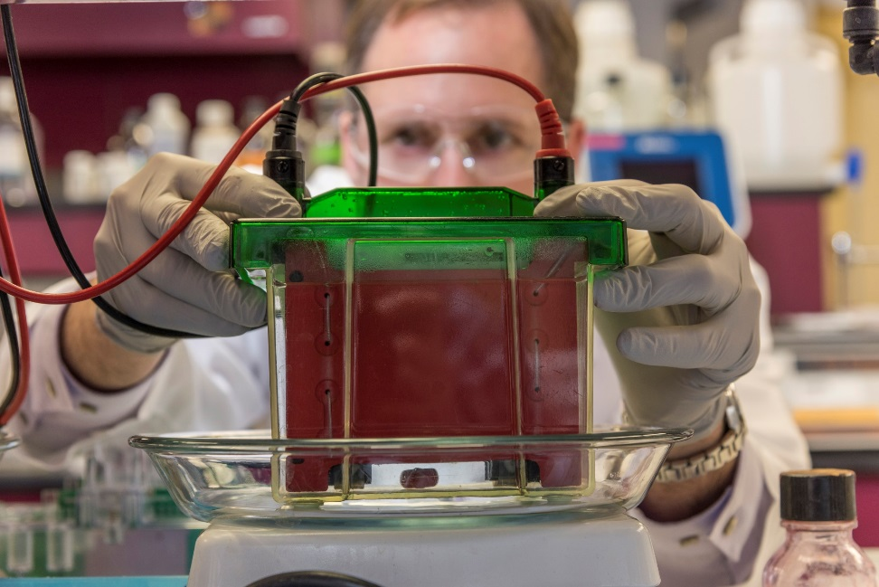
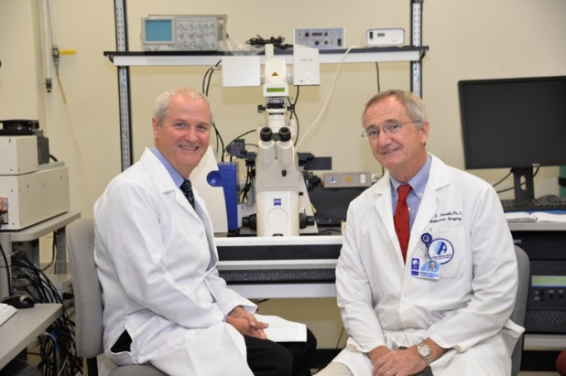
BACC Projects
Praxis: Skin cream for roseacea;
2016 BACC Academy Award Winner,
$50,000 Fuzehub Winner
Preventide: Pioneering effective, non-toxic drugs, including breast cancer drug: 2017 BACC Academy Award Winner
Kemsense: Preventing bedsores in
the hospital
…and more

Slide 15



Strategic Partnerships
Academic Partnerships
Siena College
Albany Law School
Rensselaer
Union College
Industry Partnerships
General Electric
Pharmaceutic Labs
KemSENSE
Public Partnerships
USDOC Economic Development Agency
NYS Empire State Development

Slide 16

Recognition of Excellence
Rapidly gained NYS backing as state leader in biomedical innovation
More than $1 million in government funding
$400,000 from NYS to support a collaborative project with RPI
STARTUP-NY designation
Final placement and design of named signage awaiting review from architect.

Slide 17
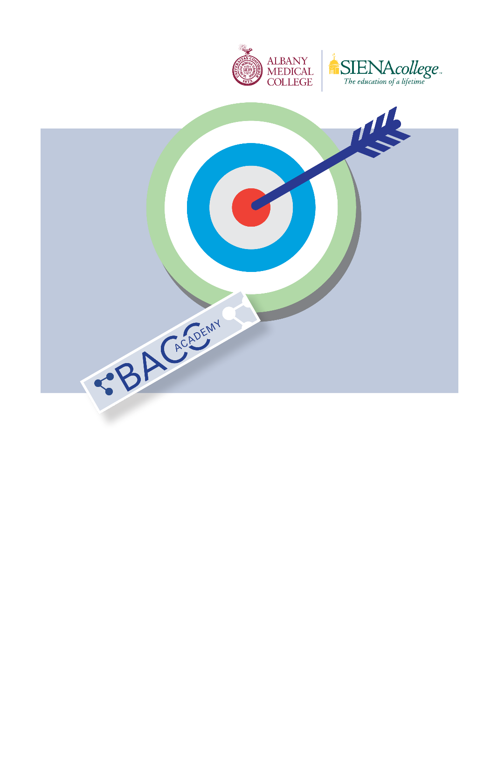
The Future
BACC Academy
Pipeline for future entrepreneurs
Collaboration of Albany Medical College and Siena College
13-week educational program
Other new projects, immersion programs developed with
local colleges
Continue to grow region’s economy
“The BACC Academy is a game-changer. I knew how to conduct research and get research grants, but BACC Academy taught me how to set up a company, which takes a new skillset.”
    - Thomas Anderson, PhD
    Professor, Albany Medical College
    BACC Academy graduate
Final placement and design of named signage awaiting review from architect.
Notes:
In 2016, BACC launched the BACC Academy
• Pipeline for future entrepreneurs
• Collaboration of Albany Medical College and Siena College
• 13-week educational program, focuses on creating biotech entrepreneurs
• Other new projects include immersion programs, developed in cooperation with area colleges, and now being sought by colleges across the state
• The BACC Academy will help to continue to grow our region’s economy by creating more opportunities for scientists and start-up businesses, attracting business

Slide 18
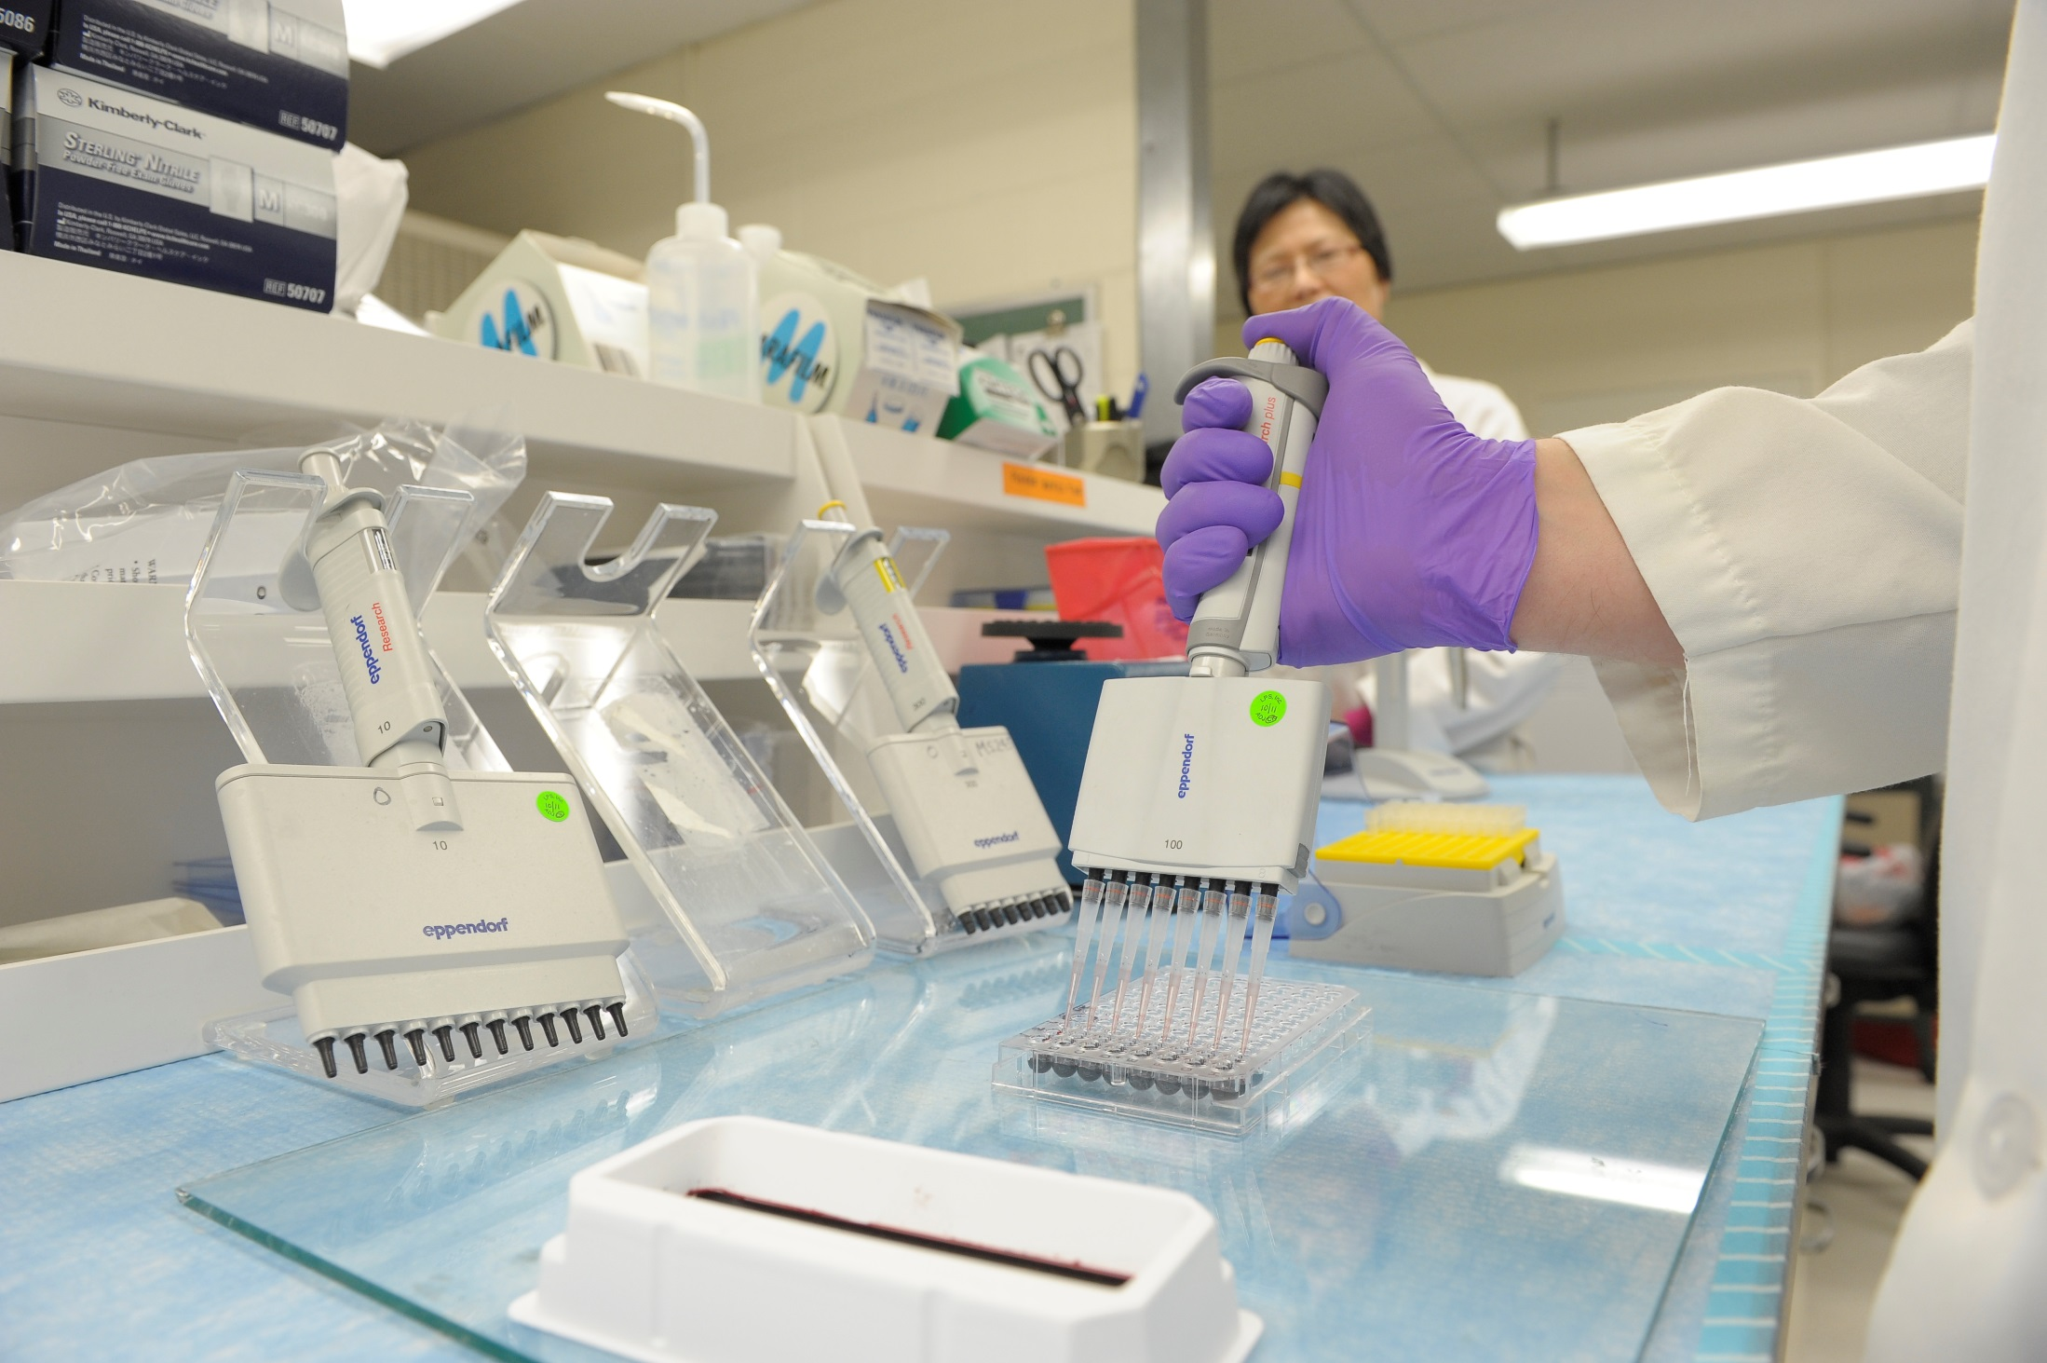
“The BACC is the most exciting new chapter in Albany Medical College’s long and rich history.”
                - Richard Blinkhorn, MD
                Professor, Albany Medical College

Slide 19
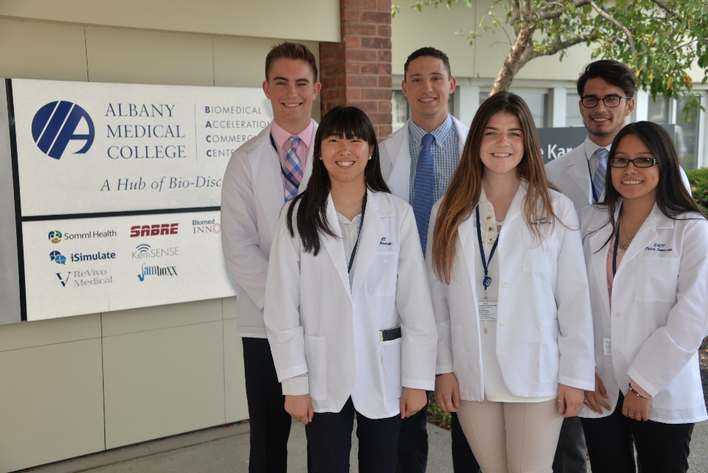
The BACC is moving forward, creating new opportunities for biomedical innovation and leading the way in creating a “biotech start-up region” that attracts businesses and entrepreneurs from our backyard, from across the country and, quite literally, from around the world
Final placement and design of named signage awaiting review from architect.

Slide 20
Introducing the
Executive Health Program
A New Concept in Health Care
Only program of its kind in our region
Allows busy executives to tap into Albany Med’s medical expertise
Ensures health is “top of mind”
Convenient, two hours
Appointments typically available in two weeks
Personal attention, setting reminiscent of a fine hotel
Personal nurse navigator
Final placement and design of named signage awaiting review from architect.

Slide 21
Program Highlights
Comprehensive health evaluation
Cardiac stress test
EKG
Blood tests, urinalysis
History, physical
Optional services depending on need
Preventive healthy lifestyle strategies
If needed, immediate referrals
Unlimited time with medical director
“Tests can be completed in several hours and most results shared during the appointment, which lasts about two hours.”
-- Nathan Mitkoff, M.D.
Medical Director,
Executive Health
Final placement and design of named signage awaiting review from architect.
Notes:
Comprehensive health evaluation
• Cardiac stress test
• EKG
• Blood tests and urinalysis
• History and physical
• Optional services available depending on need (mammography, colonoscopy, chest X-ray, etc.)
• Formulate preventive healthy lifestyle strategies
• If needed, immediate referrals to Albany Med’s specialists or to other experienced specialists and convenient, qualified hospitals
“Tests can be completed in several hours and most results shared during the appointment, which lasts about two hours.”
Neil Mitkoff, M.D., Medical Director, Executive Health Program

Slide 22
FAQS
Q: Is the program covered by insurance?
A: No, but you can submit certain bills for reimbursement/
Q: Does the program conflict with primary physician?
No. Patients are encouraged to share a summary copy of their visit with their primary care physician.
Goal is to help busy executives find the time to pay attention to their health.
Notes:
Is the program covered by insurance?
A: No.
Q: Does the program conflict with primary physician?
No. Patients are encouraged to share a summary copy of their visit with their primary care physician so that it is part of their permanent record.
Our goal is to help busy executives find the time to pay attention to their health.

Slide 23
“The Executive Health Program was developed for individuals whose time is at a premium but understand the importance of being proactive about their health.”
-- Kevin Leyden
Senior Vice President, Business Development and Strategic Partnerships

Slide 24
Questions?

