Slide 1


Slide 2

Ladies &
Gentlemen, the
Southern Rensselaer
County Rotary Club proudly presents …

Slide 3
The ^ Great North American Whizbang Trivia Test
4th annual

Slide 4
Them’s the Rules
• The test is self-scored on the honor system.
• There are four categories – one fewer than in previous years, each consisting of five regular questions and one bonus question. We also have more multiple choice possibilities.
• Each of the regular questions is worth 1 point. Each of the bonus questions is worth 3 points. Thus, a perfect score is 32.
• Should the game end in a tie, we have a series of tiebreaker questions. Miss one and you’re out.
• Should the score remain tied after the tiebreaker questions, the test will be declared a draw.

Slide 5
Them’s the categories
• Television
• Odds & Ends
• American History
• Around the World

Slide 6
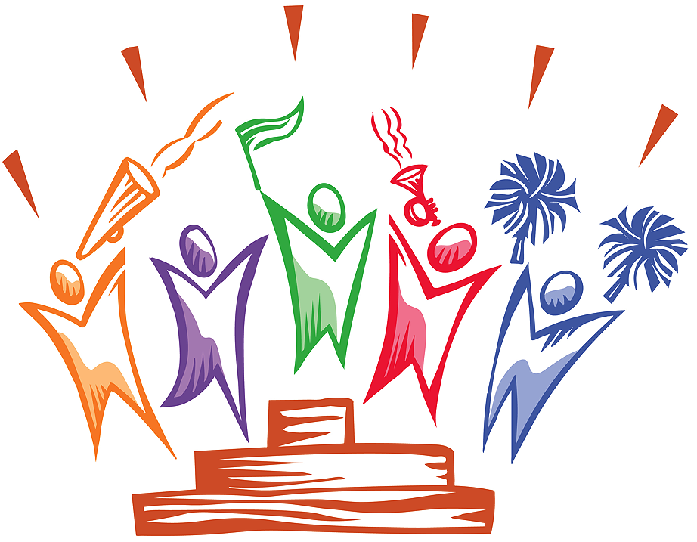
And now, let the game begin!

Slide 7
Television: 1
A once-popular children’s TV show host is gracing one of the new USPS “forever” postage stamps issued this year.
Most people knew him as Mister Rogers, on the long-running public TV series “Mister Rogers’ Neighborhood.”
What was his full name in real life?

Slide 8
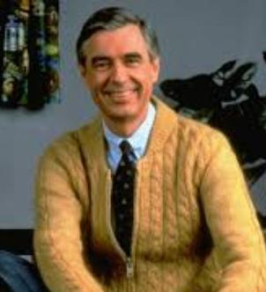
Fred McFeely Rogers.
(But, we’ll accept just Fred Rogers.)
His middle name, from a grandfather, was used as the name of one of the characters on the show – Mr. McFeely, the speedy delivery service man.

Slide 9
Television: 2
Characters from other worlds frequently have popped up
as major characters on TV series. Select just 3 of the following
that fit that description and you earn a point.
• Mork & Mindy (1978-82)
• ALF (1986-90)
• Mister Ed (1961-66)
• 7th Heaven (1996-2007)
• Aliens In America (2007-08)
• The Adventures of Superman (1952-58)
• 3rd Rock From the Sun (1996-2001)
• Fantasy Island (1978-84, 1998-99)

Slide 10
• Mork & Mindy (1978-82): Mork came from the planet Ork
• ALF (1986-90): ALF came from the planet Melmac
• Mister Ed (1961-66)
• 7th Heaven (1996-2007)
• Aliens In America (2007-08)
• The Adventures of Superman (1952-58): Superman came
from the planet Krypton
• 3rd Rock From the Sun (1996-2001): The aliens came from
an unspecified planet
• Fantasy Island (1978-84, 1998-99)

Slide 11
Television: 3
What tool, implement, or gimmick item was often used by these
TV characters? Get 2 of the 4 to earn a point.
• Maxwell Smart
(shoe-phone, wrist-radio, or ray gun)
• Doctor Who
(magic wand, sonic screwdriver, or robotic arm)
• Captain Kirk
(tribble detector, phaser, or Vulcan mind-melder)
• Hawkeye Pierce
(ceramic spoon, scalpel, or hydrosonic water pistol)

Slide 12
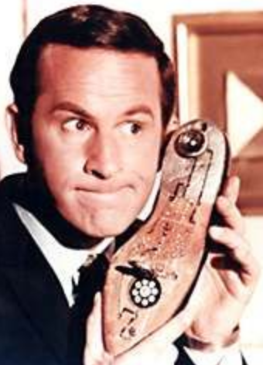
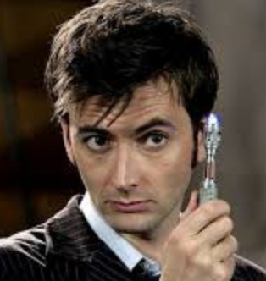
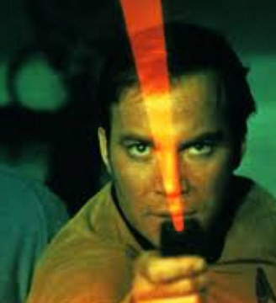
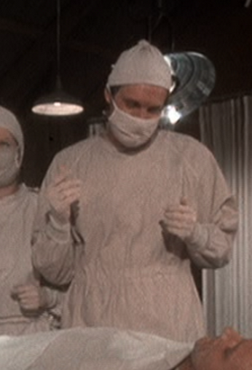
• Maxwell Smart
(shoe-phone, wrist-radio, or ray gun)
• Doctor Who
(magic wand, sonic screwdriver, or robotic arm)
• Captain Kirk
(tribble detector, phaser, or Vulcan mind-melder)
• Hawkeye Pierce
(ceramic spoon, scalpel, or hydrosonic water pistol)

Slide 13
Television: 4
Which of these is not the name of a cable TV channel?
• The WB
• FYI
• Adult Swim
• American Heroes Channel
• IFC
• Sundance
• DIY

Slide 14
Which of these is not the name of a cable TV channel?
• The WB
• FYI
• Adult Swim
• American Heroes Channel
• IFC
• Sundance
• DIY

Slide 15
Television: 5
What is the ZIP code of Beverly Hills, CA?
Hint: It’s in the title of the TV series of that name that ran
from October 4, 1990, to May 17, 2000.

Slide 16
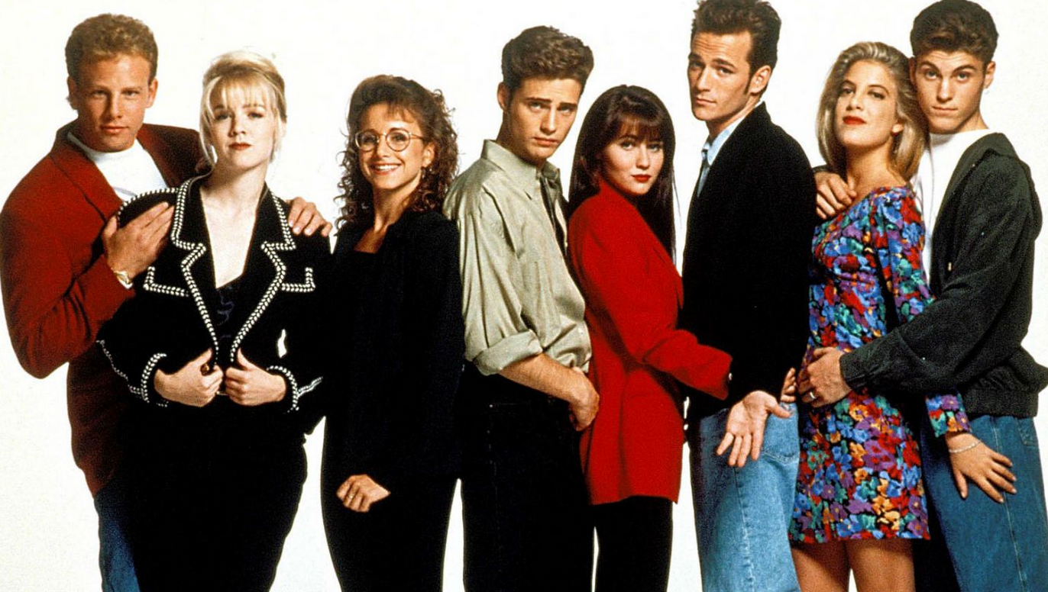
90210, of course

Slide 17
Television: Bonus
What profession do all or some of the principal characters
in these groups of TV series have in common? Get 3, earn 3 points.
• Suits, Boston Legal, Ally McBeal, Matlock, JAG
• Monk, Elementary, Psych, Magnum P.I.
• Brooklyn Nine-Nine, Reno 911, Law & Order: SVU, Rizzolli & Isles
• Home Improvement, Man With a Plan, Just Us
• Breaking Bad, Welcome Back, Kotter, Our Miss Brooks

Slide 18
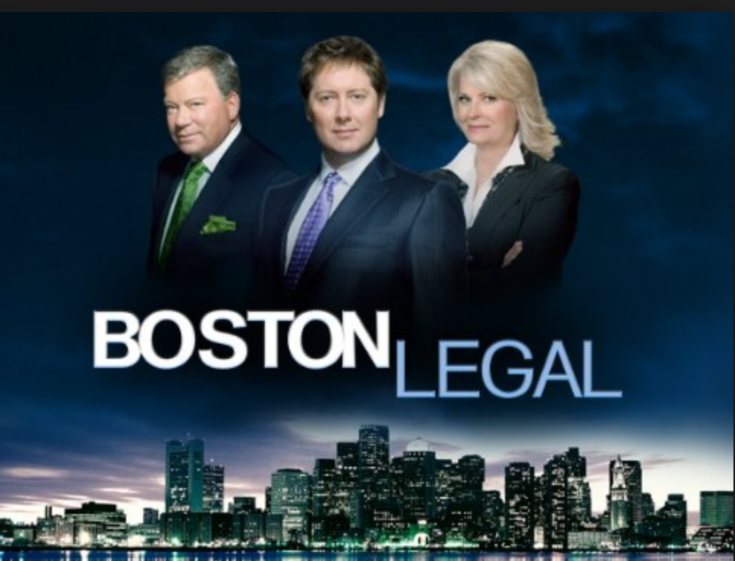
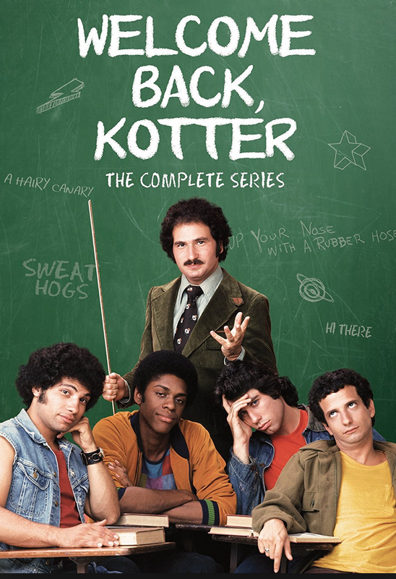
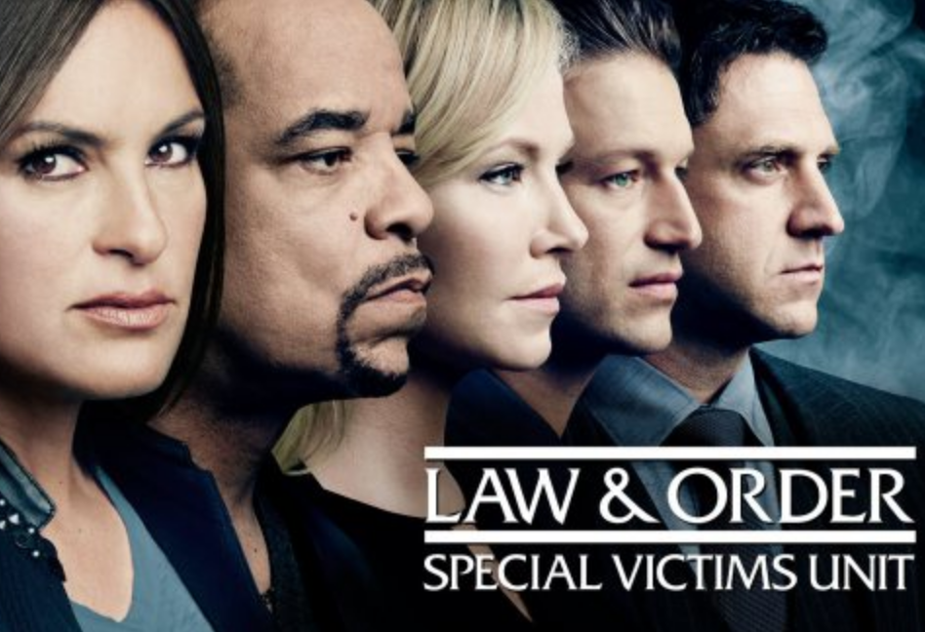
• Suits, Boston Legal, Ally McBeal, Matlock, JAG / LAWYERS
• Monk, Elementary, Psych, Magnum P.I. / PRIVATE EYES
• Brooklyn Nine-Nine, Reno 911, Law & Order: SVU, Rizzolli & Isles / COPS
• Home Improvement, Man With a Plan, Just Us / CARPENTERS
• Breaking Bad, Welcome Back, Kotter, Our Miss Brooks / TEACHERS

Slide 19
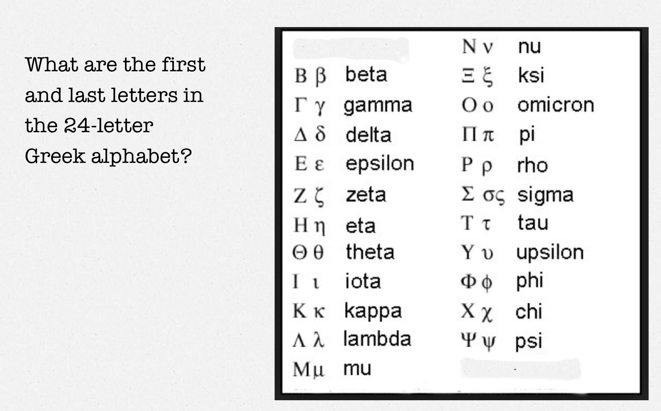
Odds & Ends: 1

Slide 20

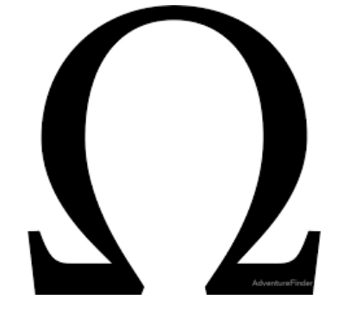
Alpha
and
Omega
“I am Alpha and Omega, the first and the last.”
-- The Book of Revelation

Slide 21
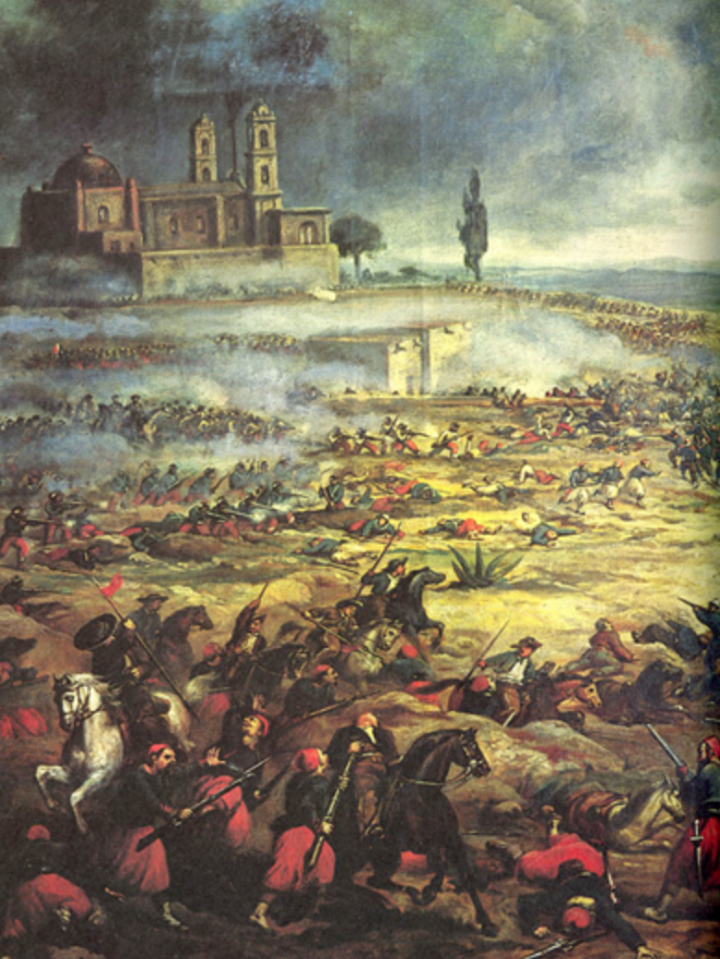
Odds & Ends: 2
The Battle of Puebla was fought in Mexico on May 5, 1862.
By what term is its commemoration popularly referred to today?

Slide 22
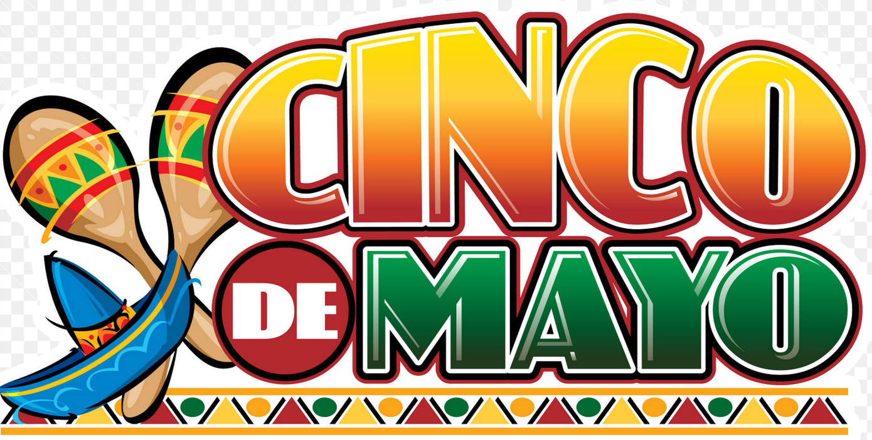

Slide 23
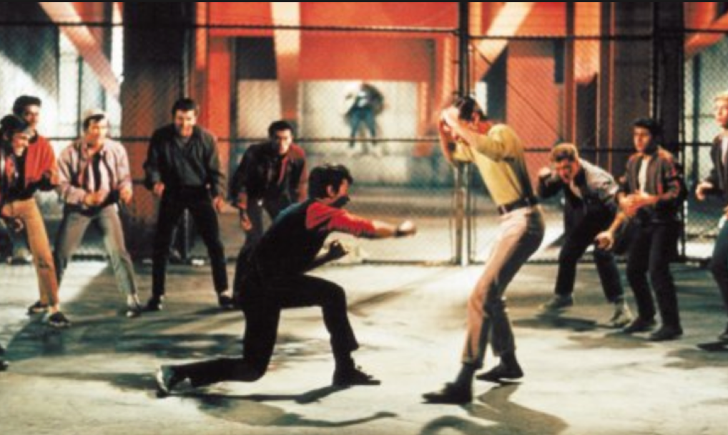
Odds & Ends: 3
What musical play and film that featured youth gangs called the Sharks and the Jets is loosely based on Shakespeare’s “Romeo and Juliet”?

Slide 24
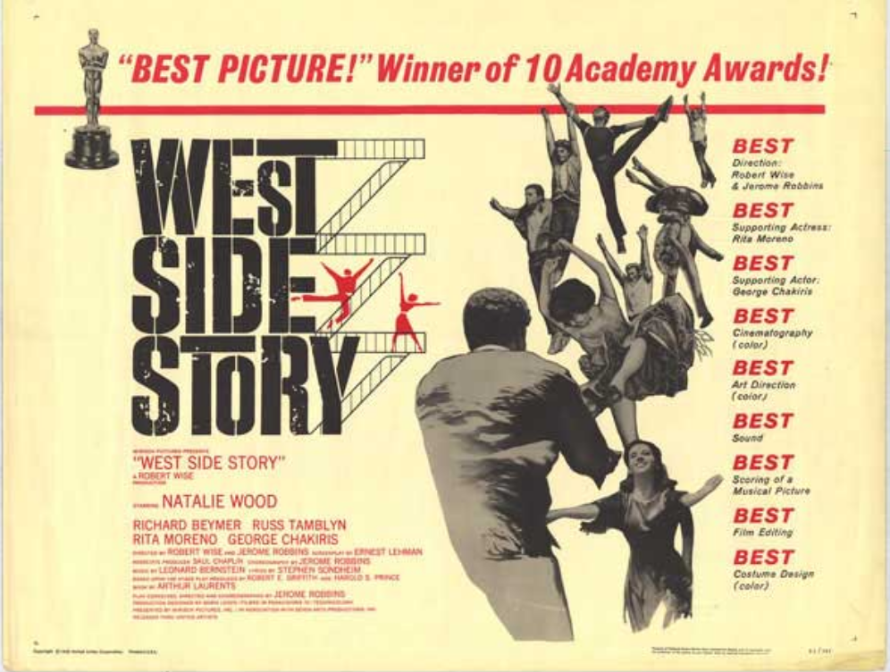

Slide 25
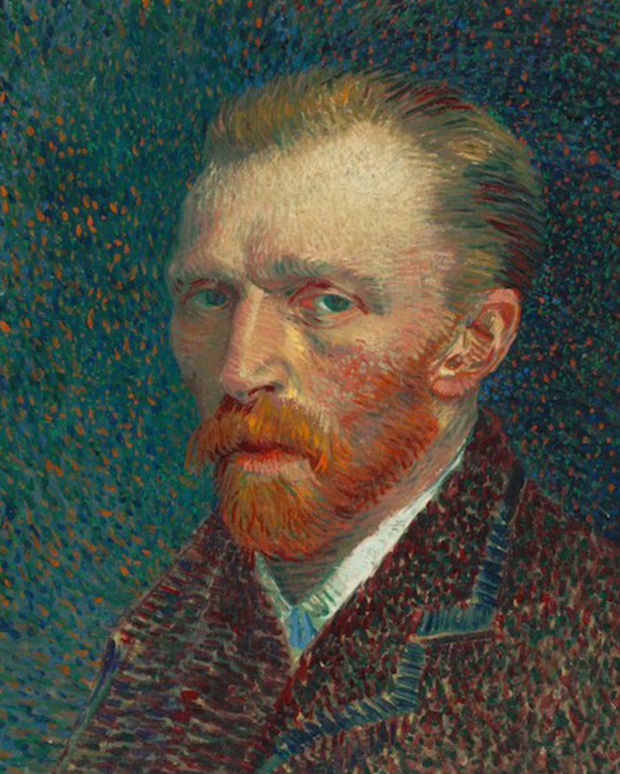
Odds & Ends: 4
How many paintings did the iconic artist Vincent Van Gogh sell during his lifetime?
• 1
• 7
• 9
• 22
• 38

Slide 26
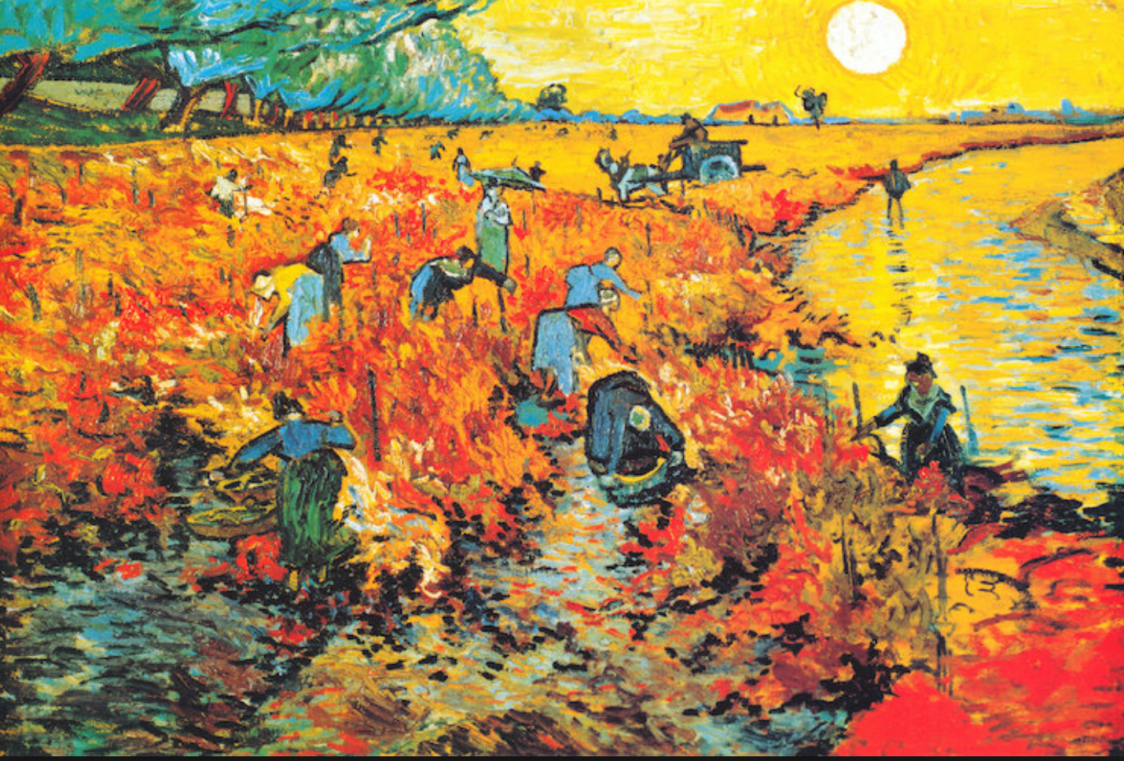
Van Gogh sold only one painting during his lifetime – “Red Vineyard at Arles.” It now hangs in the Pushkin Museum in Moscow.
The rest of
his more than
900 paintings
were not sold
until after his
1890 death.

Slide 27
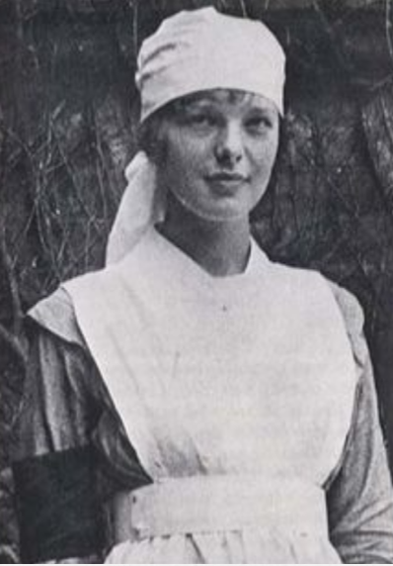
Odds & Ends: 5
This nurse’s aide served in a
Toronto, Canada, military hospital
during World War I. Many of her
patients were aviators who had
been wounded in battle.
She later went on to high-flying
worldwide fame in another sort of
uniform.
Who was she?

Slide 28
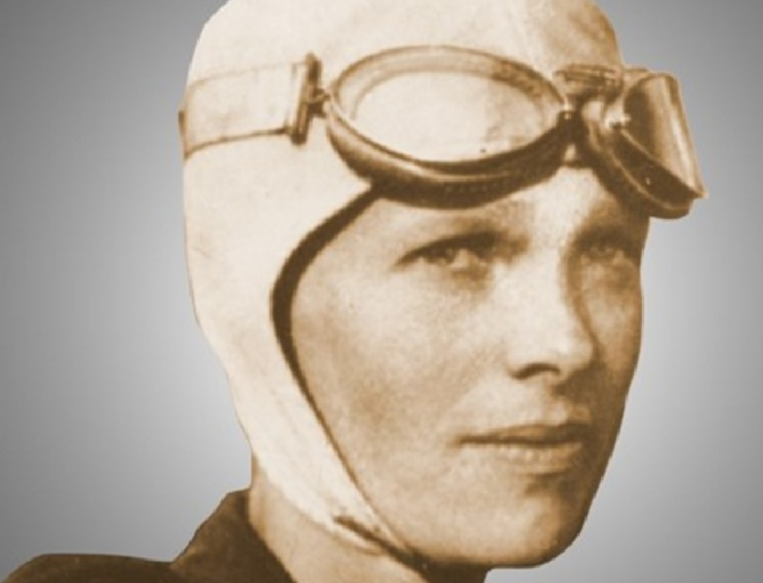
American aviator and author
Amelia Earhart: 1897 – 1937
(legally declared dead in 1939)

Slide 29
Odds & Ends: Bonus
These are opening lines of 9 books, poems and stories that helped make their authors famous? Get just 3, earn 5 points.
• “In a hole in the ground there lived a hobbit.”
• “Shall I compare thee to a summer's day?”
• “It was the best of times, it was the worst of times.”
• “Call me Ishmael.”
• “Two roads diverged in a yellow wood.”
• “Mother died today. Or maybe yesterday; I can't be sure.”
• “In my younger and more vulnerable years my father gave me some advice that I've been turning over in my mind ever since.”
• “Happy families are all alike; every unhappy family is unhappy in its own way.”
• “O Captain! My Captain! Our fearful trip is done.”

Slide 30
• “In a hole in the ground there lived a hobbit.”
J.R.R. Tolkien, “The Hobbit”

Slide 31
• “Shall I compare thee to a summer's day?”
William Shakespeare, “Sonnet 18”

Slide 32
• “It was the best of times, it was the worst of times.”
Charles Dickens, “A Tale of Two Cities”

Slide 33
• “Call me Ishmael.”
Herman Melville, “Moby-Dick”

Slide 34
• “Two roads diverged in a yellow wood.”
Robert Frost, “The Road Not Taken”

Slide 35
• “Mother died today. Or maybe yesterday; I can't be sure.”
Albert Camus, “The Stranger”

Slide 36
• “In my younger and more vulnerable years my father gave me some advice that I've been turning over in my mind ever since.”
F. Scott Fitzgerald, “The Great Gatsby”

Slide 37
• “Happy families are all alike; every unhappy family is unhappy in its own way.”
Leo Tolstoy, ”Anna Karenina”

Slide 38
• “O Captain! My Captain! Our fearful trip is done.”
Walt Whitman, “O Captain! My Captain!”

Slide 39
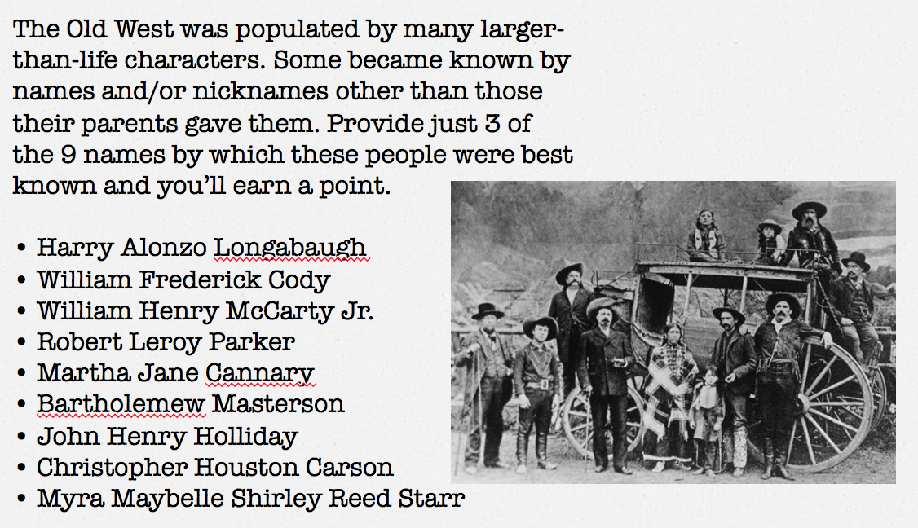
American History: 1

Slide 40
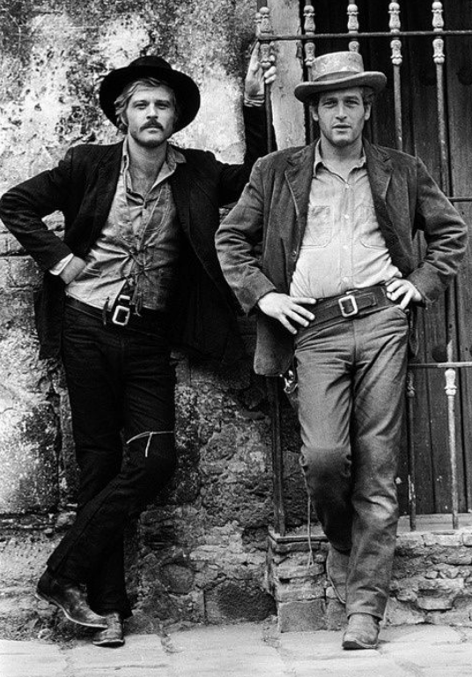
• Harry Alonzo Longabaugh / THE SUNDANCE KID
• William Frederick Cody / BUFFALO BILL
• William Henry McCarty Jr. / BILLY THE KID
• Robert Leroy Parker / BUTCH CASSIDY
• Martha Jane Cannary / CALAMITY JANE
• Bartholemew Masterson / BAT MASTERSON
• John Henry Holliday / DOC HOLIDAY
• Christopher Houston Carson / KIT CARSON
• Myra Maybelle Shirley Reed Starr / BELLE STARR

Slide 41
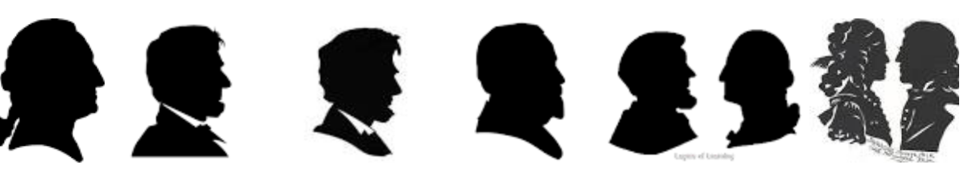
American History: 2
Which U.S. President was the first native-born chief
executive? In other words, the first president who was
born a U.S. citizen.

Slide 42
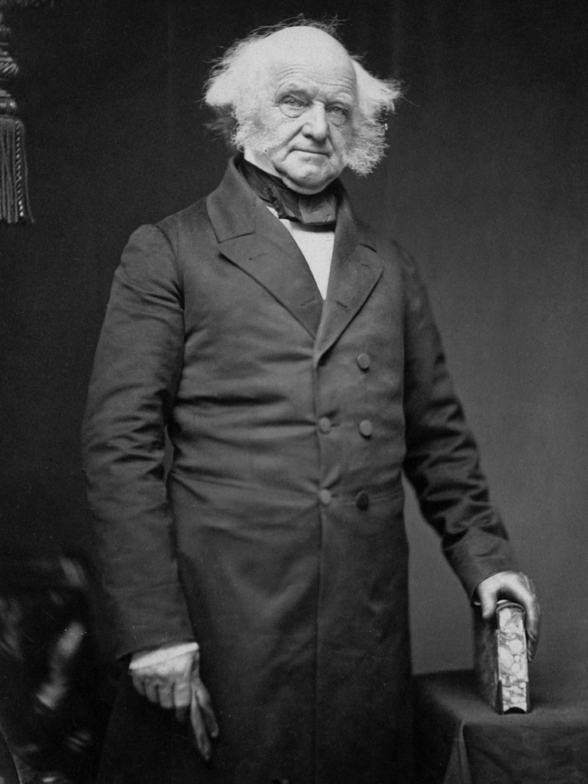
It was the Capital Region’s own Martin Van Buren, born in
Kinderhook, Columbia County, on December 5, 1782. The former NY governor became our eighth president in 1837 after defeating William Henry Harrison. Unlike every other president before or since, Van Buren spoke English as a second language even though he was native born, and his primary language in his youth was Dutch.

Slide 43
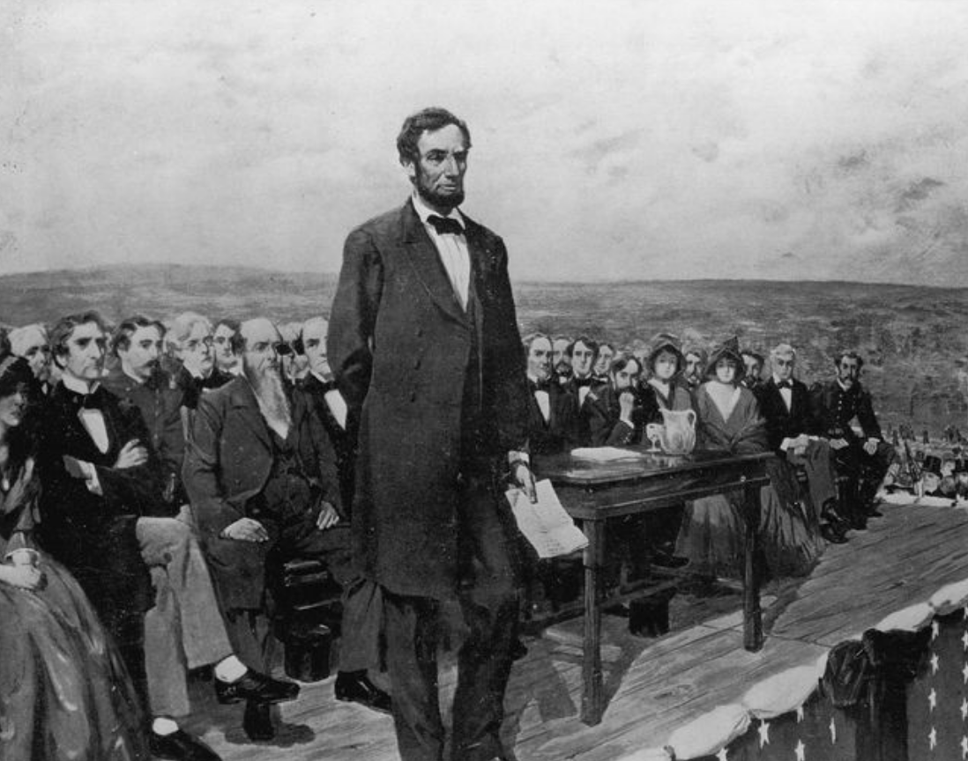
American History: 3
President Abraham Lincoln began his Gettysburg Address with the phrase “Four score and seven years ago … “
What does that mean?

Slide 44
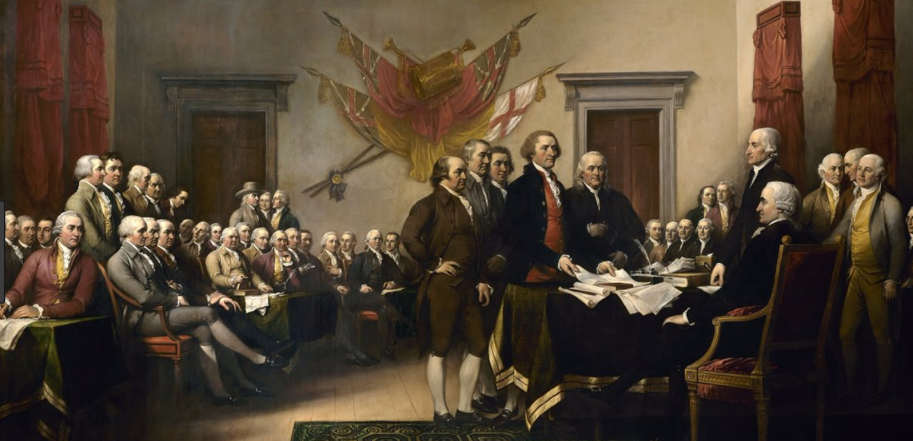
A “score” is 20.
Four score is 20 x 4 , or 80
Add 7, and you have 87.
The reference was to what happened 87 years earlier – 1776 -- the signing of the Declaration of Independence.

Slide 45
American History: 4
Name two prominent figures in American History whose first and middle names were Francis Scott.
? ?

Slide 46
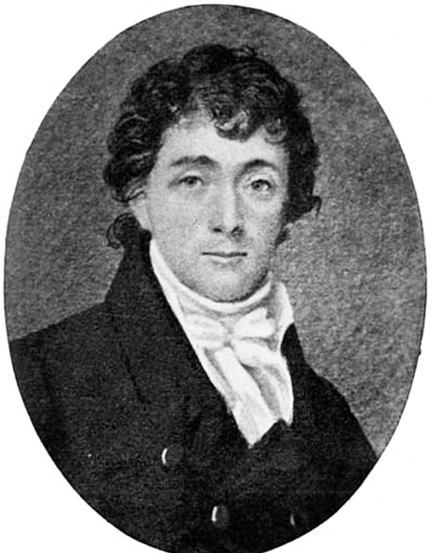
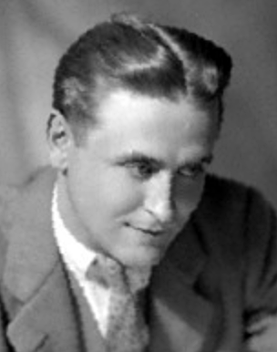
Francis Scott Key (1779-1843), a lawyer from Frederick, MD, who was inspired to write the poem “The Star-Spangled Banner” after watching the British bombard Fort McHenry near Baltimore in the War of 1812.
And, Francis Scott Fitzgerald (1896-1940) – better known as F. Scott Fitzgerald, the iconic author who wrote such classic novels as “The Great Gatsby,” “Tender Is the Night,” and “This Side of Paradise.”
Although Fizgerald was named for Key, the two were
only distantly related. Key was a 2nd cousin 3 times removed.

Slide 47
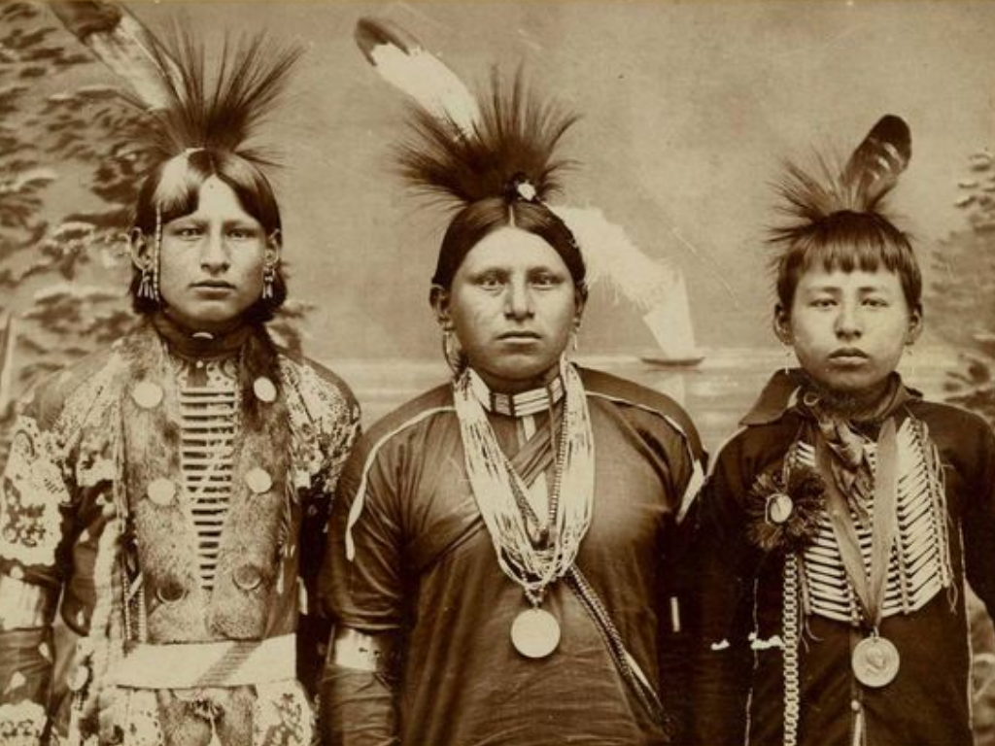
American History: 5
The 2010 Federal Census estimated the Native American population at 5.2 million people.
What city is home to the largest number of people identifying as Native Americans?

Slide 48
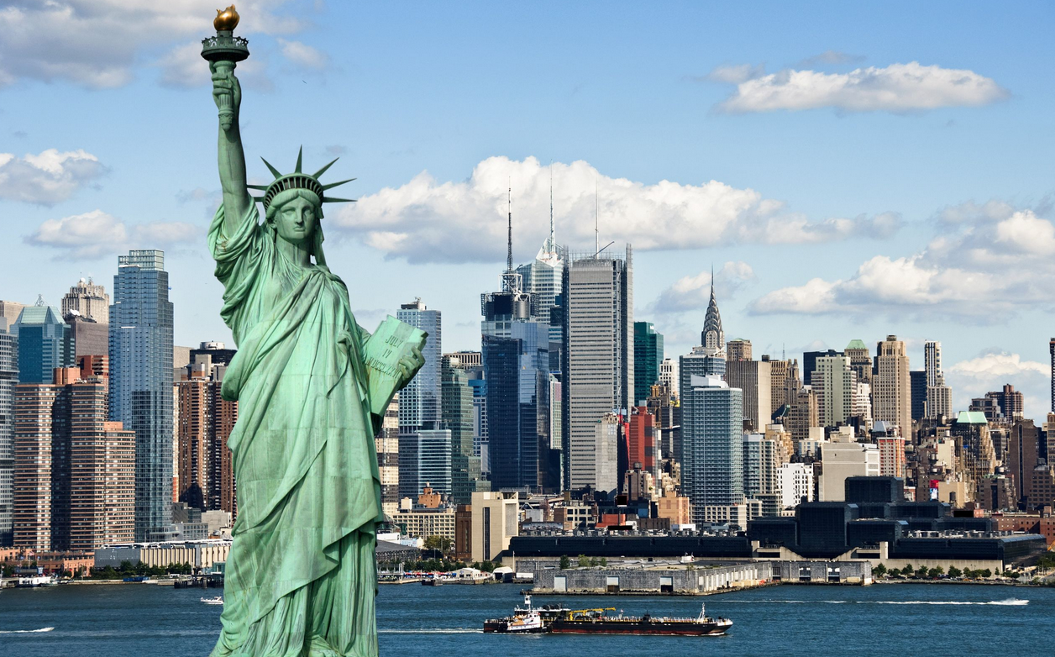
Surprise, it’s New York City!
Ranking below it, in order:
2. Los Angeles
3. Phoenix
4, Oklahoma City
5. Anchorage

Slide 49
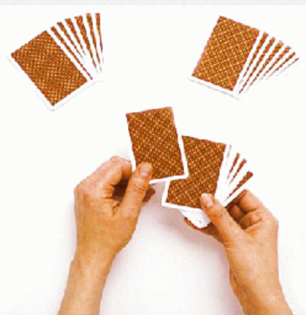
American History: Bonus
As a way of helping the nation emerge from the gloom and misery of The Great Depression, President Franklin D. Roosevelt instituted a series of programs and agencies including the WPA, CCC, NLRB, SEC, TVA and so on.
Don’t worry, we’re not asking you what those initials stand for. Just tell us the overall name for FDR’s initiatives:
New Deal
Fair Deal
Real Deal
Federal Deal
Re-Deal
Big Deal

Slide 50
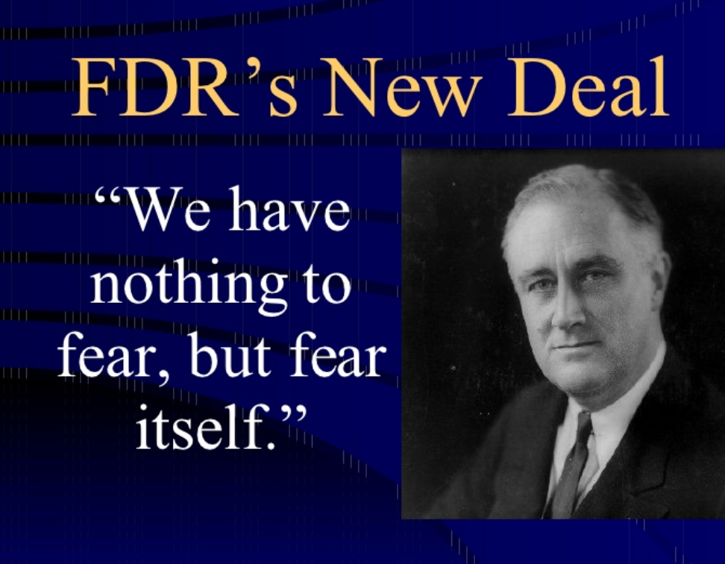

Slide 51
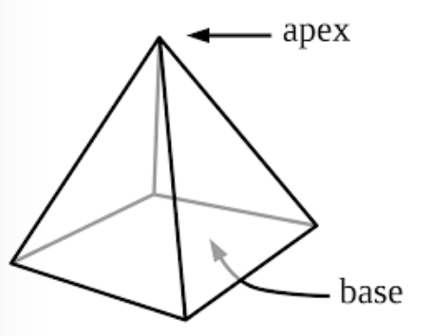
Around the World: 1
What country has the largest number of pyramids?

Slide 52
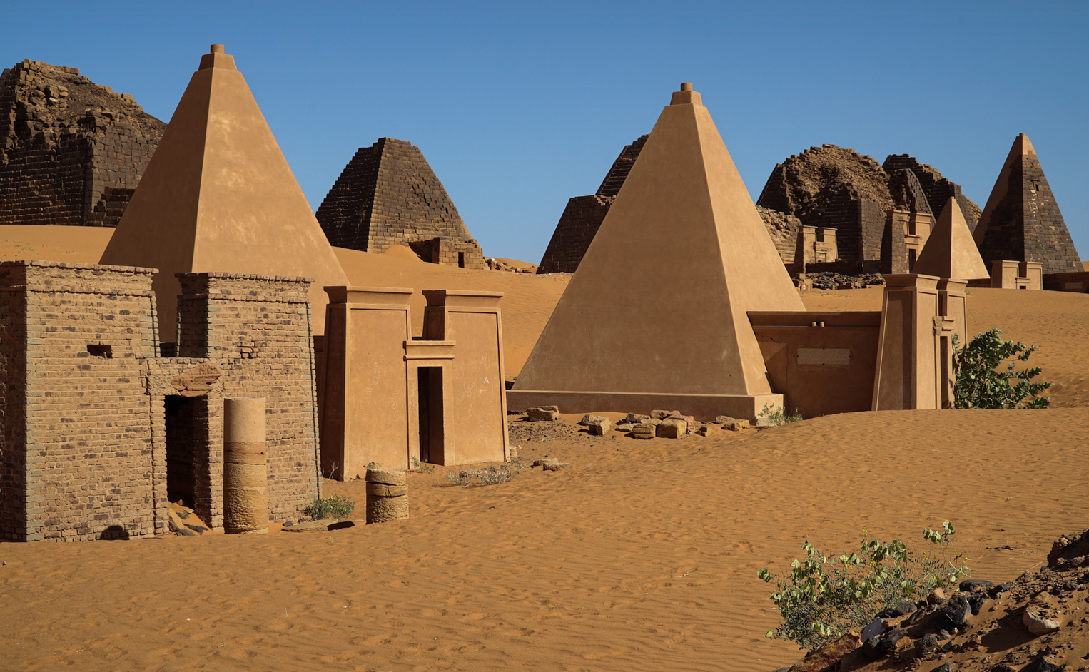
Sudan, just south of Egypt, has about 220 extant pyramidal structures, most on the east bank of the Nile. Egypt has about 80.
The most famous are the Nubian Meroe pyramids in an area that was the ancient kingdom of Kush, about 130 miles from the modern capital city of Khartoum. They are much smaller than the better-known pyramids of Egypt and Mesoamerica.

Slide 53
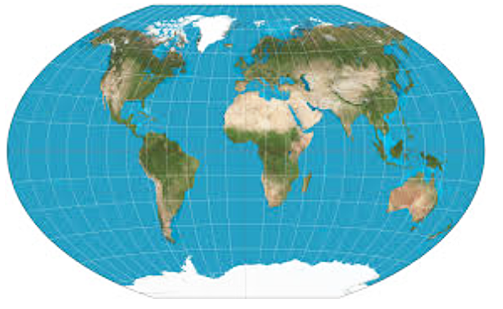
Around the World: 2
Name just 3 of the countries of which these cities are the capitals to earn a point.
• Montevideo
• Tirana
• Algiers
• Santiago
• Helsinki
• Kingston
• Lima
• Damascus
• Hanoi
• Bern
• Manila

Slide 54
Name just 3 of the countries of which these cities are the capitals to earn a point.
• Montevideo, Uruguay
• Tirana, Albania
• Algiers, Algeria
• Santiago, Chile
• Helsinki, Finland
• Kingston, Jamaica
• Lima, Peru
• Damascus, Syria
• Hanoi, Vietnam
• Bern, Switzerland
• Manila, Philippines

Slide 55
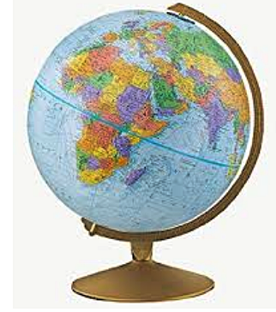
Around the World: 3
What are these countries called today?
Get just 3 correct
and you earn a point.
• Abyssinia
• Burma
• British Honduras
• Gaul
• Persia
• Ceylon
• Formosa

Slide 56
Abyssinia – Ethiopia
Burma – Myanmar
British Honduras – Belize
Gaul – France
Persia – Iran
Ceylon – Sri Lanka
Formosa -- Taiwan

Slide 57
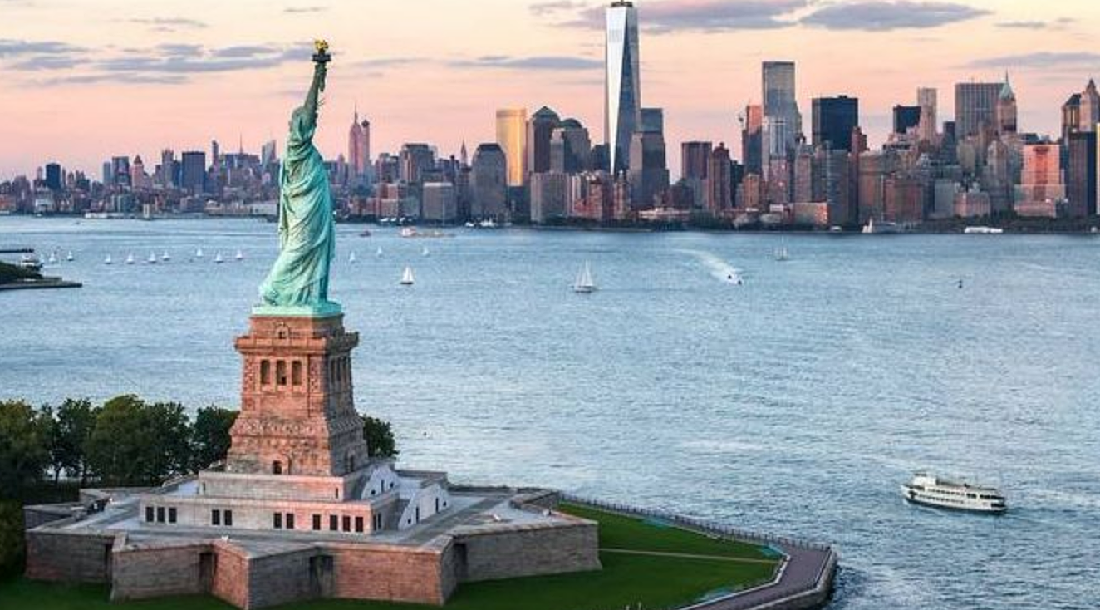
Around the World: 4
Hey, New Yorkers. The Statue of Liberty is located on Liberty Island. Before it was given that name, what was the island called?

Slide 58
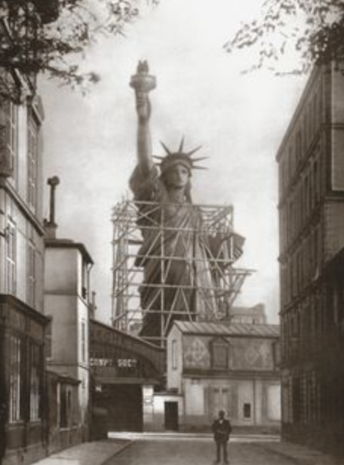
Just before it was renamed Liberty Island by an act of Congress in 1956, it was called Bedloe’s Island.
The 14-acre island originally was part of what the Dutch called the Oyster Islands (Ellis, Love, and Black Tom islands). Love Island was purchased by Isaac Bedloe from the English government in 1667, and it took on his name.

Slide 59
Around the World: 5
Along with Spain and France, what is the only other country
to have both Atlantic and Mediterranean coastlines?

Slide 60
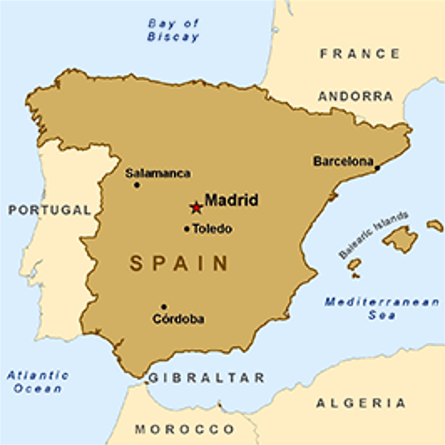
• France
• Spain
• Morocco

Slide 61
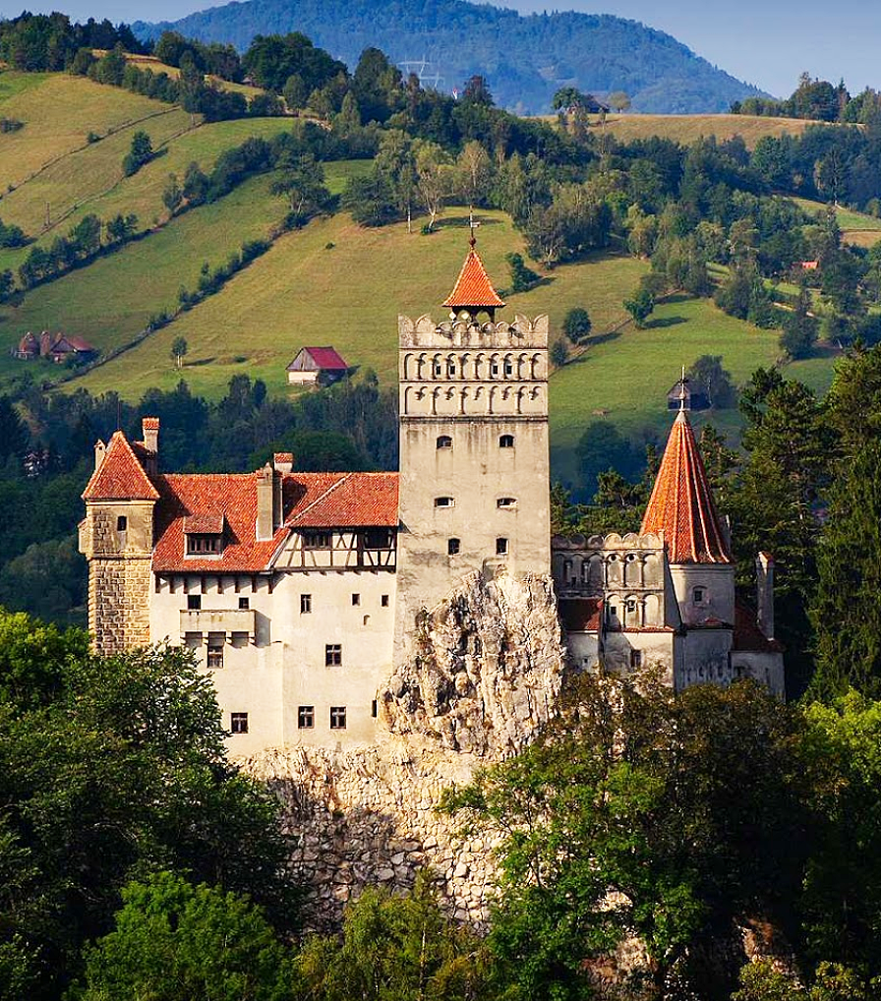
Around the World: Bonus
The fabled and forbidding land of Transylvania is home to Bran Castle, commonly known as Dracula’s Castle.
In what European country is
Transylvania located?

Slide 62
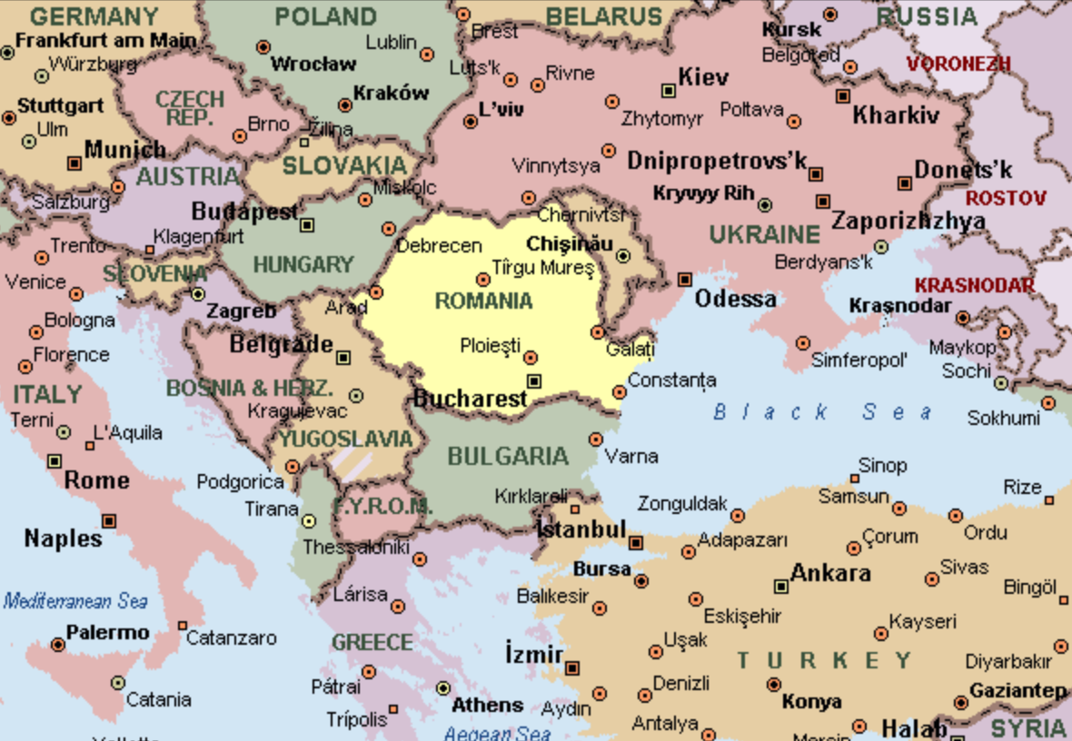
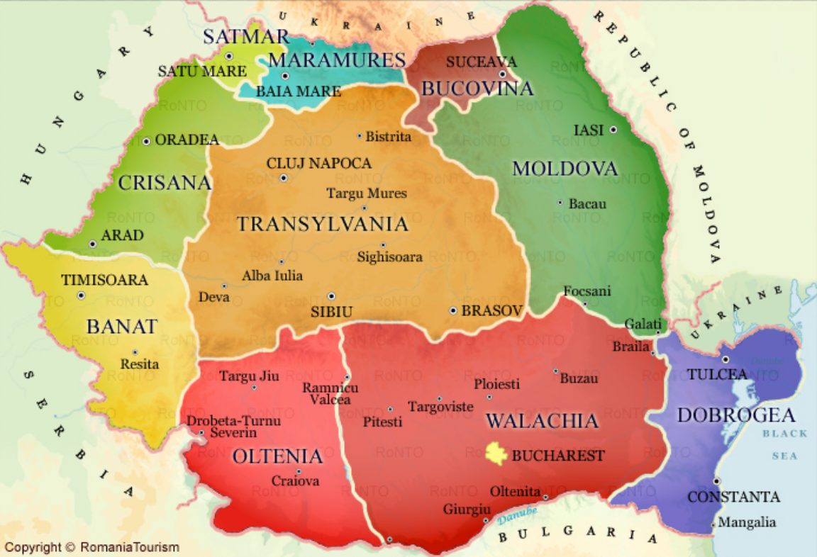
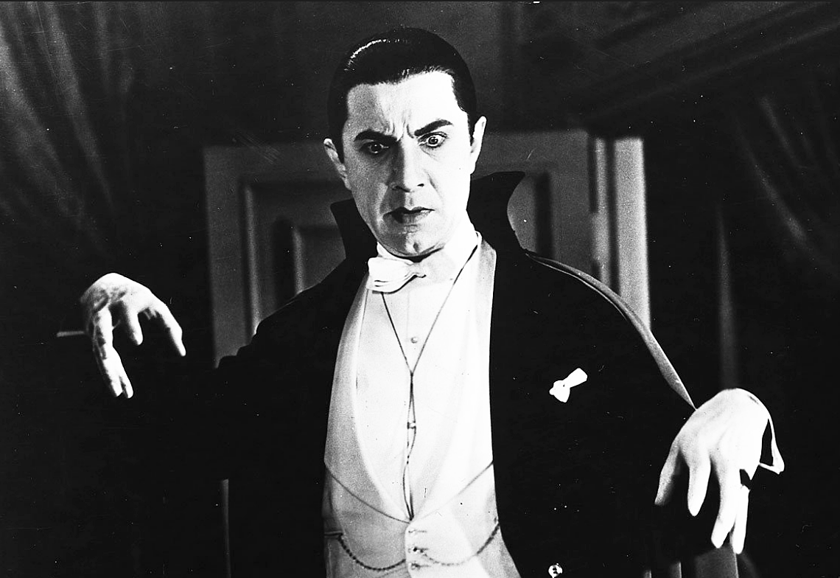

Slide 63
Tiebreaker: 1
What is the national animal of Scotland?
• Highland Sheep
• Unicorn
• Scotch Terrier
• Angus cattle
• Shetland Pony

Slide 64
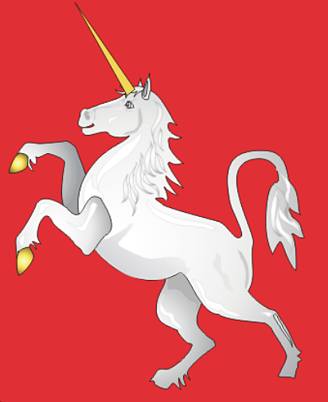
Believe it or not, it’s the mythical unicorn!
The horned horse -- which has appeared in royal heraldry throughout Europe since the Middle Ages -- was first used on the Scottish royal coat of arms by William I in the 12th Century. In the 15th Century, when King James III was in power, gold coins were
struck with the unicorn on them.
It signifies Scotland’s long love of mythical tales and characters, and its appreciation of the legendary beast’s strength and healing powers.

Slide 65
Tiebreaker: 2
Four U.S. states’ names end in the letter “O.” How many can you name in 15 seconds?

Slide 66
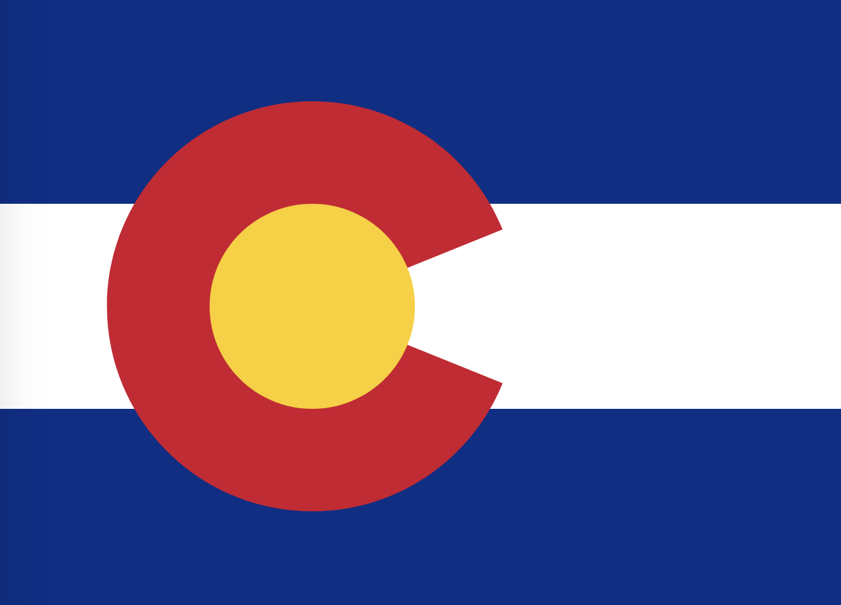
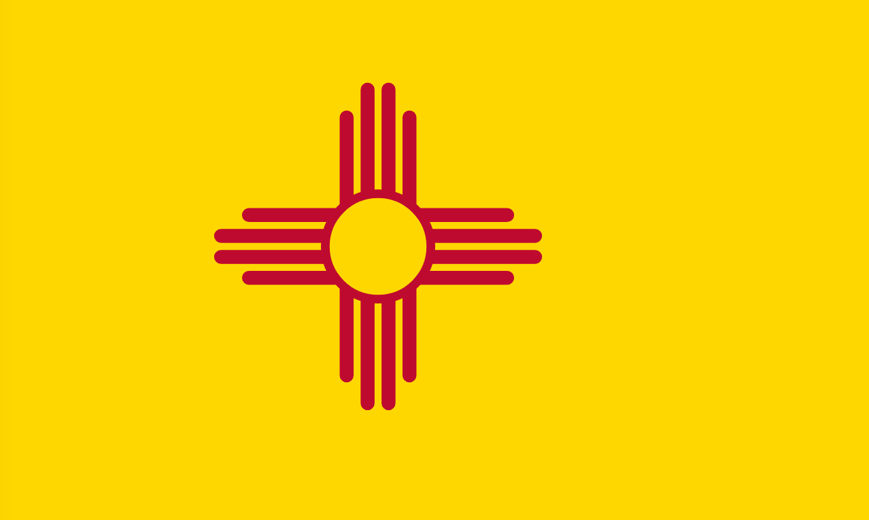
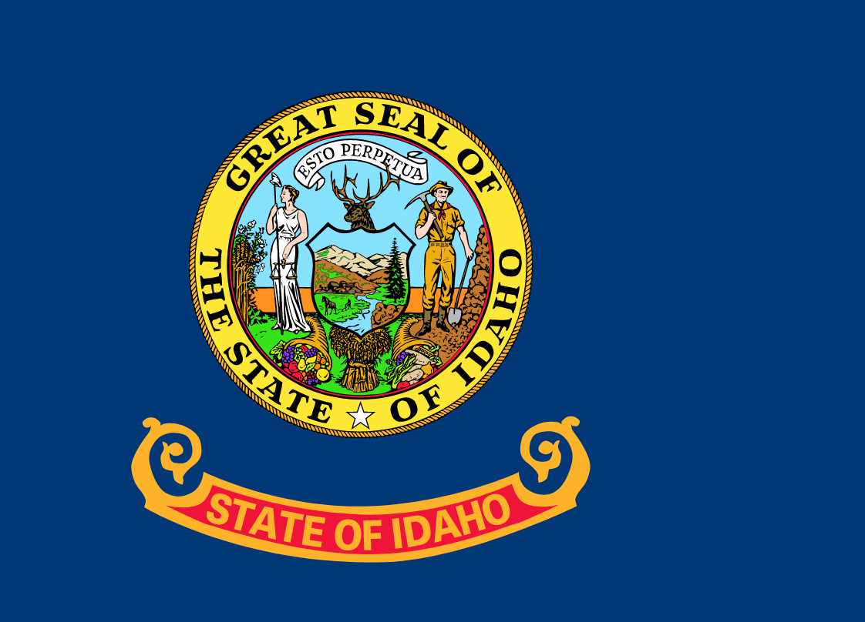
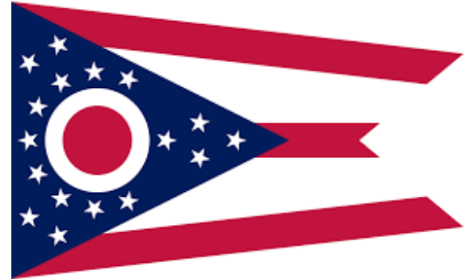
… and they are …
COLORADO
NEW MEXICO
IDAHO
OHIO

Slide 67
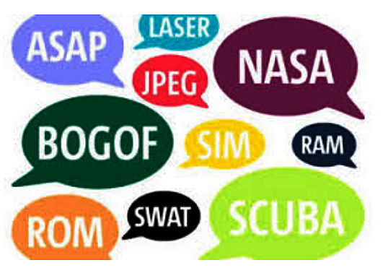
Tiebreaker: 3
We live in a world of abbreviations. Sometimes they are examples of something called “initialism,” which means you say the individuals letter – such as in FBI and CIA. But, sometimes they are “acronyms,” which means the initials are pronounced as words. Can you tell us what these acronyms stand for?
• SCUBA
• SCOTUS
• ASAP
• AWOL

Slide 68
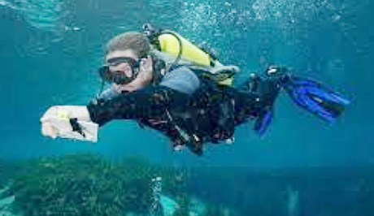
SCUBA
Self Contained Underwater
Breathing Apparatus

Slide 69

SCOTUS
Supreme Court Of The United States

Slide 70

ASAP
As Soon As Possible

Slide 71

AWOL
Absent Without Leave

Slide 72


